Slide 1
Database Management System
UNIT-1
Database System Architecture

Slide 2
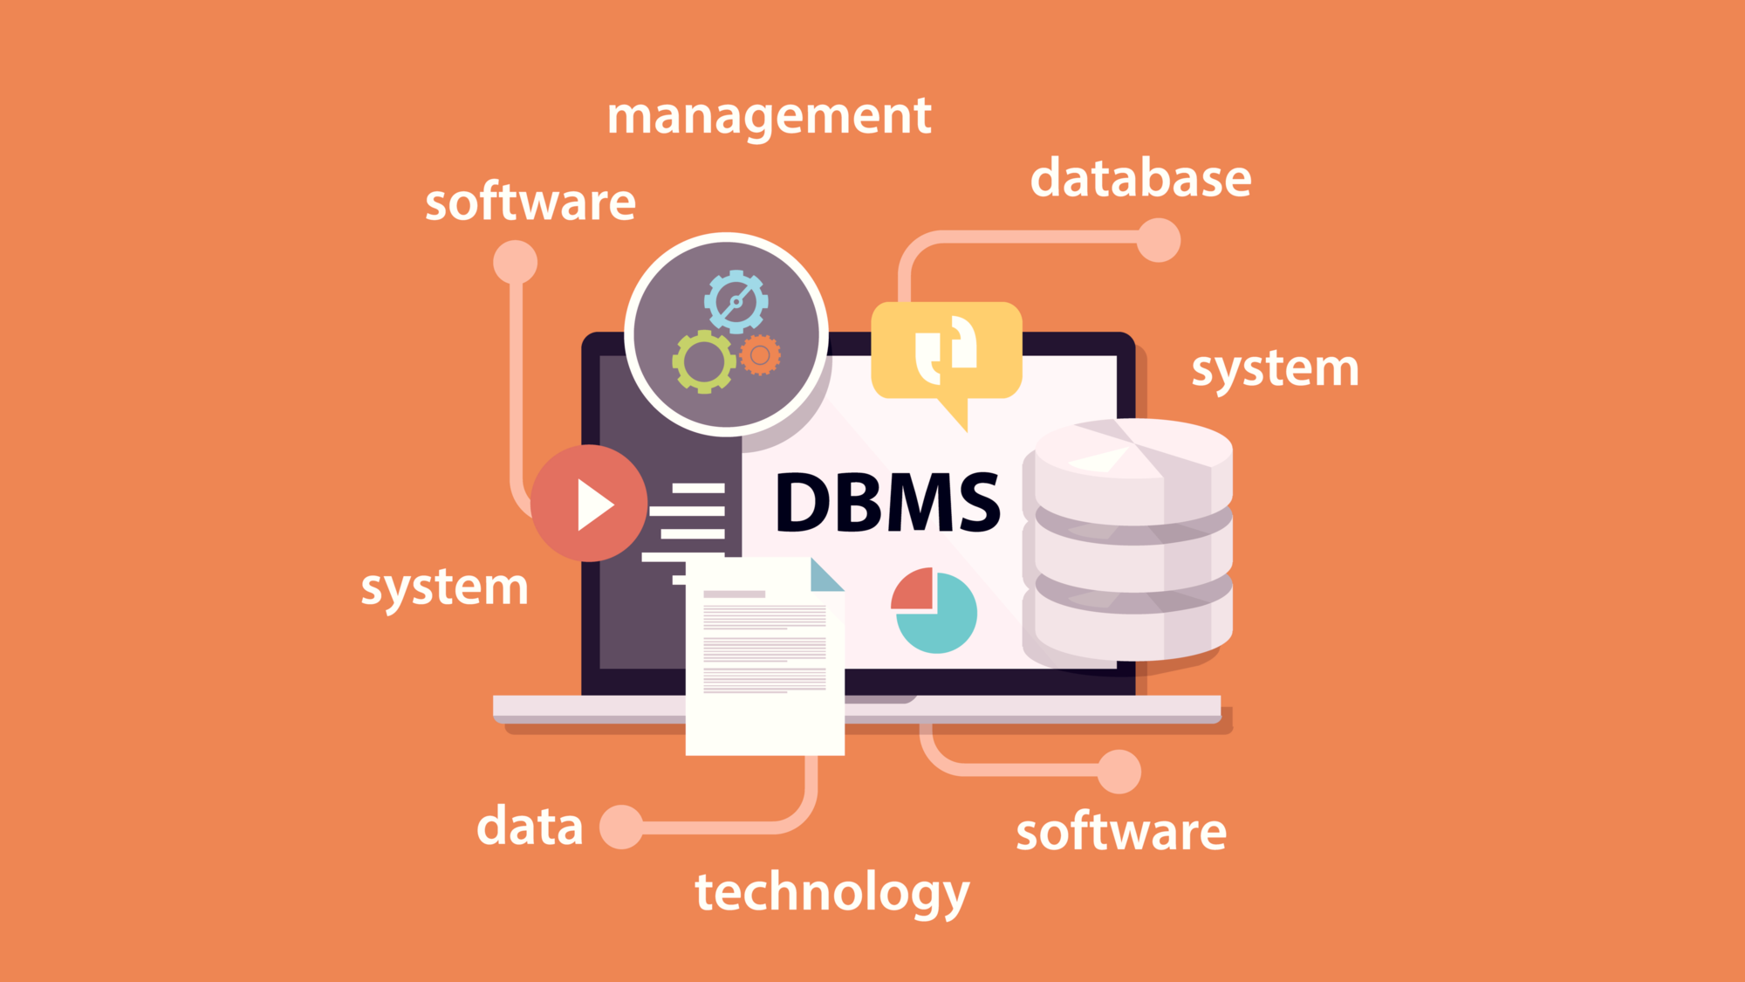

Slide 3


Slide 4
Introduction to DBMS

Slide 5
What is Database Management System (DBMS)?
Data - Fact that can be recorded or stored
e.g. Person Name, Age, Gender and Weight etc.
Database - Collection of logically related data
e.g. Books Database in Library, Student Database in University etc.
Management - Manipulation, Searching and Security of data
e.g. Viewing result in GTU website, Searching exam papers in GTU website etc.
System - Programs or tools used to manage database
e.g. SQL Server Studio Express, Oracle etc.

Slide 6
Applications of DBMS

Slide 7
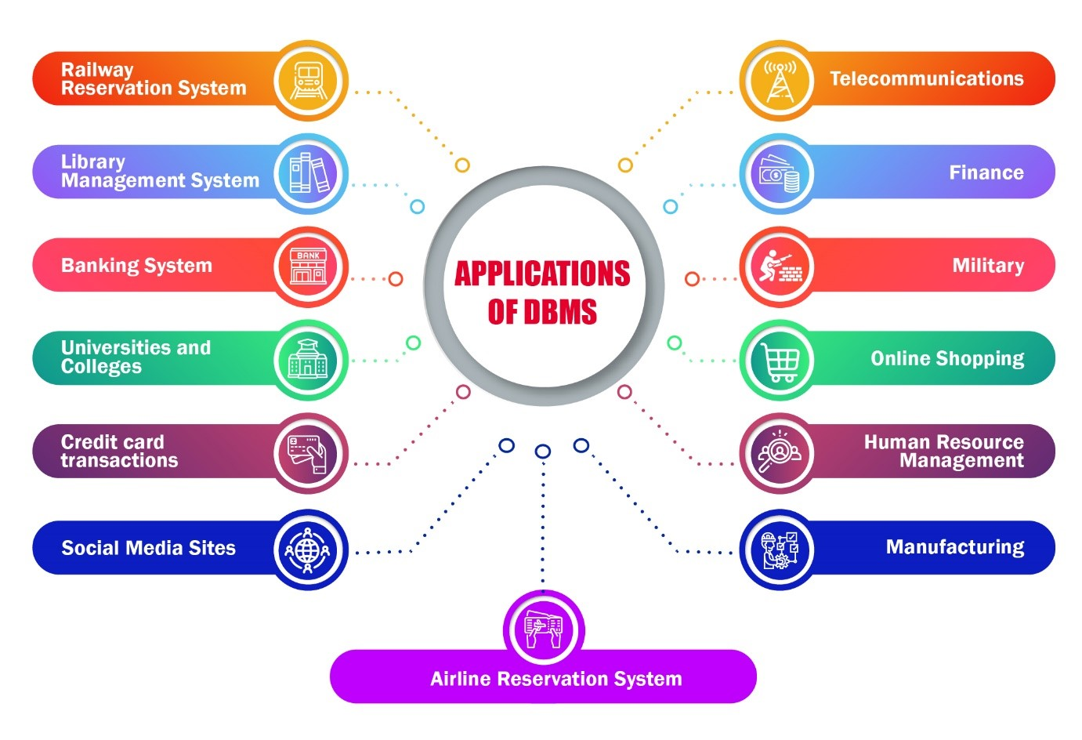

Slide 8
Applications of DBMS
DBMS is a computerized record-keeping system.
DBMS is required where ever data need to be stored.
E-Commerce (Flikart, Amazon, Shopclues, eBay etc...)
Online Television Streaming (Hotstar, Amazon Prime etc...)
Social Media (WhatsApp, Facebook, Twitter, LinkedIn etc...)
Banking & Insurance
Airline & Railway
Universities and Colleges/Schools
Library Management System
Human Resource Department
Hospitals and Medical Stores
Government Organizations

Slide 9
Advantages of DBMS

Slide 10

Reduce data redundancy (duplication)
Computer
Civil
Emp_Name | Address | Mobile | Subject
Emp_Name | Address | Mobile | Subject
Prof. Ajay Shah | Rajkot | 1234 | PPS
Prof. Ajay Shah | Rajkot | 1234 | PPS
Database management system can remove such data redundancy by storing data centrally.
Same data is stored at
four different places.
Emp_Name | Address | Mobile | Subject
Emp_Name | Address | Mobile | Subject
Prof. Ajay Shah | Rajkot | 1234 | PPS
Prof. Ajay Shah | Rajkot | 1234 | PPS
Electrical
Mechanical

Slide 11
Remove data inconsistency
Computer
Civil
Emp_Name | Address | Mobile | Subject
Emp_Name | Address | Mobile | Subject
6789
Prof. Ajay Shah | Rajkot | 1234 | PPS
Prof. Ajay Shah | Rajkot | 1234 | PPS
Database management system can keep data in consistent state.
Same data having
different state (values)
Mobile no is changed
Emp_Name | Address | Mobile | Subject
Emp_Name | Address | Mobile | Subject
6789
Prof. Ajay Shah | Rajkot | 1234 | PPS
Prof. Ajay Shah | Rajkot | 1234 | PPS
Electrical
Mechanical

Slide 12
Data isolation
Data are scattered in various files.
Files may be in different formats.
Difficult to retrieve the appropriate data.
File - 1
Emp_Name | Address | Mobile | Subject
Prof. Ajay Shah | Rajkot | 1234 | PPS
DBMS allow us to access (retrieve) appropriate data easily.
File - 2
Emp_Name | Post | Salary | Load
Prof. Ajay Shah | Lecturer | 50,000 | 15
Data isolation is a property that determines when and how changes made by one operation become visible to other concurrent users and systems.
This issue occurs in a concurrency situation.
File - 3
Emp_Name | Teaching | Knowledge | Rating
Prof. Ajay Shah | Good | Excellent | 9

Slide 13


Guaranteed atomicity
Atomicity: Either transaction execute 0% or 100%.
Sum of both account before transfer is 3000
Person A
Account A
Bal : 2000
Transfer 500
Person B
Account B
Bal : 1000
Step 1 : Debit 500 from Account A
Step 2 : Credit 500 into Account B
Transaction is failed
Sum of both account is 2500
so inconsistent
Sum of both account
after transfer is 3000

Slide 14
Allow to implement integrity constraints
Emp_Name | Address | Mobile_No | Subject
Prof. Ajay Shah | Rajkot | 9876543210 | PPS
Should contain exact 10 digits
Student_Name | Branch | Backlog | SPI
Nirav Patel | Rajkot | 0 | 8.5
Should be between 0 to 10
DBMS allows us to implement such business rules in our database..

Slide 15

Sharing of data among multiple users
Want to access
Computer
Civil
Emp_Name | Address | Mobile | Subject
Emp_Name | Address | Mobile | Subject
Prof. Ajay Shah | Rajkot | 1234 | PPS
Prof. Ajay Shah | Rajkot | 1234 | PPS
Want to access
Database management system allows more than one user to access same data simultaneously.
Emp_Name | Address | Mobile | Subject
Emp_Name | Address | Mobile | Subject
Prof. Ajay Shah | Rajkot | 1234 | PPS
Prof. Ajay Shah | Rajkot | 1234 | PPS
Electrical
Mechanical

Slide 16

Restricting unauthorized access to data
File - 1
Emp_Name | Address | Mobile | Subject
Prof. Ajay Shah | Rajkot | 1234 | PPS
Wants to access
Faculty of other college
File - 2
Emp_Name | Post | Salary | Load
Prof. Ajay Shah | Lecturer | 50,000 | 15
Wants to access
VSITR
Faculty
File - 3
Emp_Name | Teaching | Knowledge | Rating
Prof. Ajay Shah | Good | Excellent | 9
DBMS prevents unauthorized user to access data.

Slide 17
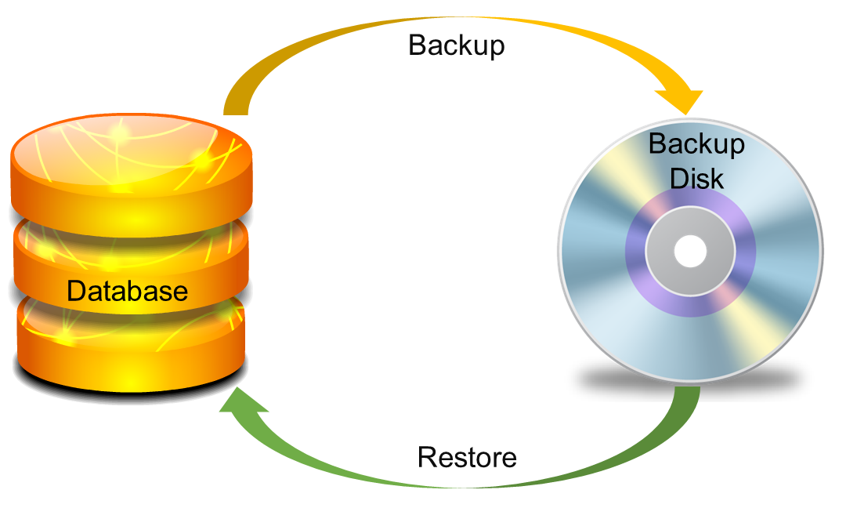
Providing backup and recovery services
Provides facilities to backup and restore the database in case of failure.

Slide 18
Advantages of DBMS (Summary)
Reduce data redundancy (duplication)
Avoids unnecessary duplication of data by storing data centrally.
Remove data inconsistency
By eliminating redundancy, data inconsistency can be removed.
Data isolation
A user can easily retrieve proper data as per his/her requirement.
Guaranteed atomicity
Either transaction executes 0% or 100%.

Slide 19
Advantages of DBMS (Summary)
Allow implementing integrity constraints
Business rules can be implemented such as do not allow to store amount less than Rs. 0 in balance.
Sharing of data among multiple users
More than one users can access same data at the same time.
Restricting unauthorized access to data
A user can only access data which is authorized to him/her.
Providing backup and recovery services
Can take a regular auto or manual backup and use it to restore the database if it corrupts.

Slide 20
Basic Terms

Slide 21
Basic terms
Data
Data is raw, unorganized facts that need to be processed.
Example: Marks of students
Student_1 = 50/100, Student_2 = 25/100.
Information
When data is processed, organized, structured or presented in a given context so as to make it useful, it is called information.
Example: Result of students (Pass or Fail)
Student_1 = Pass, Student_2 = Fail.

Slide 22
Basic terms (cont…)
Metadata
Metadata is data about data.
Data such as table name, column name, data type, authorized user and user access privileges for any table is called metadata for that table.
Metadata of above table is:
Table name such as Faculty
Column name such as Emp_Name, Address, Mobile_No, Subject
Datatype such as Varchar, Decimal
Access privileges such as Read, Write (Update)
Faculty
Emp_Name | Address | Mobile_No | Subject
Prof. Ajay Shah | Rajkot | 9876543210 | PPS

Slide 23
Basic terms (cont…)
Data dictionary
A data dictionary is an information repository which contains metadata.
Data warehouse
A data warehouse is an information repository which stores data.
Table Name – Faculty
Column Name – EmpName, Address, Mob, Subject, Salary
Datatype – Varchar, Decimal
Access Privileges – Read, Write (Update)
Faculty
Emp_Name | Address | Mobile_No | Subject
Prof. Ajay Shah | Rajkot | 9876543210 | PPS
Prof. Ajay Patel | Surat | 0123456789 | DBMS
Exercise
Why data dictionary and data warehouse are stored in the different places?

Slide 24
Basic terms (cont…)
Field
A field is a character or group of characters that have a specific meaning.
E.g, the value of Emp_Name, Address, Mobile_No etc are all fields of Faculty table.
Record / Tuple
A record is a collection of logically related fields.
E.g, the collection of fields (Emp_Name, Address, Mobile_No, Subject) forms a record for the Faculty.
Faculty
Emp_Name | Address | Mobile_No | Subject
Prof. Ajay Shah | Rajkot | 9876543210 | PPS
Prof. Ajay Patel | Surat | 0123456789 | DBMS
Fields
Prof. Ajay Shah
Rajkot
9876543210
Prof. Ajay Shah | Rajkot | 9876543210 | PPS
Record / Tuple
Prof. Ajay Patel | Surat | 0123456789 | DBMS

Slide 25
3 Levels ANSI SPARC Database System

Slide 26

3 Levels ANSI SPARC Database System
User 1
User 2
User 3
How data are viewed by each users?
View 1
View 2
View 3
View
Level
What data are stored and
What relationships exist?
Conceptual
Level
Logical
Level
How the data are actually stored on storage devices?
Internal
Level
Physical
Level
Database

Slide 27
3 Levels ANSI SPARC Database System
Internal level (Physical level)
It describes how a data is stored on the storage device.
Deals with physical storage of data.
Structure of records on disk - files, pages, blocks and indexes and ordering of records
Internal view is described by the internal schema.
Conceptual level (Logical level)
What data are stored and what relationships exist among those data?
It hides low level complexities of physical storage.
For Example, STUDENT database may contain STUDENT and COURSE tables which will be visible to users but users are unaware about their storage.
Database administrator works at this level to determine what data to keep in the database.
External level (View level)
It describes only part of the entire database that an end user concern or how data are viewed by each user.
Different user needs different views of the database, so there can be many views in a view level abstraction of the database. Used by end users and application programmers.
End users need to access only part of the database rather than the entire database.

Slide 28
3 Levels ANSI SPARC Database System: Example
We are storing student information in a student table.
User 1
User 2
User 3
User just interact with system with the help of GUI.
Users are not aware of how and what the data is stored.
View 1
View 2
View 3
View
Level
Records can be described as fields and attributes along with their data types, their relationship among each other can be logically implemented.
Programmers generally work at this level.
Conceptual
Level
Logical
Level
Records can be described as blocks of storage (bytes, gigabytes, terabytes etc.) in memory.
These details are often hidden from the programmers.
Internal
Level
Physical
Level
Database

Slide 29
Data Abstraction in DBMS
Database systems are made-up of complex data structures.
To ease the user interaction with database, the developers hide internal irrelevant details from users.
This process of hiding irrelevant details from user is called data abstraction.

Slide 30
Mapping and Data Independence
Want to access some data
User 1
User 2
User 3
View 1
View 2
View 3
View
Level
Request
Process of transforming requests and results between the three levels is called mapping.
Conceptual
Level
Logical
Level
Ability to modify a schema definition in one level without affecting a schema definition in the next higher level.
Internal
Level
Physical
Level
Result
Database

Slide 31
Types of Data Independence
Physical Data Independence
Physical Data Independence is the ability to modify the physical schema without requiring any change in logical (conceptual) schema and application programs.
Modifications at the internal levels are occasionally necessary to improve performance.
Possible modifications at internal levels are changes in file structures, compression techniques, hashing algorithms, storage devices, etc.
Logical Data Independence
Logical data independence is the ability to modify the conceptual schema without requiring any change in application programs.
Modification at the logical levels is necessary whenever the logical structure of the database is changed.
Application programs are heavily dependent on logical structures of the data they access. So any change in logical structure also requires programs to change.

Slide 32
Types of Database Users

Slide 33
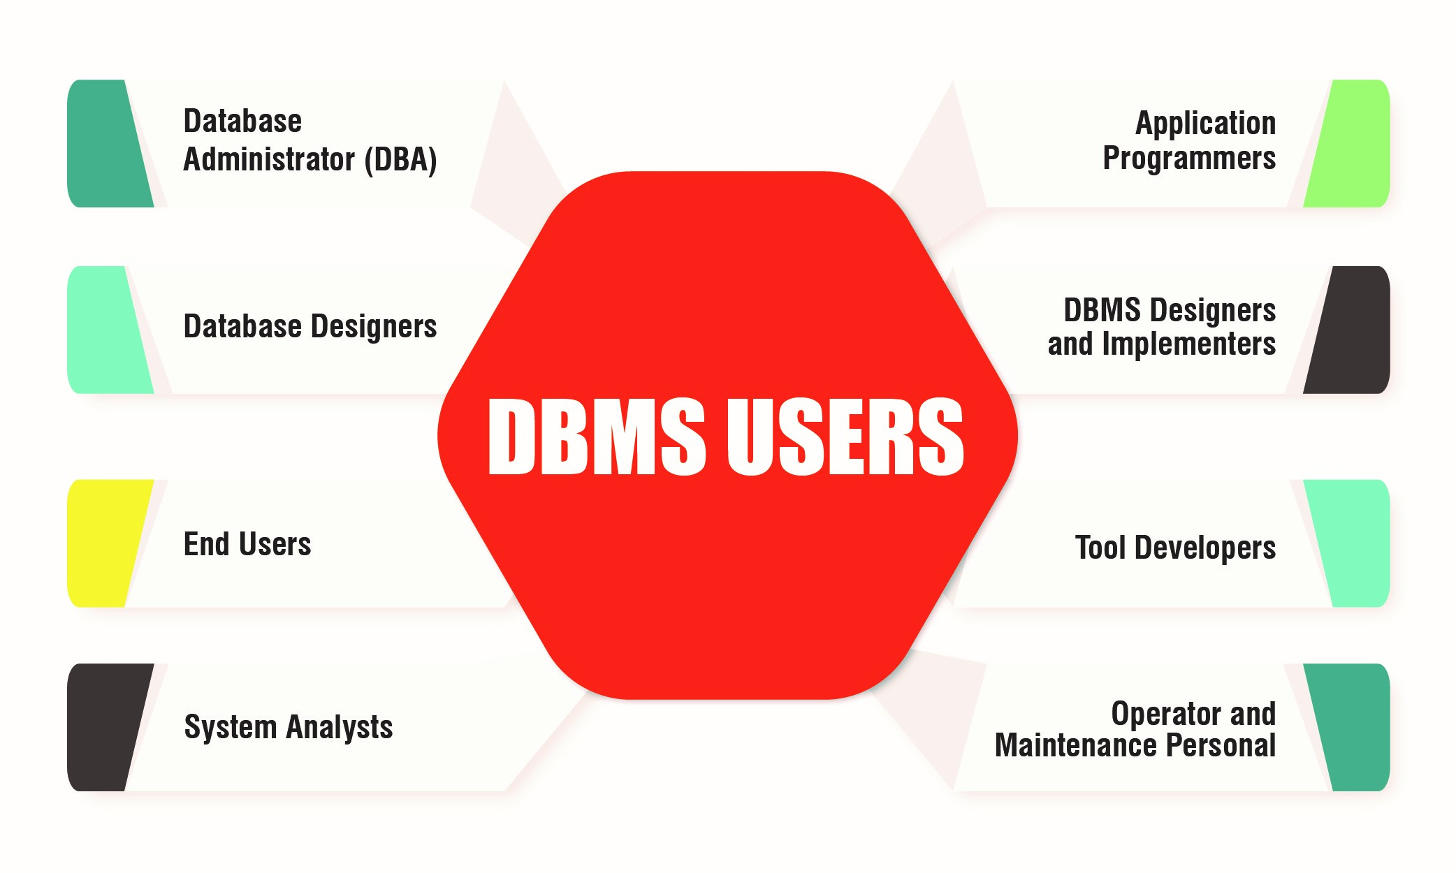

Slide 34
Types of Database Users
Naive Users (End Users)
Unsophisticated users who have zero knowledge of database system
End user interacts to database via sophisticated software or tools
e.g. Clerk in bank
Application Programmers
Programmers who write software using tools such as Java, .Net, PHP etc…
e.g. Software developers
Sophisticated Users
Interact with database system without using an application program
Use query tools like SQL
e.g. Analyst
Specialized Users (DBA)
User write specialized database applications program
Use administration tools
e.g. Database Administrator

Slide 35
Database System Architecture

Slide 36
Database System Architecture
Naive
user
Application programmer
Sophisticated
user
Database administrator
uses
write
uses
uses
Application
interfaces
Application
program
Query
tool
Administration tool
Translates DML statements into low level instructions that the query evaluation engine understands
Compiler and linker
DML queries
DDL interpreter
Interprets DDL statements into a set of tables containing metadata
Executes low level instructions generated by DML compiler.
Deals with execution of DDL and DML statements
Application program object code
DML compiler and organizer
Query evaluation engine
Query processor
Buffer manager
File manager
Authorization and integrity manager
Transaction manager
Manages allocation of space on disk storage
Storage manager
Fetches data from disk storage to memory for being used
Preserves atomicity and controls concurrency
Provides interface between low-level data stored and application program or queries
Checks the authority of users to access data and integrity constraints
To provide faster access to data items
Indices
Data dictionary
Disk storage
To store user data
Data
Statistical data
To store statistical information about the data
To store metadata

Slide 37
Structured Query Language(SQL)

Slide 38
Introduction
SQL is a Structured Query Language, which is a computer language for storing, manipulating and retrieving data stored in a relational database.

Slide 39
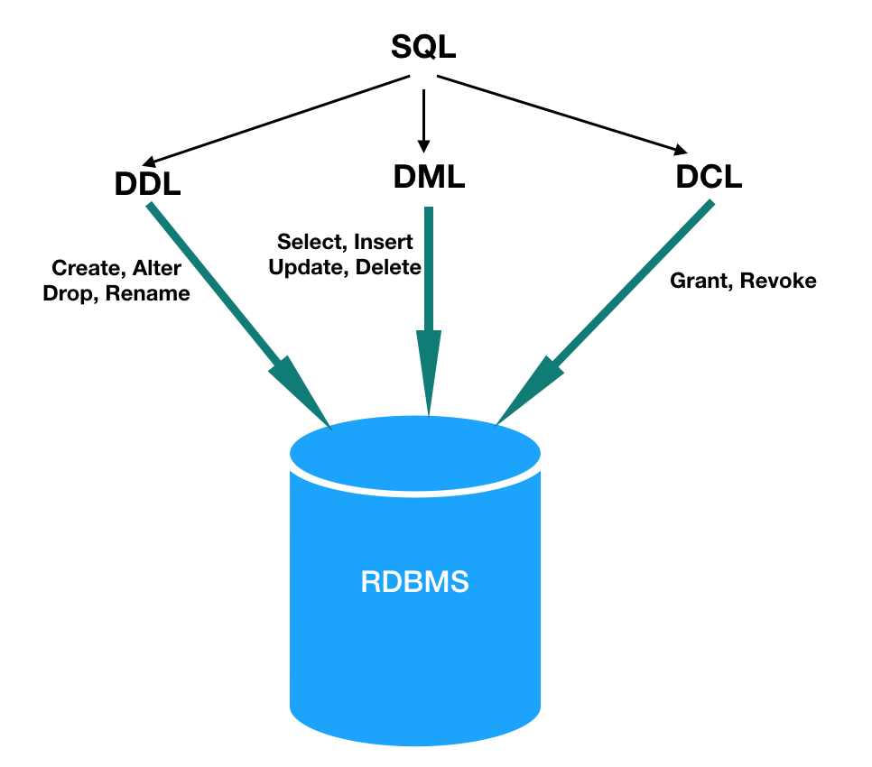

Slide 40
Data Definition Language(DDL)

Slide 41
Introduction
DDL statements are used to define the database structure or scheme.
To understand the SQL Data Definition Language
Create
Drop
Truncate
Alter

Slide 42
Creating the Database
To initialize a new database:
Syntax:
CREATE DATABASE database_name
There are numerous arguments that go along with this command but are database specific
Only some databases require database to be created and space to be allocated prior to creation of tables.
Some databases provide graphical user interfaces to create databases and allocate space.
Access only allows database to be created using User Interface

Slide 43
Creating the Table
Syntax
CREATE TABLE table_name
(
Column_name datatype[(size)],
Column_name datatype[(size)],
);
Example
CREATE TABLE books(ISBN char(20), Title char(50), AuthorID Integer, Price float);
Creates a table with four columns

Slide 44
Data types
Following broad categories of data types exist in most databases:
String Data
Numeric Data
Temporal Data
Large Objects

Slide 45
String Data
Fixed Length:
Occupies the same length of space in memory no matter how much data is stored in them.
Syntax:
char(n) where n is the length of the String
e.g. name char(50)
If the variable stored for name is ‘Sanjay’ the extra 43 fields are padded with blanks

Slide 46
String Data
Variable Length string is specified with maximum length of characters possible in the string, however, the allocation is sized to the size of the data stored in memory.
Syntax:
Varchar(n) – n is the maximum length of data possible for the type
There may be a restriction in the maximum length of the data that you can specify in the declaration which will vary according to the database.
All character data has to be enclosed in single quotes during specification.

Slide 47
Numeric Data
Store all the data related to purely numeric data.
Some numeric data may also be stored as a character field e.g. zip codes
Common Numeric Types:
Decimal Floating point number
Float Floating point number
Integer(size) Integer of specified length
Money A number which contains exactly two digits after the decimal point
Number A standard number field that can hold a floating point data
Note: Different databases name their numeric fields differently and may not support all numeric types. They may also support additional numeric types.

Slide 48
Temporal Data
These represent the dates and time
Three basic types are supported:
Dates
Times
Date-Time Combinations

Slide 49
Large Data
These are used for storing data objects like files and images:
There are two types:
Character Large Objects (clobs)
Binary Large Objects (blobs)

Slide 50
TRUNCATE Table
Truncate Statement:
used to delete all the rows of a table. Delete can also be used to delete all the rows from the table. The difference is that delete performs a delete operation on each row in the table and the database performs all attendant tasks on the way. On the other hand the Truncate statement simply throws away all the rows at once and is much quicker. The note of caution is that truncate does not do integrity checks on the way which can lead to inconsistencies on the way. If there are dependencies requiring integrity checks we should use delete.
Syntax: TRUNCATE TABLE table_name
Example:
TRUNCATE TABLE studios
This deletes all the rows of the table studios

Slide 51
Drop Table
Drop Statement:
used to remove elements from a database, such as tables, indexes or even users and databases. Drop command is used with a variety of keywords based on the need.
Drop Table Syntax: DROP TABLE table_name
Drop Table Example: DROP TABLE studios
Drop Index Syntax: DROP INDEX table_name
Drop Index Example: DROP INDEX movie_index

Slide 52
Alter Table
Alter Statement:
used to make changes to the schema of the table. Columns can be added and the data type of the columns changed as long as the data in those columns conforms to the data type specified.
Syntax:
ALTER TABLE table_name
ADD (column datatype [Default Expression])
[REFERENCES table_name (column_name)’
[CHECK condition]
Example:
ALTER TABLE studios
ADD (revenue Number DEFAULT 0)

Slide 53
Alter Table
Add table level constraints:
Syntax:
ALTER TABLE table_name
ADD ([CONSTRAINT constraint_name CHECK comparison]
[columns REFERENCES table_name (columns)]
Example:
ALTER TABLE studios
ADD (CONSTRAINT check_state CHECK (studio_state in (‘TX’, ‘CA’, ‘WA’))

Slide 54
Alter Table
Modify Columns:
Syntax:
ALTER TABLE table_name
MODIFY column [data type]
[Default Expression]
[REFERENCES table_name (column_name)’
[CHECK condition]
Example:
ALTER TABLE People
MODIFY person_union varchar(10)
Notes1: Columns can not be removed from the table using alter. If you want to remove columns you have to drop the table and then recreate it without the column that you want to discard

Slide 55
Data Manipulation Language(DML)

Slide 56
Introduction
DML statements are used for managing data within database.
To understand the SQL Data Manipulation Language
Insert
Update
Delete

Slide 57
INSERT
Insert:
Allows you to add new records to the Table
Syntax:
Insert into table_name[(column_list)] values (value_list)
Example:
INSERT INTO studios
VALUES (1, ‘Giant’, ‘Los Angeles’, ‘CA’)
INSERT INTO studios
(studio_city, studio_state, studio_name, studio_id)
VALUES (‘Burbank’, ‘CA’, ‘MPM’, 2)
Notes1: If the columns are not specified as in the first example the data goes in the order specified in the table
Notes2: There are two ways of inserting Null values
1. If the field has a default value of Null, you can use an Insert statement that ignores the column where the value is to be Null.
2. You can specify the column in the column list specification and assign a value of Null to the corresponding value field.

Slide 58
SELECT & INSERT
Select & Insert:
A select query can be used in the insert statement to get the values for the insert statement
Example:
INSERT INTO city_state
SELECT studio_city, studio_state FROM studios
This selects the corresponding fields from the studios table and inserts them into the city_state table.
Example:
INSERT INTO city_state
SELECT Distinct studio_city, studio_state FROM studios
This selects the corresponding fields from the studios table, deletes the duplicate fields and inserts them into the city_state table. Thus the final table has distinct rows

Slide 59
DELETE
Delete Statement:
is used to remove records from a table of the database. The where clause in the syntax is used to restrict the rows deleted from the table otherwise all the rows from the table are deleted.
Syntax: DELETE FROM table_name [WHERE Condition]
Example:
DELETE FROM City_State
WHERE state = ‘TX’
Deletes all the rows where the state is Texas keeps all the other rows.

Slide 60
UPDATE
Update Statement:
used to make changes to existing rows of the table. It has three parts. First, you ,must specify which table is going to be updated. The second part of the statement is the set clause, in which you should specify the columns that will be updated as well as the values that will be inserted. Finally, the where clause is used to specify which rows will be updated.
Syntax:
UPDATE table_name
SET column_name1 = value1, column_name2 = value2, …..
[WHERE Condition]
Example:
UPDATE studios
SET studio_city = ‘New York’, studio_state = ‘NY’
WHERE studio_id = 1
Notes1: If the condition is dropped then all the rows are updated.

Slide 61
End of Unit – 1
Source From: Darshan Institute, Rajkot

