Slide 1
OpenGL Picking and Quaternions
Project Miscellaneous Topics

Slide 2
Agenda
GL_SELECT picking review
Alternative picking methods
  Based on the colour buffer
  Based on the depth buffer
Quaternions
Bonus topics
  Basic skybox
  Texture-mapped text overview
  Basic height-mapped terrain

Slide 3
Picking: GL_SELECT
Concept:
  the scene is rendered in a simplified way
  objects have IDs
  IDs of objects drawn inside the picking (view) volume are returned in a hit record
Uses of IDs:
  Each object has a unique name
  At the time when an object is drawn, the name stack represents the object’s position in the hierarchical scene tree

Slide 4
GL_SELECT: Start a Pick
  glSelectBuffer(512, selectBuf); // buffer
  glRenderMode(GL_SELECT); // mode
  glInitNames(); // name stack
  // pick matrix
  glMatrixMode(GL_PROJECTION);
  glLoadIdentity();
  GLint viewport[4];
  glGetIntegerv(GL_VIEWPORT, viewport);
  gluPickMatrix((GLdouble) screen_x, (GLdouble) (viewport[3] - screen_y),
  2.0, 2.0, viewport);
  if ( // 3D picking)
  // setup standard perspective
  else
  // setup ortho perspective

Slide 5
GL_SELECT: Process Hits
glFlush();
GLint hits = glRenderMode(GL_RENDER);
pick_result result;
int offset_to_cur_record = 0;
int cur_stack_len;
int min_depth = 0xFFFFFFFF;
int cur_depth;
for (int h = 0; h < hits; ++h)
{
cur_stack_len = *(selectBuf + offset_to_cur_record);
cur_depth = *(selectBuf + offset_to_cur_record + 1);

Slide 6
GL_SELECT: Process Hits (Cont’d)
if (cur_depth < min_depth)
{
min_depth = cur_depth;
result.names.clear();
int i;
for (i = 0; i < cur_stack_len; ++i)
{
if (i > 2) break;
result.names.push_back( *(selectBuf + i + 3 + offset_to_cur_record) );
}
result.depth = (double) min_depth / 0xFFFFFFFF;
}
offset_to_cur_record += cur_stack_len + 3;
}

Slide 7
GL_SELECT: Hierarchical IDs
// in scene::draw(…)
glPushMatrix();
// here: apply transforms
// here: draw the current node
for ( // children)
{
glPushName(i);
// call draw(…) for the children
glPopName();
}
glPopMatrix();
}
Notes:
  It is also necessary to have a way to query the scene for a particular node, given a sequence of names
  This is easy to do since each name is the number of the branch taken on the path from the root to the query node
  In the code on the left, the root is not picked

Slide 8
Problems with GL_SELECT
GL_SELECT (outrageous) slow down
  ATI: http://www.it.usyd.edu.au/~tapted/slow_glselect.html (useful info)
  NVIDIA: http://forums.nvidia.com/lofiversion/index.php?t24035.html (evidence of the problem and forum drama only)
  OpenGL 3.0: GL_SELECT deprecated?
Xiachunyi host abuse hack
  Insert empty glBegin(GL_LINES); glEnd(); after glPushName(…);
Additional Technical Problem:
  GL_SELECT does not respect per fragment operations; therefore incorrectly picks transparent objects.

Slide 9
Alternative: Colour-based Picking
Most similar to GL_SELECT:
  Instead of the special GL_SELECT render mode, render each object in a unique flat colour
  Get the colour of the pixel under the cursor
  Query for the object given the colour
Need to make sure that the specified unique colours are actually drawn.
Render to the back buffer (and don’t swap), so that the user can’t see the special rendering operation.
No perspective changes are necessary.

Slide 10
Colour-based Picking: Colours
From OpenGL FAQ:
  Obtain the number of bits that can be used for each channel using glGetIntegerv;
  Turn off features that affect colour and use GL_FLAT shading model;
  Use glColor3ui() to set the colour;
  Details at http://www.opengl.org/resources/faq/technical/color.htm#0050 ;

Slide 11
Colour-based Picking: Reading the Colours
using glReadPixels:
  void glReadPixels(
  GLint x,
  GLint y,
  GLsizei width,
  GLsizei height,
  GLenum format,
  GLenum type,
  GLvoid *pixels) ;
Notes:
  x, y are in r.t. to the lower left corner of the screen
  width, length are the size of the area to be read
  format is GL_RGB
  type is GL_UNSIGNED_BYTE – the data type of the pixel data
  pixels is the location to save the data
Colour Picking Example: http://www.lighthouse3d.com/opengl/picking/index.php?color1

Slide 12
Alternative: Depth-based Picking
Proposed here: http://blogs.agi.com/pointbreak/index.php/2008/03/05/picking-using-the-depth-buffer/
Basic idea:
  RenderSceneForPick()
  {
  modify the view frustum to just cover the picked pixel;
  scissor out everything except the picked pixel;
  for each visible object
  {
  clear depth buffer;
  render object;
  read depth buffer at pick location;
  if (depth value != clear value)
  { add object to list of picked objects; }
  }
  sort list of picked objects near to far;
  }

Slide 13
Depth-based Picking: Performance Considerations
Scissoring everything out except the one pixel:
  Makes drawing objects and clearing the buffers faster
  All vertices are processed but only a few of the fragments
Using the smallest possible view frustum:
  Implies the need for culling with bounding volumes, etc.

Slide 14
Picking Methods Comparison
Method | Pros | Cons | Will buy again?
GL_SELECT | Easy to implement | Can’t deal with alpha test | Hell, no
Colour-based | Easy to implement | The above + possible trickyness with colours | Yes
Depth-based | Handles anything | Multiple readPixels(); Culling? | Maybe
CPU intersections | Fancy data structures? | No GPU => no per-fragment operations | Maybe not

Slide 15
Quaternions
Practical Introduction

Slide 16
Motivation
Quaternions as representation of rotations
  vs. Matrices:
    easier to construct
    use fewer numbers (4 vs. 9)
    require fewer multiplications
  Make interpolation for smooth rotations easier
Rotations are specified using unit quaternions

Slide 17
Basic Quaternion Math
A quaternion is like a complex number with 3 complex components: q = r + a*i + b*j +c*k;
i^2 = -1 and so on
i*j = -j*i = k
Addition and Multiplication: follow basic algebra rules
Magnitude: obvious generalization of complex number magnitude
Inverse: 1/(abs(q)^2)*(r - a*i - b*j - c*k)

Slide 18
Rotation Using Quaternions
Given axis and angle:
  Quaternion(const Vector3D &axis, const double angle)
  { double t = angle / 180 * M_PI;
  Vector3D u = (1 / axis.length()) * axis;
  real = cos(t / 2);
  complex = sin(t / 2) * u; }
Rotating a point represented by a vector (very informal…):
  Vector3D operator* (const Vector3D &v) const
  { Quaternion P(0, v);
  return (*this * (P * this->conjugate())).complex; }
Converting back to a rotation matrix
  http://www.j3d.org/matrix_faq/matrfaq_latest.html#Q54

Slide 19
A Note about Interpolation
Interpolation between two quaternions representing rotations has to produce intermediate unit quaternions
This makes spherical interpolation a straightforward way to do it
However, there are some complications
http://www.theory.org/software/qfa/writeup/node12.html

Slide 20
Example: Arcball thing
Vector3D track =
track_vec(mouse.old_x - track_center_x(),
(sts.video.resolution_h - mouse.old_y) - track_center_y())
.cross(track_vec(mouse.new_x - track_center_x(),
(sts.video.resolution_h - mouse.new_y) - track_center_y()));
double len = track.length();
if (len < 0.0001) return;
track.normalize();
objh->rot = Quaternion(track, len / M_PI * 180) * objh->rot;
objh->need_recalc = true;

Slide 21
Example: Camera
4 “advance” functions:
  void advance_right(float sec)
  { Vector3D delta (sec * speed, 0, 0);
  pos += rotation * delta; }
4 “move” functions:
  void move_right()
  { anim_on = true; dir = 0; }
void tick(float sec)
  { if (anim_on)
  switch(dir)
  {
  case 0: advance_right(sec); break;
  case 1: advance_forward(sec); break;
  case 2: advance_left(sec); break;
  case 3: advance_back(sec); break;
  default: break; } }

Slide 22
Example: Camera (Cont’d)
inline void look_h (int pix)
{ look_h(-pix * act.pix_to_deg); }
inline void look_v (int pix)
{ look_v(-pix * act.pix_to_deg); }
void look_h (double deg)
{ rotation = Quaternion(Vector3D(0, 1, 0), deg) * rotation; }
void look_v (double deg)
{ rotation = rotation * Quaternion(Vector3D(1, 0, 0), deg); }

Slide 23
Example: Camera: Cont’d
void apply_to_world()
{
glMatrixMode(GL_MODELVIEW);
glMultTransposeMatrixd((const GLdouble *) rotation.conjugate().asMatrix().begin());
glTranslated(-1*pos[0], -1*pos[1], -1*pos[2]);
}

Slide 24
Bonus: Basic Skybox
// save old camera position
Point3D oldp = cam.get_position();
Quaternion oldr = cam.get_rotation();
// move camera to skybox
cam.set_to(oldr, sky_pos);
glMatrixMode(GL_MODELVIEW); glPushMatrix(); glLoadIdentity();
cam.apply_to_world();
glPushAttrib(GL_ENABLE_BIT);
glDisable(GL_DEPTH_TEST); glDisable(GL_LIGHTING); glDisable(GL_BLEND);
// here: draw the sky
glPopAttrib(); glPopMatrix();
// restore camera
cam.set_to(oldr, oldp);
Note: texture mapping a sphere in a straightforward way will produce a lot of distortion;

Slide 25
Bonus: Texture-mapped text
Based on: http://nehe.gamedev.net/data/lessons/lesson.asp?lesson=17
Create a texture made up of equally-spaced white letters on transparent background
Generate the display lists like in the Red Book, one for each letter
Each list makes a small textured rectangle and uses the appropriate texture coordinates
Use glTexEnvi(GL_TEXTURE_ENV, GL_TEXTURE_ENV_MODE, GL_MODULATE);

Slide 26
Bonus: Texture-mapped Text (Cont’d)
glDepthFunc(GL_LEQUAL);
glBlendEquation(GL_FUNC_ADD);
glBlendFunc(GL_SRC_ALPHA, GL_ONE_MINUS_SRC_ALPHA);
glEnable(GL_BLEND);
glMatrixMode(GL_MODELVIEW); glPushMatrix(); glLoadIdentity();
// here set up the font’s colour with glMaterial
while (*txt)
{
// here call the list for the letter
glTranslated(cur_width, 0, 0);
++txt;
}
glPopMatrix();
glDisable(GL_BLEND);
glDepthFunc(GL_LESS);

Slide 27
Bonus: Height-mapped Terrain
Based on particle deposition described at: http://www.lighthouse3d.com/opengl/terrain/index.php3?particle
Implementation details:
  Better to use triangles (triangle strip)
  Each vertex is adjacent to 6 others (4 close and 2 farther away)
  Smoothing the normals by averaging the 6 neighbours helps
  Improvement suggestion: experiment with depositing “large” particles, to create the terrain faster and avoid having to scale the heights afterward

Slide 28
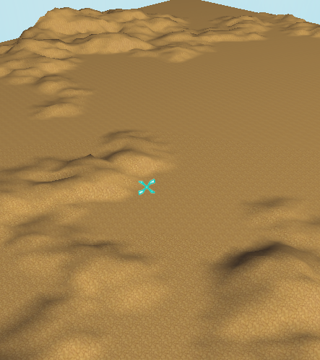
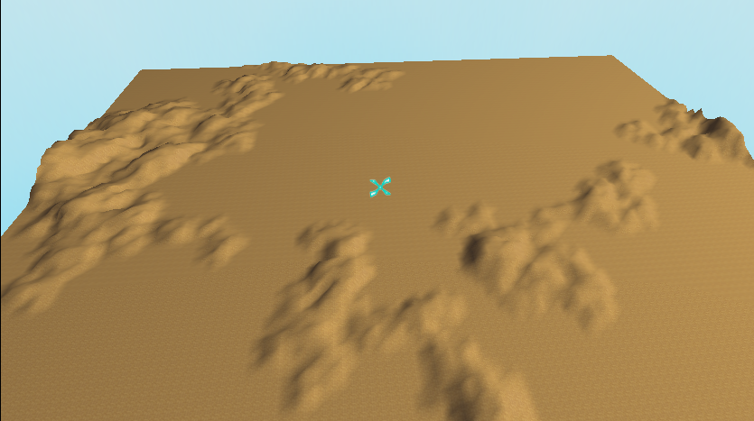
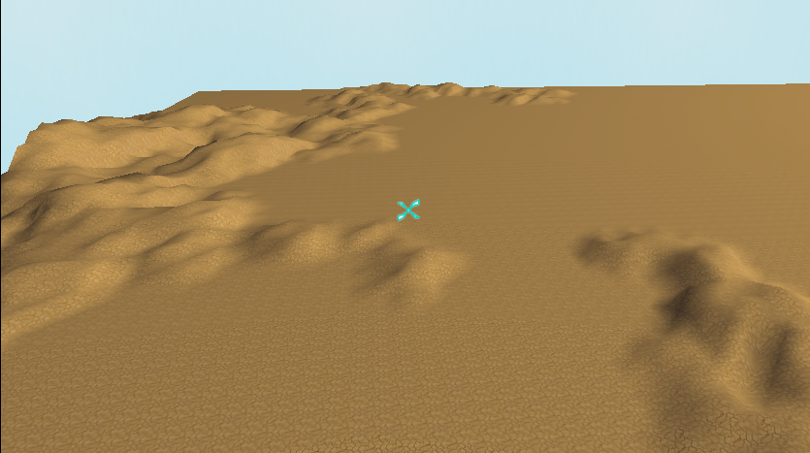
Height-mapped Terrain Pictures

