Slide 1

Modcom
Institute of Technology
Notes:
5/5/2025
1
1

Slide 2
Student Name:
Project Name:
Notes:
5/5/2025
2
2

Slide 3
Slide 2: Problem Definition
Problem Definition.
Many travelers and temporary residents struggle to find reliable, well-documented rental houses that fit their preference and budget
Safaritours aim to solve this by:
A seamless, user-friendly interface that allows renters to browse verified house listings.
A clear pricing model with transparent booking processes.
Reliable property descriptions, images, and user reviews for informed decision-making.
Smooth interaction between users and property owners, ensuring secure and efficient transactions
Notes:
5/5/2025
3
3

Slide 4
Slide 3: Your Solution
Ensuring all price tags are labeled so that the users can compare and sort their house preference
We allow direct communication between the the person booking and the organization
Providing users with a user friendly interface to ensure people don’t have challenges while trying to acquire a house
Notes:
5/5/2025
4
4

Slide 5
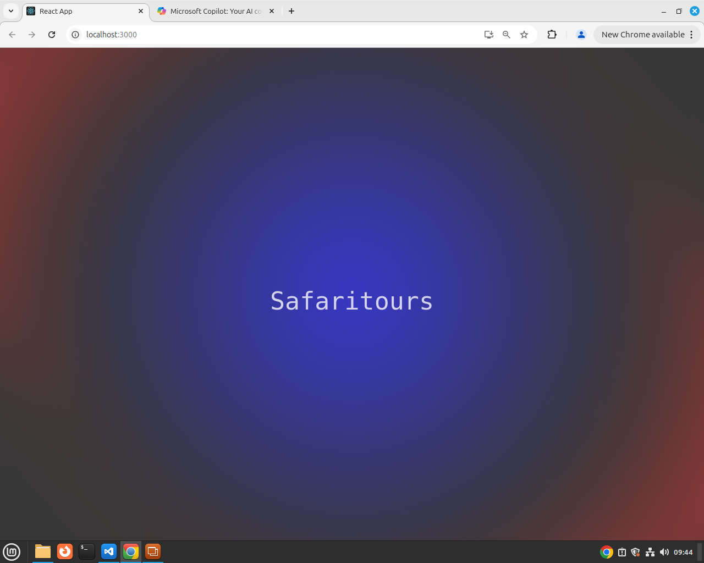
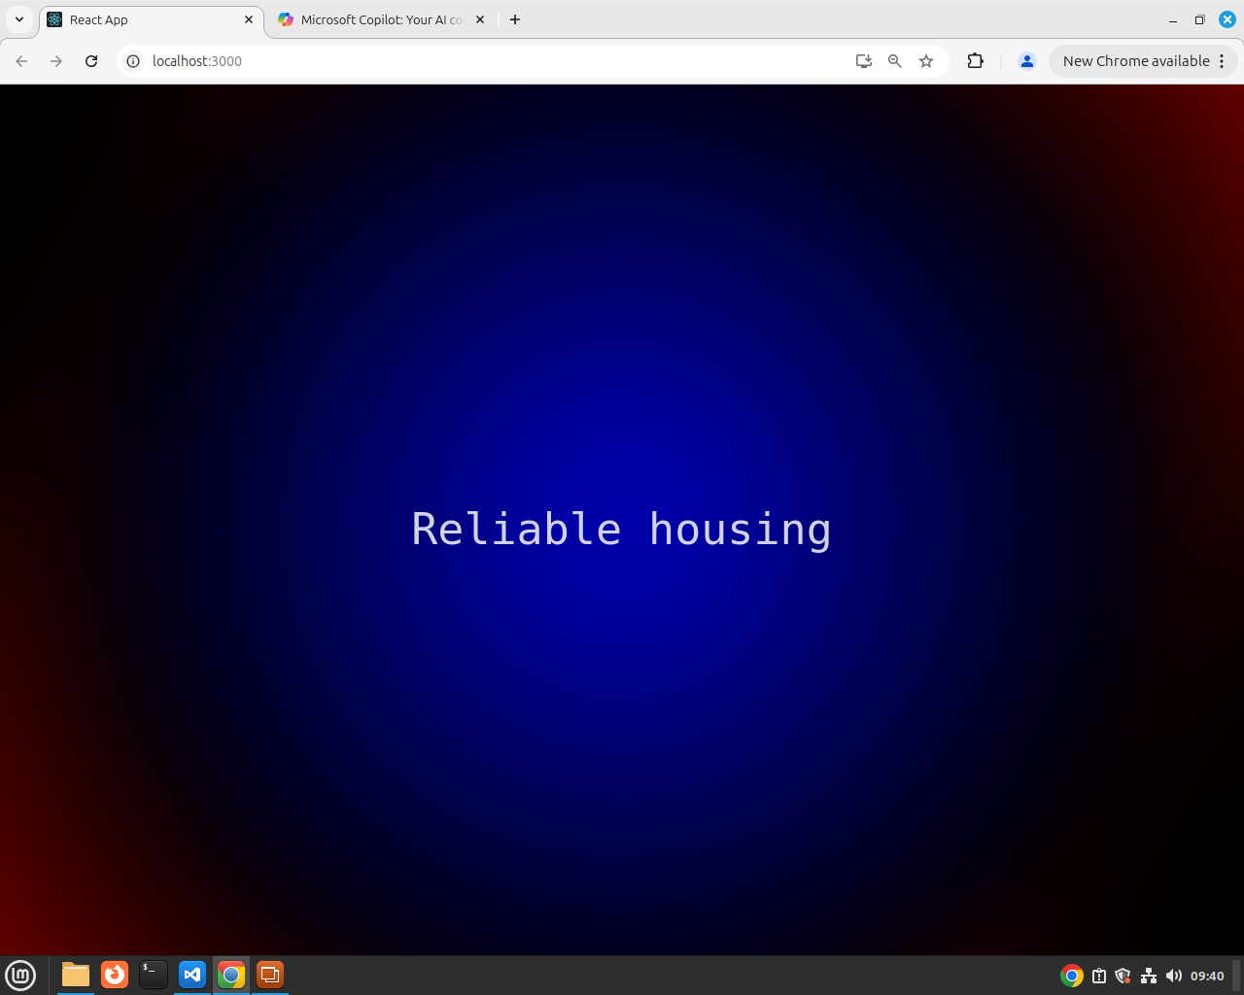
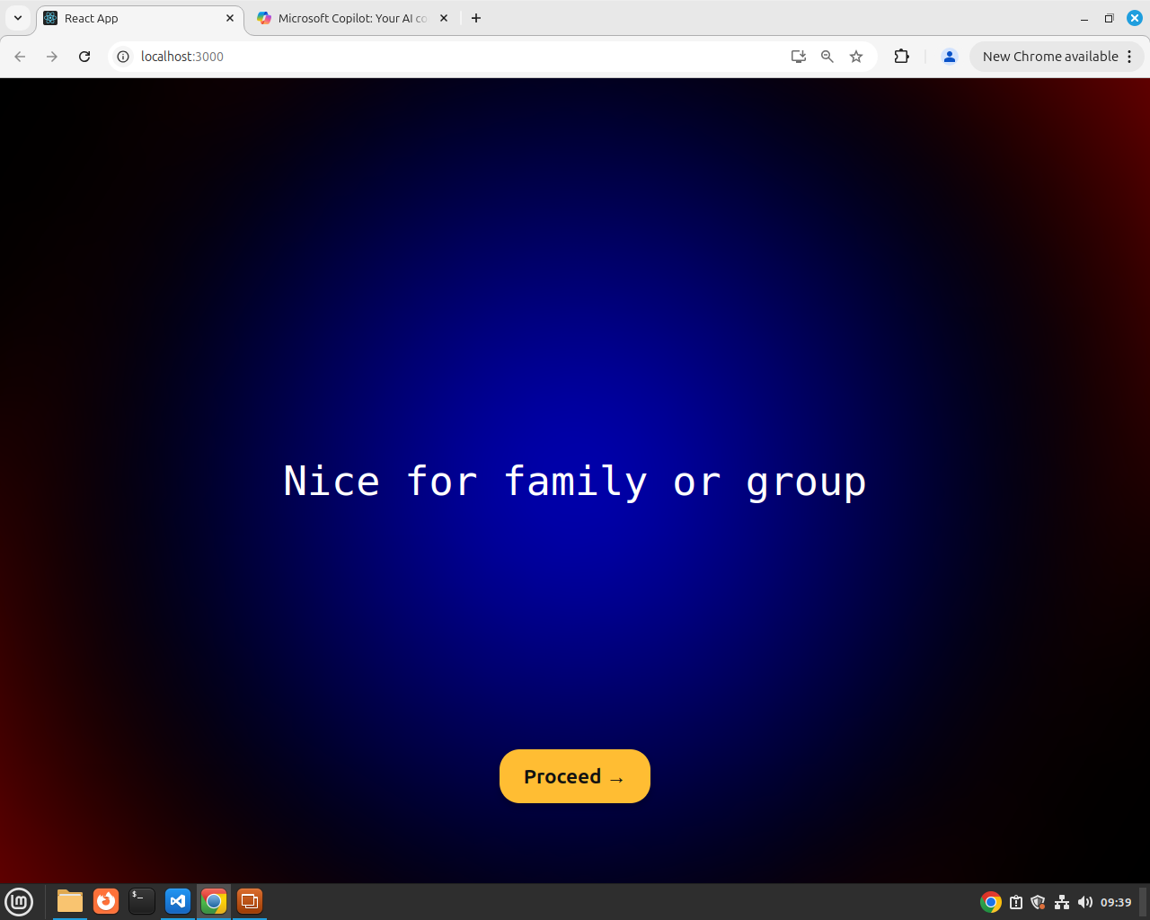
Slide 4: Screenshots
Main interface
Notes:
5/5/2025
5
5

Slide 6
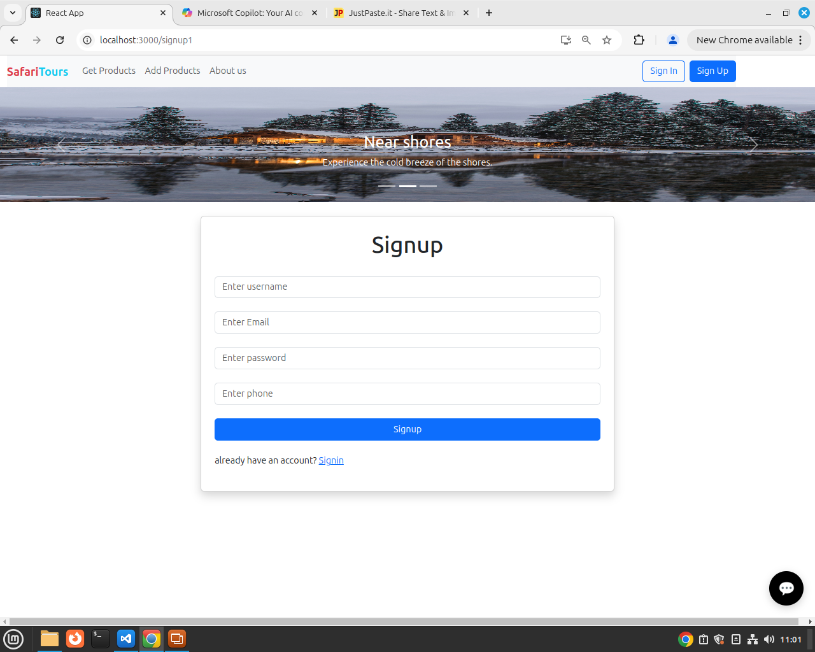
Slide 5: Screenshots
Sign up page
Notes:
5/5/2025
6
6

Slide 7
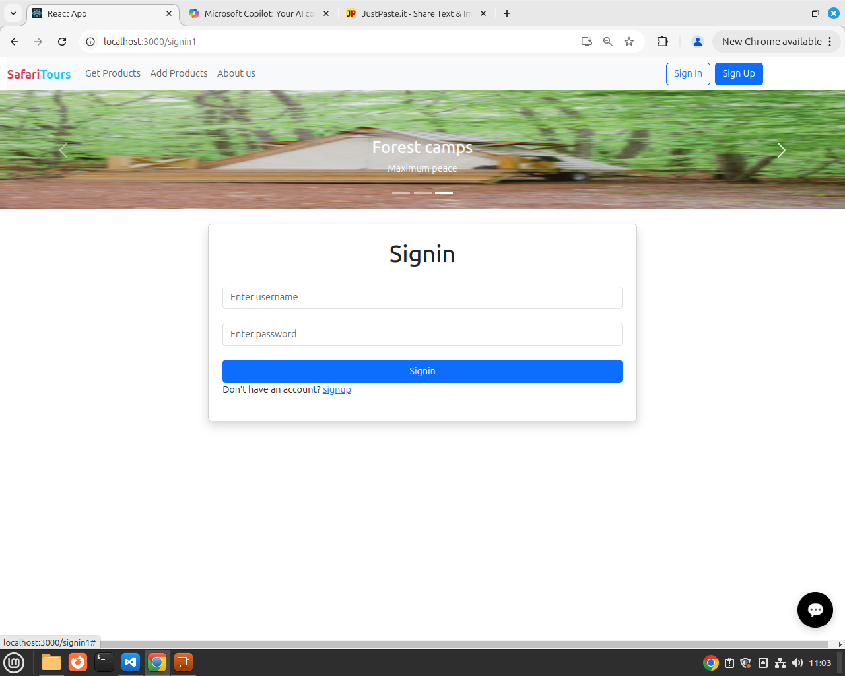
Slide 5: Screenshots
Sign in page
Notes:
5/5/2025
7
7

Slide 8
Slide 5: Screenshots
Notes:
5/5/2025
8
8

Slide 9
Slide 5: Screenshots
Notes:
5/5/2025
9
9

Slide 10
Slide 5: Screenshots
Notes:
5/5/2025
10
10

Slide 11
Slide 5: Screenshots
Notes:
5/5/2025
11
11

Slide 12
Slide 5: Screenshots
Notes:
5/5/2025
12
12

