Slide 1
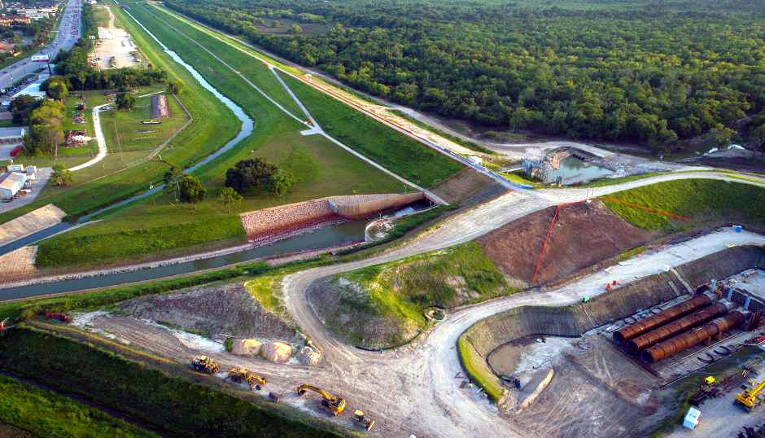
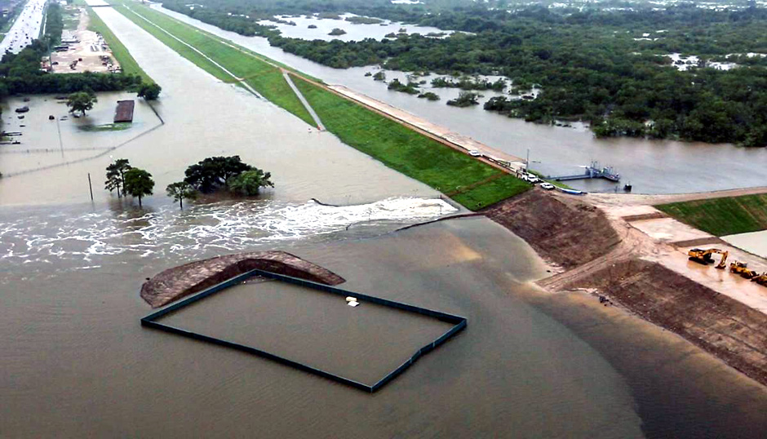
Buffalo Bayou Flood Risk Reduction for Next Harvey
January 23, 2019
Data Science Project 1
Rice University - Houston, Texas
Lesly Bohuchot
Doug Newsom
Margret Saniel

Slide 2
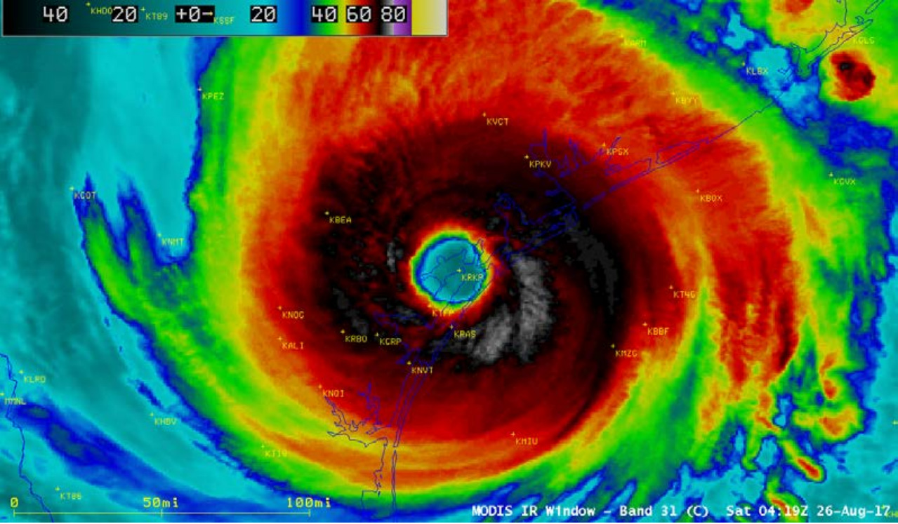

Slide 3
Motivation and Summary Slide
Hypothesis
We all saw the destruction first hand of severe storms, we were personally affected by the devastation and we want to help reducing the risk of flooding in Houston for future storms
What are the best ways to reduce flood risk?
What did harvey teach us
Questions:
What was the economic impact from Harvey upstream flooding?
What role did social media play? And how did it impact the city?
What does the data suggest would help to reduce flood risk in future storms?

Slide 4
Questions & Data
Harvey damage
What were the water levels for dams before, during and after Harvey?
Release rates, historical floodings
What was the capacity of the reservoirs before, during and after Harvey?
Historical data, watersheds
What economic impact did this have?
Social Media Influence
What were the trending topics during Harvey?
Patterns, spkes, trends from twitter
Social media role in preventative crises
Twitter API’s
Risk reduction for future storms
What can we do to improve our current reservoirs?
Release rate data, data reservoir conditions
What other solutions does the data suggest can help improve flooding conditions in Houston
Katy prairie data, soil data,
How does the Houston rapid development affect future flood disaster?
Population growth projections, census

Slide 5
Data clean up & exploration
Describe the exploration & clean up process
Discuss insights you had while exploring the data and how you solved them
Present and discuss interesting figures developed during exploration

Slide 6
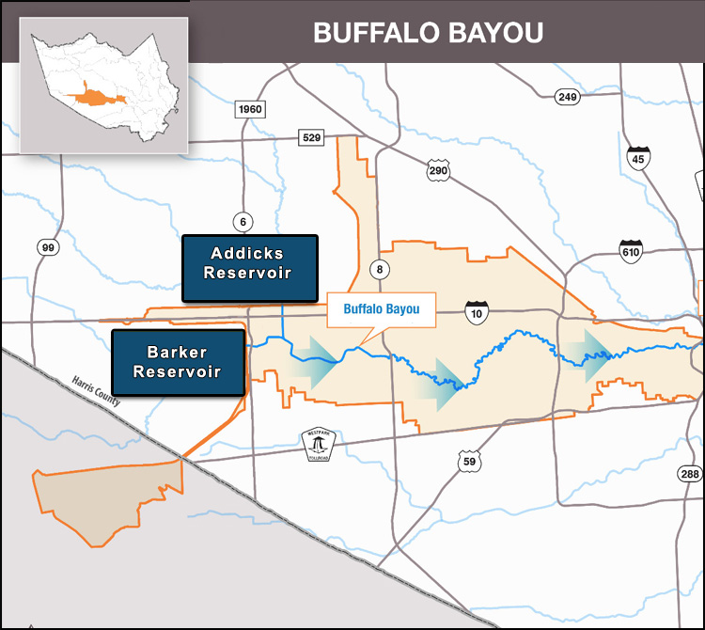
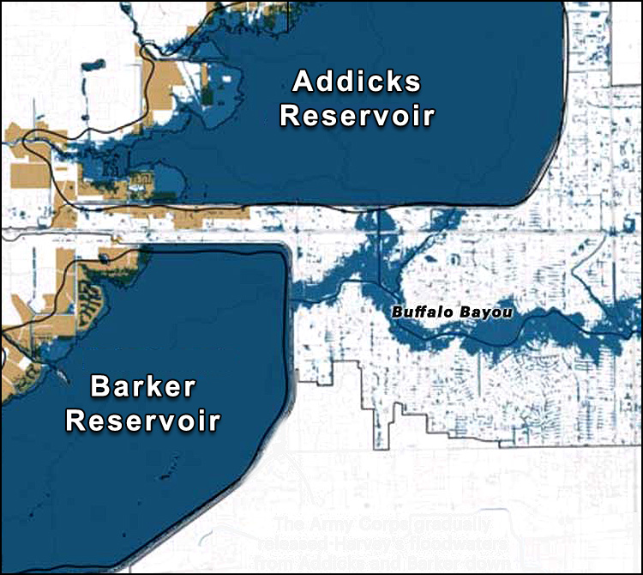
Data Analysis: Buffalo Bayou Study Area

Slide 7
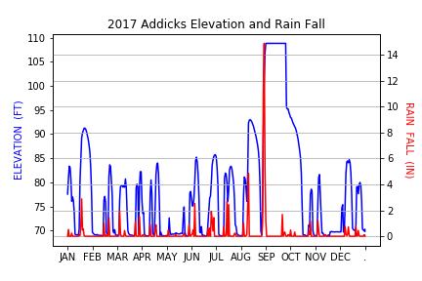
Reservoir Flooding

Slide 8
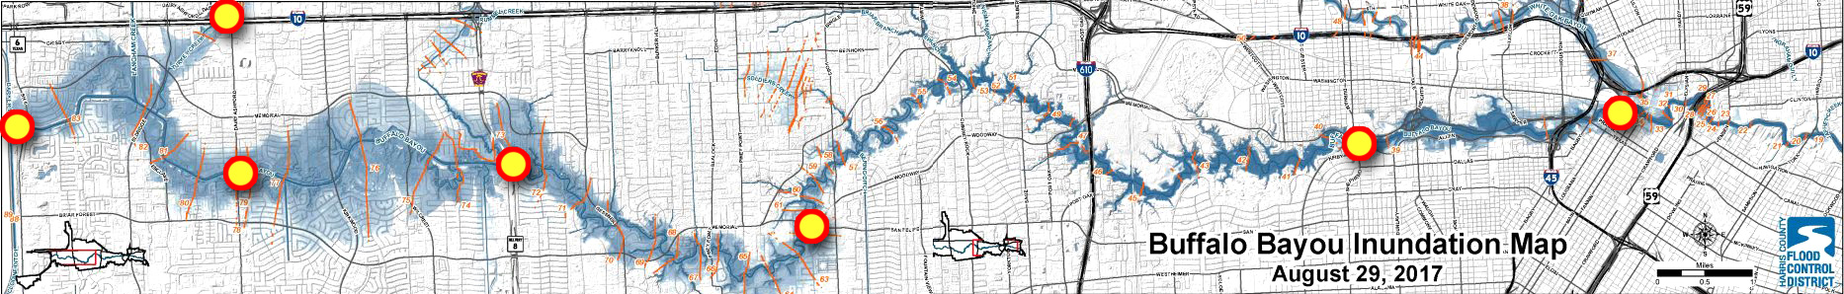
Buffalo Bayou Flood Monitoring

Slide 9
Margret Slide 1

Slide 10
Margret Slide 2

Slide 11
Margret Slide 3

Slide 12
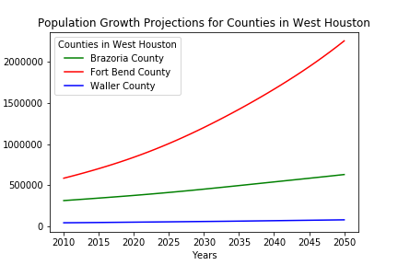
Population Growth Projection

Slide 13
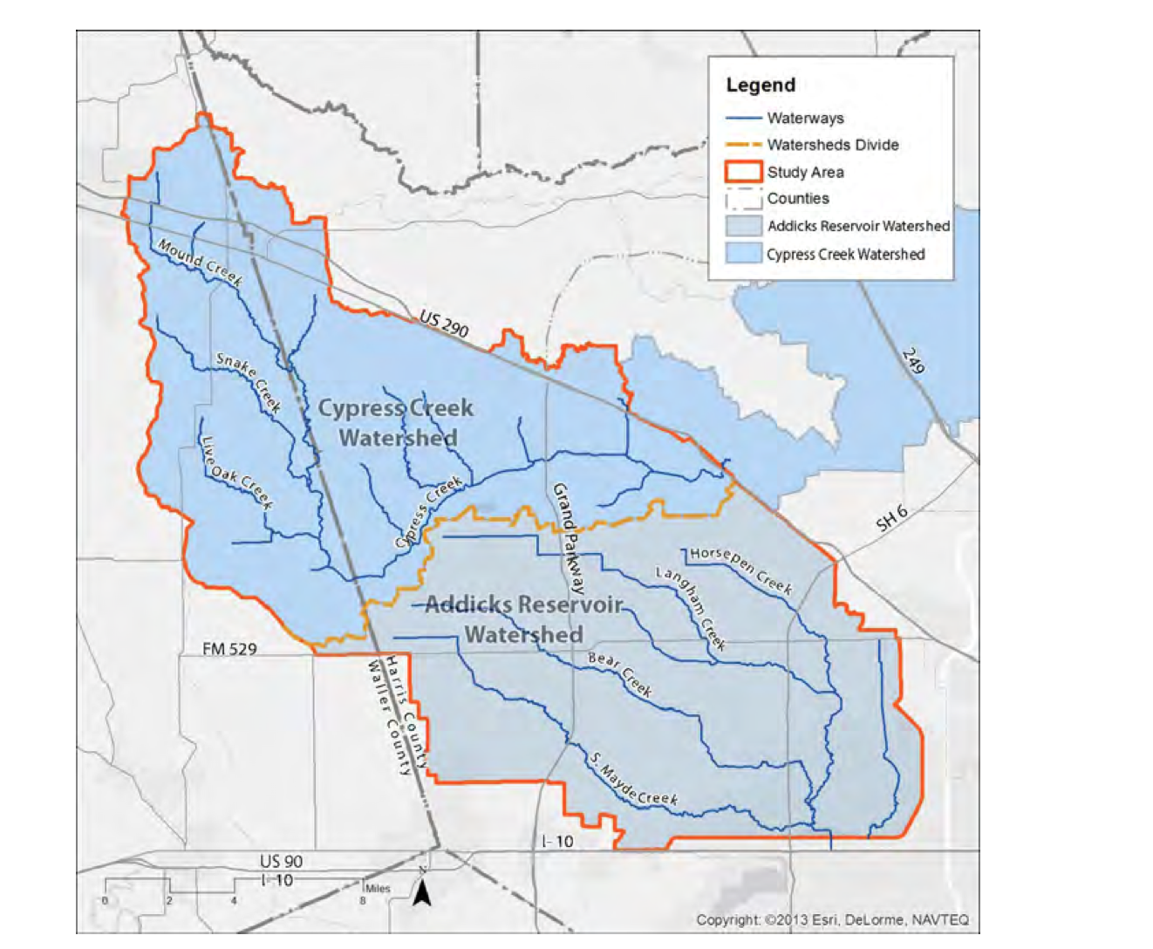
3rd reservoir Cypress Creek Watershed

Slide 14
Lesly Slide 3

Slide 15
Discussion
What were the findings?
Did we expect them? What inferences or general conclusions can we draw from the analysis

Slide 16
Post Mortem
What difficulties arose and how did we deal with them?
Lack of raw data
Talking with experts
Matthew Zeve, Dr. Phil Bedient steered our analysis in a different direction
What additional questions came up with no time to answer?
Underground tunnel solution
What would you research next if you had two more weeks?

Slide 17
Questions
Q & A with the audience

