Slide 1
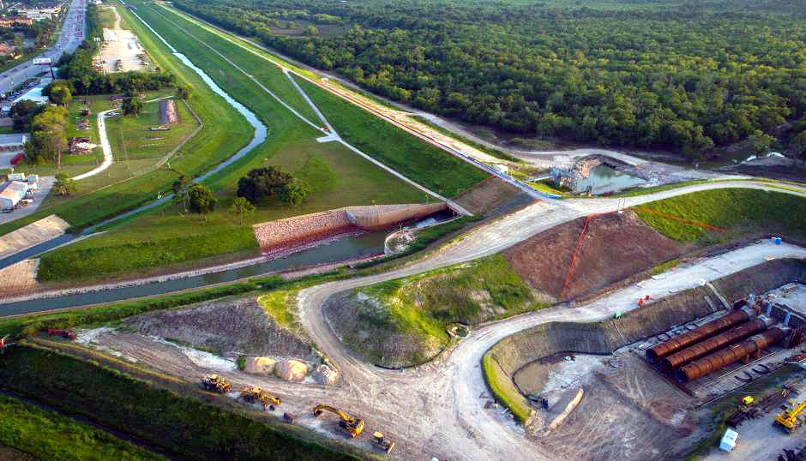
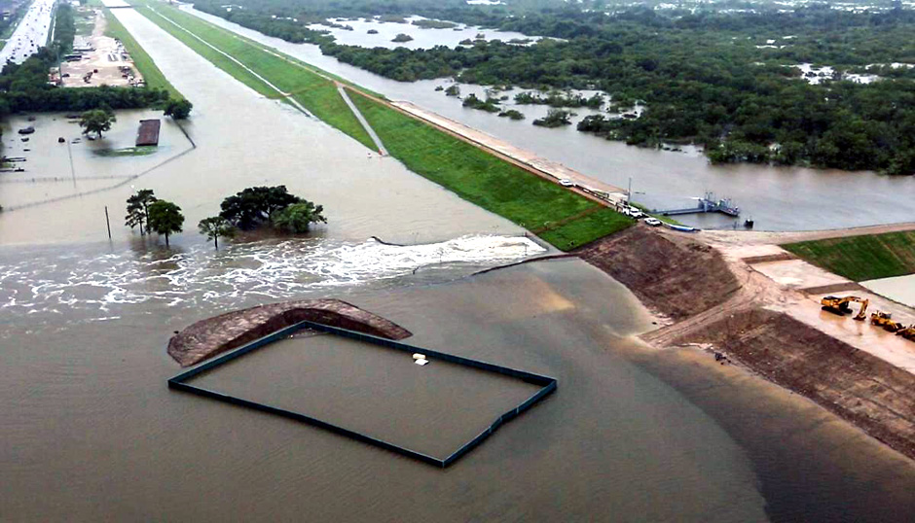
Buffalo Bayou Flood Risk Reduction for Next Harvey
January 23, 2019
Data Science Project 1
Rice University - Houston, Texas
Lesly Bohuchot
Doug Newsom
Margret Saniel

Slide 2
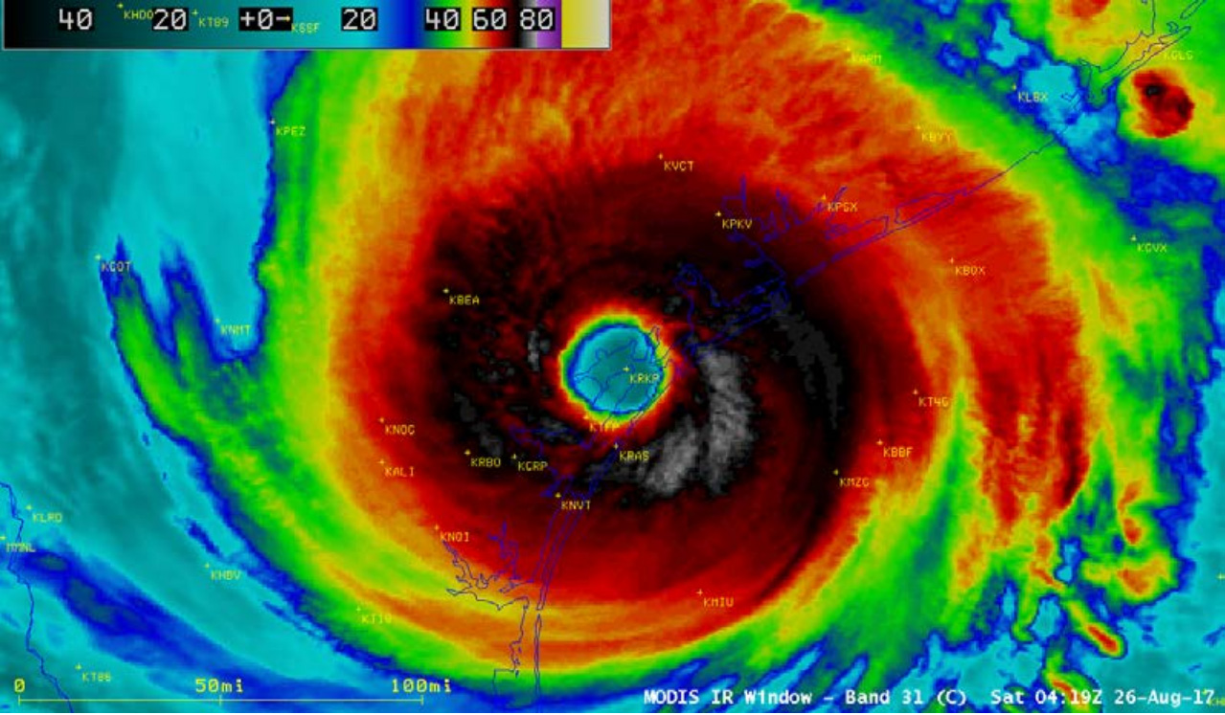

Slide 3
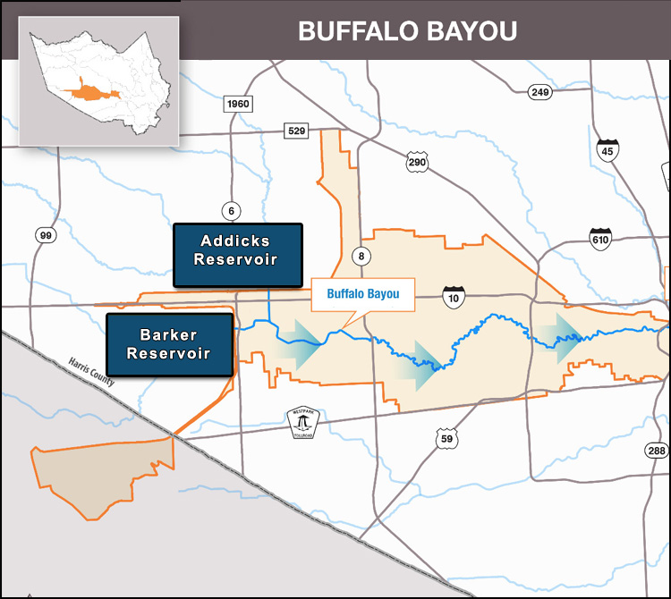
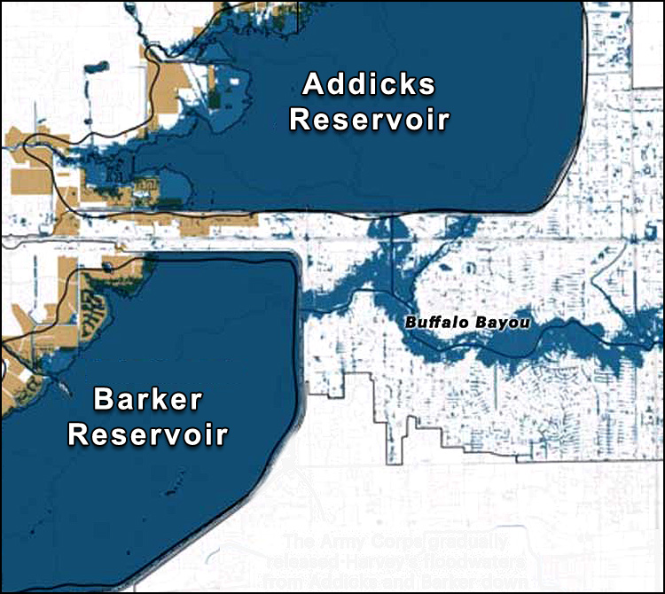
Buffalo Bayou Study Area

Slide 4
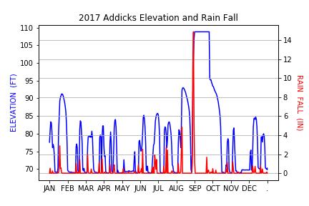
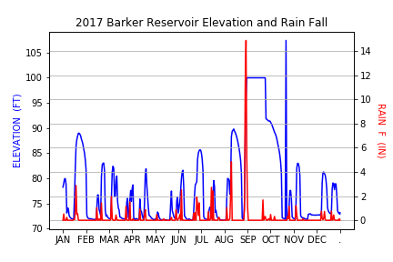
Reservoir Flooding

Slide 5
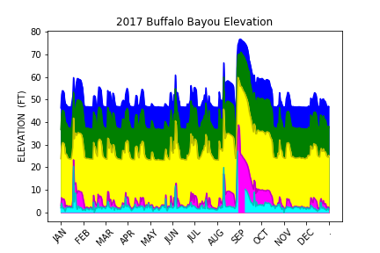
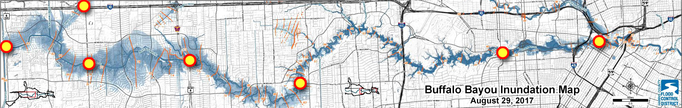
Buffalo Bayou Flood Monitoring

Slide 6
Margret Slide 1

Slide 7
Margret Slide 2

Slide 8
Margret Slide 3

Slide 9
Lesly Slide 1

Slide 10
Lesly Slide 2

Slide 11
Lesly Slide 3

Slide 12
Conclusions

