Slide 1
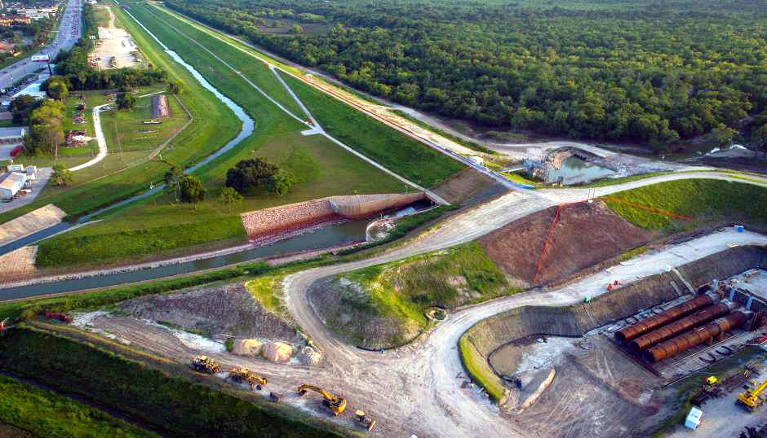
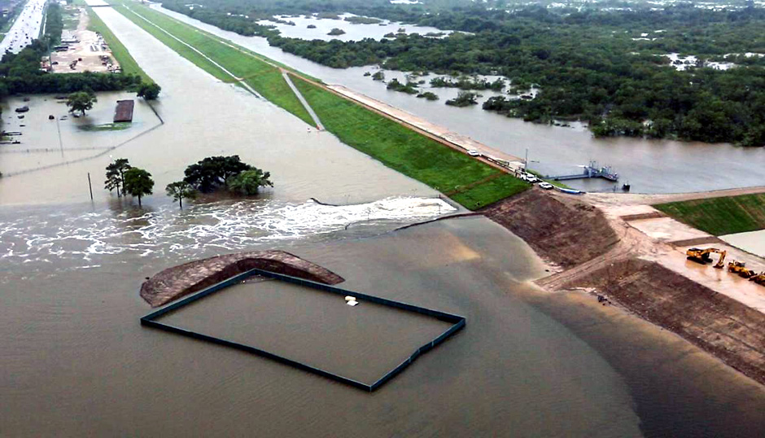
Upstream Flood Risk Reduction for Next Harvey
January 23, 2019
Data Science Project 1
Rice University - Houston, Texas
Lesly Bohuchot
Doug Newsom
Margret Saniel

Slide 2
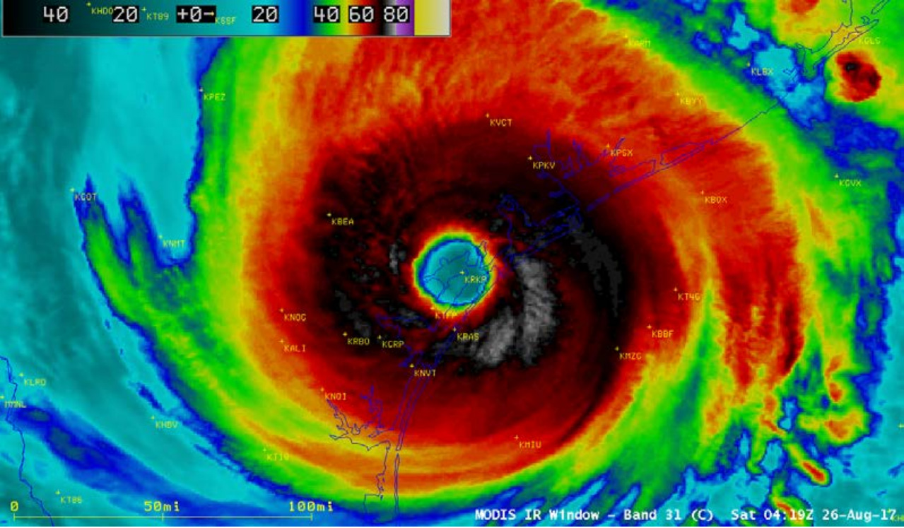

Slide 3
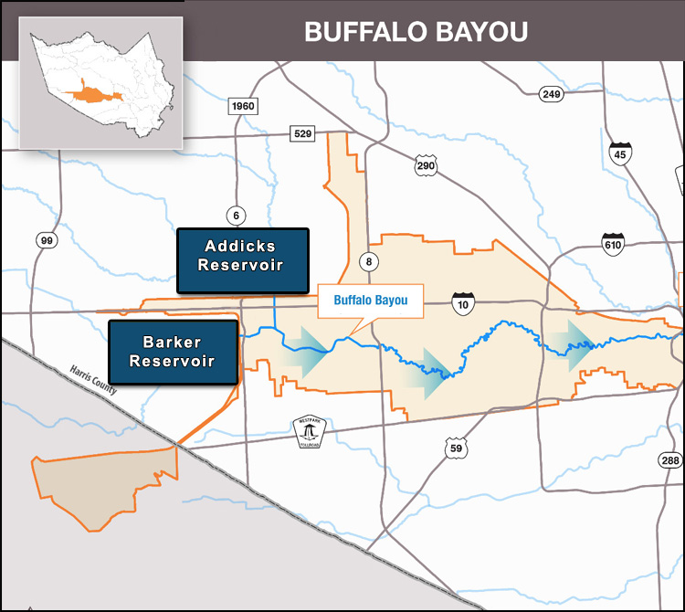
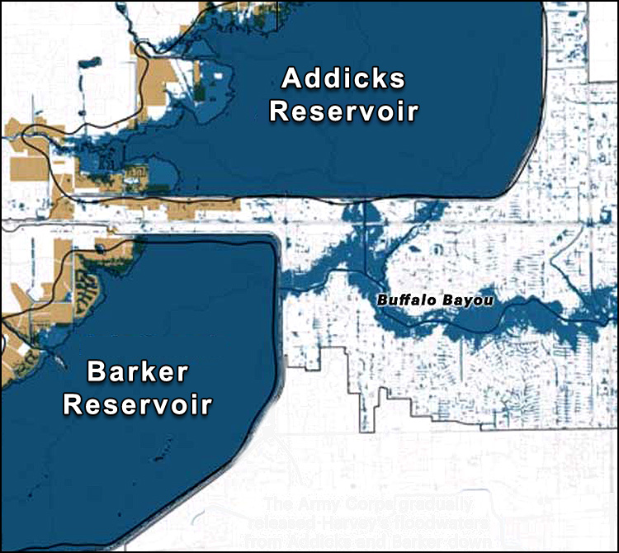
Buffalo Bayou Study Area

Slide 4
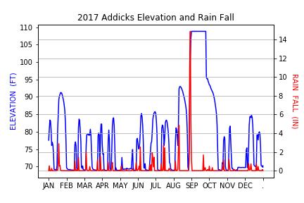
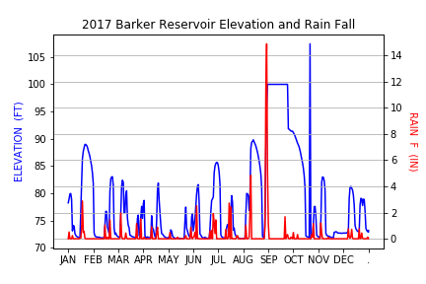
Reservoir Flooding

Slide 5
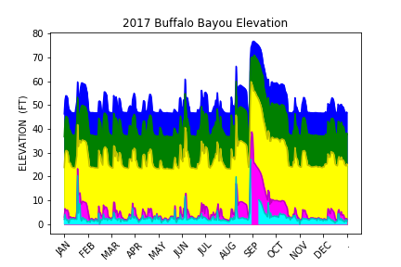
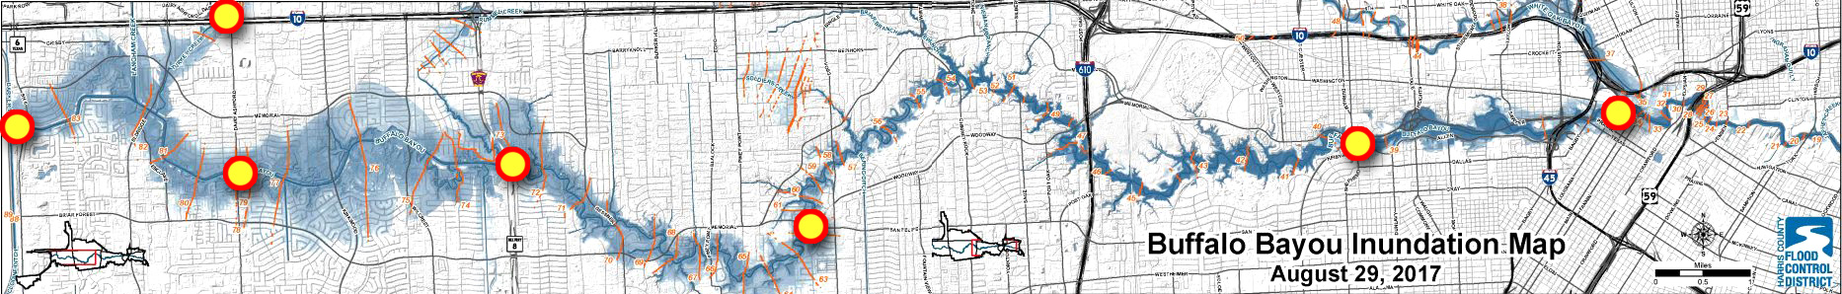
Buffalo Bayou Flood Monitoring

Slide 6
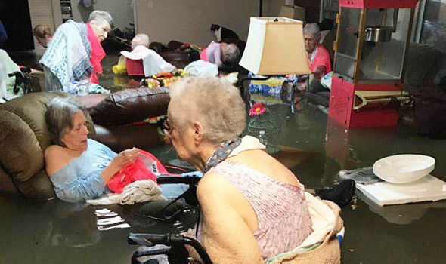
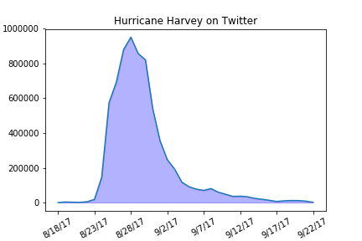
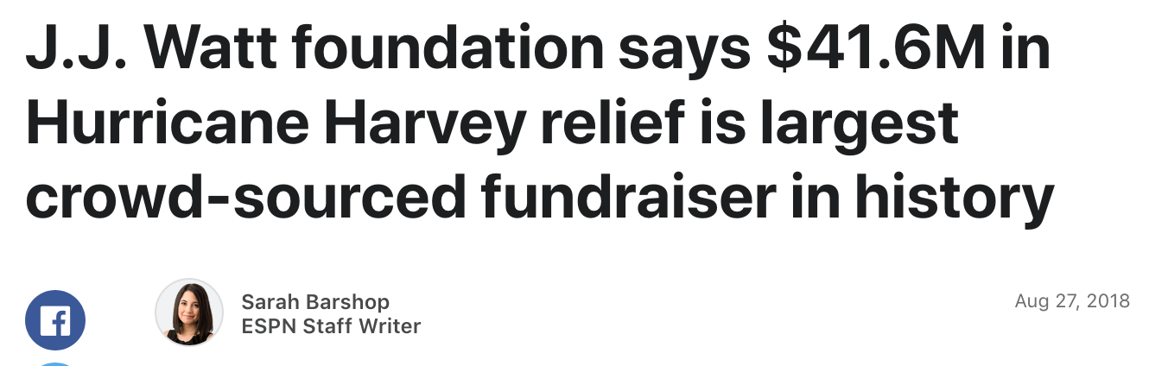
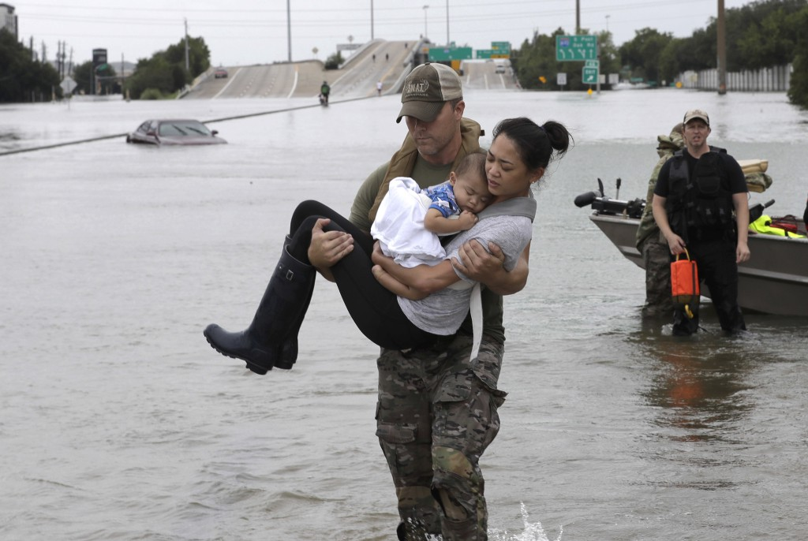
Hurricane Harvey on Social Media

Slide 7
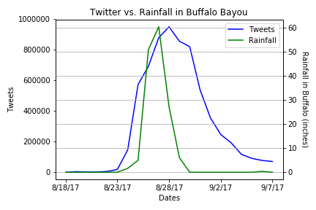
Buffalo Bayou and Twitter
Peak rainfall total to 60.36 inches
Peak tweets hit 950,000

Slide 8
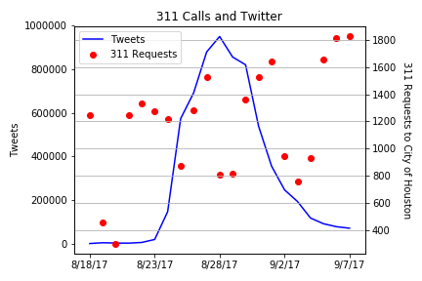
Service Requests and Social Media
About 50,000 requests sent in 8/18 – 9/22
700+ SR still open to date

Slide 9
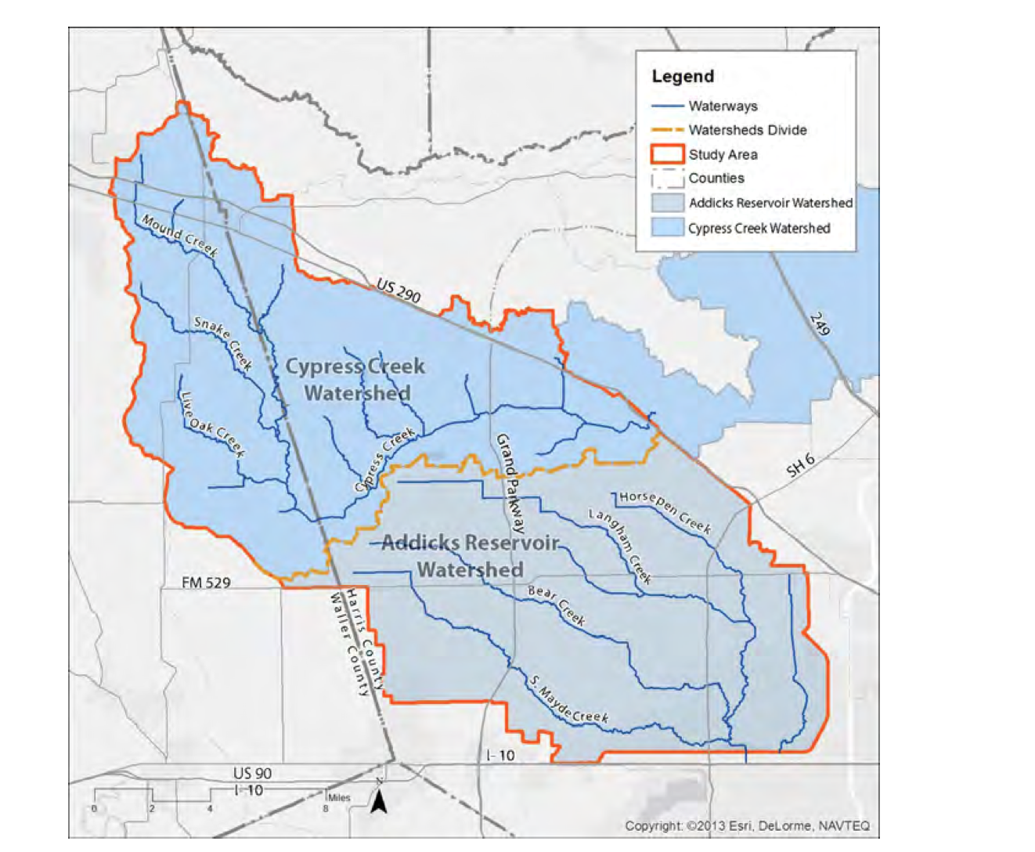
3rd reservoir Cypress Creek Watershed

Slide 10
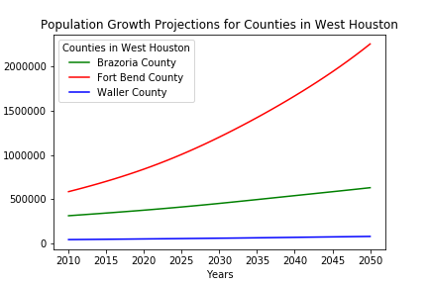
Population Growth Projection

Slide 11
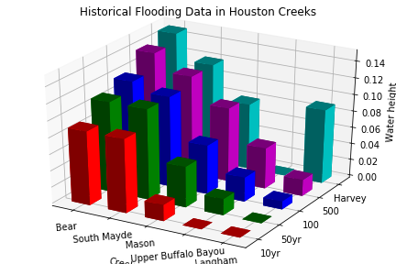
Flood Risk Probability
Add Plot Here

Slide 12
Conclusions
Addicks and Barker Reservoirs - Constant Threat
Future Buffalo Bayou Flooding - High Risk
Number 3 - Margret
Number 4 – Margret
High population growth expected on West Houston
Flood levels from Harvey indicate a need to protect the incoming communities

