Slide 1
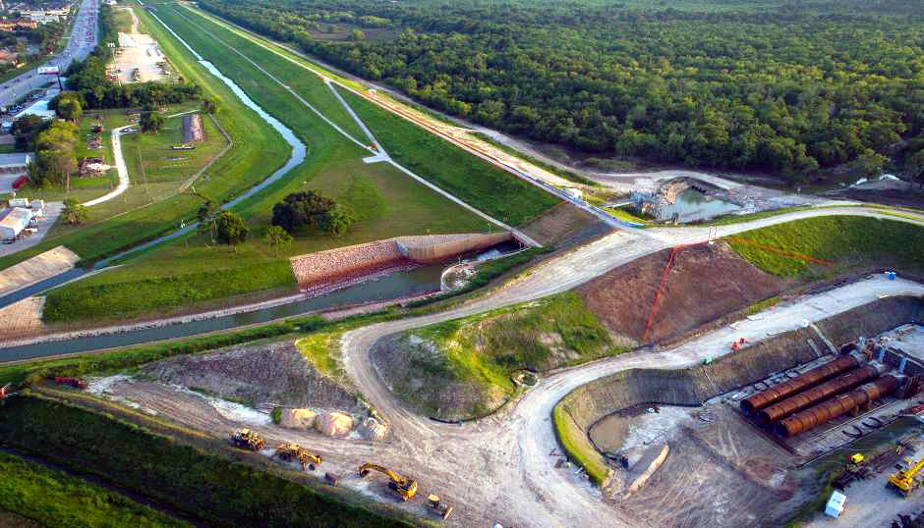
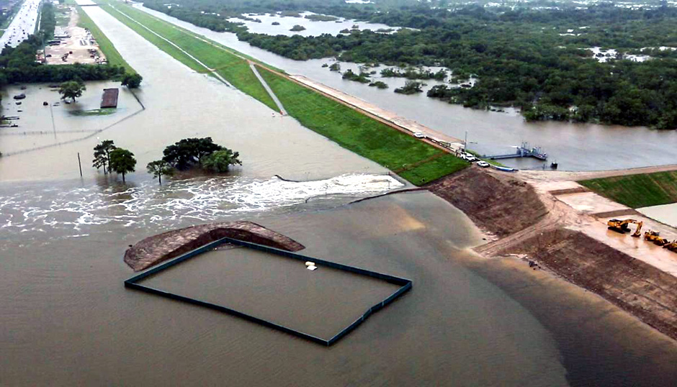
Buffalo Bayou Flood Risk Reduction for Next Harvey
January 23, 2019
Data Science Project 1
Rice University - Houston, Texas
Lesly Bohuchot
Doug Newsom
Margret Saniel

Slide 2
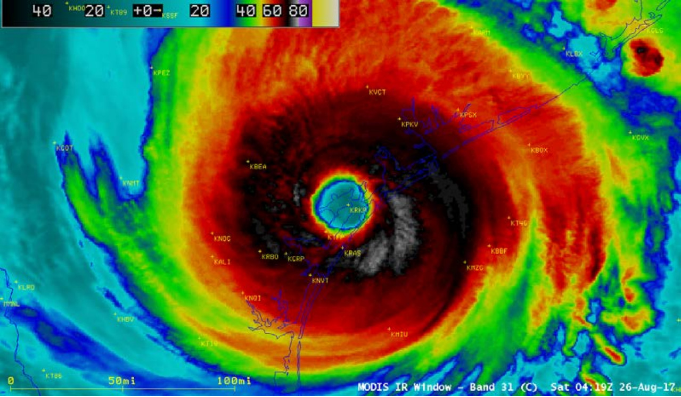

Slide 3
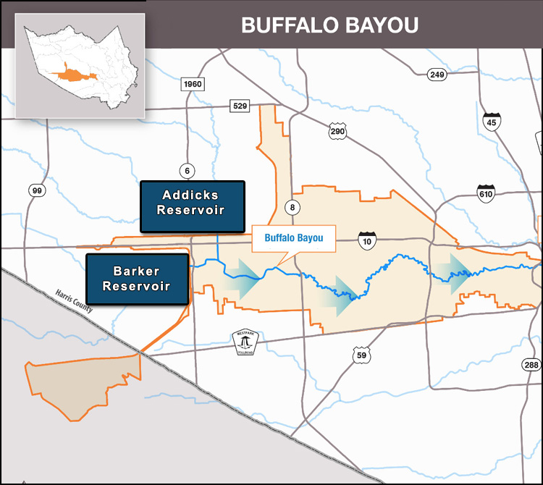
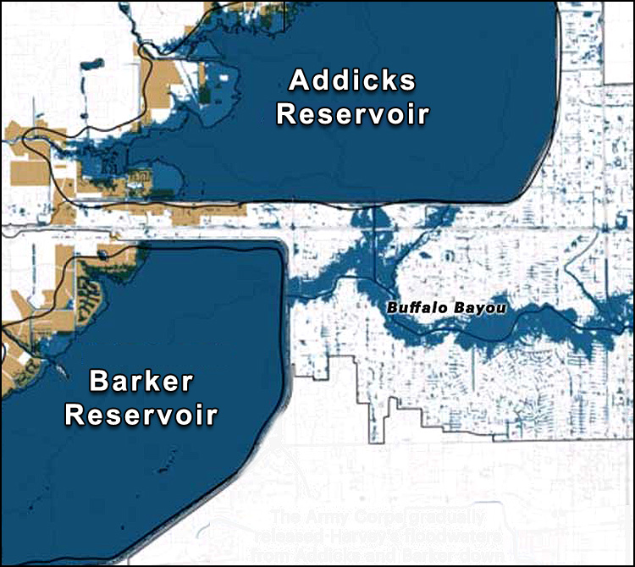
Buffalo Bayou Study Area

Slide 4
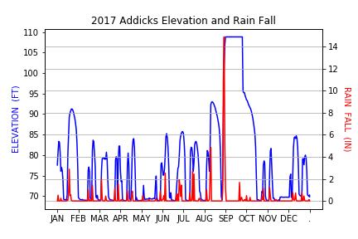
Reservoir Flooding

Slide 5
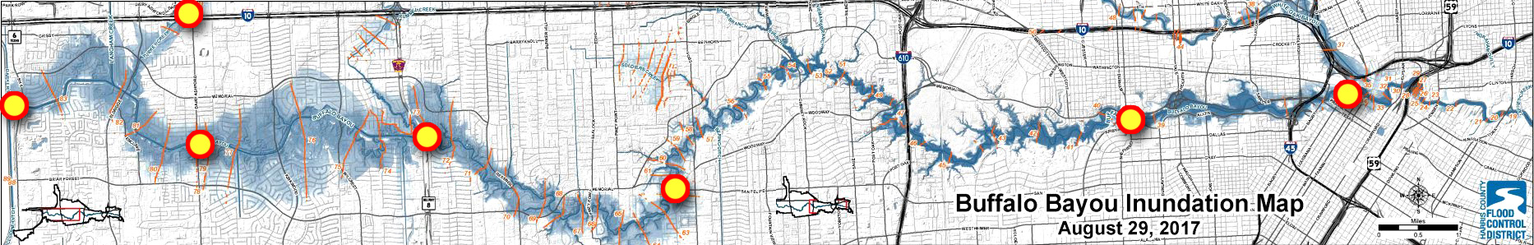
Buffalo Bayou Flood Monitoring

Slide 6
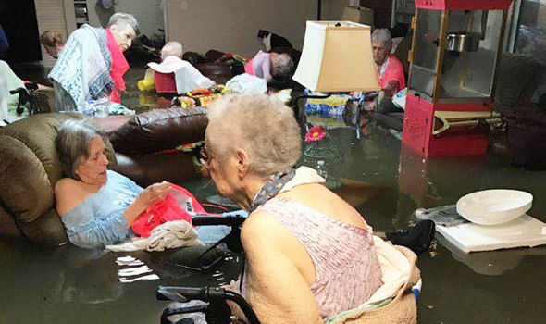
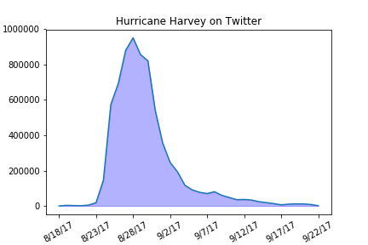
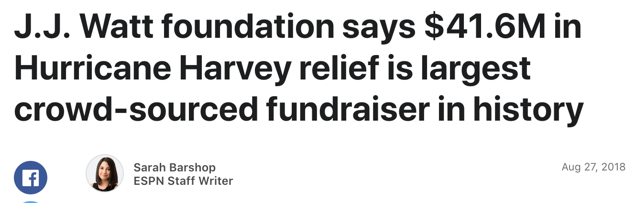
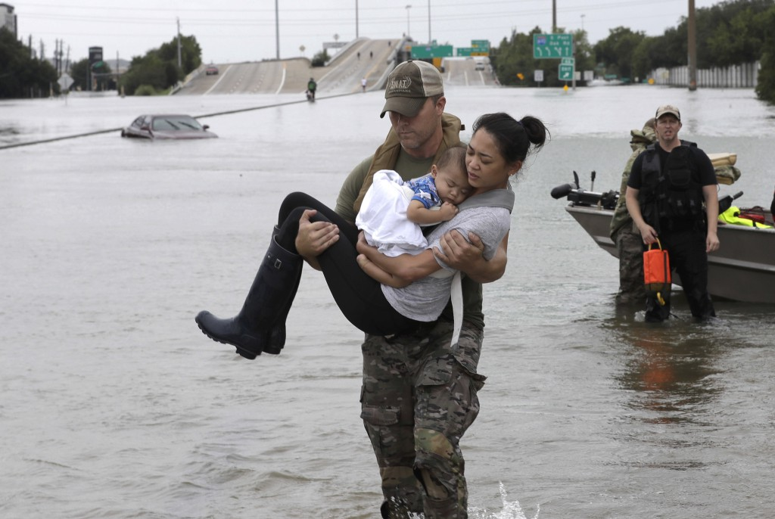
Hurricane Harvey on Social Media

Slide 7
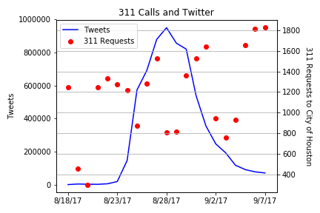
Service Requests and Social Media
About 50,000 requests sent in 8/18 – 9/22
700+ SR still open to date

Slide 8
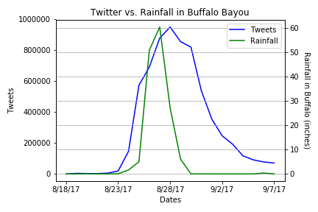
Buffalo Bayou and Twitter
Peak rainfall total to 60.36 inches
Peak tweets hit 950,000

Slide 9
Margret Slide 3

Slide 10
Lesly Slide 1

Slide 11
Lesly Slide 2

Slide 12
Lesly Slide 3

Slide 13
Conclusions

