Slide 1
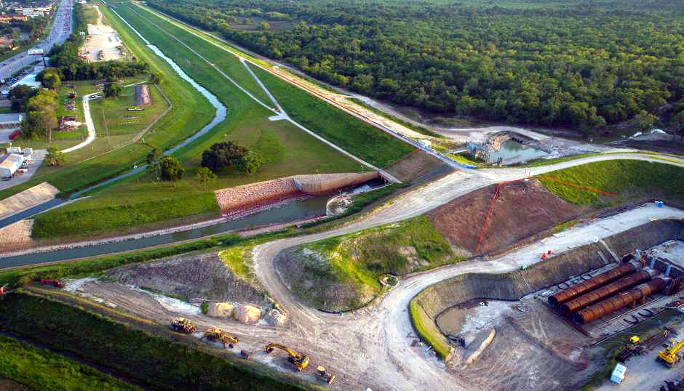
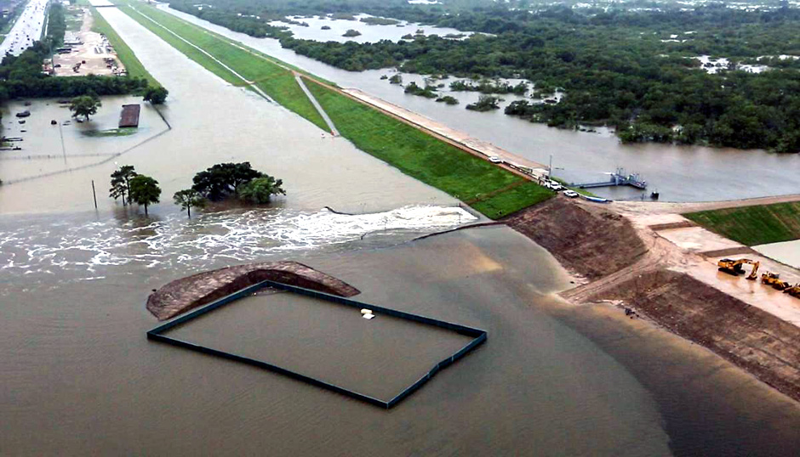
Buffalo Bayou Flood Risk Reduction for Next Harvey
January 23, 2019
Data Science Project 1
Rice University - Houston, Texas
Lesly Bohuchot
Doug Newsom
Margret Saniel

Slide 2
Doug - Motivation & Summary
Hypothesis
We all saw the destruction first hand of severe storms, we were personally affected by the devastation and we want to help reducing the risk of flooding in Houston for future storms
What are the best ways to reduce flood risk?
What did Harvey teach us
Questions:
What was the economic impact from Harvey upstream flooding?
What role did social media play? And how did it impact the city?
What does the data suggest would help to reduce flood risk in future storms?

Slide 3
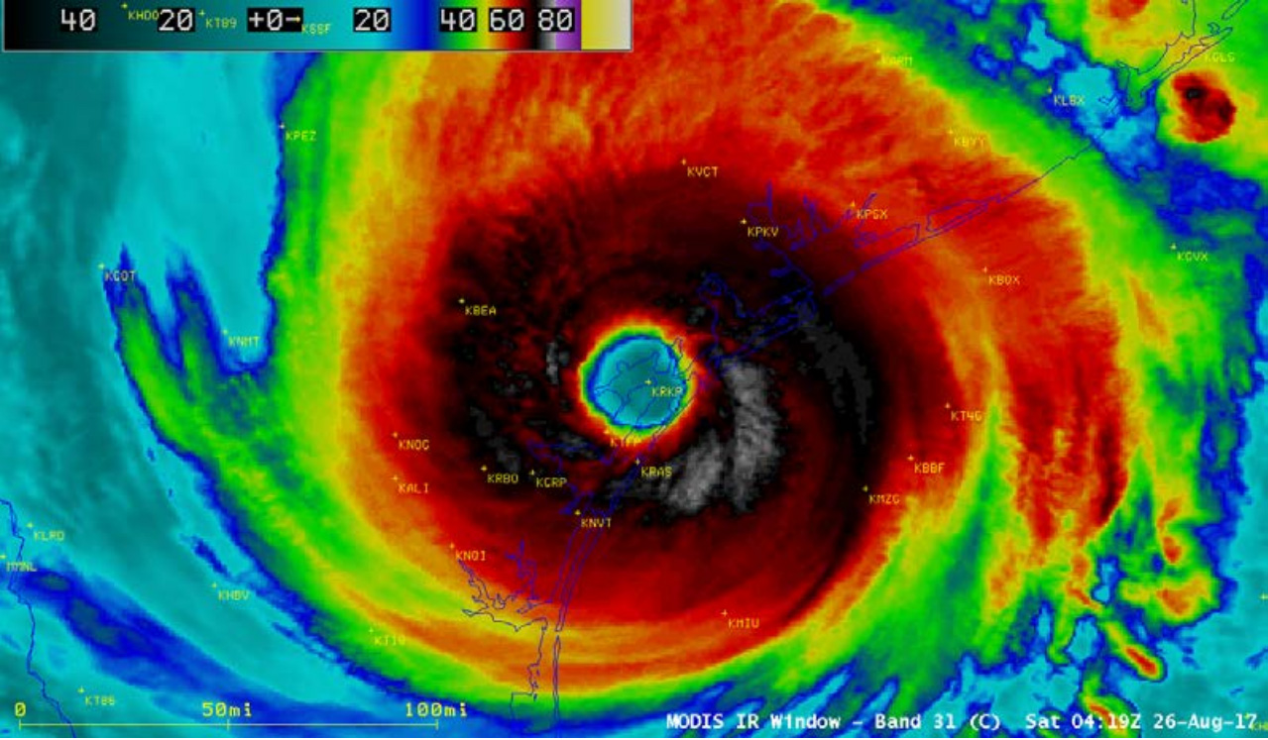

Slide 4
Doug - Questions, Exploration & Data Clean-Up
Buffalo Bayou
What were the water levels for dams before, during and after Harvey?
Release rates, historical flooding
What was the capacity of the reservoirs before, during and after Harvey?
Historical data, watersheds
What economic impact did this have?
Describe the exploration & clean up process
Discuss insights you had while exploring the data and how you solved them

Slide 5
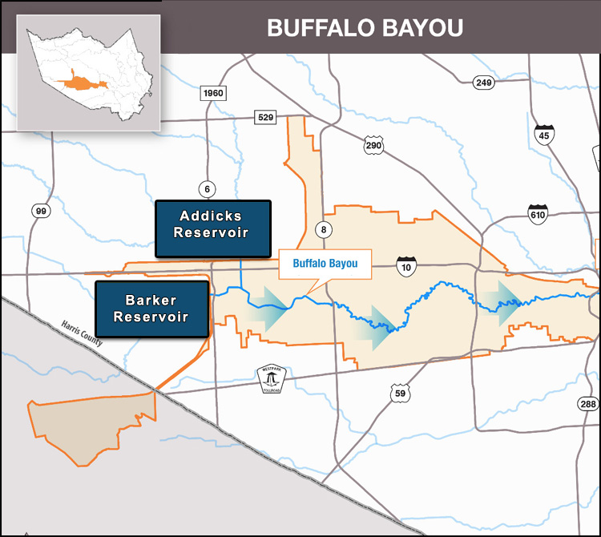
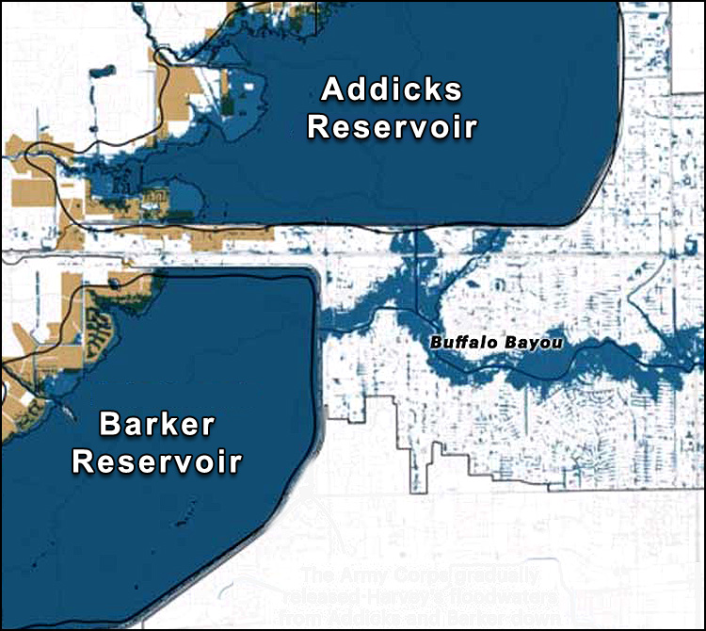
Buffalo Bayou Study Area

Slide 6
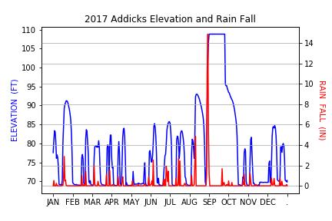
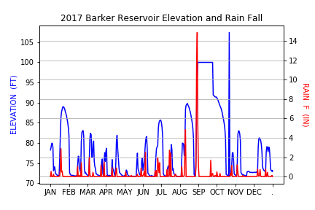
Reservoir Flooding

Slide 7
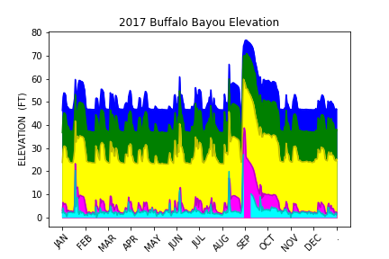
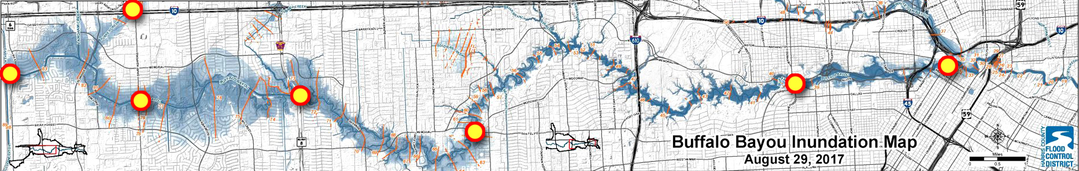
Buffalo Bayou Flood Monitoring

Slide 8
Margret - Questions, Exploration & Data Clean-Up
Social Media Influence
What were the trending topics during Harvey?
Patterns, spikes, trends from twitter
Social media role in preventative crises
Twitter API’s
Describe the exploration & clean up process
Discuss insights you had while exploring the data and how you solved them

Slide 9
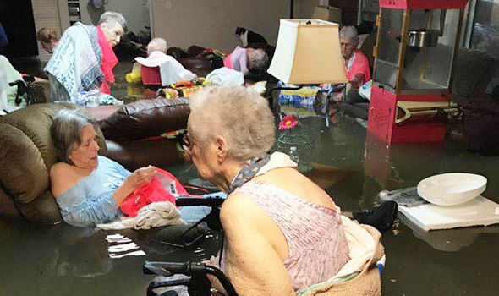
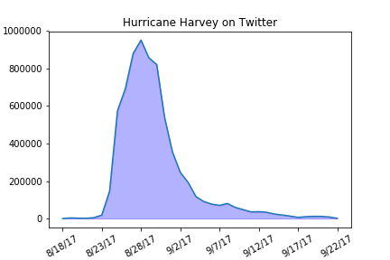
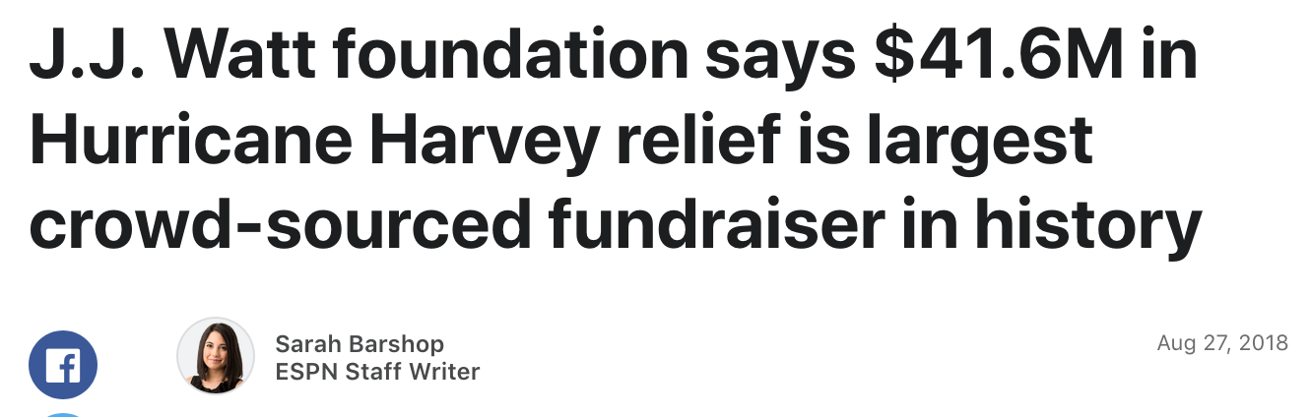
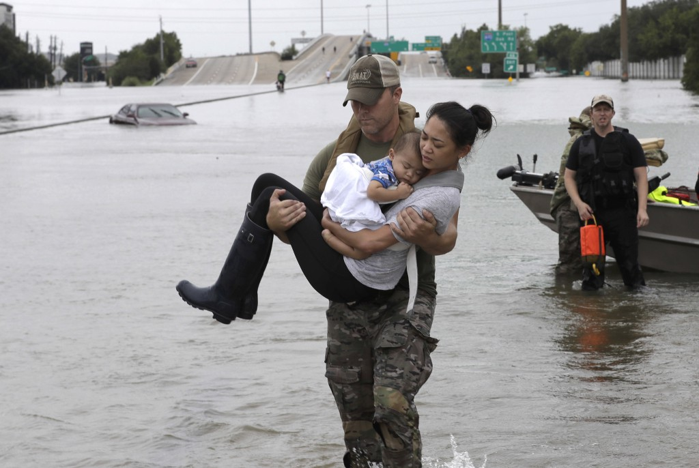
Hurricane Harvey on Social Media

Slide 10
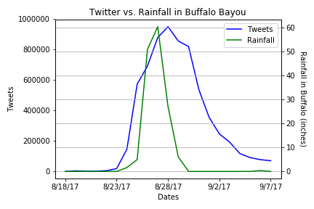
Buffalo Bayou and Twitter
Peak rainfall total to 60.36 inches
Peak tweets hit 950,000

Slide 11
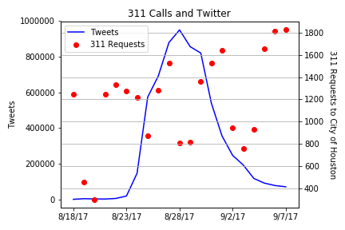
Service Requests and Social Media
About 50,000 requests sent in 8/18 – 9/22
700+ SR still open to date

Slide 12
Lesly - Questions, Exploration & Data Clean-Up
Risk reduction for future storms
What can we do to improve our current reservoirs?
Release rate data, data reservoir conditions
What other solutions does the data suggest can help improve flooding conditions in Houston
Katy prairie data, soil data,
How does the Houston rapid development affect future flood disaster?
Population growth projections, census
Describe the exploration & clean up process
Discuss insights you had while exploring the data and how you solved them

Slide 13
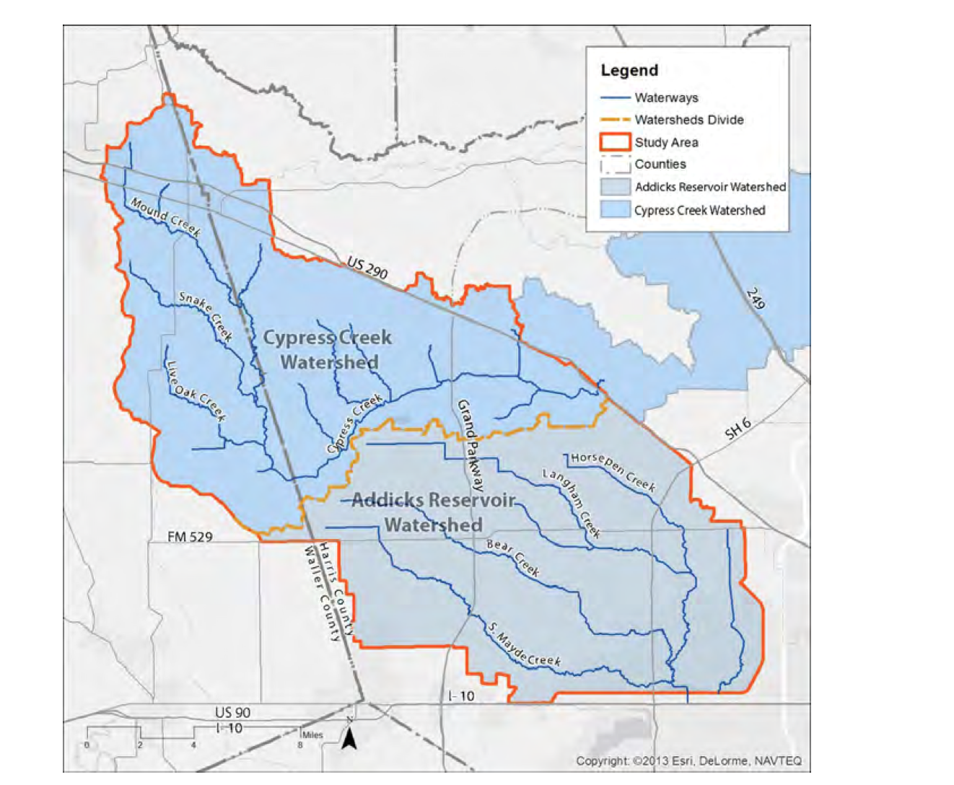
3rd reservoir Cypress Creek Watershed

Slide 14
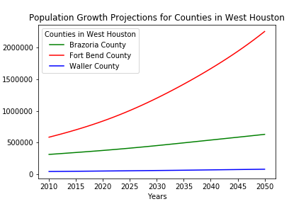
Population Growth Projection

Slide 15
Flood Risk Probability
Add Plot Here

Slide 16
Lesly & Margret - Discussion and Post Mortem
What were the findings?
Did we expect them? What inferences or general conclusions can we draw from the analysis
What difficulties arose and how did we deal with them?
Lack of raw data
Talking with experts
Matthew Zeve, Dr. Phil Bedient steered our analysis in a different direction
What additional questions came up with no time to answer?
Underground tunnel solution
What would you research next if you had two more weeks?

Slide 17
Conclusions
Number 1 - Doug
Number 2 - Doug
Number 3 - Margret
Number 4 - Margret
Number 5 - Lesly
Number 6 - Lesly

