Slide 1
PITCH DECK · 2026
KIU Nexus
A single prioritized academic feed
for KIU CS students.
Archil Margvelashvili · Nikoloz Jvebenava · Giorgi Papidze · Giorgi Kveladze
KIU Capstone Program · June 2026
Notes:
Welcome everyone. We are the KIU Capstone Team and this is KIU Nexus — a single prioritized academic feed for third-year Computer Science students at KIU. Over the next few minutes we will show you the problem we discovered through interviews, the solution we built, and why we believe this is worth funding and deploying this Fall.

Slide 2
The Problem
Third-year KIU CS students waste hours chasing information they can't afford to miss
30–40
Moodle · MS Teams · Messenger · Discord · WhatsApp
Students enrolled in 3+ project courses are forced to manually sweep five platforms every day. Professors post updates inconsistently — a deadline change in Teams, a format update in Moodle, a clarification buried in a group chat. The result: missed announcements, lost grade points, and real integrity costs.
min/day on manual sweeps
5
“
platforms checked daily
I emailed the professor and I lied. I said I had a family thing. He gave me twelve hours. I worked the whole night. I got the points but I felt like a loser.
— TS-3CS, Third-year KIU CS student
Notes:
Our ICP is a third-year KIU CS student enrolled in three or more project-based courses. They spend 30 to 40 minutes every day checking Moodle, Teams, Messenger, Discord, and WhatsApp — and they still miss things. Our discovery interviews show at least one missed deadline per student per semester. The cost is not just points — students told us they lie to professors, lose sleep, and question themselves. This quote is from a real interview, verbatim. Pause here and let it land.

Slide 3
The Solution
One trusted feed. One action. Zero missed deadlines.
KIU Nexus aggregates critical course announcements from all five platforms into one prioritized feed. Students see only what matters — and acknowledge urgent items into their weekly plan in a single tap.
🔗 Unified aggregation
Pulls updates from Moodle, Teams, Messenger, Discord, and WhatsApp automatically.
⚡ Intelligent triage
Core User Journey
Surfaces only critical academic updates — deadlines, format changes, urgent announcements.
1 Open KIU Nexus
2 See prioritized critical updates
✅ One-tap action
3 Tap the urgent item
Acknowledge and add to weekly plan in a single interaction. No manual entry required.
4 Acknowledge and add to weekly plan
Notes:
The solution is simple: one feed, one action. KIU Nexus reads all five platforms the student already uses, applies intelligent triage to find what is actually critical, and surfaces those items in priority order. The student opens the app, sees three things that matter this week, taps one, and is done. No manual entry. No maintenance. That is the key: zero ongoing student input after onboarding.

Slide 4
Why Now
Platform fragmentation at KIU has reached a tipping point
Fragmentation is now the default
KIU professors today distribute critical course updates across Moodle, Microsoft Teams, and informal chat groups. This is not a temporary quirk — it is the established pattern.
The infrastructure already exists
All five platforms are live and student-adopted. KIU Nexus does not require professors to change tools — it ingests what already exists.
The manual sweep is the failure mode
Students have tried to solve this with bots, scripts, Notion, and paper notebooks. Every workaround failed. The problem is unsolved and the market is waiting.
Solvable today with modern APIs
Platform APIs exist and are accessible. The aggregation and triage layer is buildable now, at low cost, with the team's current tech stack.
Notes:
Why is this the right moment to build KIU Nexus? Four reasons. First, platform fragmentation is now the default at KIU — not a bug, but the way the institution works. Second, we do not need professors to change behavior; we ingest the channels they already use. Third, students have tried everything else and failed — the market has pre-validated that no current workaround works. Fourth, modern APIs make this technically feasible today with a student-scale budget.

Slide 5
Market Size
Starting narrow, scaling to the Georgian university system
SOM
SAM
TAM
Serviceable Obtainable
Serviceable Addressable
Total Addressable Market
200 KIU 3rd-year CS students
2,000 Georgian CS students
in project-heavy programmes
300,000 Georgian university
students
× 8 GEL/mo × 12
× 8 GEL/mo × 12
× 8 GEL/mo × 12
19,200 GEL ARR
192,000 GEL ARR
28.8M GEL ARR
Notes:
We are starting with the tightest possible beachhead: 200 third-year CS students at KIU, our SOM, generating 19,200 GEL ARR at 8 GEL per month. Once we prove the model there, the SAM expands to 2,000 Georgian CS students across project-heavy programs, and the TAM is every Georgian university student at an institution with similar platform fragmentation — 300,000 students, 28.8 million GEL ARR. We are not chasing TAM on day one. We are proving the beachhead.

Slide 6
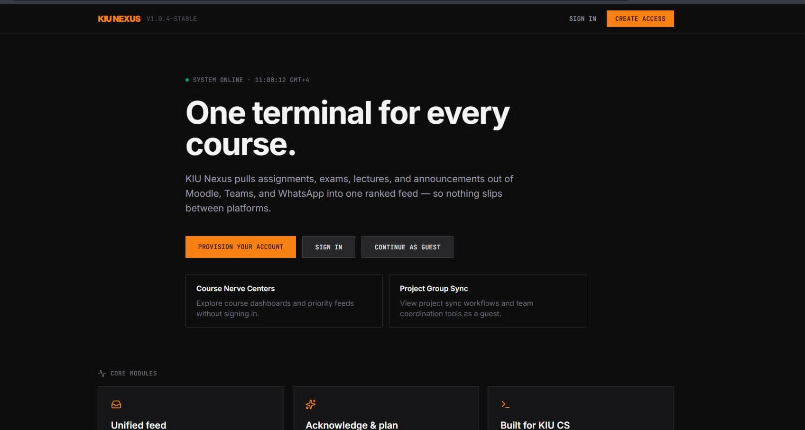
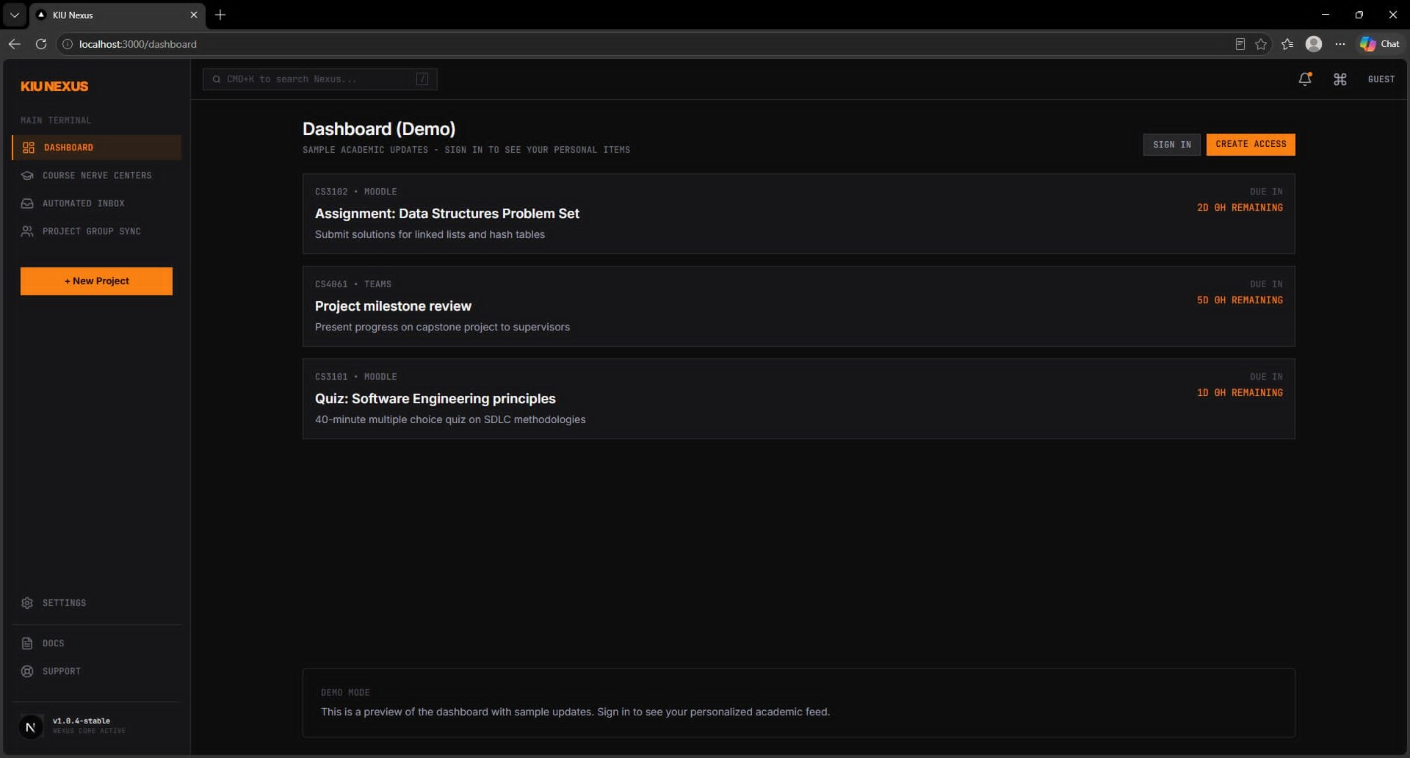
Product
Live at v1.0.4-stable — one terminal for every course
Landing page · kiu-nexus.vercel.app
Prioritized deadline feed · Dashboard (Demo)
🔗 5-platform aggregation
⚡ Intelligent triage
✅ One-tap plan action
📊 Mixpanel analytics live
Notes:
This is the real product, live at v1.0.4-stable. Left: landing page. Right: the prioritized academic feed dashboard with three items ranked by urgency and due-date countdowns. The product is built and running. Next slide shows the full product tour across Course Nerve Centers, Project Group Sync, and the new project flow.

Slide 7
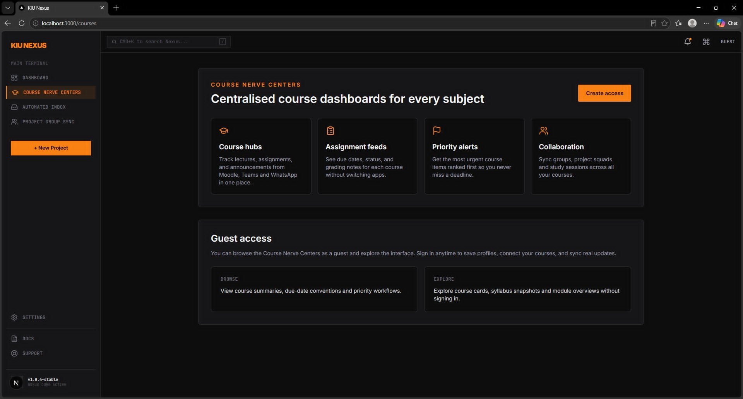
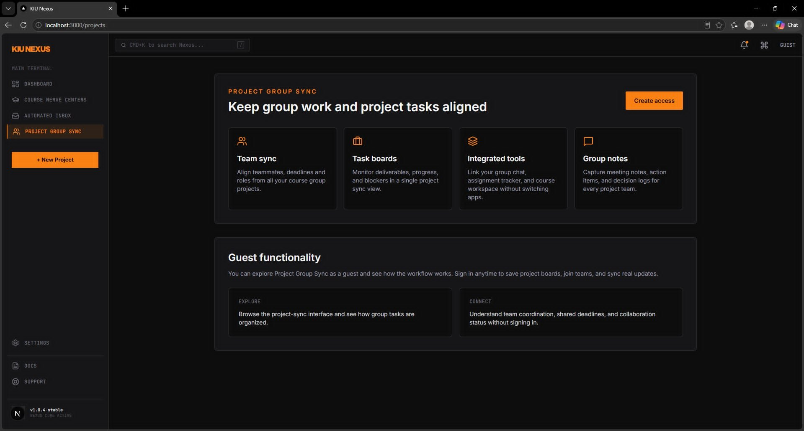
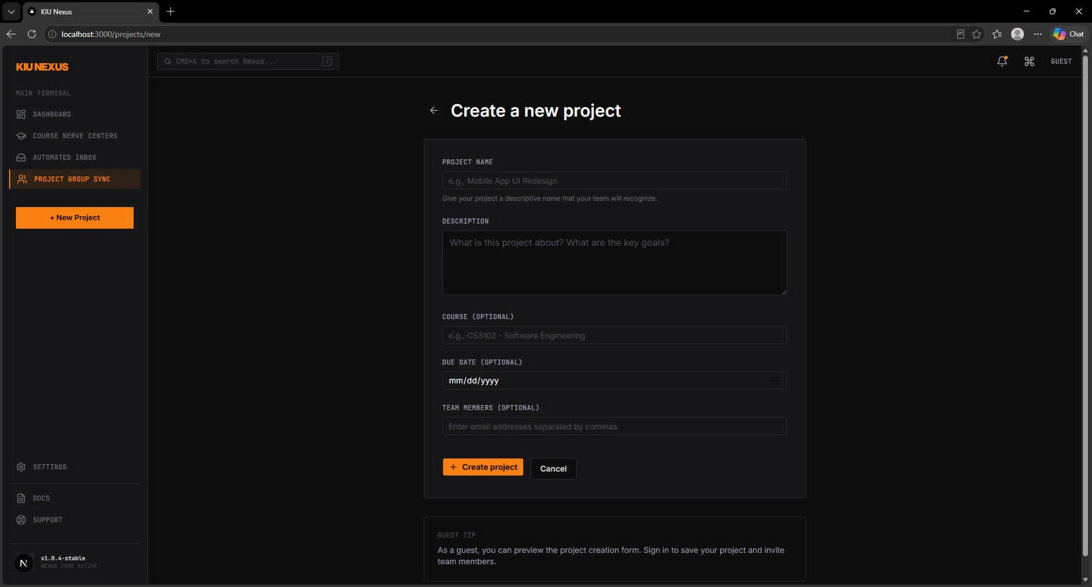
Product Tour
Course hubs · Project sync · Team coordination
Course Nerve Centers
Project Group Sync
Create New Project
Centralised dashboard per subject
Group tasks and deadlines aligned
Link course, due date, invite teammates
Notes:
Three more screens. Course Nerve Centers: each subject gets its own hub aggregating Moodle, Teams and WhatsApp with assignment feeds and priority alerts. Project Group Sync: shared task boards and integrated tools keep teams aligned. The new project form links to a course, sets a due date, and invites teammates in one screen. Full product is live today.

Slide 8
Traction
Pre-launch — foundation built across discovery, product, and GTM
8
5
MVP
✓
Discovery interviews
Pain dimensions mapped
Activation flow
Analytics ready
with third-year KIU CS students
time, grades, integrity, workarounds, asker role
built and tested
Mixpanel dashboard configured
GTM Channels Ready
→ KIU Messenger groups
Immediate organic fit — share onboarding demos
→ Bridge / asker referrals
Early users are natural coordinators who spread within project groups
→ Discord & student communities
Complementary reach into active technical networks
Notes:
We are pre-launch, but the foundation is solid. Eight on-topic discovery interviews with our exact ICP. The MVP is built with the full activation flow. Mixpanel is configured and the acknowledge_update event is live. Our go-to-market channels are mapped: Messenger groups, bridge-student referrals, and Discord communities. 4-week targets: 100 visitors, 40 signups, 20 activations, 30 percent of active users inviting a teammate.

Slide 9
Business Model
Free MVP → institutional site licence → proven unit economics
Phase 1: Free student MVP → Phase 2: KIU institutional site licence for third-year CS cohorts
$6.33
$25.80
4.1:1
~1 mo
CAC
LTV
LTV:CAC
Payback
Blended across 3 channels
4-month active lifetime proxy
Strong for early-stage MVP
CAC recovered in first month
Channel CAC Breakdown
Sensitivity check
Channel | Spend | Activations | CAC
Instagram / WhatsApp | $180 | 30 | $6.00
RA Referrals | $120 | 20 | $6.00
Dorm Posters (QR) | $80 | 10 | $8.00
Blended Total | $380 | 60 | $6.33
Conservative: LTV $12.90, LTV:CAC 2.0
Base: LTV $25.80, LTV:CAC 4.1
Optimistic: LTV $48.25, LTV:CAC 7.6
Notes:
The model has two phases. Phase 1 is a free student MVP to prove retention and activation. Phase 2 is an institutional site licence sold to KIU directly for third-year CS cohorts. Our unit economics come from the DormSync model adapted for the student segment: blended CAC of $6.33, LTV of $25.80, and a 4.1-to-1 LTV:CAC ratio. Payback period is approximately one month. Even in the conservative sensitivity scenario, the ratio stays above 2.0, which is acceptable for an early-stage campus product.

Slide 10
Competitive Advantage
The only product purpose-built for this job at this institution
 | Moodle | MS Teams | Calendar / Notion | Discord | KIU Nexus
Unified aggregation | ✗ | ✗ | Manual only | ✗ | ✓
Intelligent triage | ✗ | ✗ | ✗ | ✗ | ✓
Zero-maintenance | ✓ | ✓ | ✗ | ✓ | ✓
Student-focused design | ✗ | ✗ | ✗ | ✗ | ✓
Mobile-first | ✗ | ✓ | ✓ | ✓ | ✓
Faculty integration | ✓ | ✓ | ✗ | ✗ | Roadmap
Defensible Moat: Switching Costs
🏠 Student habit formation (daily check-in ritual replaces 5-platform sweep)
🔗 Workflow dependency (downstream tool integrations create migration friction)
🏛 Institutional lock-in (faculty integrations make switching costly for both sides)
Notes:
Here is the competitive landscape. Moodle is mandatory but doesn't aggregate other channels. Teams is noisy and wasn't built for deadline triage. Calendar and Notion require manual maintenance — our interviews showed students abandon them within four weeks. Discord is social-only. KIU Nexus is the only product that does the one job students actually need: zero-maintenance aggregation with intelligent triage. Our moat is switching costs: habit formation, workflow dependency, and eventually faculty integration. Once professors are broadcasting through KIU Nexus, neither side wants to migrate.

Slide 11
Go-to-Market & Ask
4-week targets · 60,000 GEL raise · Fall 2026 deployment
→ KIU Messenger
Organic onboarding demos via existing student groups
The Ask
60,000 GEL
→ Bridge referrals
Asker students invite teammates — natural network spread
at 250,000 GEL pre-money valuation
→ Discord / communities
Reach active technical student networks
✓ Deploy to 200 KIU students
4-Week Goals
✓ Validate retention metrics
100
40
20
30%
✓ Secure faculty announcement pilot
visitors
signups
activations
invite a teammate
✓ KIU IT partnership (formal SLA)
We also need:
KIU IT access · One professor partner for Fall 2026 pilot
Notes:
Here is the ask. We are raising 60,000 GEL at a 250,000 GEL pre-money valuation. The funds will be used to deploy KIU Nexus to 200 students, validate retention, and secure the first faculty announcement pilot. We are also asking for two non-financial resources: KIU IT access to formalize the API partnership, and one professor willing to broadcast one critical announcement per week through KIU Nexus this Fall. That faculty commitment creates our first institutional switching cost and is the foundation of our moat. We are not asking for permission to solve this problem. We have already solved it. We are asking for the runway to prove it at scale.

