Slide 1









Medicine Inventory Management System
Students’ Names: Mariam Sabry, Lujayn Nabil, Leen Hamdy, Walaa Ezz

Slide 2

TABLE OF CONTENTS
01.
02.
Database overview
ER diagram
03.
04.
Entities
Triggers
05.
Queries

Slide 3

Database overview
Database name:
Inventory_managment
Conceptual design :
The database is designed based on a relational model that represents a Medicine Inventory Management System. It organizes healthcare data into multiple entities with clear relationships to ensure consistency and efficient data management.

Slide 4
Entities:
• Medicine
• Disease
• Doctor
• Prescription
• Prescription_Details (junction table)
• Bill
• Medicine_Disease (junction table)

Slide 5
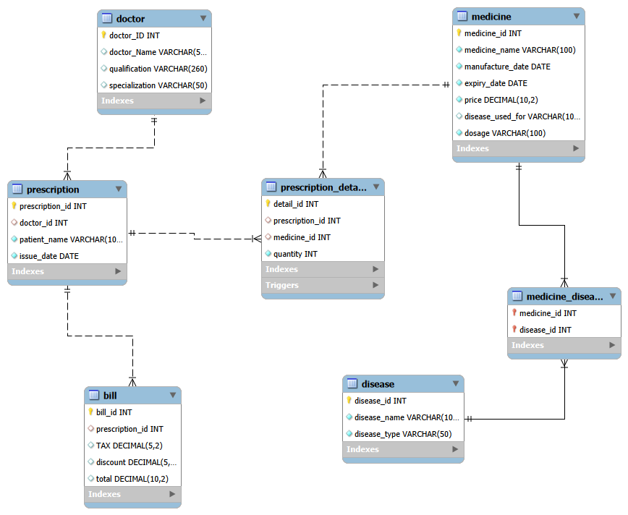
ER Diagram
The database diagram shows the relationships between all entities in the system, including Medicine, Disease, Doctor, Prescription, Bill, and the junction tables used to implement many-to-many relationships.
The design includes both one-to-many (1:N) and many-to-many (M:N) relationships, implemented using foreign keys and junction tables to ensure normalization and referential integrity.

Slide 6


01
MEDICINE ENTITY

Slide 7




CONCEPTUAL DESIGN:
Entity Name: Medicine
Description:
The Medicine entity stores information about medicines in the inventory system, including basic details such as name, manufacturing date, expiry date, price, dosage, and a disease reference field used for descriptive purposes.

Slide 8

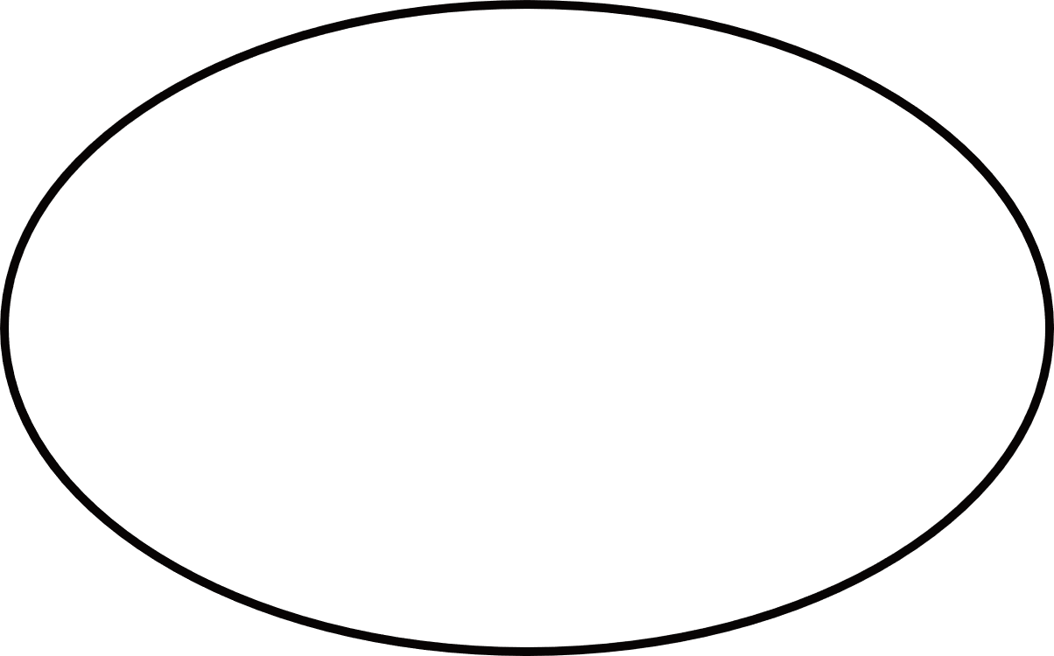



ATTRIBUTES
expiry_date
manufacture_date
price
medicine_id
medicine_name
disease_used_for
dosage
Medicine

Slide 9

PRIMARY KEY
uniquely identifies each record in the table and does not allow duplicate values.
medicine_id
if two medicines had the same medicine_id, the database would not be able to distinguish between them.
For example:
two records cannot both have medicine_id = 1, because the primary key must be unique for each medicine.

Slide 10

CONSTRAINTS
medicine_id
PRIMARY KEY
medicine_id, medicine_name, manufacture_date, expiry_date, price, dosage
NOT NULL
optional attribute (nullable, not normalized)
disease_used_for:
2013

Slide 11




Relational Schema
MEDICINE(
medicine_id PK,
medicine_name,
manufacture_date,
expiry_date,
price,
disease_used_for,
dosage
)
Relationship Description
The Medicine entity is related to Disease and Prescription entities through junction tables to support many-to-many relationships and ensure normalization.

Slide 12
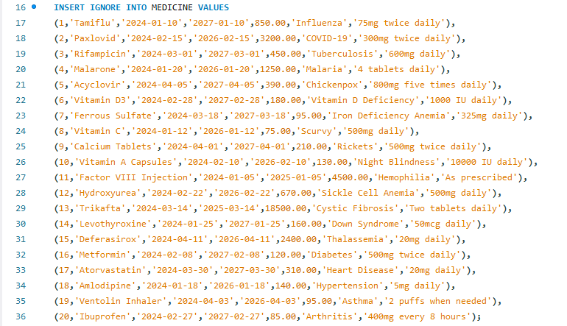
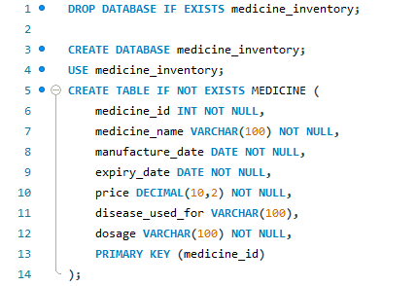
Code 1
CREATE TABLE MEDICINE
INSERT INTO MEDICINE VALUES

Slide 13







02
Disease

Slide 14


Description
The Disease entity stores basic information about diseases in the system.
It helps organize diseases and improve database structure.
It includes an ID, name, and type of disease.

Slide 15
Attributes
Primary KEY
Relational Schema
disease_id
disease _name
disease_type
DISEASE(
disease_name,
disease type
disease id PK, )
disease _ id

Slide 16
Disease Types
Infectious Disease
Deficiency
Genetic Hereditary DISEASE
Non _ Genetic Hereditary Disease

Slide 17
CONSTRAINTS
PRIMARY KEY (disease_id)
NOT NULL disease_id disease name, disease_type
CHECK constraint on disease_type
Relationship Description
The Disease entity has a many-to-many (M:N)
relationship with the Medicine entity because
one medicine can be used to treat multiple diseases,
and one disease can be treated using multiple medicines.

Slide 18
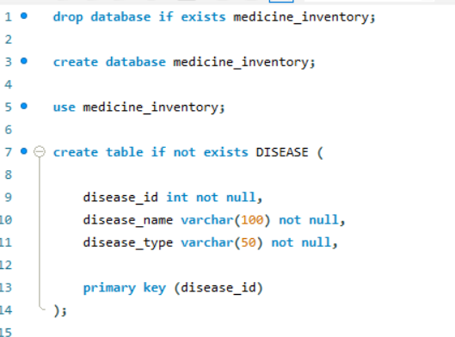
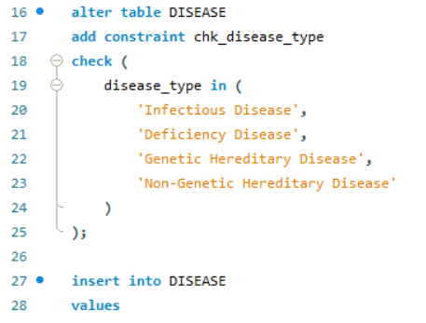
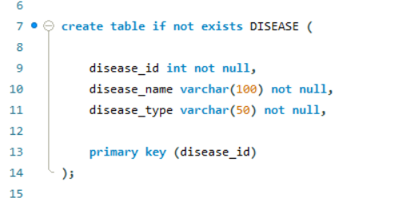
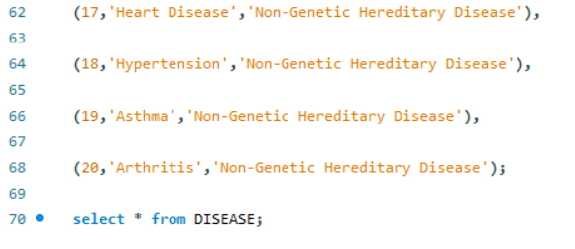

Slide 19


03
MEDICINE-DISEASE ENTITY

Slide 20



CONCEPTUAL DESIGN:
Entity Name: Medicine_Disease
Description:
The Medicine_Disease entity is a junction table used to represent the many-to-many (M:N) relationship between Medicine and Disease entities. It stores which medicines are used to treat which diseases in the system.

Slide 21



ATTRIBUTES
medicine_id
disease_id
Medicine_Disease

Slide 22
PRIMARY KEY
medicine_id
disease_id
A composite primary key is used to uniquely identify each record in the
MEDICINE_DISEASE table by combining both medicine_id and disease_id, ensuring that the same medicine–disease relationship cannot be duplicated.

Slide 23
CONSTRAINTS
(medicine_id, disease_id)
PRIMARY KEY
medicine_id → Medicine(medicine_id)
disease_id → Disease(disease_id)
FOREIGN KEY
medicine_id, disease_id
NOT NULL

Slide 24


Relational Schema
MEDICINE_DISEASE(
medicine_id PK/FK,
disease_id PK/FK
)
Relationship Description
The Medicine entity is related to Disease and Prescription entities through junction tables to support many-to-many relationships and ensure normalization.

Slide 25
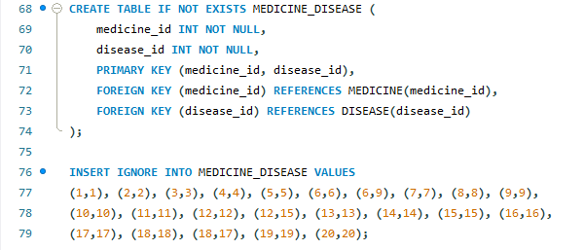
Code 2
CREATE TABLE MEDICINE
INSERT INTO MEDICINE VALUES

Slide 26

Doctor
04

Slide 27
Doctor Entity
Conceptual design
Entity Name: Doctor
Description: The Doctor entity stores information about doctors who diagnose patients and issue prescriptions for the appropriate medicines. It includes their ID, name, qualification, and specialization.

Slide 28
Attributes
CONSTRAINTS
Primary Key: doctor_id
NOT NULL: doctor_id
• doctor_id
• doctor_name
• qualification
• specialization
Relational schema
( doctor_id PK, doctor_name, qualification,
specialization )
Primary Key
• doctor_id

Slide 29
Relationship description
The Doctor entity is related to the Prescription entity.
• One Doctor can issue many prescriptions (1:N)
• Each Prescription is issued by exactly one Doctor
This relationship is implemented using the doctor_id foreign key in the Prescription table.

Slide 30
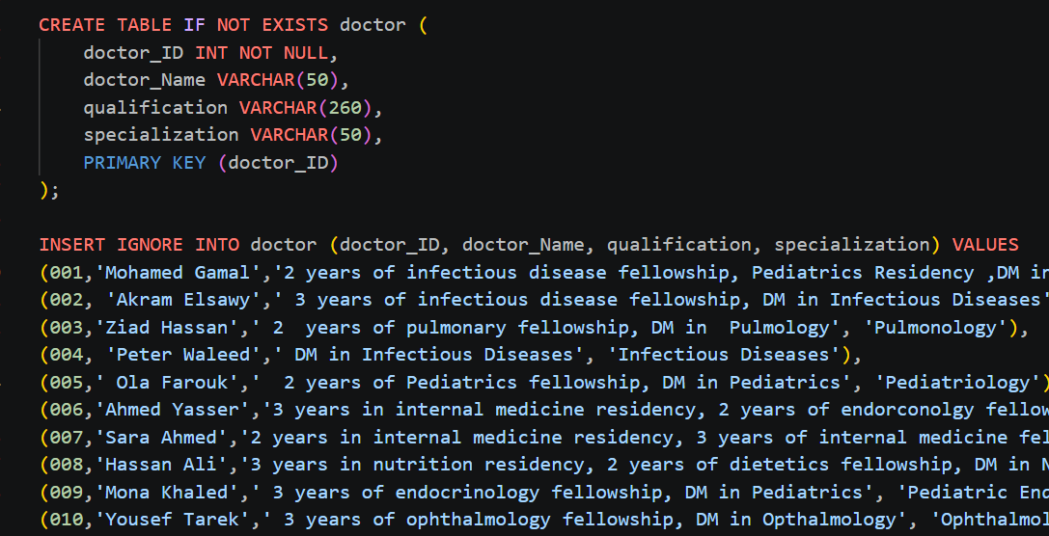

Slide 31
05
Prescription Entity

Slide 32

Prescription Entity
--- Conceptual Design ---
Entity Name: Prescription
Description: The Prescription entity stores header information for medical prescriptions issued by doctors to patients, including the prescribing doctor, patient name, and issue date.

Slide 33
Attributes (1)
Unique identifier for each prescription (auto-generated)
PRIMARY KEY
prescription_id
INT
PRIMARY KEY/AUTO_INCREMENT
Identifies the doctor who issued the prescription
doctor_id
INT
FOREIGN KEY (references doctor.doctor_id)

Slide 34
Attributes (2)
Name of the patient receiving the prescription
PRIMARY KEY
NOT NULL
patient_name
VARCHAR (100)
Date when the prescription was issued
issue_date
DATE
NOT NULL

Slide 35

Primary Key
prescription_id
Foreign Key
doctor_id
Reference: doctor(doctor_id)
Relationship: Many prescriptions can be issued by one doctor (Many-to-One)

Slide 36

Constraints
PRIMARY KEY
NOT NULL
pattient_name
issue_date
prescription_id
AUTO_INCREMENT
FOREIGN KEY
prescription_id
doctor_id

Slide 37
Relational Schema
Prescription (
prescription_id: INT [PK, AUTO_INCREMENT],
doctor_id: INT [FK → doctor.doctor_id],
patient_name: VARCHAR(100) [NOT NULL],
issue_date: DATE [NOT NULL]
)

Slide 38
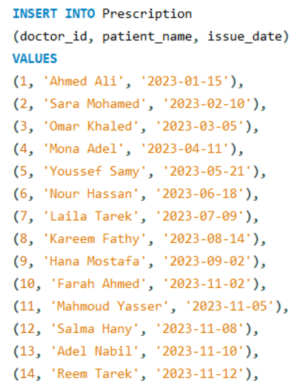
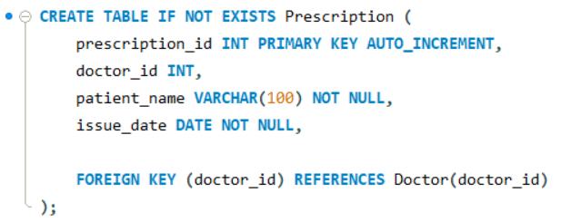
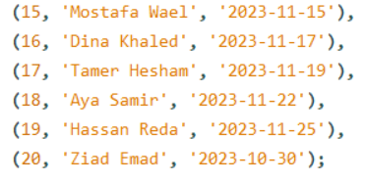

Slide 39
06
Prescription_Details Entity

Slide 40

Prescription_Details Entity
--- Conceptual Design ---
Entity Name: Prescription_Details
Description: The Prescription_Details entity stores line-item details of each prescription, linking specific medicines with their prescribed quantities. Acts as a junction/associative entity between Prescription and Medicine..

Slide 41
Attributes (1)
Unique identifier for each detail line (auto-generated)
PRIMARY KEY
PRIMARY KEY/AUTO_INCREMENT
detail_id
INT
Links to the parent prescription header
prescription_id
INT
FOREIGN KEY (references Prescription.prescription_id)

Slide 42
Attributes (2)
FOREIGN KEY (references Medicine.medicine_id)
Links to the specific medicine being prescribed
PRIMARY KEY
medicine_id
INT
Number of units of the medicine prescribed
quantity
INT
NOT NULL

Slide 43
medicine_id
Primary Key
• detail_id
Reference: Medicine(medicine_id)
Foreign Key
Many details can reference one medicine (Many-to-One)
prescription_id
Reference: Prescription(prescription_id)
Many details belong to one prescription (Many-to-One)

Slide 44
Constraints
PRIMARY KEY
NOT NULL
detail_id
quantity
AUTO_INCREMENT
FOREIGN KEY
detail_id
prescription_id
medicine_id
ON DELETE CASCADE

Slide 45
Relational Schema
Prescription_Details (
detail_id: INT [PK, AUTO_INCREMENT],
prescription_id: INT [FK → Prescription.prescription_id, ON DELETE CASCADE],
medicine_id: INT [FK → Medicine.medicine_id],
quantity: INT [NOT NULL]
)

Slide 46
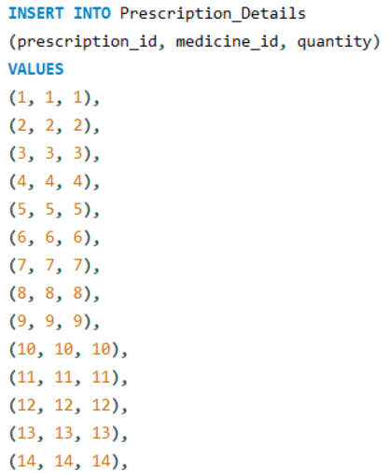
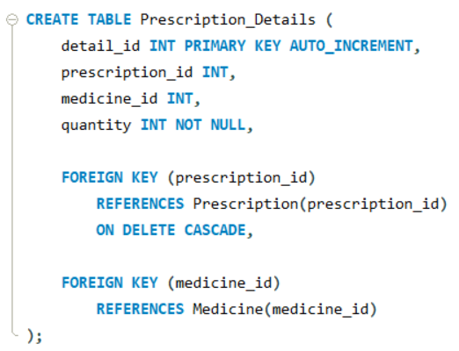
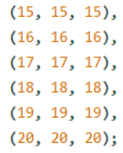

Slide 47


07
Bill

Slide 48
Bill Entity
Conceptual design
Entity Name:
Bill
Descreption:
The Bill entity stores financial information generated after a patient purchases prescribed medicines. It includes tax, discount, and total amount.

Slide 49
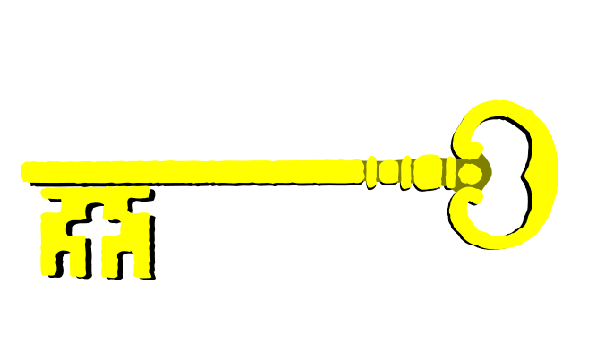
Attributes
Primary Key
• bill_id
• tax
• discount
• total
• bill_id
Relational schema
BILL ( bill_id PK, tax, discount, total )

Slide 50
constraints
Relationship description
The Bill entity is related to the Prescription entity.
• One Bill can be linked to many prescriptions (M:1 relationship conceptually grouped)
• Primary Key: bill_id
• AUTO_INCREMENT: bill_id
• NOT NULL: bill_id

Slide 51
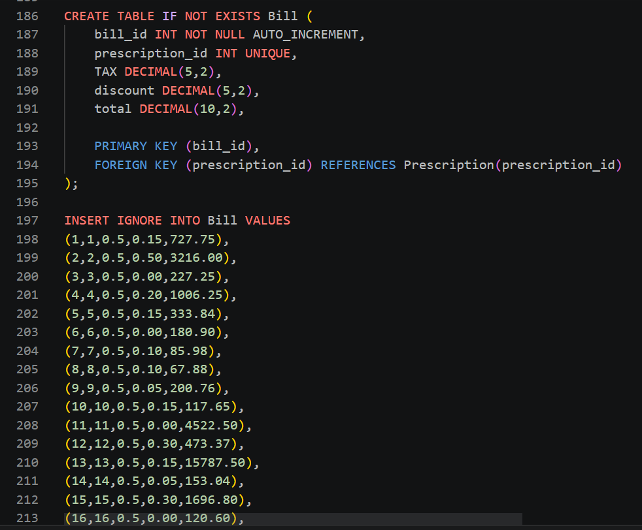

Slide 52



Trigger: After_Prescription_Detail_Insert
Automatically updates the bill total when a new medicine is added to a prescription.
Updates the corresponding bill to maintain data consistency.
Retrieves the medicine price and calculates the total cost.
Uses COALESCE() to prevent errors caused by NULL values.

Slide 53
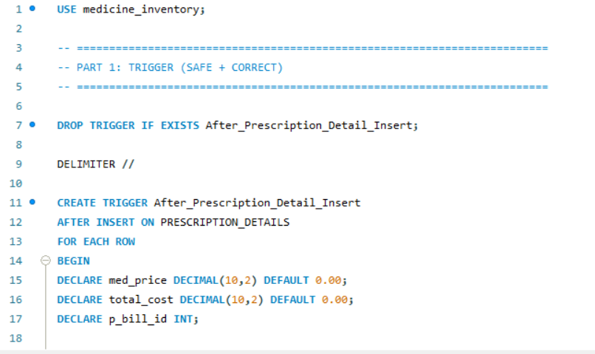
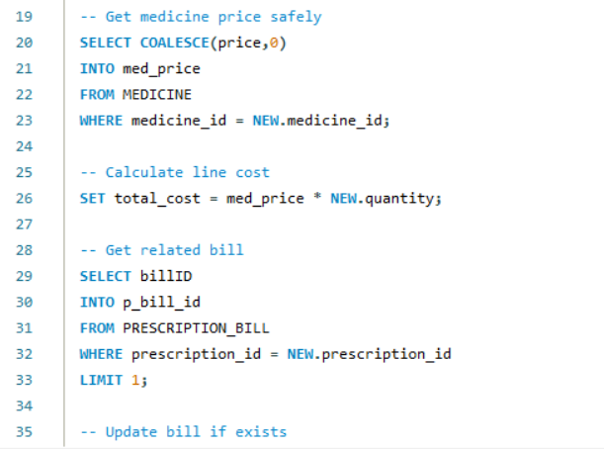
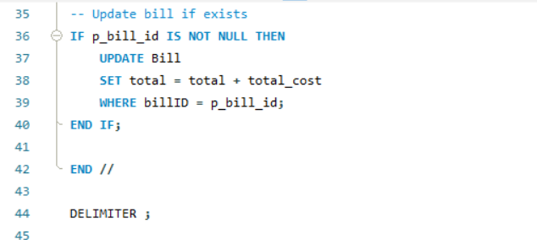

Slide 54
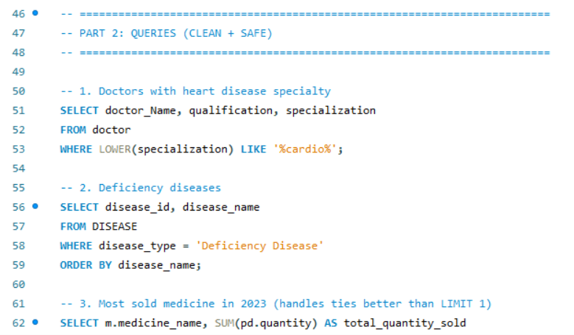
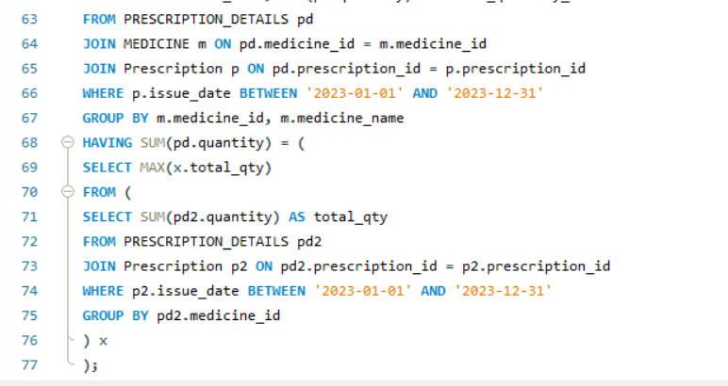

Slide 55




Query
Query 1: Heart Disease Specialists
Query 2: Deficiency Diseases
Query 3: Most Sold Medicine in 2023
Displays diseases classified as deficiency diseases.
Sorts the results alphabetically.
Calculates total quantities sold for each medicine in 2023.
Identifies the medicine(s) with the highest sales.
Handles ties by displaying all top-selling medicines.
Retrieves doctors specialized in cardiology.
Uses LIKE to search for specializations containing "cardio".

Slide 56
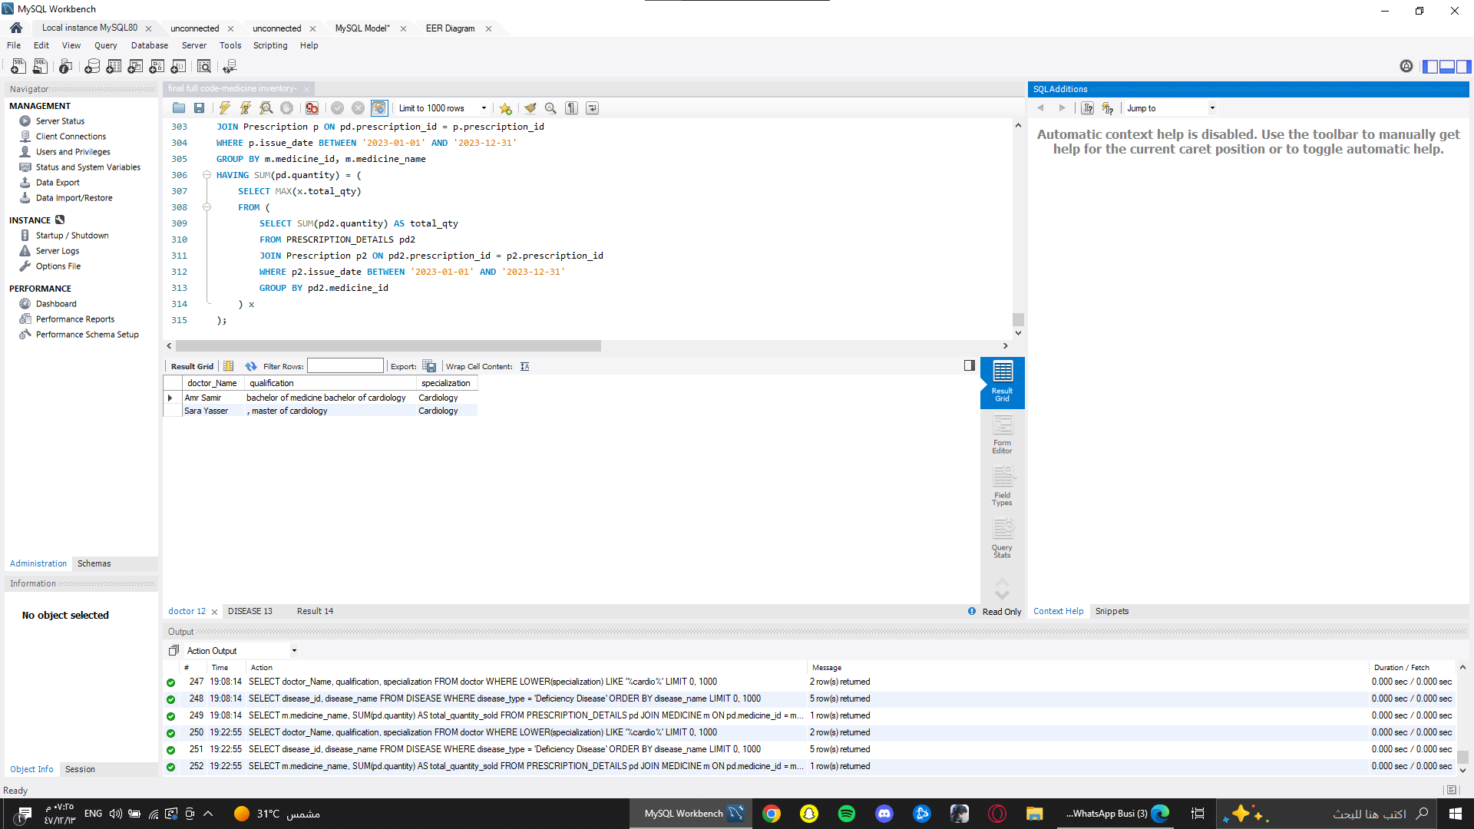

Slide 57
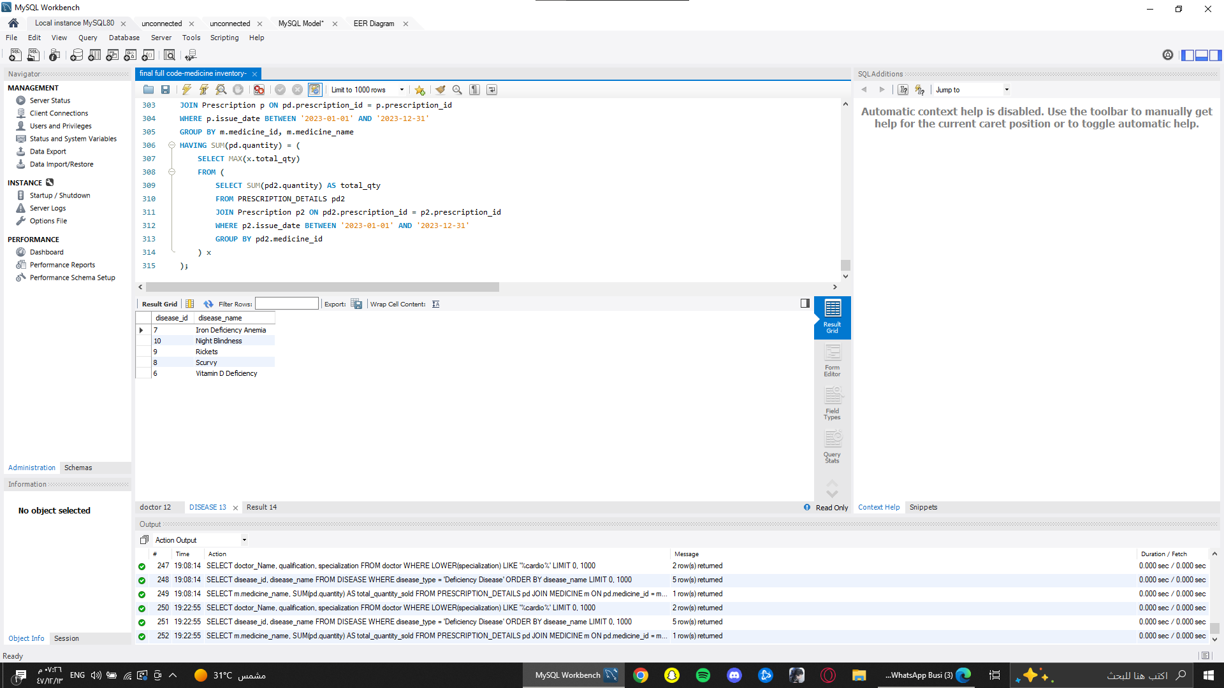

Slide 58
