Slide 1

Notes:
Time: 2 min Stage: Introduction (5 min) Desc: -

Slide 2
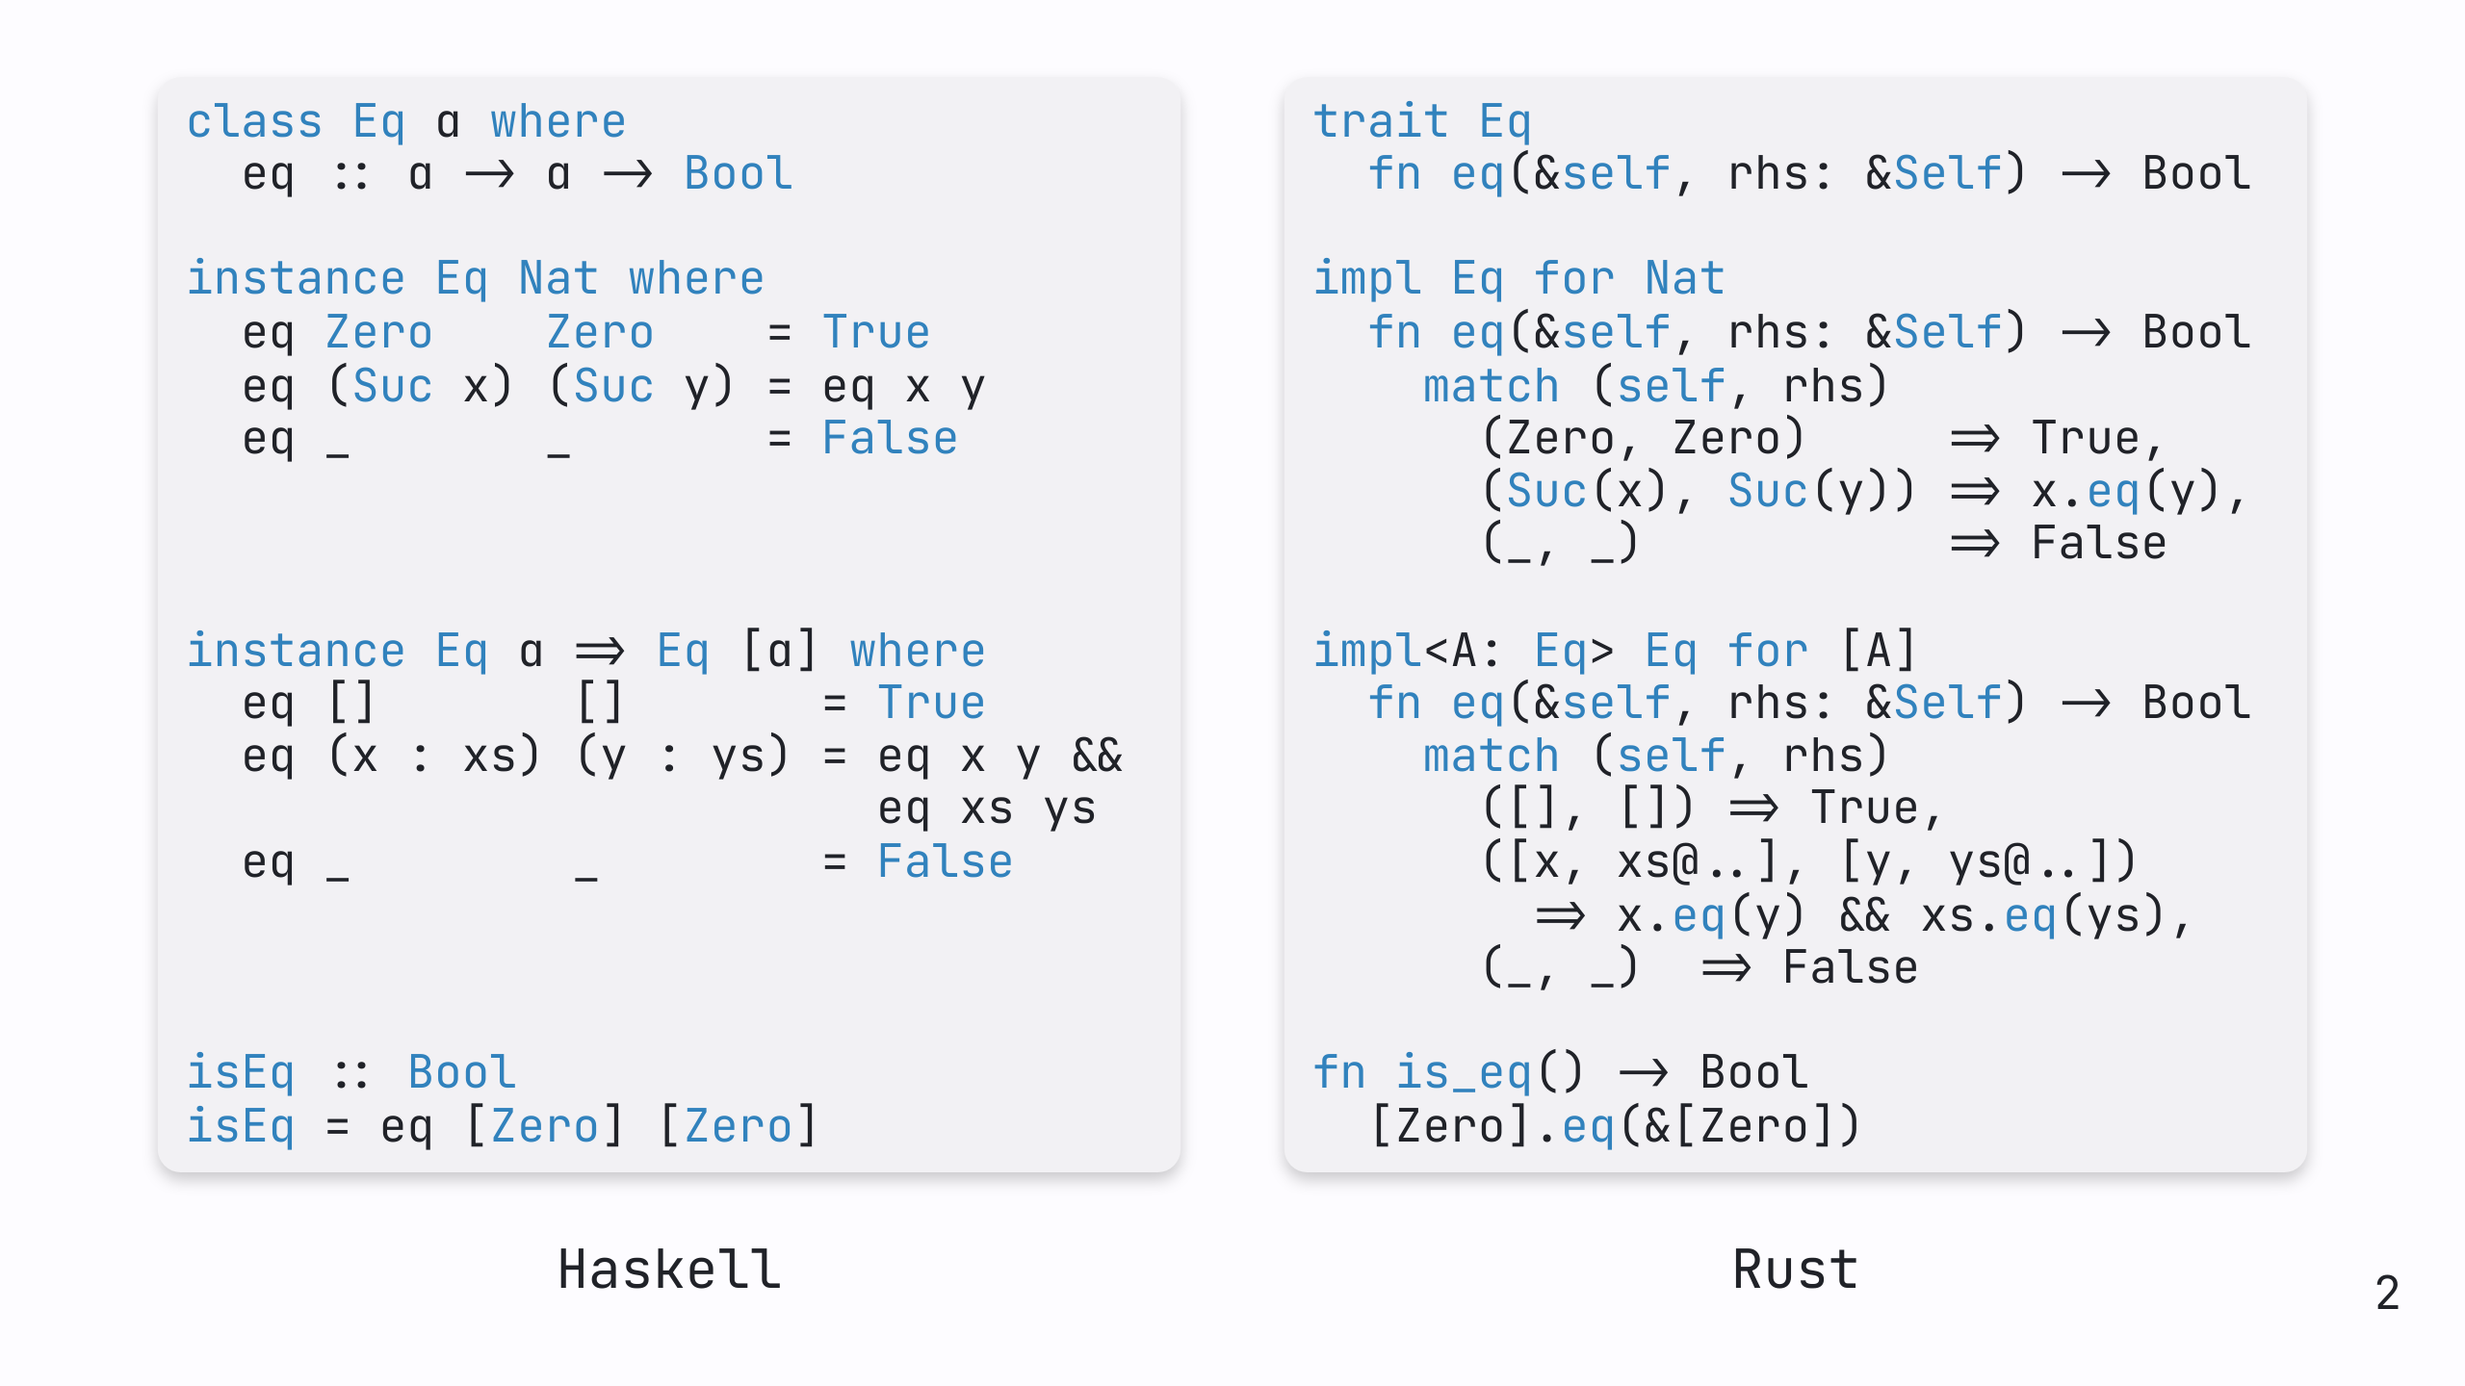
Notes:
Time: 2 min Stage: Introduction (5 min) Desc: Ask who knows Rust / Haskell; explain the one more know about

Slide 3
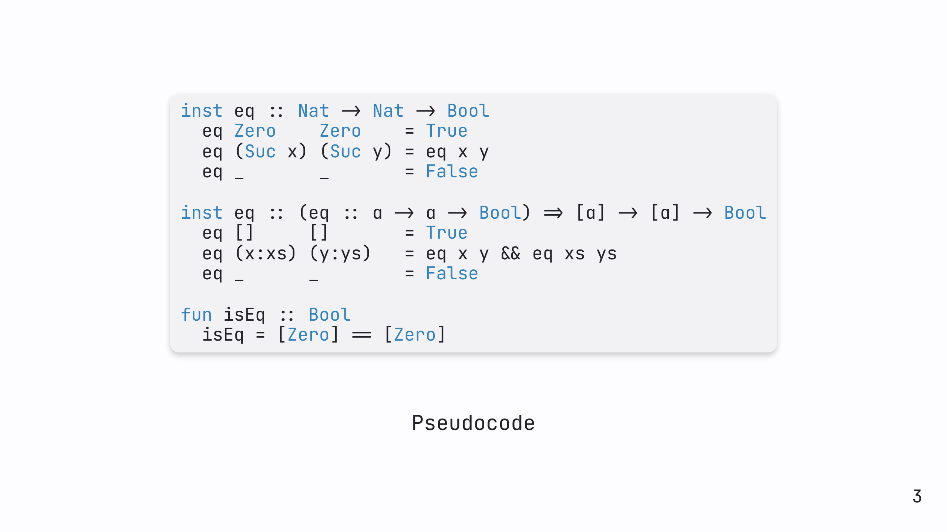
Notes:
Time: 1 min Stage: Introduction (5 min) Desc: Reduce example before to a simpler pseudo code

Slide 4
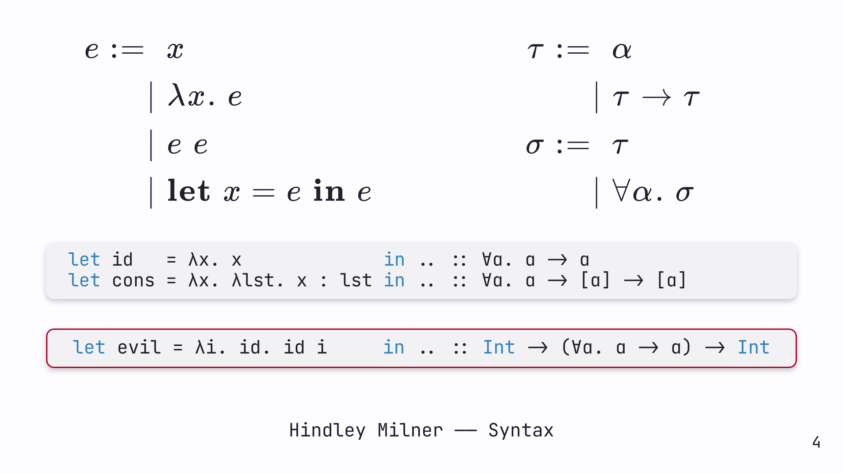
Notes:
Time: 3 min Stage: Main (20) Desc: Explain Hindley Milner syntax, especially let polymorphism & type schemes

Slide 5
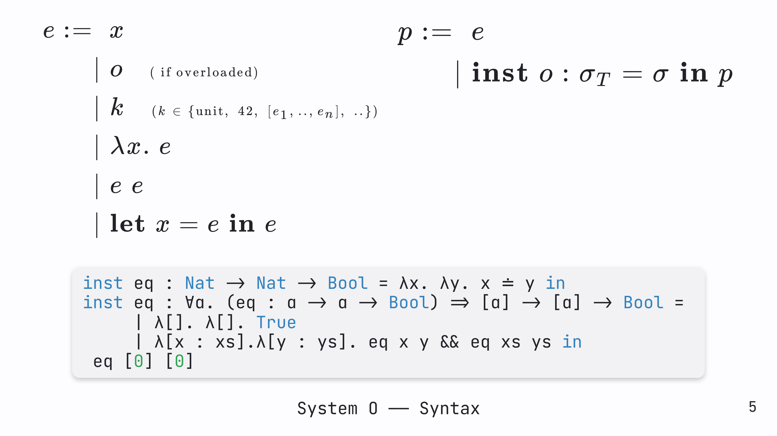
Notes:
Time: 2 min Stage: Main (20) Desc: Explain extension with instances + example

Slide 6
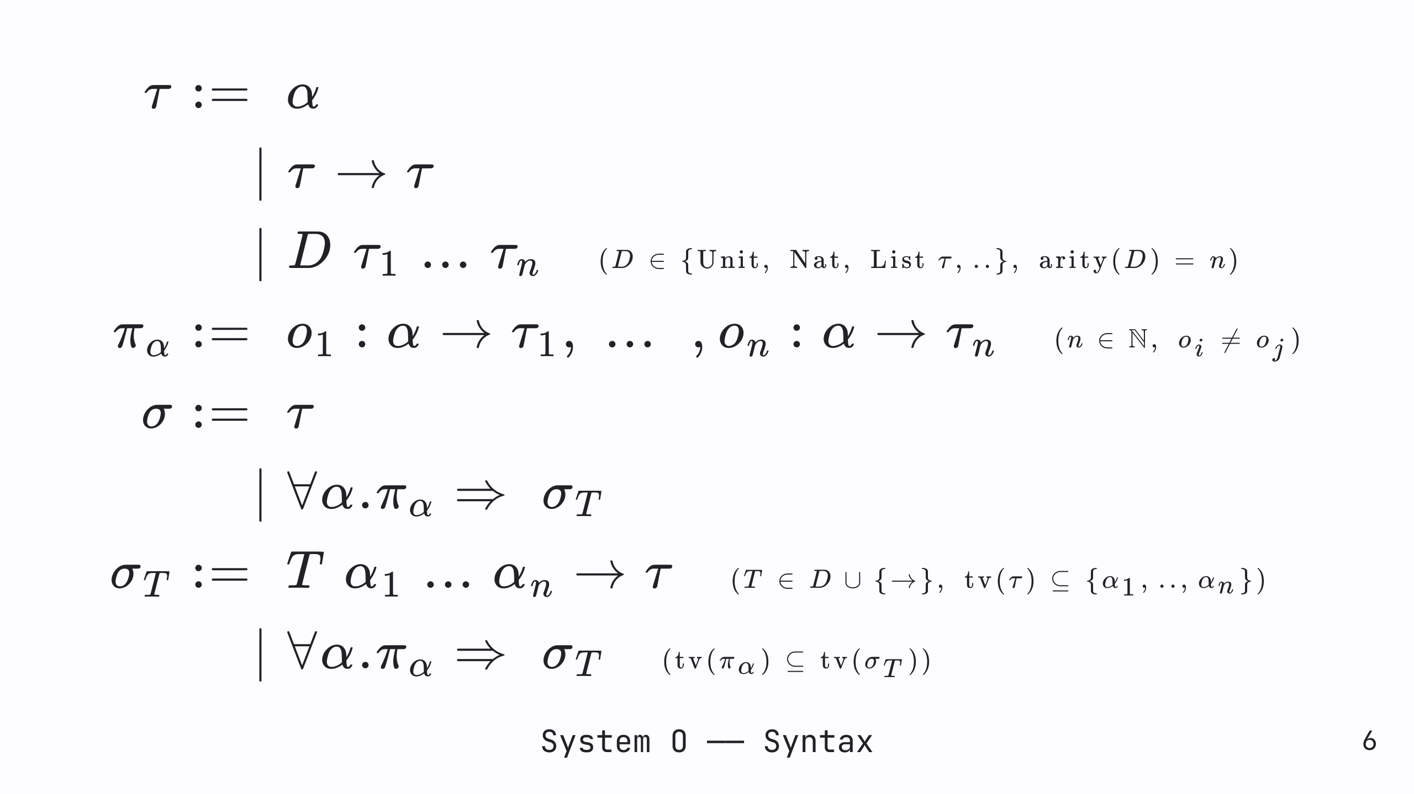
Notes:
Time: 5 min Stage: Main (20) Desc: Explain extension with constraints + type indexed poly types

Slide 7
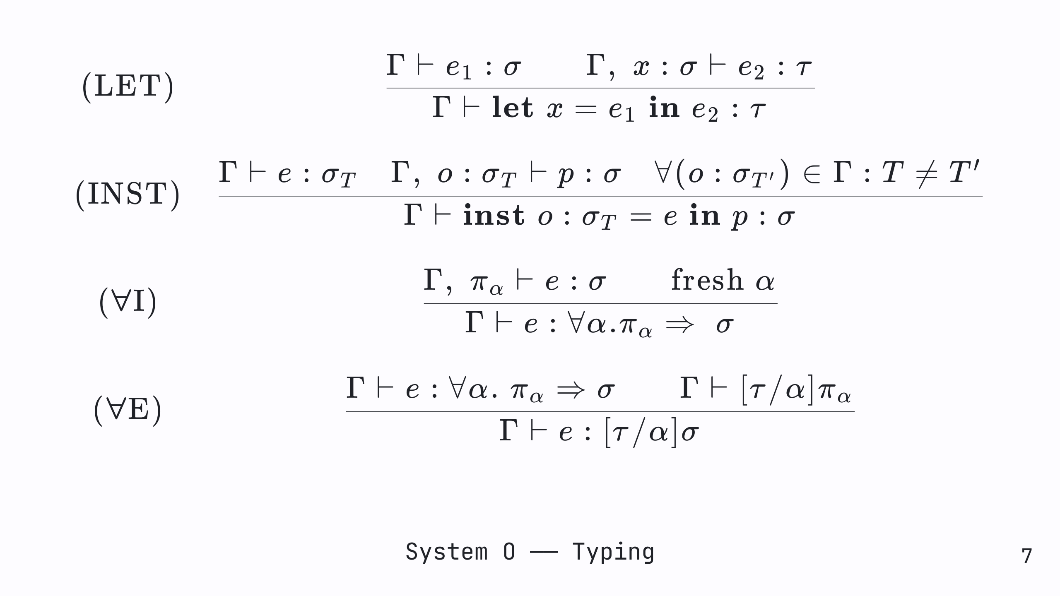
Notes:
Time: 4 min Stage: Main (20) Desc: Explain relevant typing rules (might insert STLC rules beforehand for intuition)

Slide 8
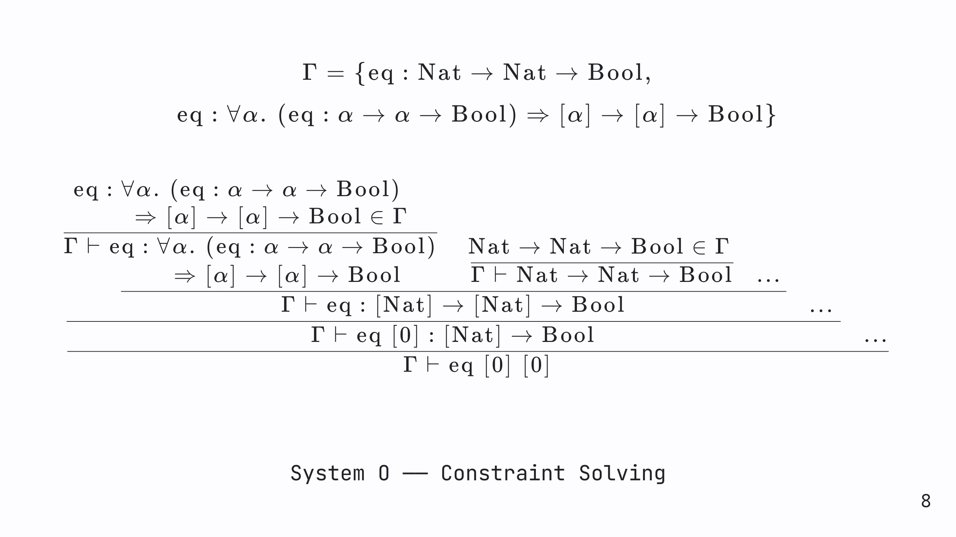
Notes:
Time: 3 min Stage: Main (20) Desc: Explain example proof derivation + constraint solving, mention nondeterminism + inference algorithm (similar to algorithm w)

Slide 9
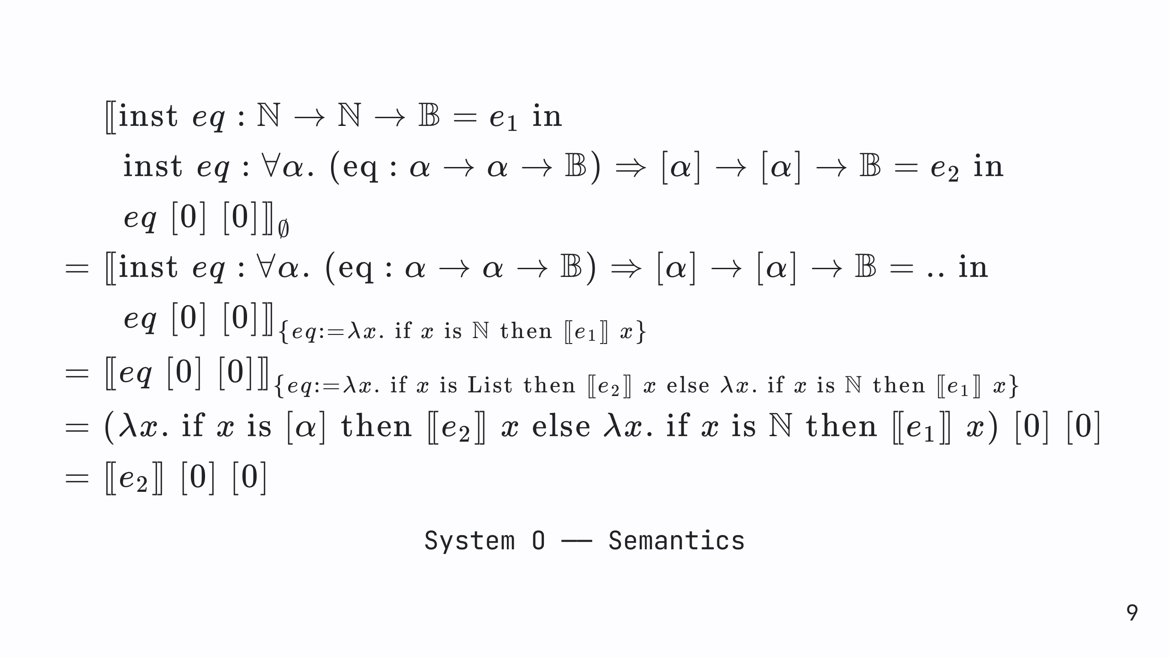
Notes:
Time: 3 min Stage: Main (20) Desc: Explain example reduction using compositional semantics (very high level, no need to understand the mathematical objects this is translated to)

Slide 10
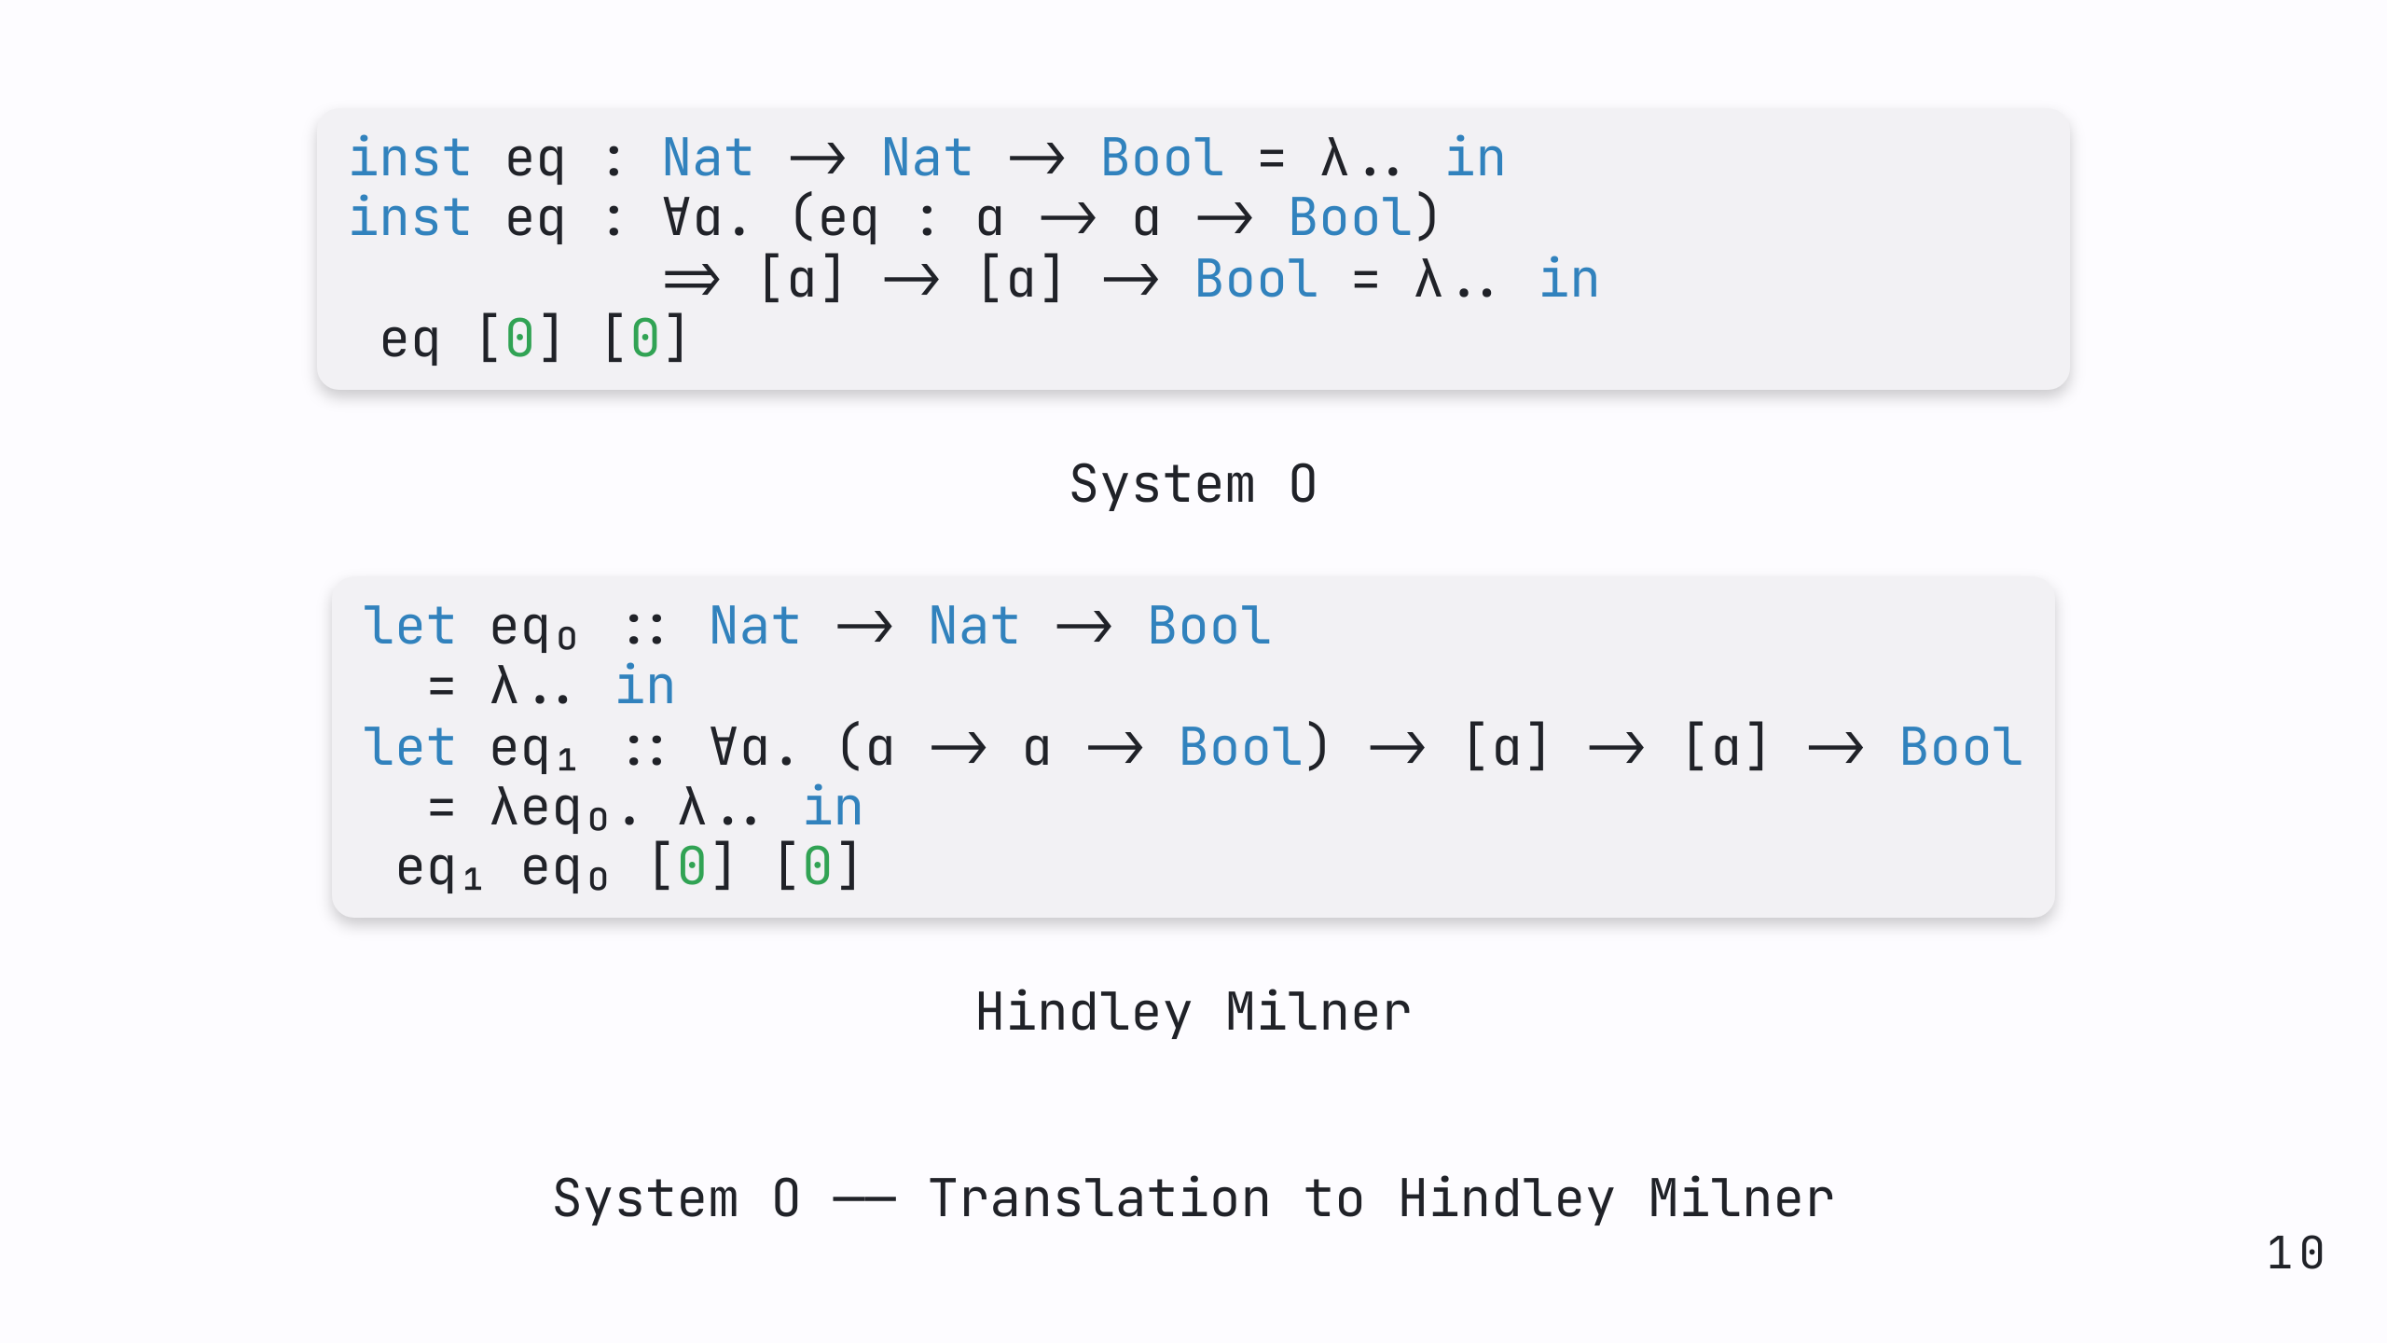
Notes:
Time: 2 min Stage: Extra (5 min) [skip if no time] Desc: Explain example translation from system o to Hindley Milner system

Slide 11
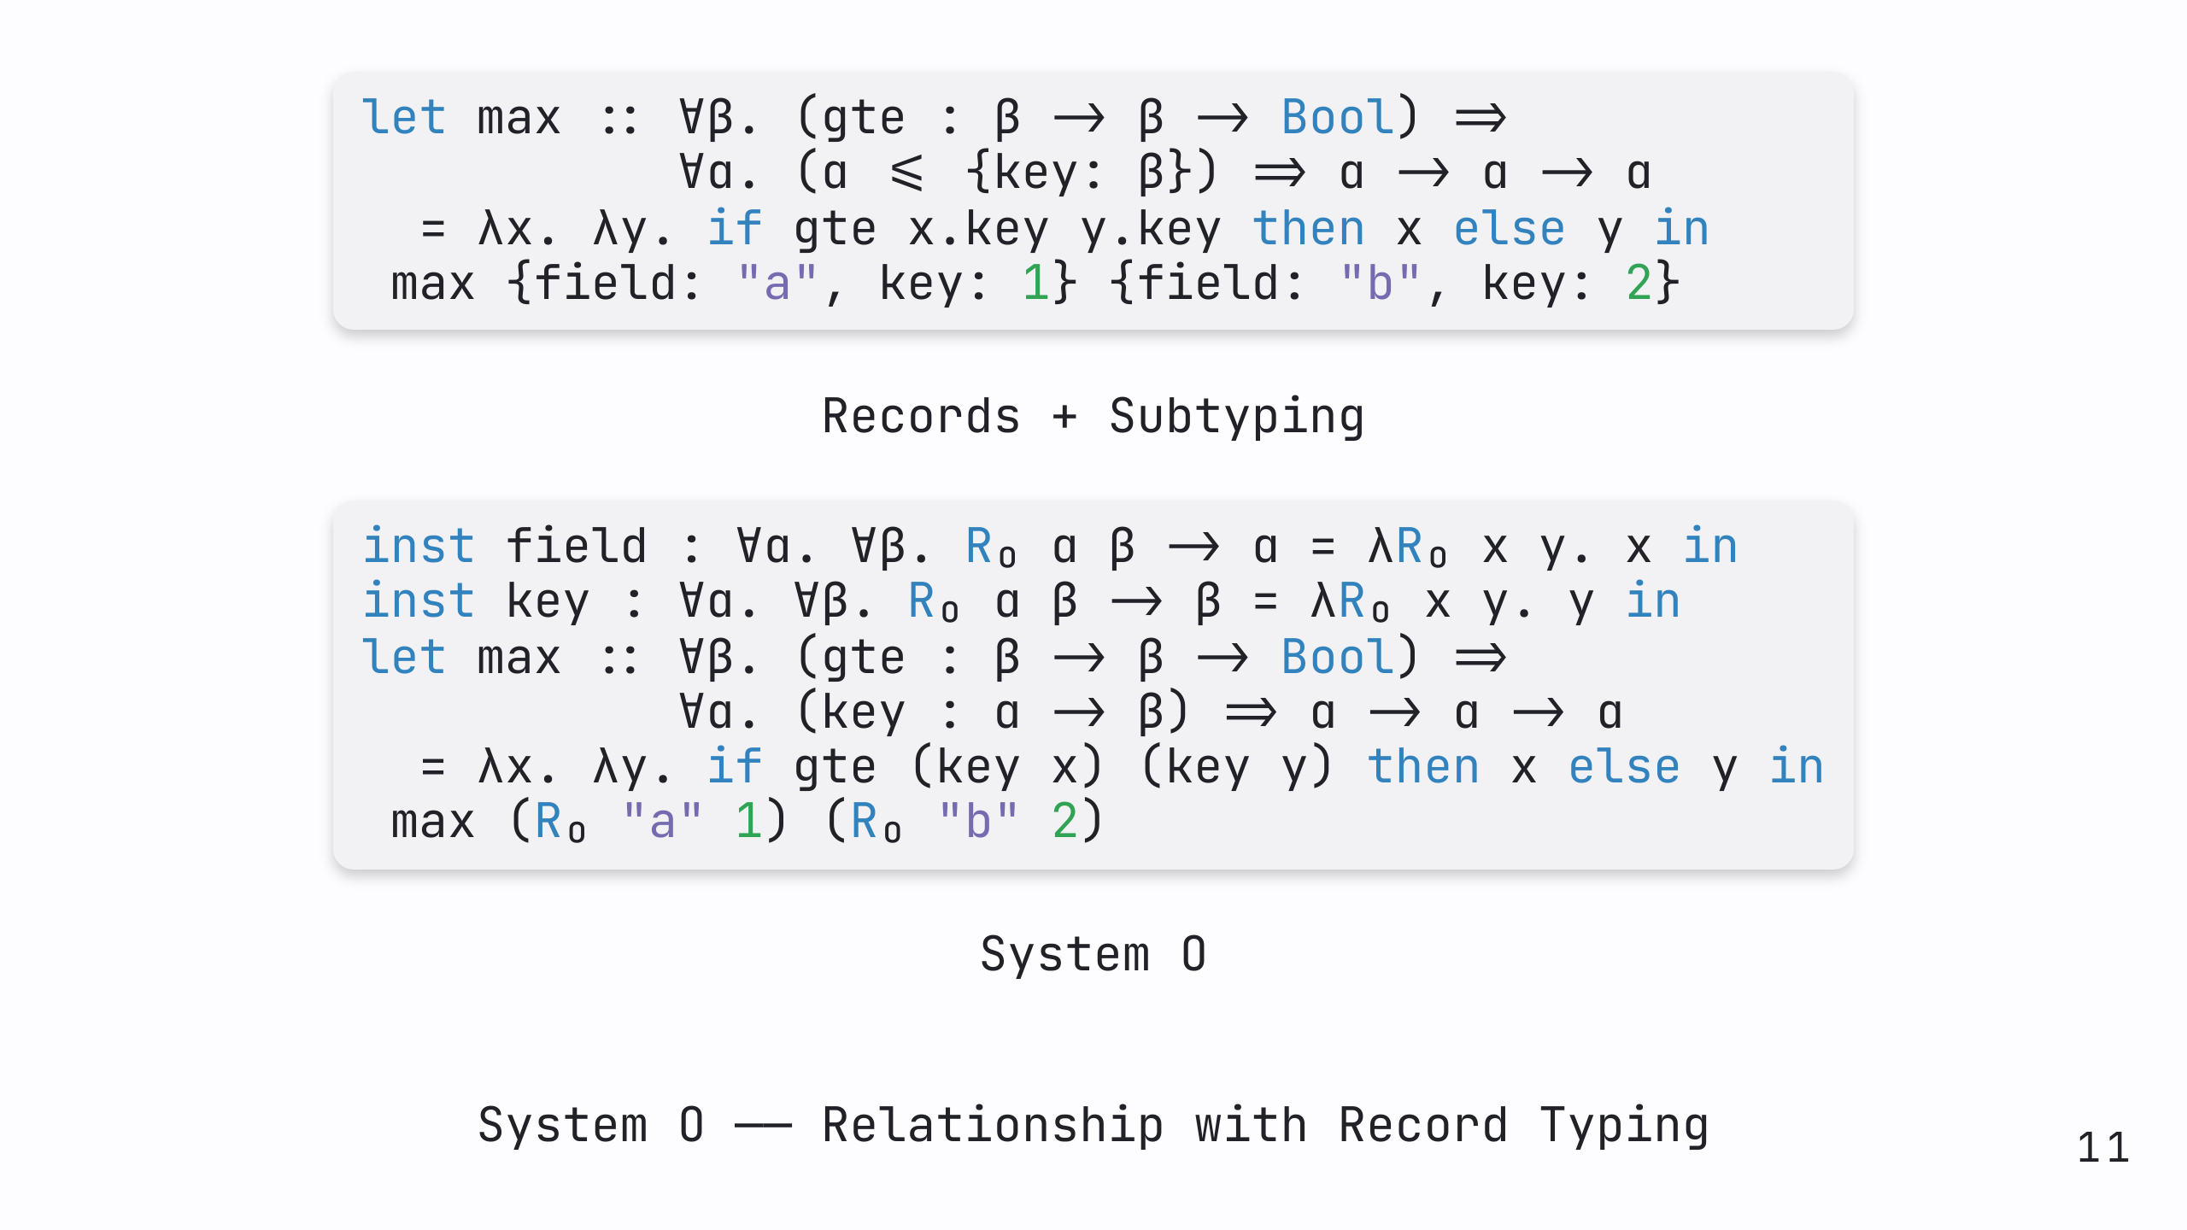
Notes:
Time: 3 min Stage: Extra (5 min) [skip if no time] Desc: Explain example translation from record calculus with subtyping to system o

Slide 12
