Slide 1
What does an MMM assume before it sees your data?
Every marketing mix model commits to three answers before reading a single row.
1. How fast does response flatten?
Where is the point of diminishing returns for this channel?
2. What shape is the curve?
Does response build before it bends, or diminish from impression one?
3. How long does an impression keep working?
How much of the effect lands this week, and how far does it carry?
You are never asked these questions. They ship as defaults.
We can inspect these choices only because Meridian is open source — every closed MMM makes the same three choices, unauditably.

Slide 2
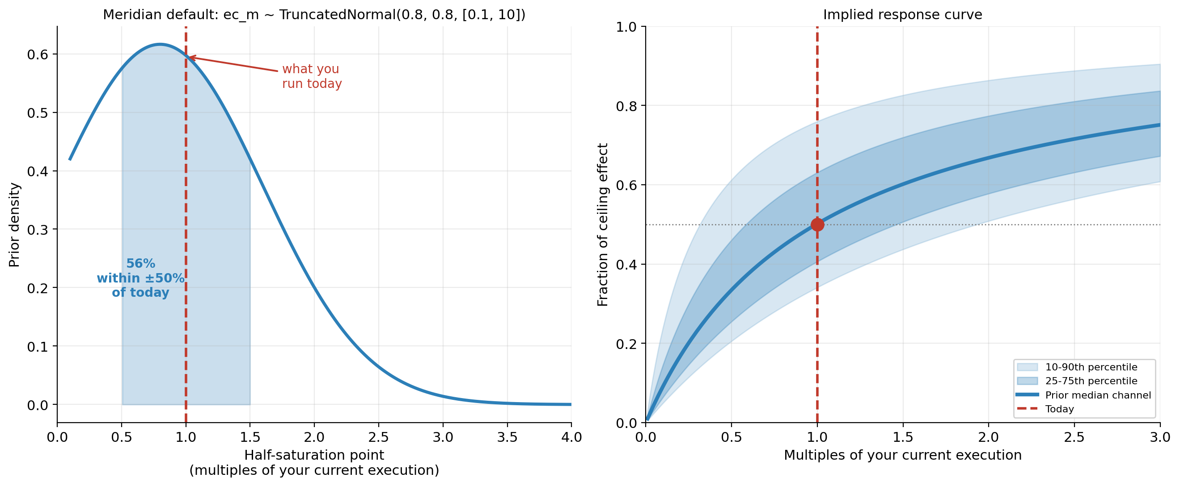
Assumption 1 — Saturation: the default says you are already there
Meridian scales each channel by its own median execution first, so "1.0" on the model’s x-axis means "what you already run".
Out of the box: 50% odds you are already past half-saturation, and 92% odds you have captured more than a third of the channel’s maximum effect — applied identically to every channel, whatever its audience or reach.
ec_m ~ TruncatedNormal(0.8, 0.8, [0.1, 10]). https://developers.google.com/meridian/docs/advanced-modeling/default-prior-distributions#ec_m_and_ec_om

Slide 3
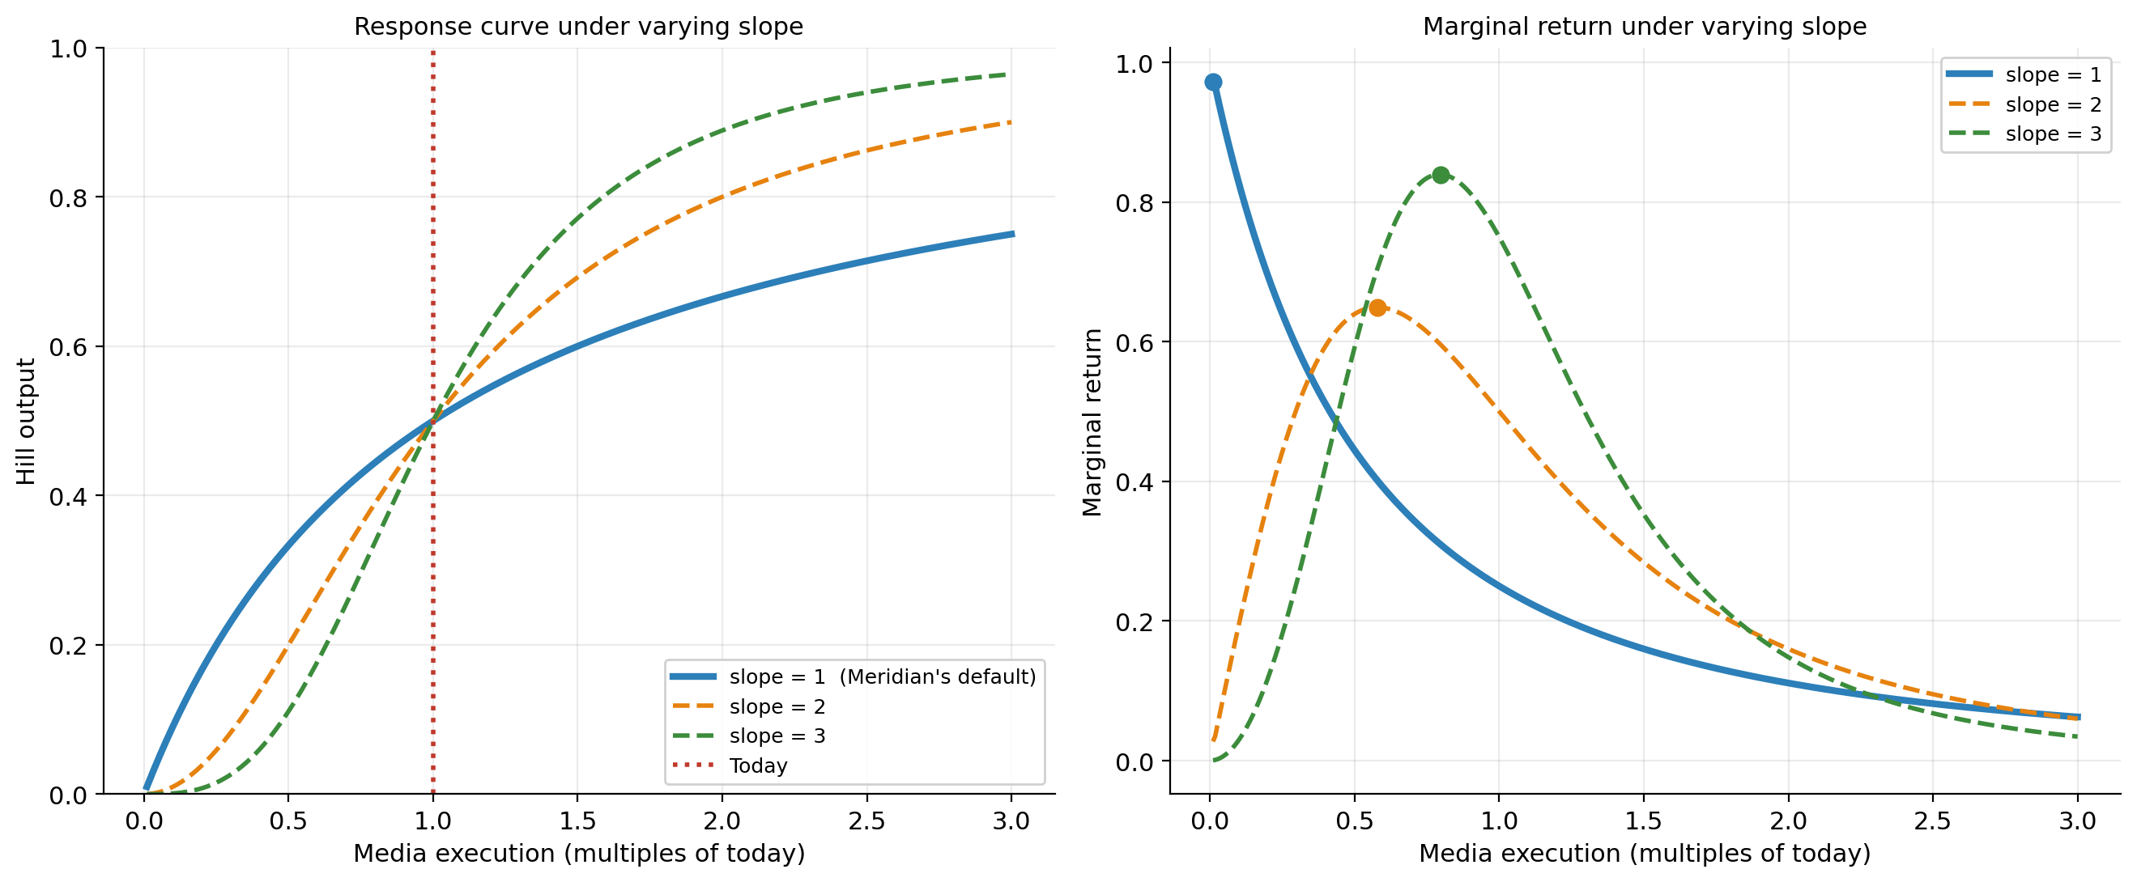
Assumption 2 — Slope: the parameter that is never estimated
slope_m = Deterministic(1.0). It has no prior, because it is not a random variable.
Fixing the slope at 1 means diminishing returns from the very first impression — no build-up, no threshold effect. The stated reason is tractability, not advertising: concave curves guarantee the budget optimizer a global optimum.
Meridian: hill(x) = x^slope / (x^slope + ec^slope).

Slide 4
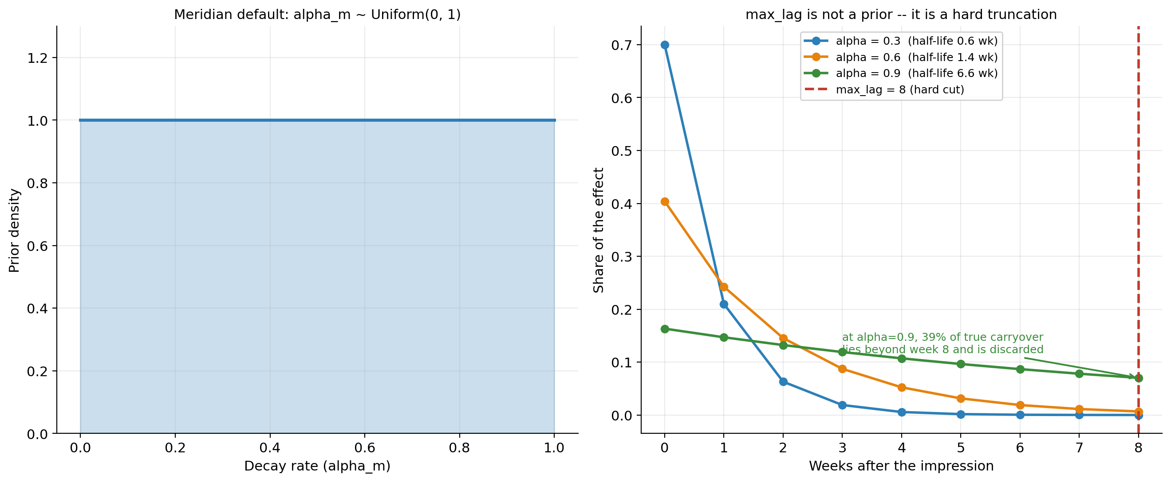
Assumption 3 — Adstock: a fair prior, and a hard cutoff behind it
alpha_m ~ Uniform(0, 1) is honestly flat — no skew to complain about here. The binding assumption sits elsewhere.
Decay rate alone is not interpretable — half-life is. The same flat prior spans routines from a 0.6-week half-life at alpha=0.3 to a 6.6-week half-life at alpha=0.9.
And the binding assumption is not a prior at all: max_lag = 8 is a hard truncation, never estimated. At a decay rate of 0.9 (6.6-week half-life), 39% of true carryover falls beyond week 8 and is silently discarded.

Slide 5
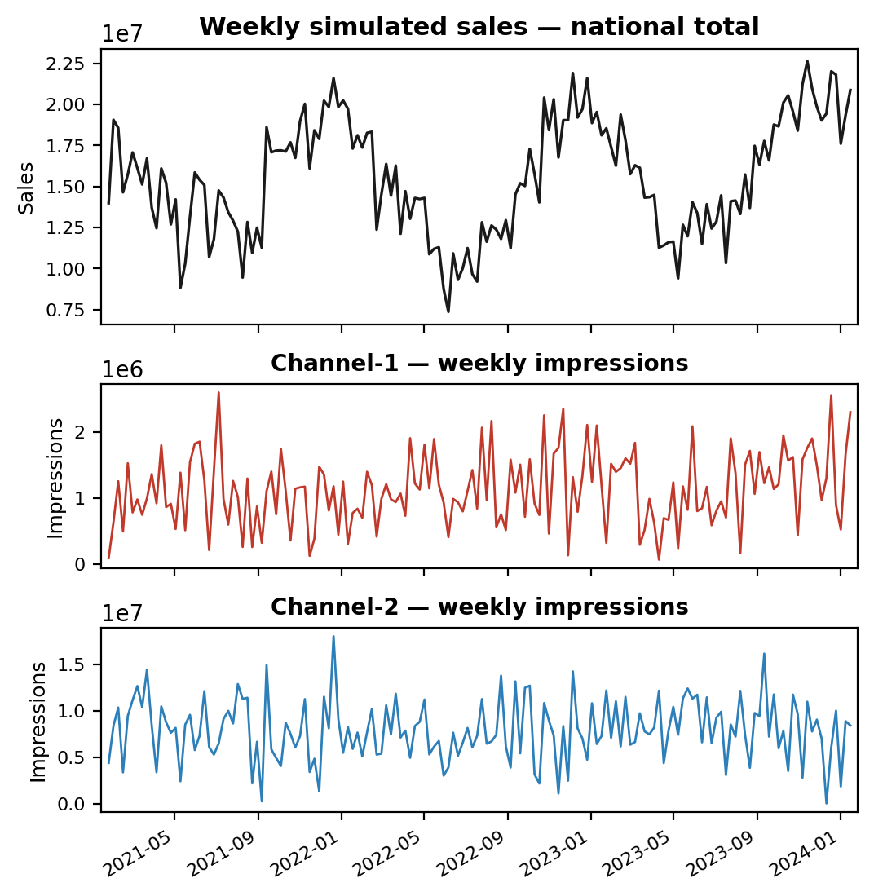
Simulated data with known ground truth
In the real world the true saturation point is never observed, only the fitted one. So: simulate geo × time data from a known generative model, fit an MMM to it, and check whether it recovers the truth it was built from.
Realistic Data Generation Process
Sales_g,t = Intercept_g
+ Trend_t
+ Seasonality_t
+ SharedShock_t
+ Σ_c ControlWeight_g,c · Control_g,t,c
+ Σ_m Coefficient_g,m · Saturation( Carryover(Impressions_g,t,m; Decay_m) ; HalfSaturation_m, Slope_m )
+ Noise_g,t
What we know that no real dataset tells you — across all 10 simulated datasets
Channel | Half-saturation (× current delivery) | True ROI | True carryover (α)
Channel-2 | 1.30× | 6.0 | 0.15
Channel-1 | 9.00× | 6.6 | 0.30
20 regions × 156 weeks, media 32% of the outcome — a well-powered dataset, not a starved one.
Ranges span the 10 simulated datasets the results slides pool. A single value means the quantity is pinned across all of them by construction, so the comparison isolates it; ROI is re-derived from whatever data each draw produces, so it moves. The specific saturation threshold is a stated modelling assumption, not a claim about real-world saturation; what is being tested is the mechanism, not that number.

Slide 6
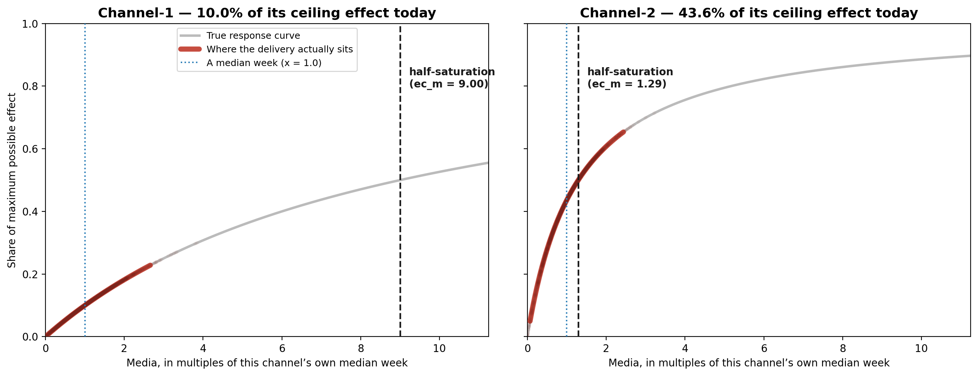
Where the spend actually sits on each channel’s own curve
Same x-axis as slide 2: media measured in multiples of that channel’s own median week, so 1.0 is "what you already run".
Channel-1 is running at 10.0% of its ceiling — every week of it sits on the straight part of its own curve. Channel-2, at 43.6%, is up around the bend.
This is the whole setup: one genuinely under-invested channel, one that is not. No statistics yet — just where the money currently lands.
Each dot is one region-week of simulated delivery, placed on the true response curve it was generated from.

Slide 7
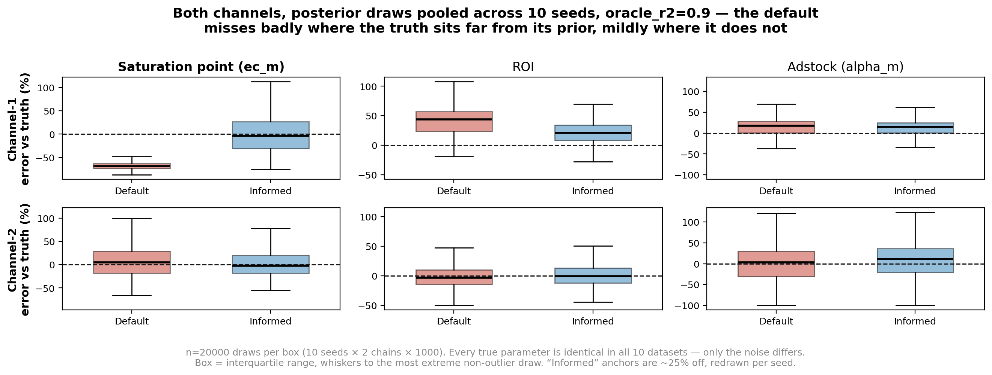
Does the model recover the truth it was built from?
Same data, same model, same settings. The only difference between the two boxes in each panel is the saturation prior.
The same default prior misses Channel-1’s saturation point by -69% and Channel-2’s by +5%. The error tracks how far the truth sits from the prior — not which channel it is.
A reach-informed prior — built from ordinary planning inputs and ~25% wrong — removes that bias (-4% median) and wins on 10/10 datasets, though it is far noisier on any single one. ROI improves (+44% → +21%) without being fixed; carryover is unchanged either way.
10 simulated datasets with IDENTICAL true parameters — only the noise differs, so seed-to-seed spread is noise and nothing else. Posterior draws pooled across seeds and chains (20000 per box); box widths show combined spread, not one model’s calibrated credible interval. The informed prior’s anchors are perturbed ~25% per dataset rather than set to the truth — an oracle prior would be unbiased by construction. oracle_r2 = 0.9.

Slide 8
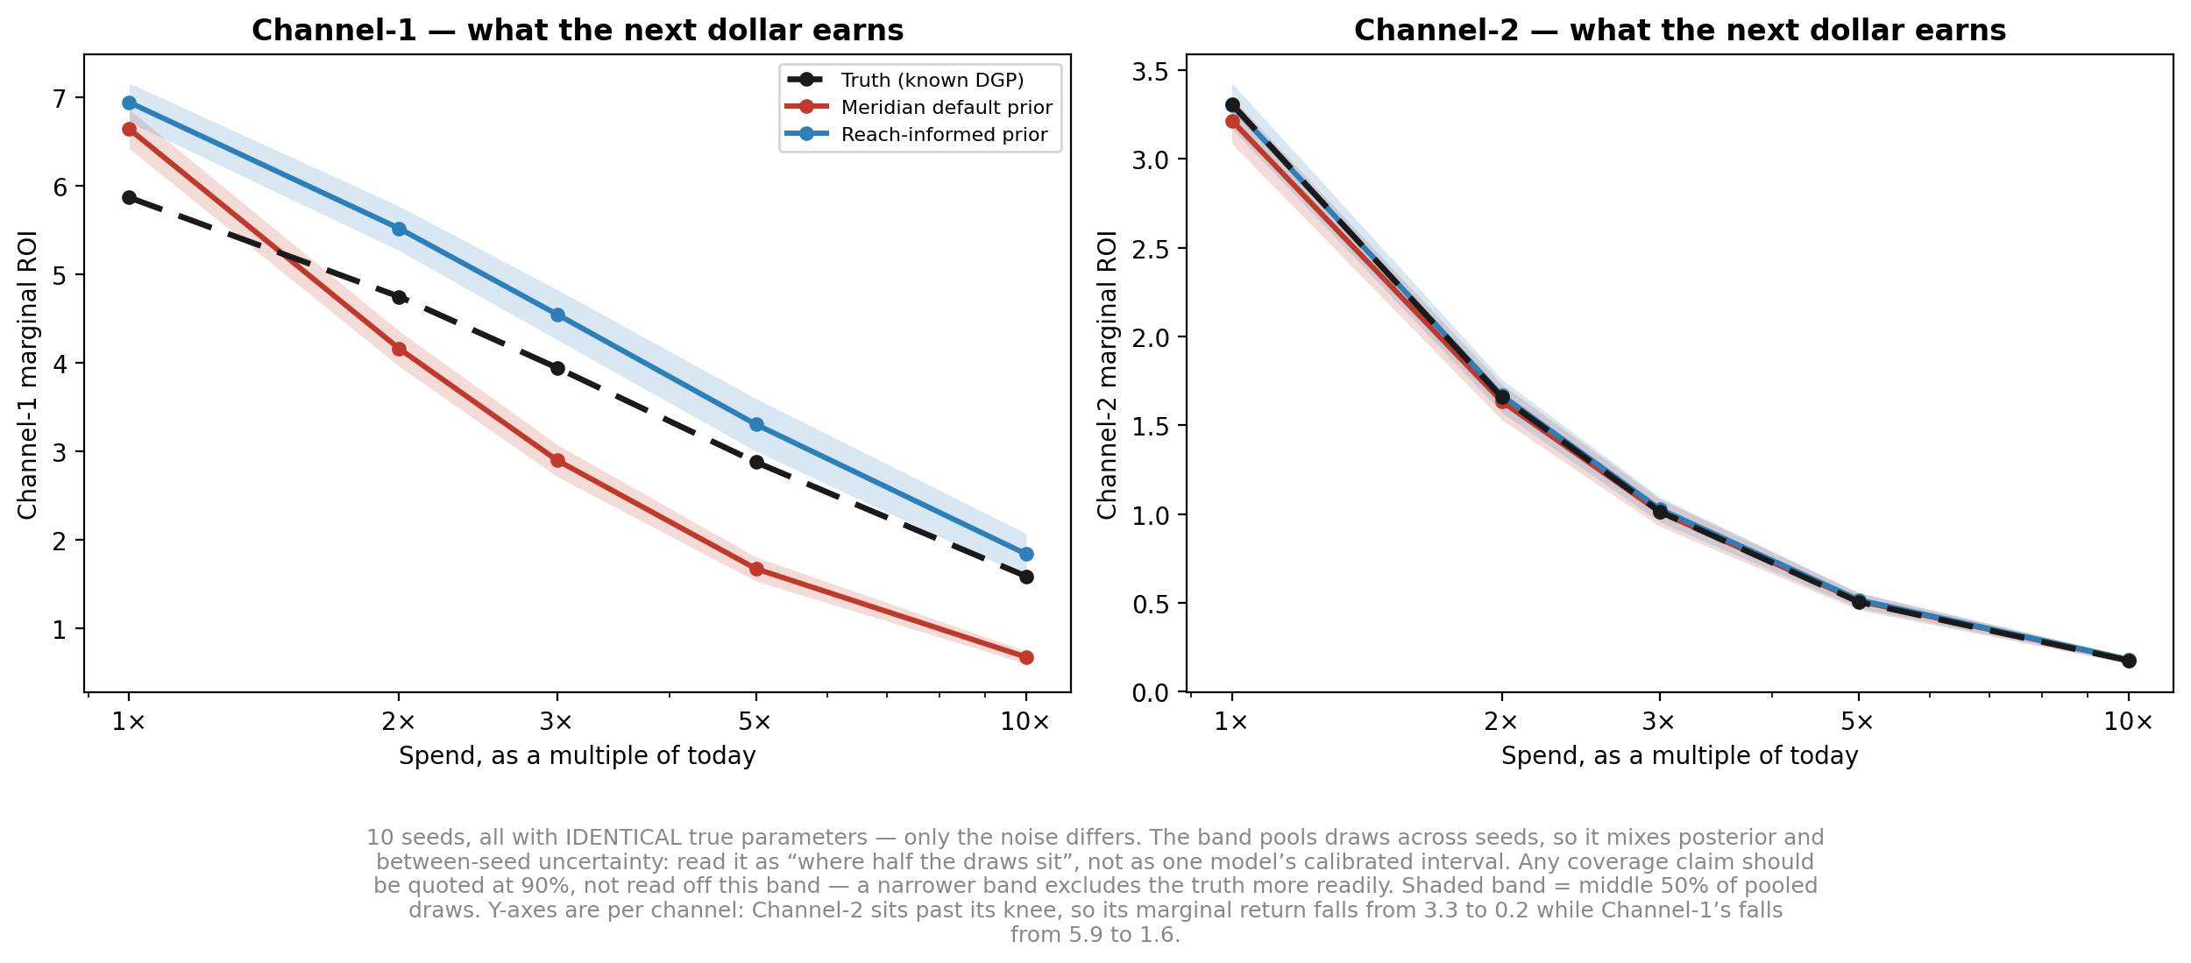
So ask the model the question you actually bought it for
"Should I spend more here?" — marginal return at spend levels above today’s, across 10 datasets. Channel-2 is the control.
Same prior, same extrapolation to 10x: on Channel-1 the default is off -58%, on Channel-2 just -3%. The model does not break when you extrapolate — it breaks when you extrapolate from a misplaced saturation point.
On Channel-1 the default’s error also changes sign — +13% at today’s spend, -58% at 10x — flattering the channel today and starving it tomorrow. The reach-informed prior is biased but stably so, which is the property a reallocation needs.
10 datasets with identical true parameters; shaded band is the middle 50% of pooled draws, so it mixes posterior and between-seed spread rather than being one model’s calibrated interval. At a 90% interval the default contains the truth on 4/10 datasets at 1x and 0/10 at 10x for Channel-1, versus 7/10 for Channel-2. Y-axes differ by channel.

Slide 9
Key takeaways
The defaults are a starting point, not a measurement — and you are never asked to confirm them.
WHAT THE TEN DATASETS SHOWED
1. The saturation prior is the same for every channel.
It assumes you are already near the knee. On the under-reached channel it missed the truth by -69%.
2. It only misleads where your channel sits far from it.
Same prior, same fit, same 10 datasets: the well-reached channel came back +5%. That is a prior problem, not a broken model.
3. The error compounds as you extrapolate.
Marginal ROI ran +13% at today's spend to -58% at 10x, with the 90% interval missing the truth on 10/10 datasets.
WHAT TO CHANGE IN YOUR OWN MODEL
1. Ask what your model assumes before it sees your data.
We did: the default gives 50% odds that every channel — whatever its audience or delivery — is already past half-saturation.
2. Build the saturation prior from delivery.
What share of your addressable audience you reach, and how often. Audience size alone is not the input — it cancels; the shortfall against it is what moves the answer.
3. Set the carryover window deliberately.
max_lag is a hard truncation, not a prior, and it moved our results. The decay prior alone did not: +17% vs +15%, indistinguishable.
4. Stress-test at 2–5x spend, not at today's.
ROI and marginal ROI at current spend both concealed this. Only the elevated-spend curve separated the two priors.
An informed prior removes the systematic bias; it does not recover the parameter. Its anchors were perturbed ~25% per dataset and it won 10/10, but it is wide on any single one (-31% to +27% interquartile) — its accuracy is inherited from your planning inputs, not estimated from the data.

