Slide 1
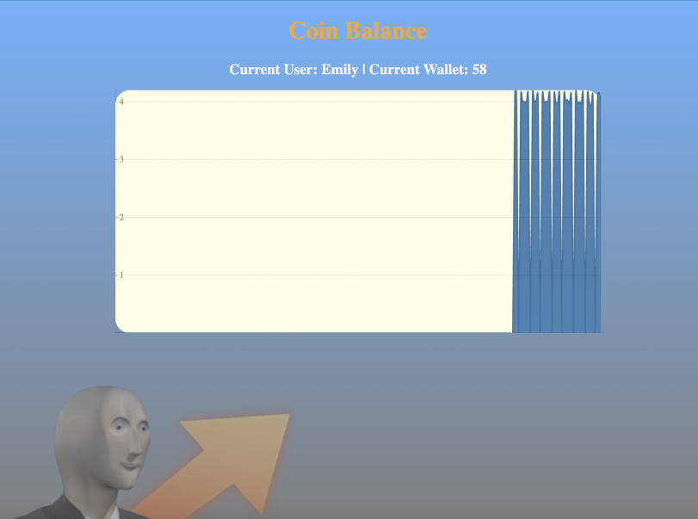
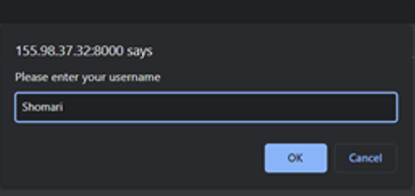
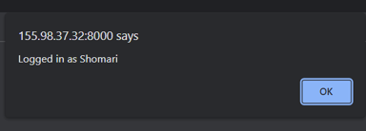

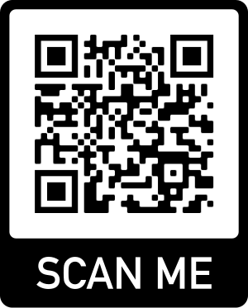
What is it? Our team is envisioning a 24/7/365 best-of-breed coin trading and generating website that allows the user to log into an account and view the amount of “Ram Coins” in their wallet.
Coin Balance
Collyn Gregory | Patrick Ryan | Declan Teofilak | Shomari Turner | Meredith Urban
Where We Are:
Coin Balance in its current state allows for a user to access the front page, log-in (and create a new user if necessary), and monitor their crypto as it adds to the wallet in real-time
Our Goal:
We plan to introduce a way to save new users and their coins to a database, that. This will allow a final feature of allowing users to "trade" their coins, sending them to existing users in the database
Cloud Infrastructure:
We are using docker to containerize each service, from the Web UI to the hasher functionality. From there, we have implemented Kubernetes to simplify deployment and manage our containerized services
https://github.com/Mari3e/CSC468Project

