Slide 1
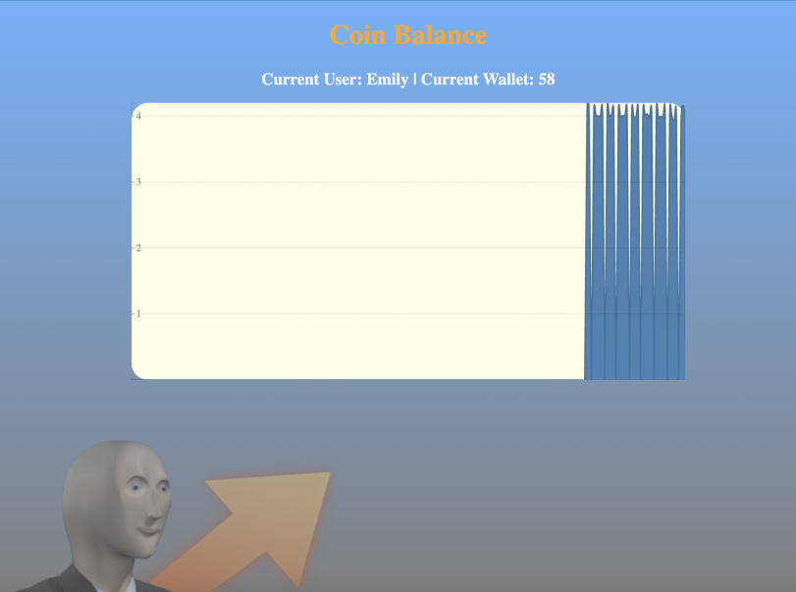
What is it? Our team is envisioning a 24/7/365 best-of-breed coin trading and generating website that allows the user to log into an account and view the amount of “Ram Coins” in their wallet. The reason why we picked this project is to reflect what’s happening in our world today and focus on empowering users with a service that allows them to quickly and synergistically cooperate on a cloud-based level; a way to create efficiency in today’s diverse, globalized environment.
Ram Coin Balance
Collyn Gregory | Patrick Ryan | Declan Teofilak | Shomari Turner | Meredith Urban
Where We Are:
Our project currently allows for the end user to specify who they are (or conversely whose wallet they want to view). When they enter this single credential, they are able to view and monitor the specified wallet. The goal from here is to ensure that the front-end is communicating properly with the backend to spin up a table and write to that specific table, and then allow another user to access the same table as long as the instance persists.
We have been able to implement the provided Docker and Docker Compose files with augmentations to work with our repository. As of this writing, we are currently able to launch from our project repository from Cloudlab, clone our main branch, build via docker-compose and run our project. Additionally, we have been able to manage the containers via Kubernetes.
The final goal has been adjusted slightly, as we have decided to use a file reading system in the webui to communicate wallet totals. This change will allow us more time to work on the CI/CD aspect of the final project deliverable which we believe should take precedent. The final page will have the ability to view the total coins earned in the current session (when you last logged in through to now) and log-out. Upon log-out (or redirecting to another page) all user’s will have their wallets written to a file stored locally in the webui directory. This should create a sufficient method of tracking the individual coins mined. Beyond this, it may reintroduce the ability to initiate coin trades.
https://github.com/Mari3e/CSC468Project

