Slide 1

remitmart
A Blockchain-based marketplace to send remittances
Image source: McKinsey

Slide 2
The problem
Current remittance market engages around 230 million people, to the tune of 500 million dollars in remittances a year. Most remittances take place between known parties, like family/friends. (2015 data)
Around half of the world’s population, more than 3 billion people, live on less than 2.5 dollars a day (2015 data). Out of this, about 700 million live on extreme poverty, or less than 1.9 dollars a day (2017 data). These people cannot afford the basic necessities of life.*
People are more likely to donate money when they feel that their donation will have a direct impact on the life of a person, but they are wary of giving money directly to people in need out of concern for fraud.
WHAT IF… there was a solution that could guarantee that donations could get directly to the intended recipients and that the money would be used for the intended purpose?
*Source: https://www.dosomething.org/us/facts/11-facts-about-global-poverty

Slide 3
Current solutions
Bank transfers:
Requires knowing the person that you are donating to directly
No guarantee that the money will be used in the intended way
Can take several days to clear, specially in the case of international transfers
Can carry substantial fees, specially in the case of international transfers
Money transfer services (Western Union, Xoom):
Requires knowing the person that you are donating to directly
No guarantee that the money will be used in the intended way
Can carry substantial fees, specially in the case of international transfers
May need a physical presence in location for transfers that do not require a bank account
Donations to NGOs:
No need to know the person you are sending money to BUT
NGOs can have administrative overhead, so no guarantee that the money will be used in an efficient manner
Process can take weeks or months for the donation to get to the recipients

Slide 4
Our solution
Create a marketplace that connects people in need, vendors and donors:
People in need can create wish list for items that would be useful for them and their families
Vendor with the ability to fulfill those items can offer them
Donors can select which items they would like to pay for
This marketplace would be composed of the following elements:
A website:
To onboard vendors and allow them to put their catalogs up for selection
To enable people to create wish lists of items they need by looking at what’s available from the vendors
To help donors explore the catalog and select items that they would like to pay for
A Blockchain platform:
To allow transactions to be paid in crypto
To allow vendors and donors to enter an agreement for payment of the goods

Slide 5
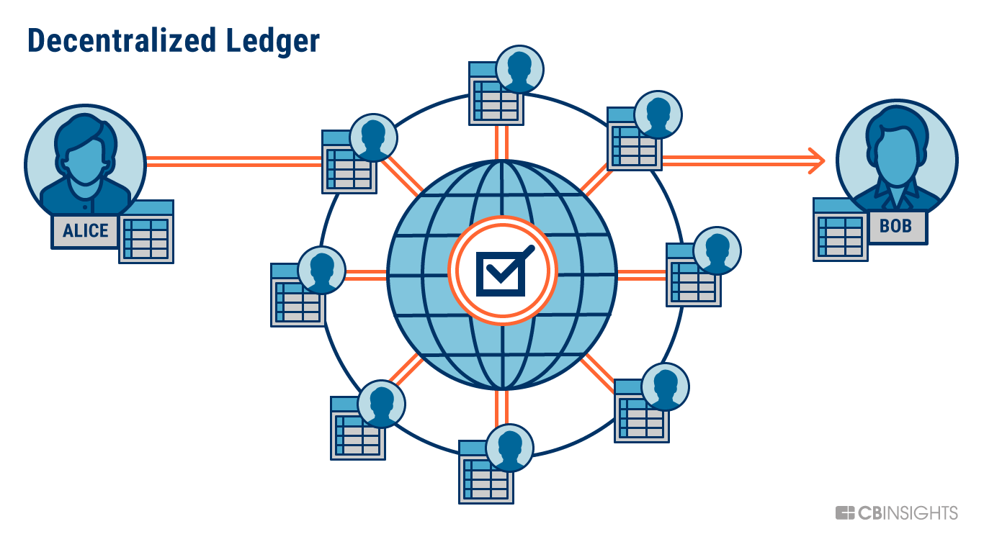
What is blockchain?
A decentralized ledger composed of several blocks of transactions linked to each other
A peer-to-peer network that works on validating, processing and adding the transactions to the Blockchain
A consensus mechanism that determines which node gets to add the next block of transactions
A token or cryptocurrency used as an incentive mechanism for the nodes in the network
A platform that enables more complex operations through code (smart contracts)

Slide 6
Why blockchain?
Trustless:
No need for the participants (senders, vendors, receivers) to know each other.
Immutable:
All transactions are recorded in the Blockchain and available for audit if needed. No one can tamper the transactions on the Blockchain.
Decentralized:
No need for a centralized party (a bank, a money transfer service, an NGO) to process the transactions. Transactions can happen between any nodes in the network anywhere they are and take as little as a few minutes to process with very low fees.
Fraud-resilient:
Through smart contracts, the integrity of the transactions is guaranteed. Neither senders or vendors can back out from meeting their end of the bargain once they have committed to a smart contract.

Slide 7
Solution Platform: ethereum

Slide 8
HELP WANTED!
We have:
A project manager
An Ethereum developer
A couple of consultants
We need:
UX designers
Front-end developers!!! Ethereum uses the web3.js API to interact with smart contracts
Super enthusiastic people

Slide 9
Additional information
Contacts:
Marissa Iannarone:
Perla Mendez Maldonado: perla.mendez@gmail.com
GitHub repository:
https://github.com/MariLeigh/summer-code-a-thon-2018/
Business Case: https://github.com/MariLeigh/summer-code-a-thon-2018/wiki/Business-Case

