Slide 1
FINAL PROJECT
Cute Land
Martínez Santana Diana Anayanssi
Arguelles Macosay Mariana

Slide 2
Index
Dates and activities to be fulfilled by the members.
Rules and ways to play.
Schedule
Dynamic
Target expected to be met with the final project.
Drawings of the way the play could be seen.
Target
Sketches

Slide 3
Objectives
Prepare a project using the advanced computer graphics course .
Use of elements learned in the different practices carried out.
Use tools like Gimp, Blender and Mixamo.
Implement different lights and cameras in the game.
1
2
3
4

Slide 4
Activity Schedules
November |  |  | December
Week3 | Week4 | Week5 | Week1 | Week2 | Week3
Carry out the project approach. | Carry out amendments and recommendation. | Search for models or realization. Texture and skybox search. | Creation of scenery (heights and textures map) and lights. | Creation of animations of the different models, adjustment of view in first and third person. | Import of models, animations, maps, textures, etc., in the project.

Slide 5
Activity Schedules
December |  | January
Week4 | Week5 | Week1 | Week2 | Week3 | Week4
Perform the necessary code for shots to be recognized. | Agree on the number of balls to be shot as well as the time to shoot. | Perform the code for the number of balls and time. First tests | Error correction. | Perform of the necessary documentation and multimedia. | Presentation.

Slide 6
Playing dydamics
The player must shoot the bouncing balls.
D1
D3
You win by killing all the bouncing balls within a certain time.
It has shoot, movement, rotation and jump control.
D2
D4
You lose in case of losing three lives due to the bouncing balls or if time runs out.

Slide 7
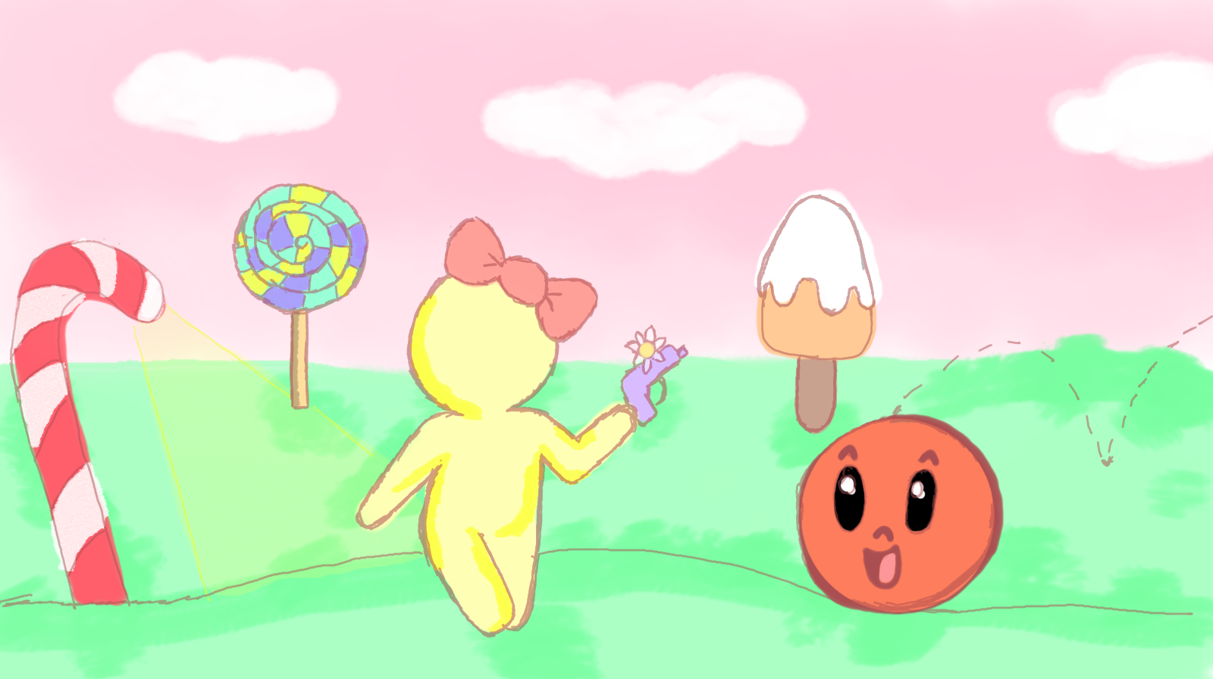
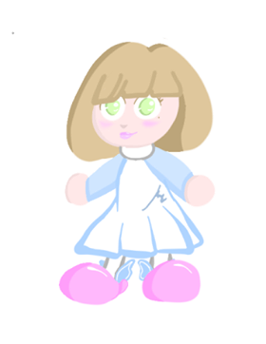
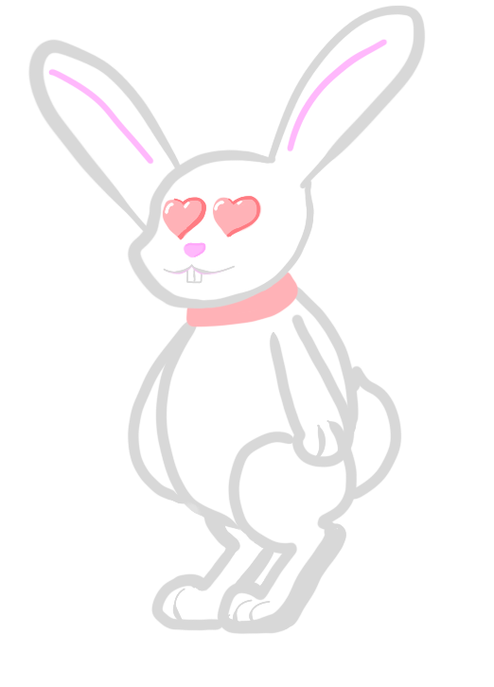
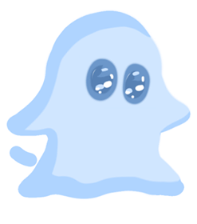
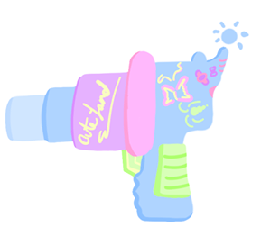
Game sketches
Scenery sketch
Characters sketch
Weapons sketch

Slide 8
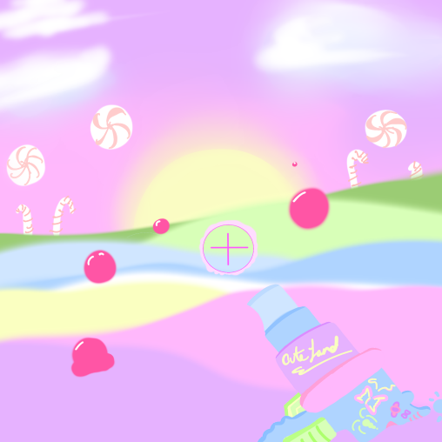
General sketch (first person view)

Slide 9
Conclusion
To perform a project, it is always necessary to be clear about the objectives and have a firm approach to avoid returning to this part when starting to design.
For our final project, it is very important to have solved the doubts that may have arisen during the different practices carried out during this weeks. In such a way that we can consult the practices as support or guides across the project.

