Slide 1


MONOPOLY
GAME
PLAY

Slide 2

OUR GROUP
AIDA KIRAKOSYAN
MARI MINASYAN
RAFFI POGOSYAN

Slide 3

RULES

Slide 4


RULES
To win the one must Be the last player left with money after others go bankrupt.
Start the game with 1500$ initial money
If you land on an unowned property, you may buy it. If you don’t the turn passes to next player
If you land on someone else’s property, you pay them rent.
Build houses and hotels on properties to increase rent once you own all properties in a color group.

Slide 5
RULES
Collect $200 every time you pass start. If you Stopped in start you can get 300$.
If you stopped in Chance and Community chance cards square, you get cards that can help or hurt you.
Land in Jail by card, rolling doubles 3 times in a row, or landing on “Go to Jail.” Get out by paying $50, using a card, or rolling doubles.
If you owe more than you can pay, You go bankrupt and leave the game
If you are in Free parking square you skip your next turn

Slide 6
UML

Slide 7
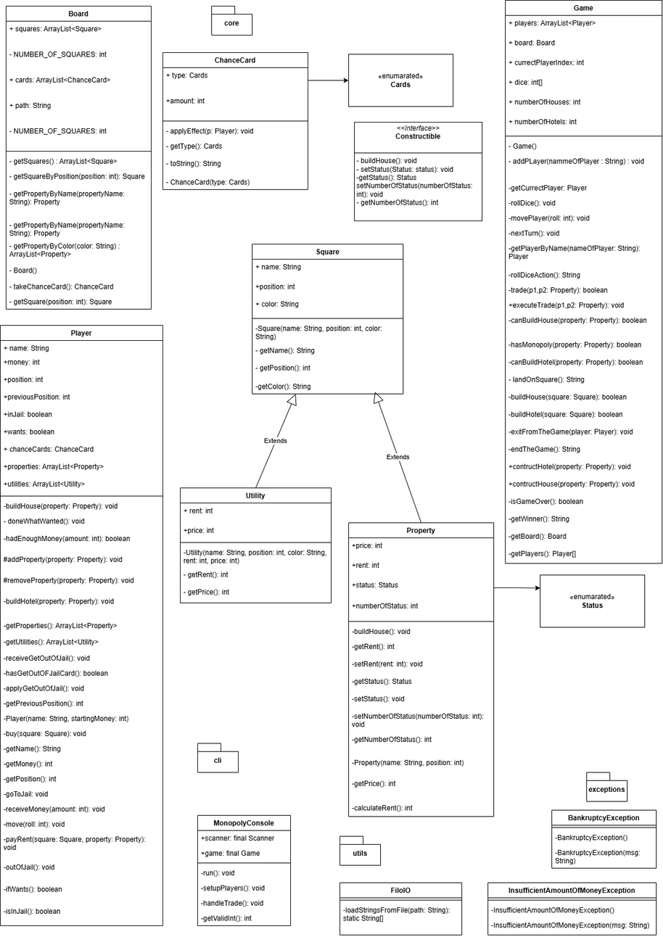

Slide 8
Q&A
START

Slide 9
THANKS FOR ATTENTION
UNTIL NEXT TIME

