Slide 1

Augmented Reality

Slide 2
What is ar?
An interactive experience of an enhanced real-world environment
The enhancement is created by adding computer generated perceptual information
An experience which is artificial and which adds to the already existing reality
Three basic features:
A combination of real and virtual worlds
Real-time interaction
Accurate 3D registration of virtual and real objects

Slide 3
Ar vs vr
Virtual Reality
The users’ perception is completely based on virtual information
Creates a completely new world
Augmented Reality
The users’ perception is a mixture between the real world and computer generated information
Adds layers of information on the real environment

Slide 4
Use cases
Archeology
Architecture
Urban Design and Planning
STEAM Education
Industrial Manufacturing
Commerce
Literature
Visual Arts
Fitness
Human Computer Interaction

Slide 5
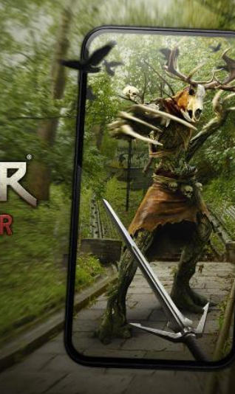
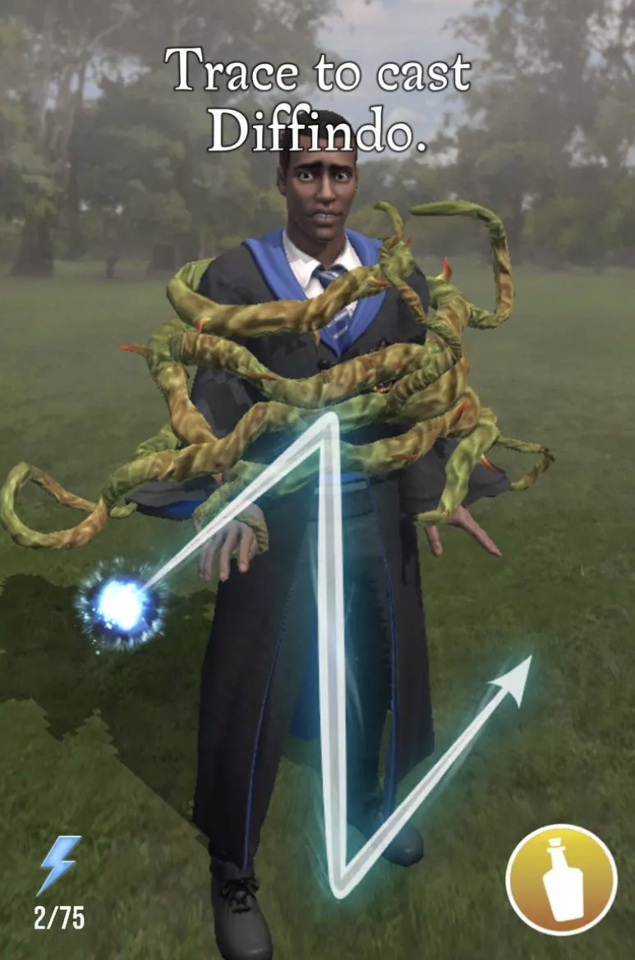
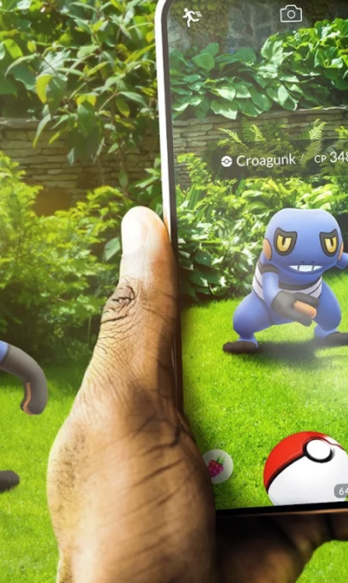
AR Games
Pokemon GO
Harry Potter: Wizards Unite
The Witcher: Monster Slayer

Slide 6


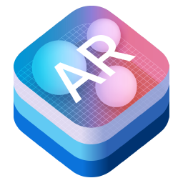

Development kits
Vuforia
ARCore
ARKit
AR Foundation

Slide 7
Vuforia

Slide 8
Vuforia
Augmented Reality SDK (Software Development Kit)
Mobile devices
Computer vision technology to recognize and track Image Targets and 3D objects in real-time

Slide 9
Features
Tracking Images
Tracking Objects
Tracking Environments
Vuforia Fusion
Device Tracking
Cloud Recognition Service
Recording and Playback
Driver Framework
External Camera

Slide 10
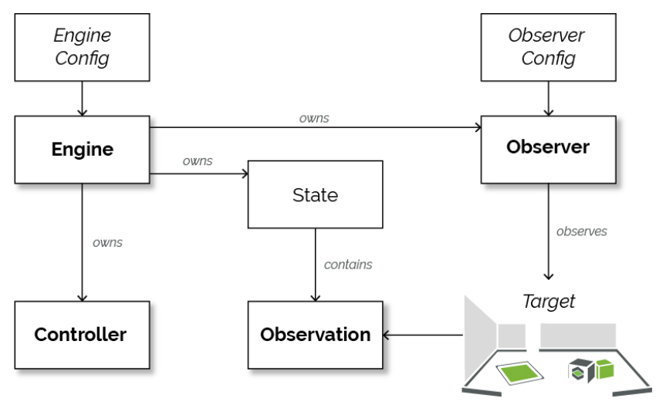
Vuforia 10 api

Slide 11
Read More about vuforia
https://library.vuforia.com/getting-started/vuforia-engine-10-api
https://library.vuforia.com/getting-started/tools-overview
https://library.vuforia.com/getting-started/vuforia-features

