Slide 1

Project 2 microarray gene expression data related to COVID19
Prepared by:
Maria Sameh
Martina Romany
Marina Ehab
Fady Emad
Atta Ahmed

Slide 2
Dataset details
Data Set Title : PBMC is Peripheral Blood Mononuclear Cells.
GEO accession : GSE1739
Status : public on 18/1/2005
Number of attributes:15
Number of records: 20 gene expression
Data Resource :
https://www.ncbi.nlm.nih.gov/geo/query/acc.cgi?acc=GSe1739
https://pubmed.ncbi.nlm.nih.gov/15655079/

Slide 3
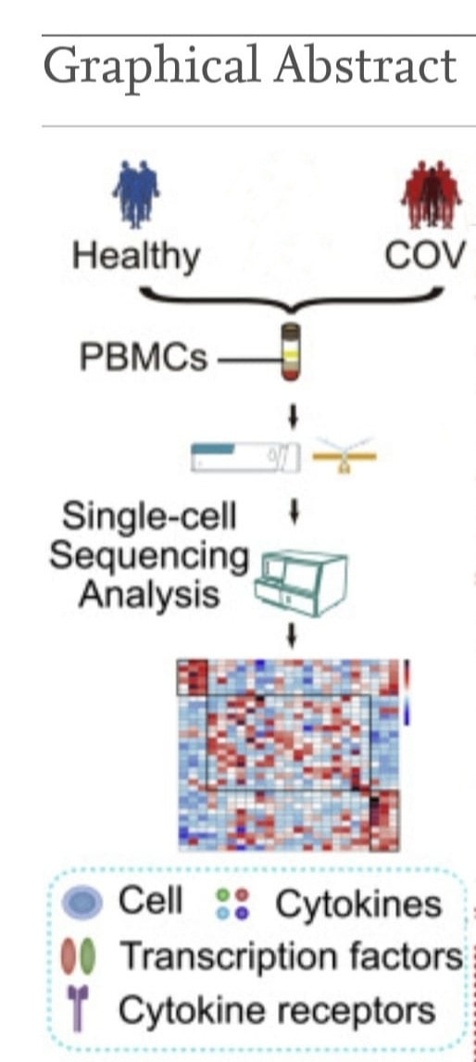
Peripheral blood mononuclear cells (PBMCS)
Define:
They are found in the peripheral blood circulating throughout the body and not sequestered in the lymphatic system, spleen, liver or bone marrow.
PBMCS are composed of four cell types: t cells, b cells, natural killer cells and monocytes, each having a round nucleus.
conclusion:
PBMCS from patients with SARS strongly suggests that the response of SARS affected patients seems to be mainly an innate inflammatory response, rather than a specific immune response against a viral infection, as we observed a complete lack of cytokine genes usually triggered during a viral infection. our study shows for the first time how the immune system responds to the SARS infection, and opens new possibilities for designing new diagnostics and treatments

Slide 4
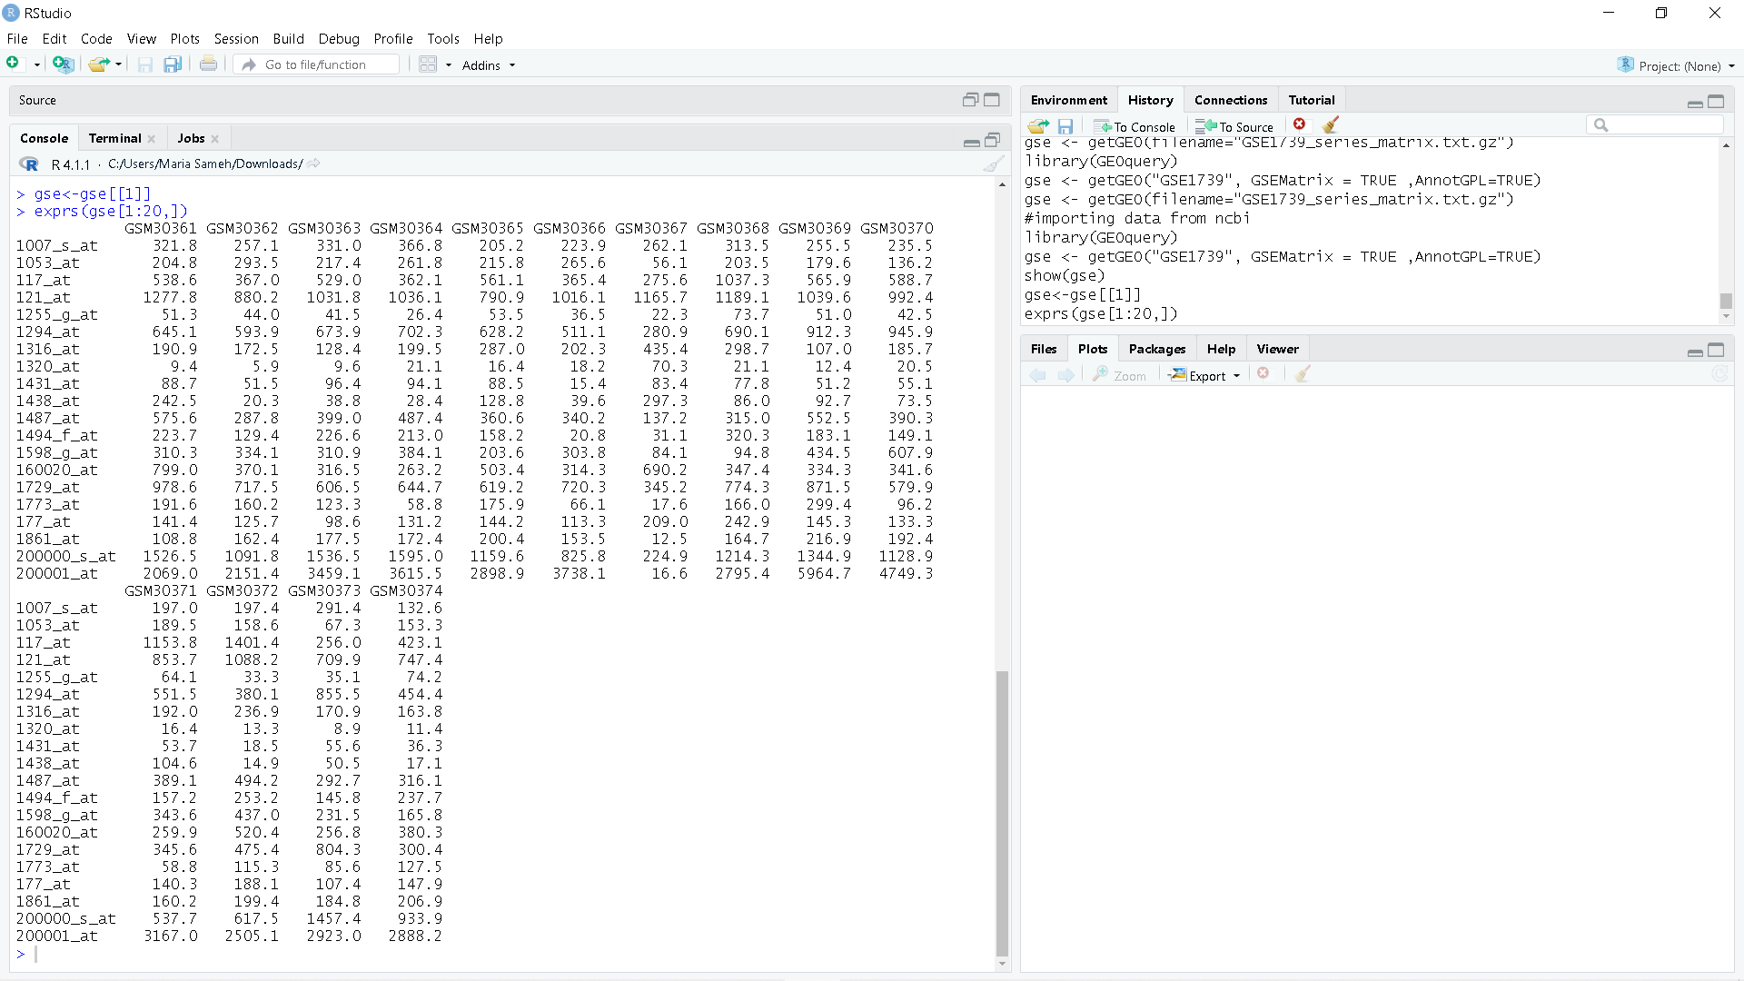
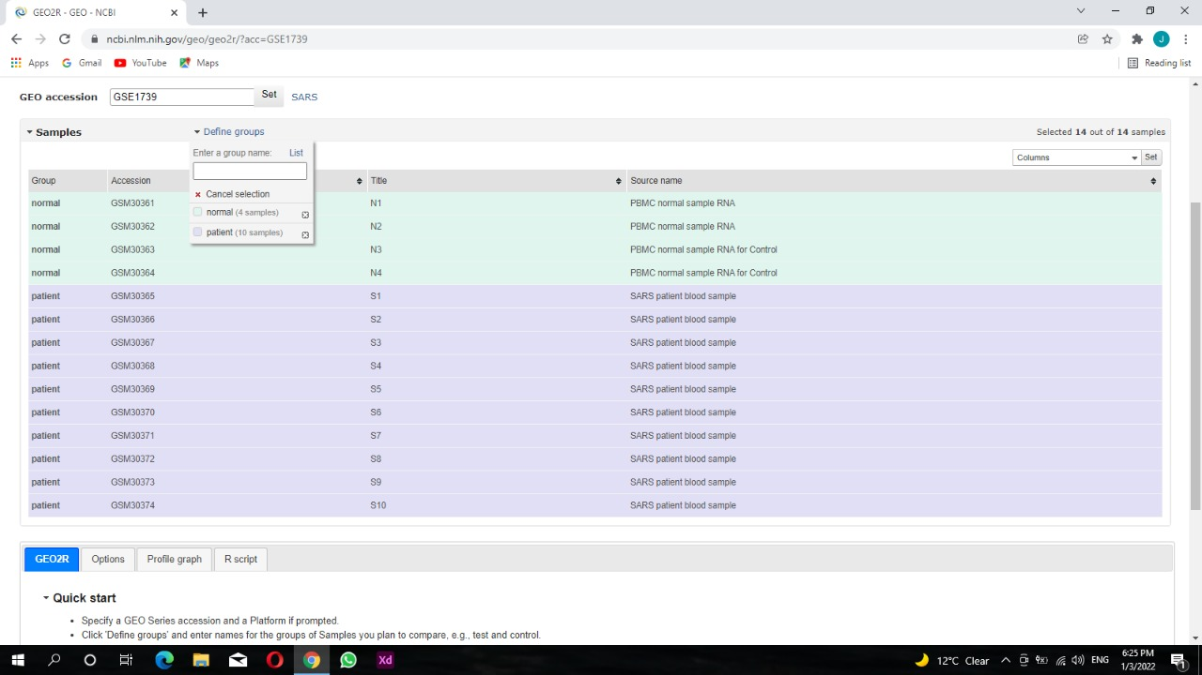
General overview about Geo Geo is an international public repository that archives and freely distributes microarray, next-generation sequencing, and other forms of high-throughput functional genomics data submitted by the research community.

Slide 5
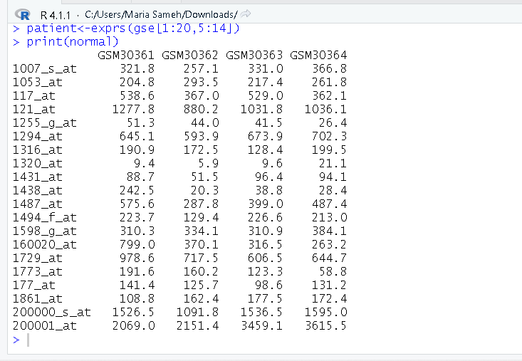
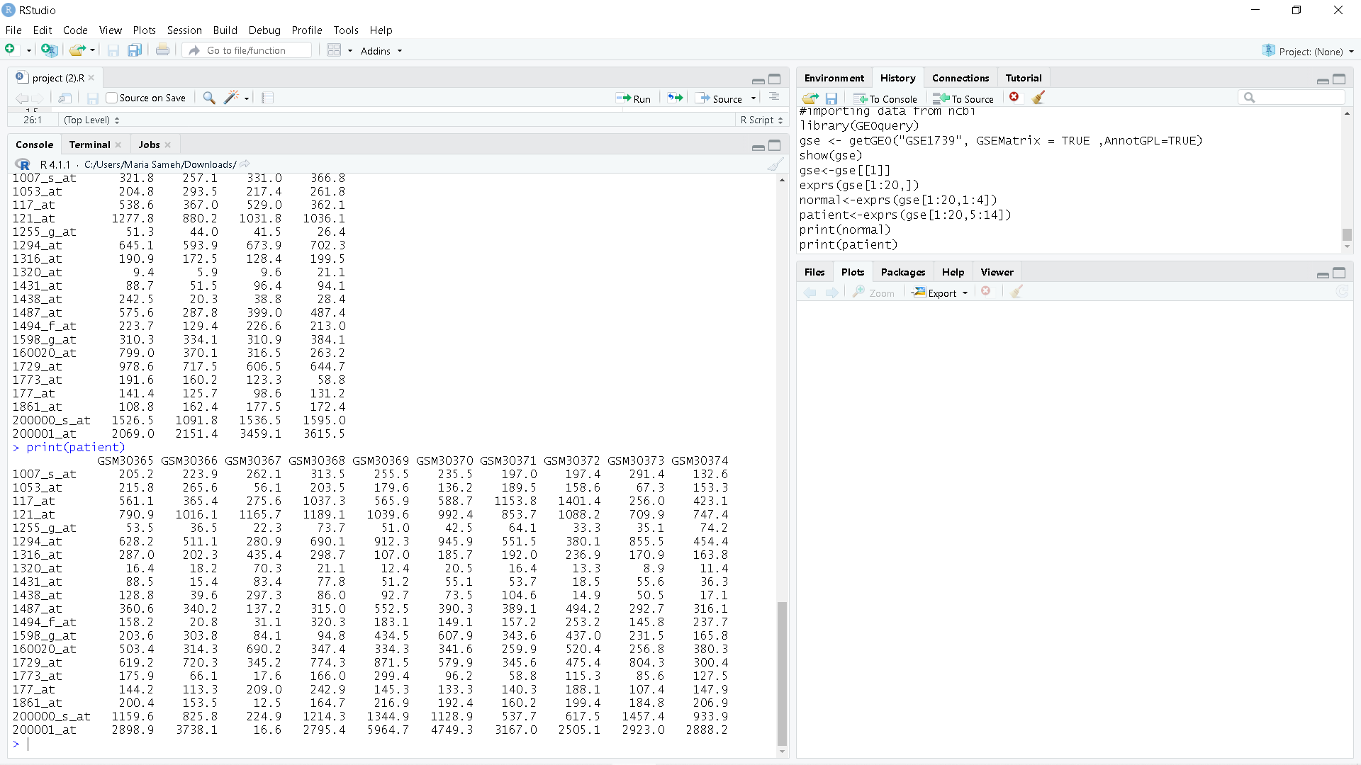
we used the( GSE1739 )dataset (10 SARS-positive PBMC and 4 normal PBMC) Gene expression matrix

Slide 6
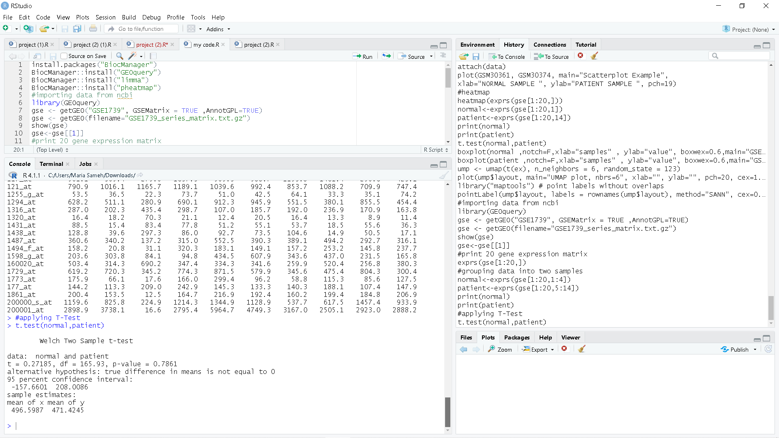
T-test
A t-test is a statistical test that is used to compare the means of two groups. It is often used in hypothesis test to determine whether a process or treatment actually has an effect on the population of interest, or whether two groups are different from one another. You can test the difference between two groups using a t-test by use.
The null hypothesis (H₀) is that the true difference between these group means is zero.
The alternate hypothesis (H_{a}) is that the true difference is different from zero
Types of t-tests
One-sample t-test
Two-sample t-test
Paired t-test
In this experiments, we used the t-test to find out if there is a difference between the values(row signal intensity)of genes in a blood sample from a patient with SARS and the values(row signal intensity) of a blood sample from a healthy person, and Null hypothesis is no difference between two value(mean=zero) and The alternate hypothesis is the true difference is different from zero
Results is we could not reject Null hypothesis and p-value = 0.7861

Slide 7
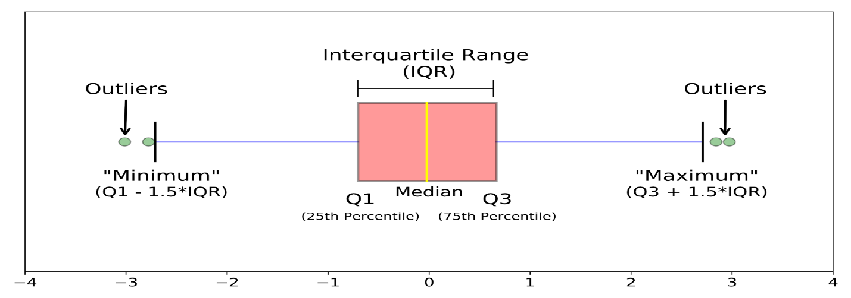
Box Plot
Boxplots is a type of chart often used in explanatory data analysis.
Box plots visually show the distribution of numerical data and skewness through displaying the data quartiles (or percentiles) and averages.
Boxplot can show whether a data set is symmetric or skewed by the median .
If the median in the middle of the box : symmetric data .
If the median is not in the middle of the box : skewed data .
How to compare boxplot ?
1) The boxes .
2) The middle line .
3) The whiskers .

Slide 8
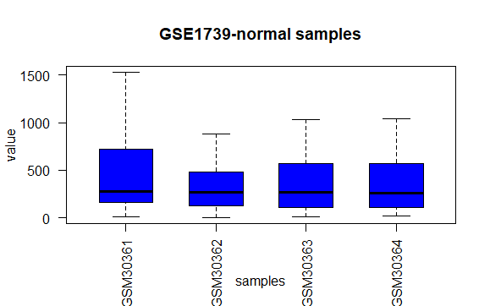
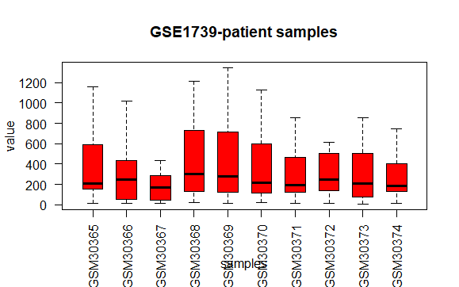
In the experiment, samples were divided into two groups: control group(4) and treatment group(10)
visualization for control group
visualization for treatment group

Slide 9
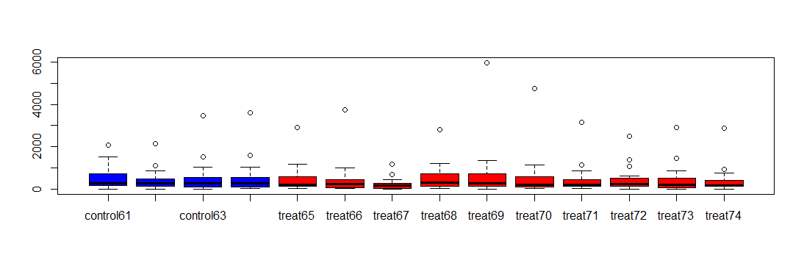
Total result of all samples

Slide 10
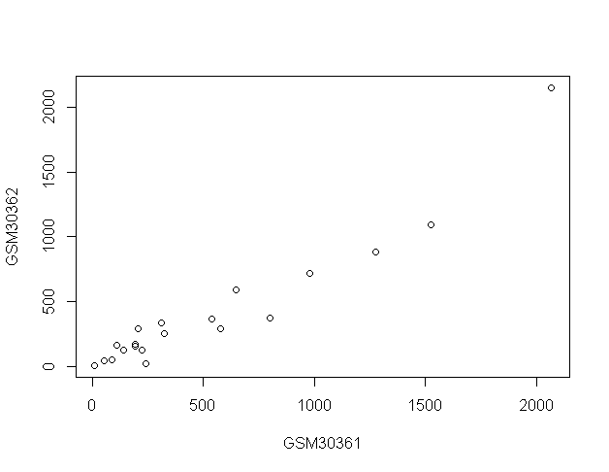
Scatter-plot
A scatter plot uses dots to represent values for two different numeric variables. The position of each dot on the horizontal and vertical axis indicates values for an individual data point. Scatter plots are used to observe relationships between variables and for microarray data it is used group data points that belong to each individual groups.

Slide 11
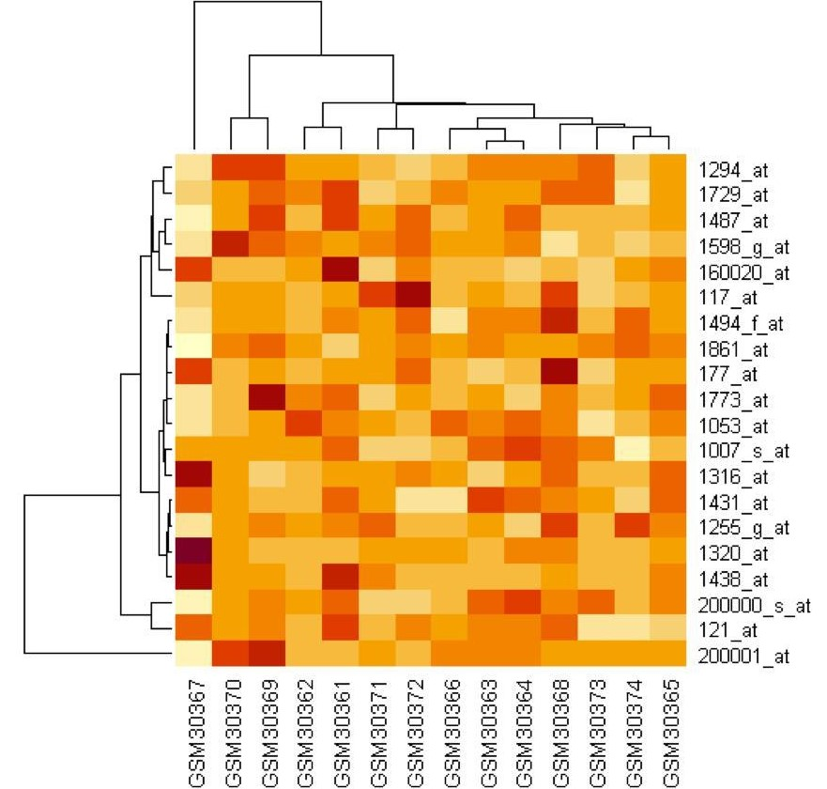
Heat Map
A heatmap is another way to visualize hierarchical clustering. it’s also called a false colored image, where data values are transformed to color scale.
the warm colors representing high-value data points and the cool colors representing low-value data points.
Heat map analysis of microarray data showing differentially expressed genes between two samples this hierarchical clustering can detect the type of sample from the microarray data, follow-up to such an analysis would be to determine the genes that contribute to a gene expression “fingerprint” that predicts the type of sample based on the gene expression profile of a patient sample or a normal one.

Slide 12
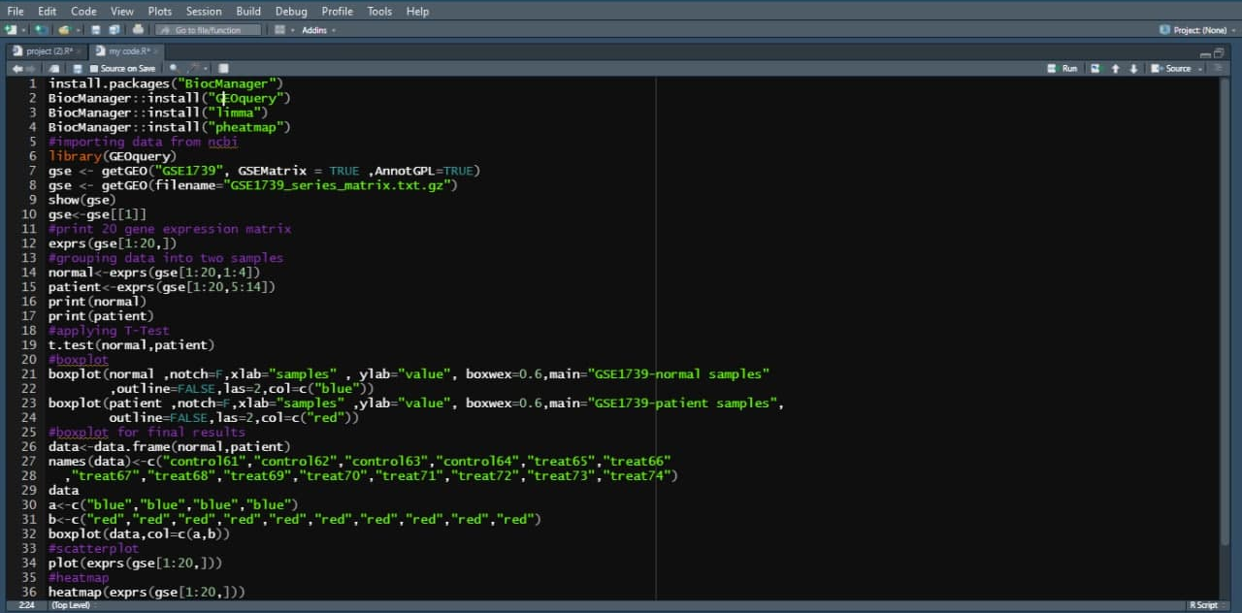
Final code

Slide 13
Thank you

