Slide 1
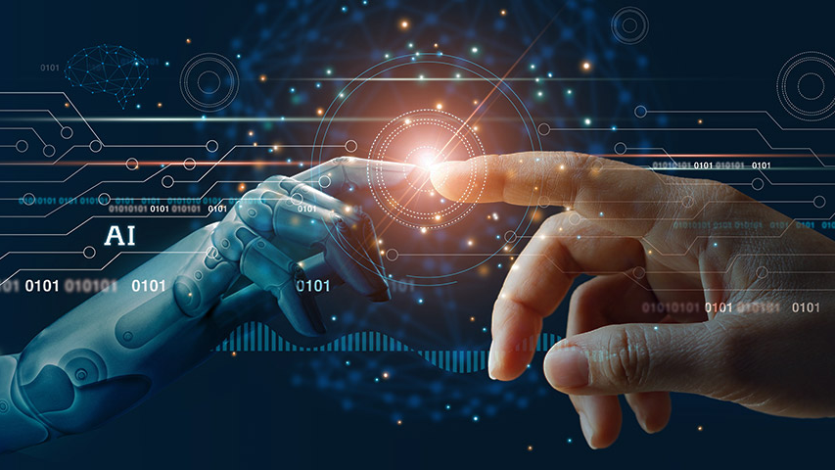
ARTIFICIAL INTELLIGENCE

Slide 2

1. WHAT IS AI:
2. HISTORY OF AI
3. ADVANTAGES OF AI
4. DEMERITS OF AI
5. INTRODUCTION TO CYBERSECURITY
TABLE OF CONTENTS:

Slide 3
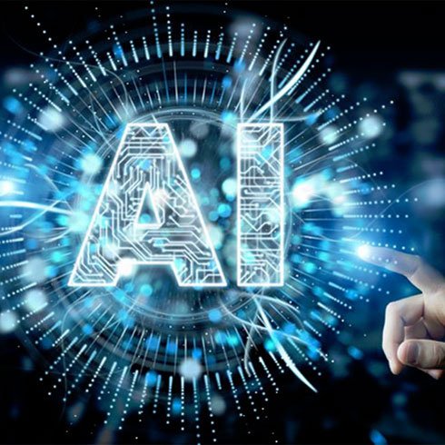
1. WHAT IS ARTIFICIAL INTELLIGENCE ?
Artificial intelligence (AI) is the ability of a computer or a robot to do tasks that are usually done by humans.
The term "Artificial Intelligence" refers to the simulation of human intelligence processes by machines, especially computer systems.
The ideal characteristic of artificial intelligence is its ability to rationalize and take actions that have the best chance of achieving a specific goal.

Slide 4
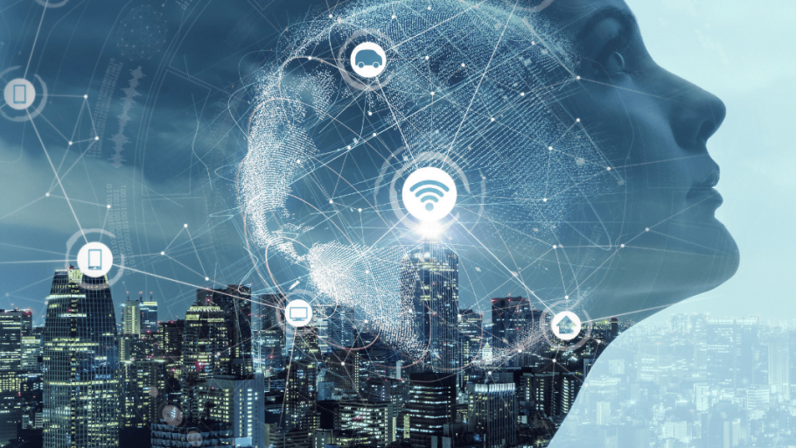
2. HISTORY OF AI:
The Beginning: The “heartless” Tin man from the Wizard of Oz and continued with the humanoid robot that impersonated Maria in Metropolis.
By the 1950s: All the scientists had artificial intelligence culturally assimilated in their minds.
ALAN TURING: The Father of AI
1. Alan Turing: A young British polymath who explored the mathematical possibility of artificial intelligence.
2. Humans solve problems and make decisions, so why can’t machines do the same thing?
3. This was logical framework of his 1952, Computing Machinery and Intelligence

Slide 5
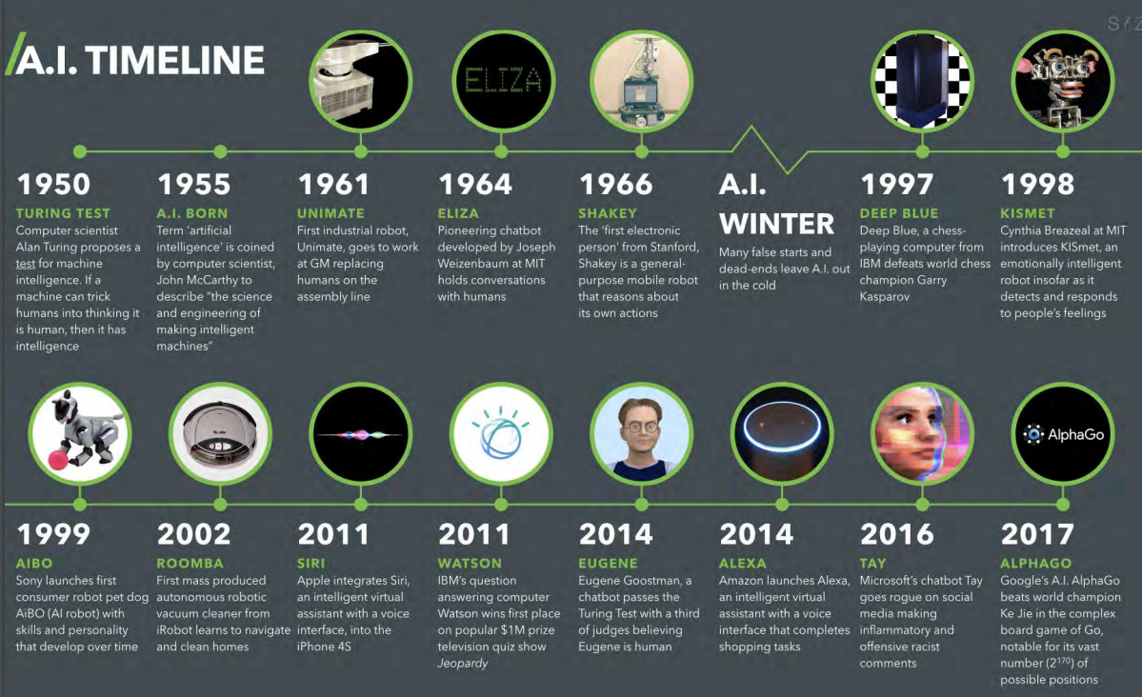

Slide 6
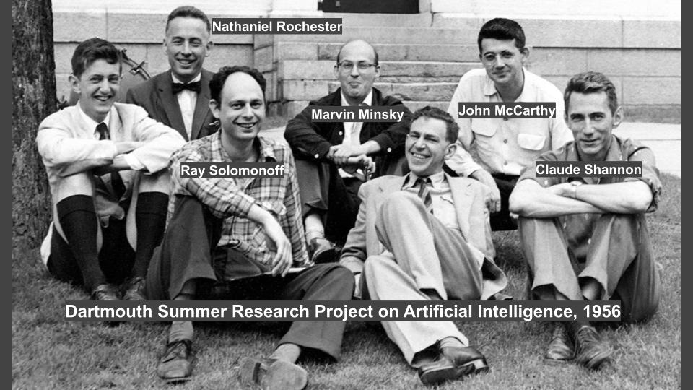
THE CONFERENCE THAT STARTED IT ALL:
The Logic Theorist was a program designed to mimic the problem solving skills of a human.
It’s considered by many to be the first artificial intelligence program and was presented at the Dartmouth Summer Research Project on Artificial Intelligence.
John McCarthy brought together top researchers for discussion on Artificial Intelligence
The significance of this event cannot be undermined as it catalyzed the next twenty years of AI research.

