Slide 1
ART SER
Engineering Excellence, Delivered.
Corporate Capabilities & Client Partnership Overview
ART SER DI SHEHEZAD TARIQ · Verona, Italy · Est. 2015 · 26+ Years Industry Experience

Slide 2



OUR CLIENTS
Trusted Partnerships with Industry Leaders
Over the years, I have collaborated with established companies operating in the Italian aluminum window and door sector, including ART FER SRL, CORRADINI SRL, SOAVE SERRAMENTI SRLS, and MASSIGNANI & C. S.R.L. My work with these companies takes place within their operational and d…
ART FER SRL
CORRADINI SRL
MASSIGNANI & C. S.R.L.
SOAVE SERRAMENTI SRLS
Manufacturing
Construction
Manufacturing
Windows & Doors
artfer.it
www.corradinivr.it
www.massignani.it
www.facebook.com/share/1CZcPwt9wz

Slide 3
CLIENT EXPERTISE
What We Deliver to Our Partners
Production and installation of aluminum windows and doors
AT A GLANCE
Supply and installation of PVC windows and doors
26+
Years in the Field
Aluminum fabrication for the commercial and industrial sectors
2015
Independent Since
On-site installation, finishing, and technical execution
2021
Last Registration
Production support for aluminum systems
6
Certifications

Slide 4
ABOUT ART SER
Our Story & Professional Journey
THE BEGINNINGS
My experience in the aluminum window and door industry began in 2001 with Dal Bosco Serramenti srl, where I worked until 2015, developing solid practical expertise in the production, assembly, and installation of aluminum windows, doors, and related systems.
INDEPENDENCE
Since 2015, after obtaining my tax license (VAT number) for freelancers, I have continued to operate independently in the aluminum industry, providing professional production, assembly, and installation services for commercial and industrial applications.
CURRENT WORK
Through ART SER DI SHEHEZAD TARIQ, based in Verona, I specialize in production and installation of aluminum windows and doors, supply and installation of PVC windows and doors, aluminum fabrication for the commercial and…

Slide 5
OUR SERVICES
Comprehensive Aluminium & Serramenti Solutions
01
Aluminium Windows & Doors Production
02
PVC Windows & Doors
03
Installation & Assembly
Professional production and fabrication of aluminium window and door systems, including cutting, assembly, and quality-controlled finishing for commercial and industrial applicatio…
Supply and installation of high-quality PVC window and door systems, offering excellent thermal insulation, durability, and cost-effective solutions for residential and commercial …
On-site installation, assembly, and fitting of aluminium and PVC serramenti systems. Precise technical execution with certified safety practices for both new builds and renovation …
04
Facade & Curtain Wall Systems
05
Sliding & Folding Systems
06
Sun Protection & Shutters
Production and installation of aluminium facade systems, curtain walls, and structural glazing for commercial buildings. Engineered for aesthetics, thermal performance, and weather…
Installation of premium sliding and folding door systems that maximise space and provide seamless indoor-outdoor transitions. Featuring superior thermal insulation and smooth opera…
Supply and installation of roller shutters, mosquito nets, blinds, and sun protection systems. Complete solutions for privacy, comfort, energy efficiency, and security.

Slide 6
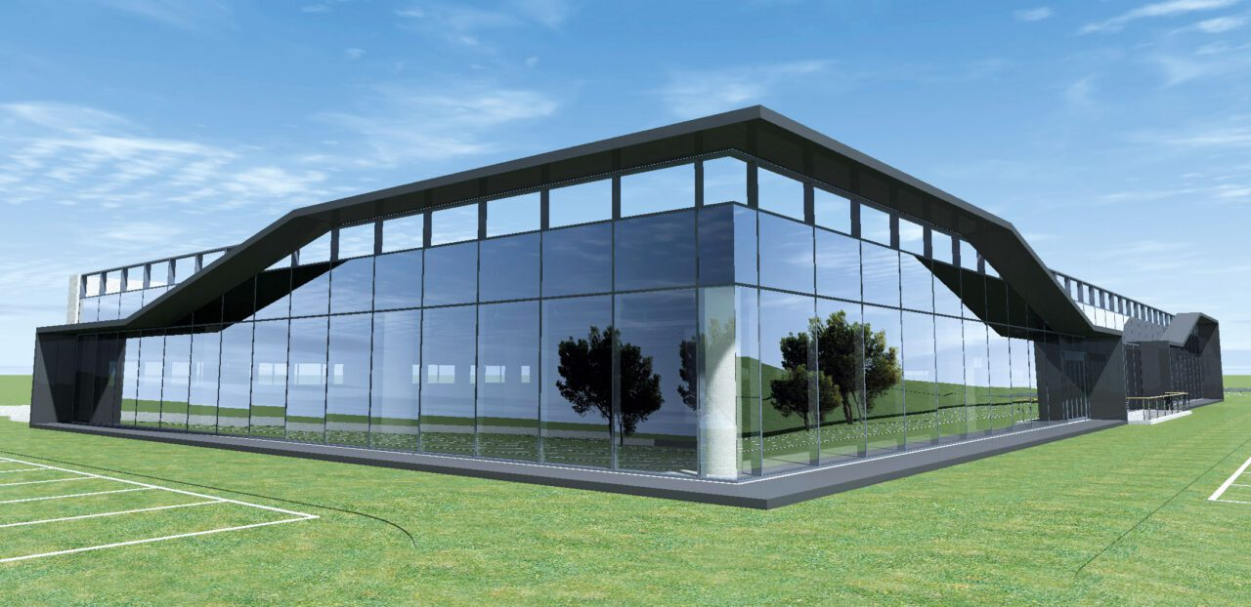
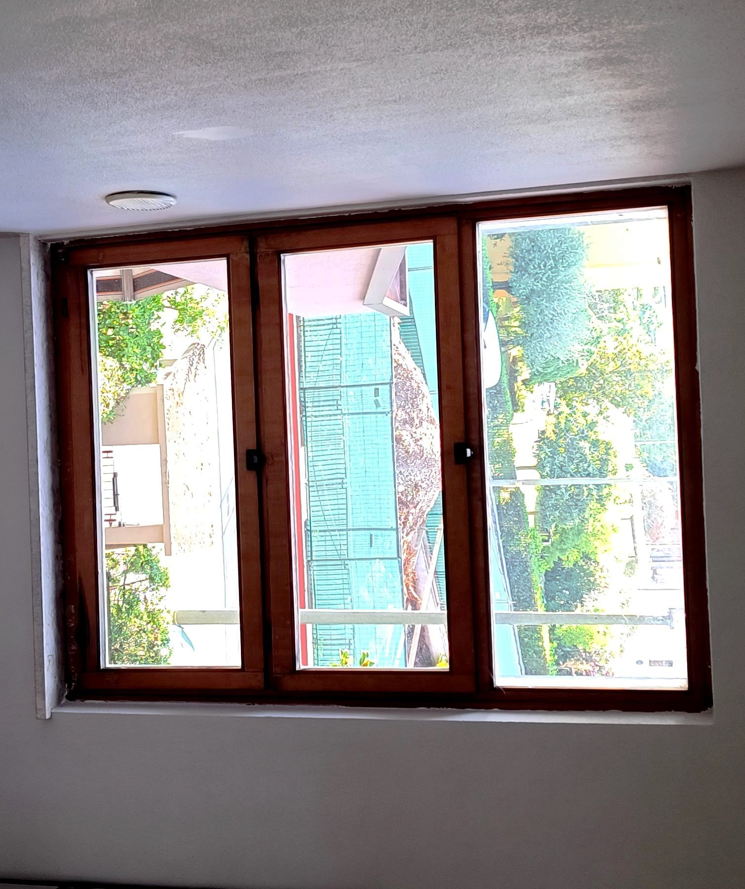
FEATURED PROJECTS
Precision Engineering in Action
Iconic Commercial Complex — Curtain Wall Production
S. Pietro Residential — Window & Door Installation
Verona, Italy · 2023 · Facades & Curtain Walls
San Pietro, Verona, Italy · 2023 · Windows & Doors
ARTSER handled the full production and fabrication of aluminium and glass curtain wall systems for this landmark commercial complex, in collaboration with ART FER SRL. The project involved manufacturing precision-engineered aluminium frames, structur…
Complete production and installation of premium aluminium window and door systems for a residential building in San Pietro, Verona. ARTSER manufactured and fitted casement windows, tilt-and-turn units, and entrance doors with wood-effect aluminium fi…

Slide 7




OUR SUPPLIERS
Premium European Material Partners
AluK
Paesani Group
Reynaers Aluminium
Eko-Okna
Effezeta (FZ)
Italy · Aluminium Systems
Italy · Aluminium Systems
Belgium · Aluminium Systems
Poland · PVC Systems
Italy · Roller Shutters & Mosquito Nets
Windows, Doors, Facades, Sliding Systems
Hinged Windows, Hinged Doors, Sliding Systems, Continuous Facades
Windows, Doors, Curtain Walls, Sliding Systems
PVC Windows, PVC Doors, Aluminium Windows, Wood Windows
Roller Shutters, Mosquito Nets, Blinds, Sun Protection Systems

Slide 8
CERTIFICATIONS & QUALIFICATIONS
Professional Standards & Safety Compliance
2023
Posa in Opera di Serramenti Esterni
2023
Responsabile Prevenzione e Protezione (RSPP)
2023
Lavori in Quota e DPI di Terza Categoria
O.P.N. Italia Lavoro / CNL
UESE Italia S.p.A. / E.N.Bi.Form.
UESE Italia S.p.A. / A.N.P.I.
Training course for workers involved in the installation of external window and door frames
Training course for Prevention and Protection Service Manager (RSPP) for high-risk employers
Training and practical course for workers performing tasks at height and using Category III PPE
2023
Piattaforme di Lavoro Mobili Elevabili (PLE)
2023
Addetti al Primo Soccorso
2023
Formazione Antincendio Livello 1
UESE Italia S.p.A. / A.N.P.I.
UESE Italia S.p.A. / E.N.Bi.Form.
O.P.N. Italia Lavoro / CNL / O.P.T.
Certification for operating Mobile Elevated Work Platforms (MEWP) with and without stabilizers
First aid training course for designated first aid personnel in Group A companies
Fire safety training course for designated fire prevention personnel — Level 1

Slide 9
MISSION & VISION
Our Guiding Principles
OUR MISSION
OUR VISION
To deliver dependable aluminium and serramenti workmanship through precision, professionalism, and practical field expertise — supporting production, fitting, and installation activities with quality, safety, and technical reliability.
To build lasting trust within the aluminium industry by continuously providing skilled workmanship, professional collaboration, and high standards of execution in every project environment we contribute to.

Slide 10
ART SER
Let's Build Something Exceptional Together
ART SER DI SHEHEZAD TARIQ
Verona, Italy · 26+ Years of Industry Excellence
www.artser.it

