Slide 1
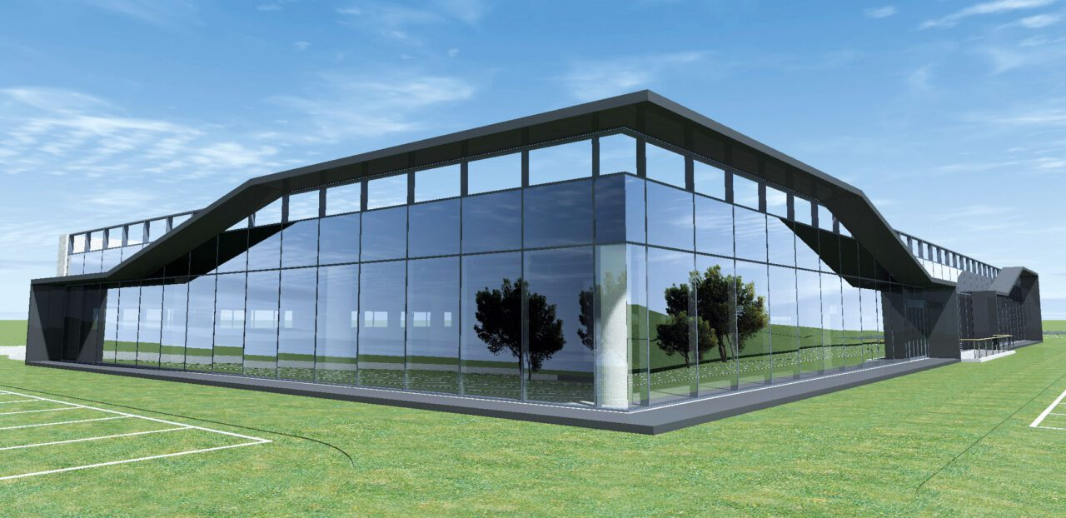

COMPANY PORTFOLIO
Aluminium Window & Door Solutions
Engineering Excellence, Delivered.
ART SER DI SHEHEZAD TARIQ
Verona, Italy - 26+ years of experience

Slide 2
ABOUT US
Company Profile
For over 26 years, ART SER has transformed aluminium and PVC into premium solutions for residential and industrial construction.
We are a team of professionals specialising in the production, installation and technical execution of windows, doors, roller shutters, insect screens and complex structural systems. Our strength comes from hands-on field experience: we combine craftsmanship precision with the most advanced technologies to ensure thermal and acoustic insulation and maximum safety.
We don't just sell windows and doors — we create the perfect union of aesthetics, functionality and energy efficiency, guiding every project from technical design to final installation.
26+
2015
Years in the field
Independent since
5
6
European partners
Professional certifications
The focus is on precision, reliability and solutions that meet strict technical and site requirements — based in Verona and operating independently since 2015.
ART SER - Company Portfolio
02

Slide 3
EXPERIENCE
Our Journey
2001
2015
Today
The Beginnings
Independent Practice
ART SER DI SHEHEZAD TARIQ
Window & Door Fitter / Installer |
Entered the aluminium window and door industry with Dal Bosco Serramenti srl, gaining a thorough understanding of the entire product cycle.
Production & Assembly: Cutting, machining and assembly of aluminium profiles for window and door frames and facades.
Installation: On-site fitting and final assembly of windows and doors for residential and industrial clients, ensuring precision and thermal-acoustic insulation.
After obtaining a VAT registration, began independent operations serving commercial and industrial applications.
Based in Verona, specialising in the production, supply and installation of aluminium and PVC windows and doors, roller shutters and insect screens. The company directly manages every phase of on-site work, combining technical fabrication with professional installation to ensure maximum insulation, energy savings and tailored solutions for every client.
With over 26 years of field experience — built on passion, reliability, precision and technical expertise.
ART SER - Company Portfolio
03

Slide 4
SERVICES
What We Do
01
Aluminium Windows & Doors
02
PVC Windows & Doors
03
Installation & Assembly
Production, cutting, assembly and quality-controlled finishing.
Supply and installation — efficient, cost-effective systems.
On-site fitting with certified safety practices.
04
Structural Facades & Curtain Walls
05
Sliding & Folding Systems
06
Sun Protection, Insect Screens & Roller Shutters
Structural glazing for commercial buildings.
Seamless indoor-outdoor transitions.
Roller shutters, insect screens, blinds and screening.
ART SER - Company Portfolio
04

Slide 5
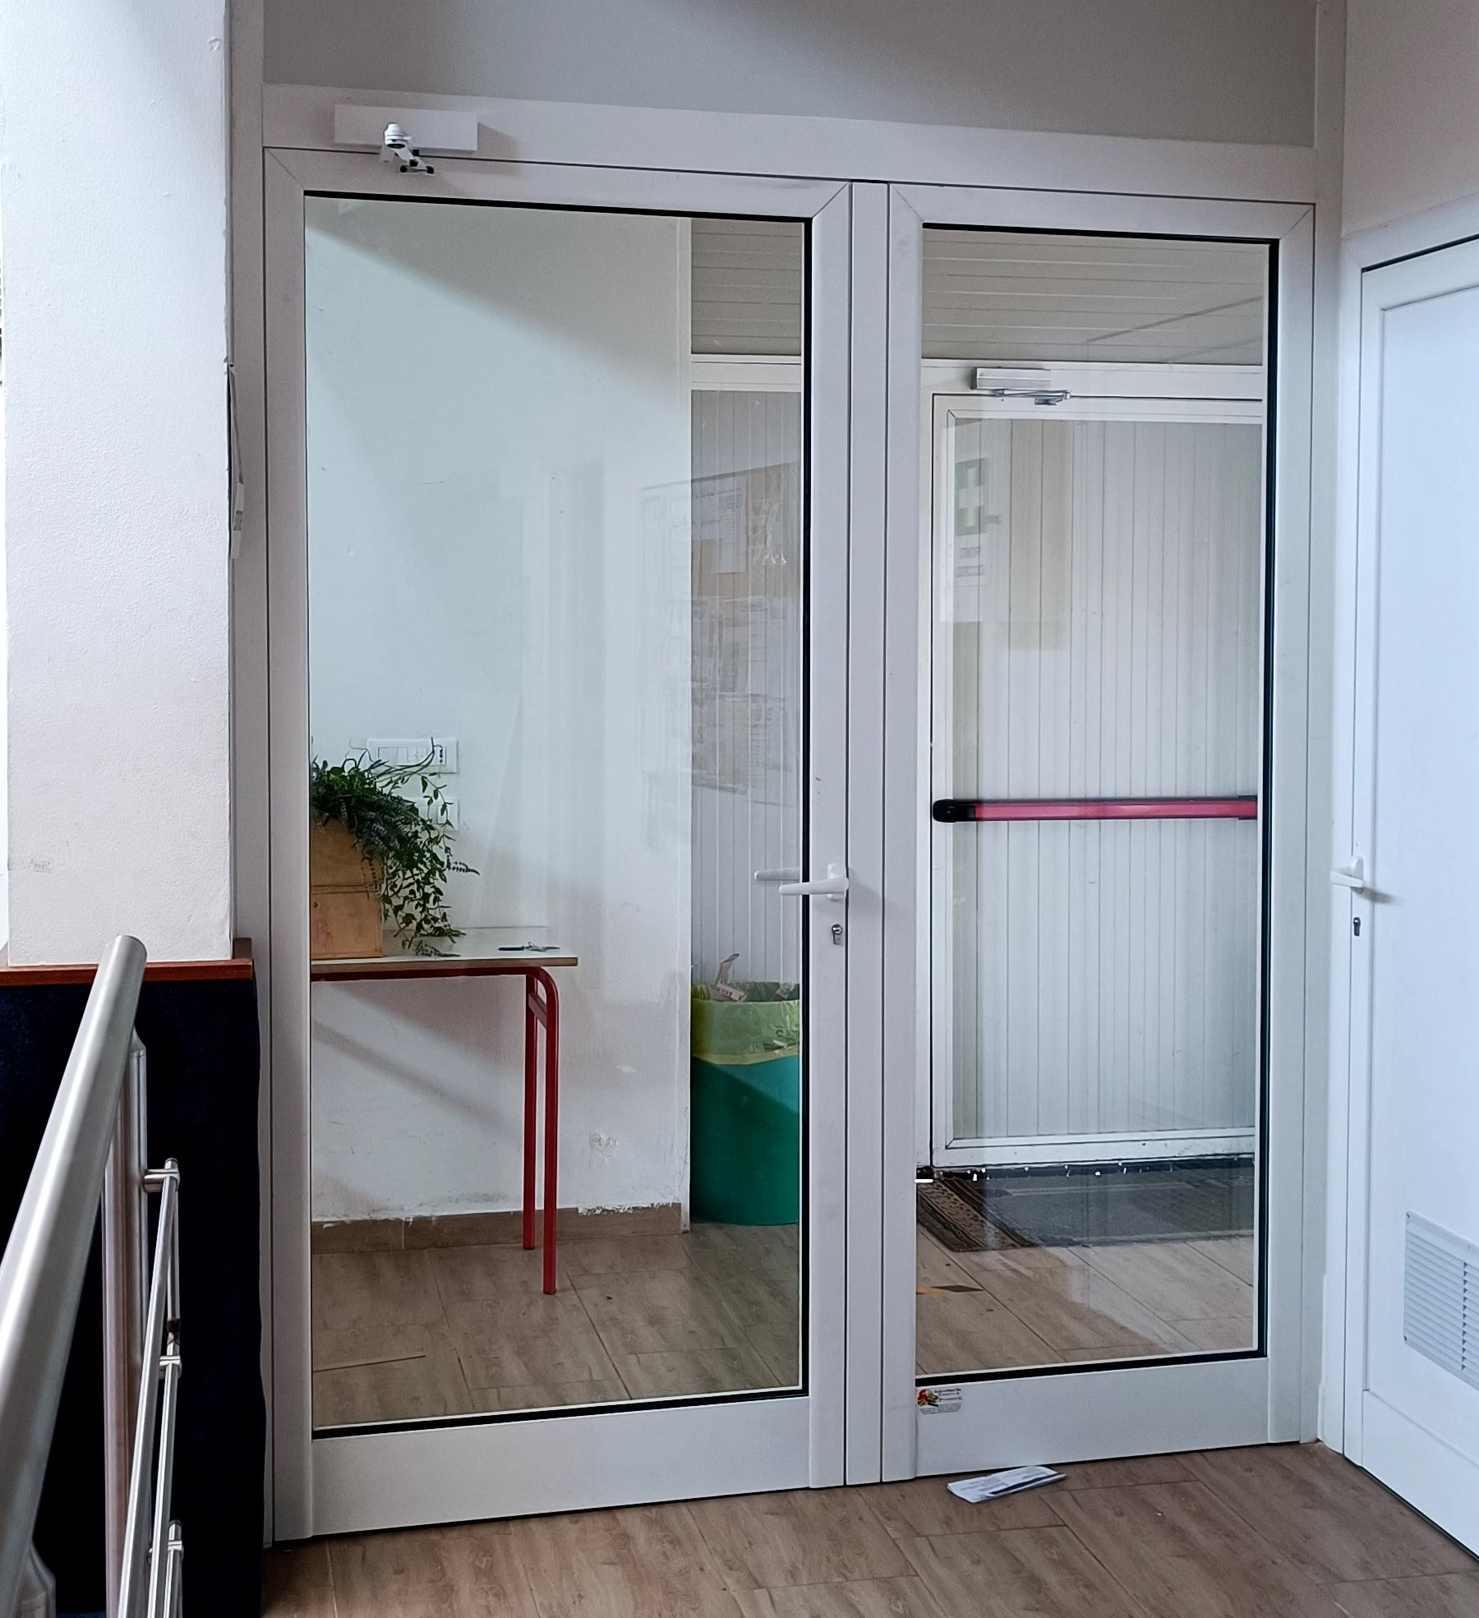
EXPERTISE
Expertise & Craftsmanship
Excellence in production: We manufacture durable, certified aluminium and PVC window and door frames.
Supply and installation of PVC windows and doors, roller shutters and insect screens.
Industrial and residential solutions: From home windows and doors to large structural facades.
Technical execution: We manage complex projects with the utmost engineering precision.
Skilled installation: Workmanlike installation for maximum thermal insulation.
QUALIFICATIONS
Window & door installation - Work at height (Cat. III PPE) - MEWP operation - First aid - Fire safety
ART SER - Company Portfolio
05

Slide 6
FEATURED PROJECT
Iconic Commercial Complex
Facades & Curtain Walls
Verona, Italy - 2022
Complete production and fabrication of aluminium and glass curtain wall systems for a major commercial complex, in collaboration with ART FER SRL. Precision aluminium frames, structural glazing and connection elements — produced through CNC cutting, certified welding and quality-controlled finishing, engineered to withstand seismic loads while reducing the load on the structure.
06

Slide 7
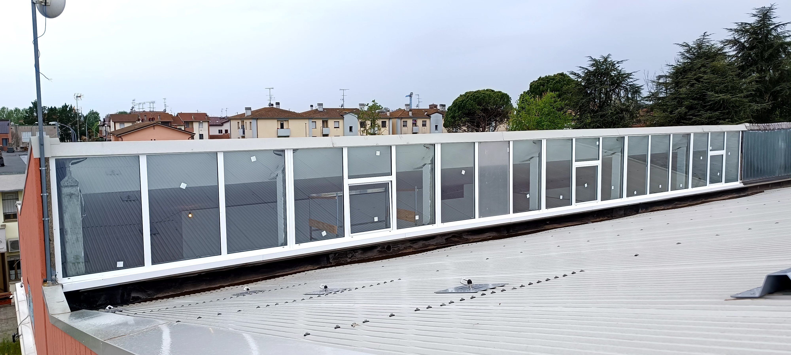
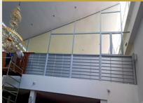
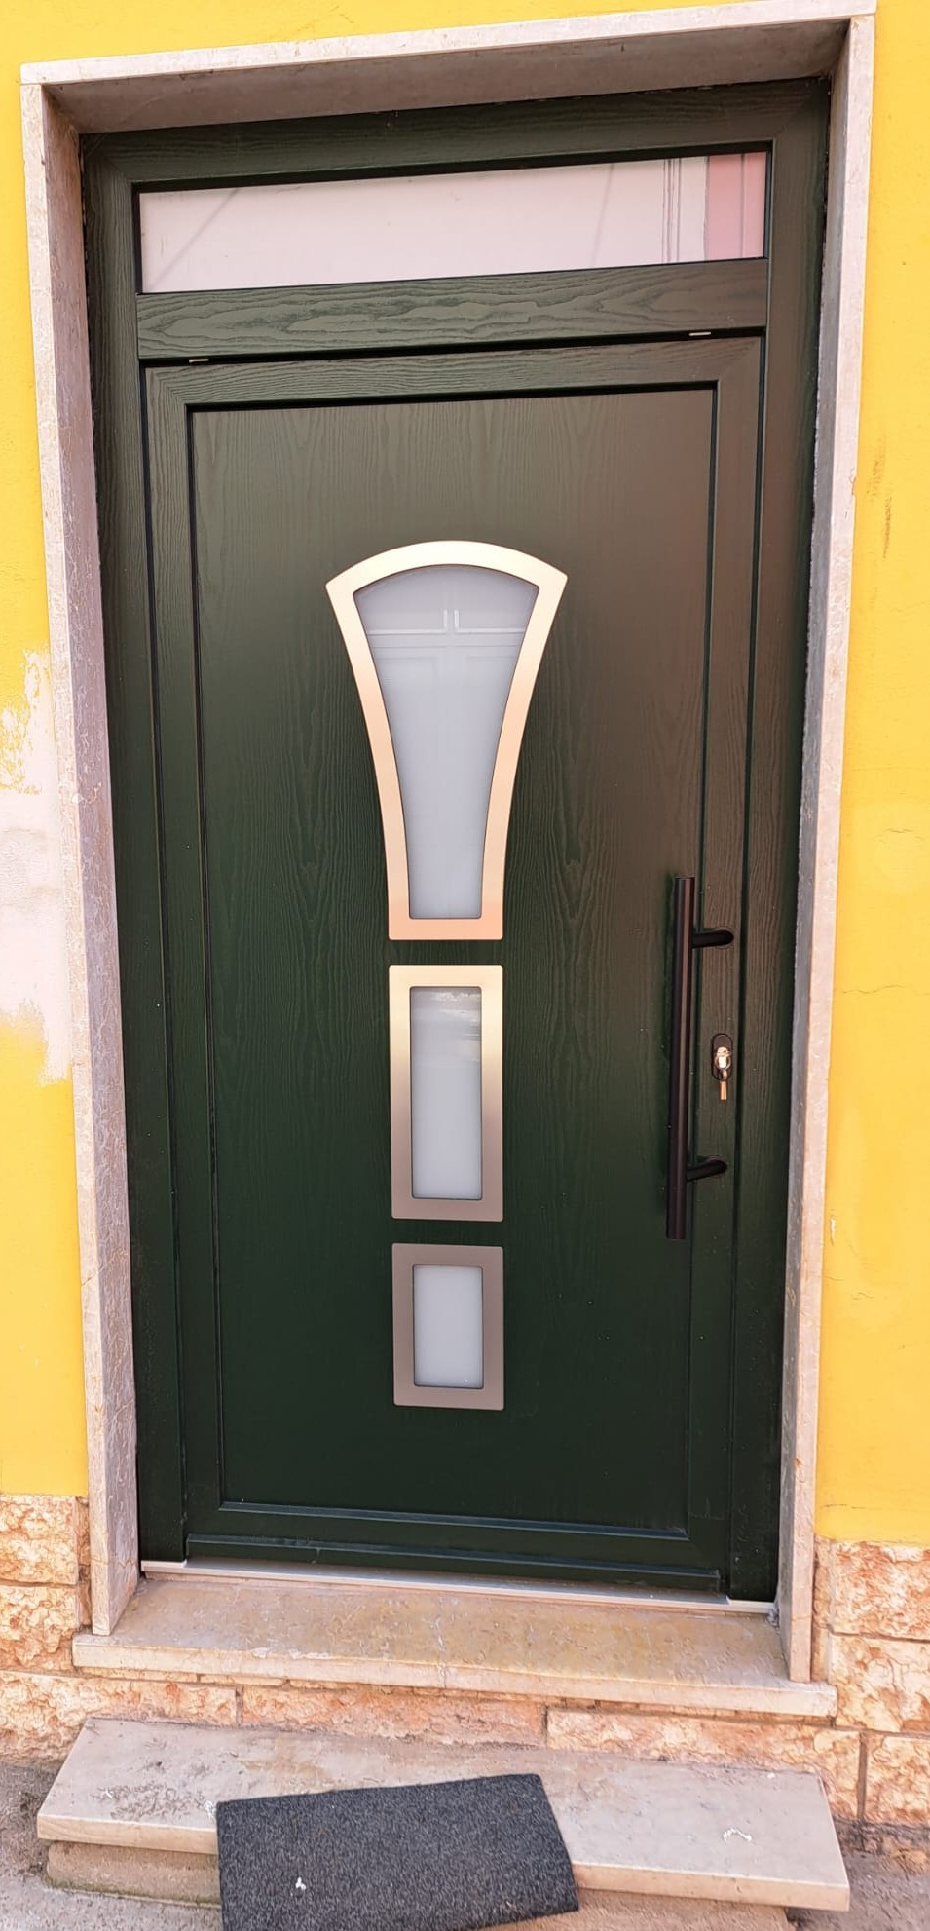
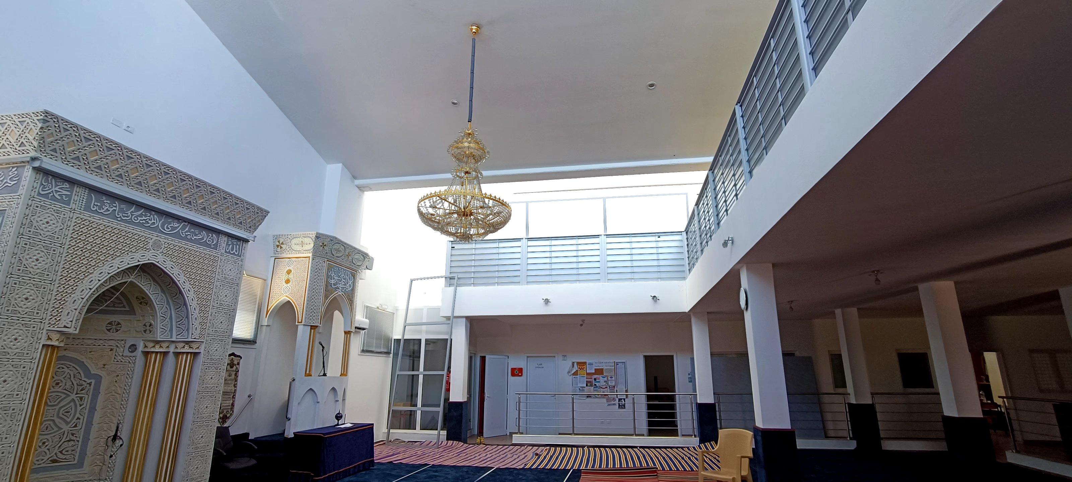
FEATURED PROJECT
S. Pietro Residential
Windows & Doors - San Pietro, Verona - 2023
Art.Ser di Shehzad Tariq completed the production and installation of high-end aluminium windows and doors for a residential building, combining modern performance with classic style.
The Tailored Solution
Casement and hopper windows: maximum natural light and controlled ventilation.
Premium entrance doors: advanced security and refined design.
RAL and wood-effect finishes: traditional aesthetic warmth in harmony with the neighbourhood.
The Technical Benefits
Thermal insulation: lower consumption and reduced energy bills.
Acoustic comfort: complete protection from external noise.
Maximum durability: premium aluminium lasts over time and eliminates maintenance.
ART SER - Company Portfolio
07

Slide 8

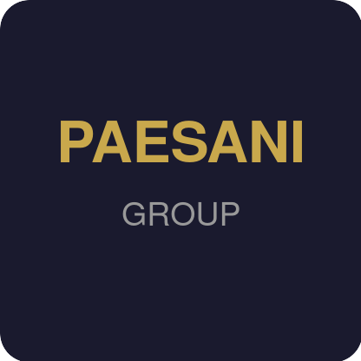
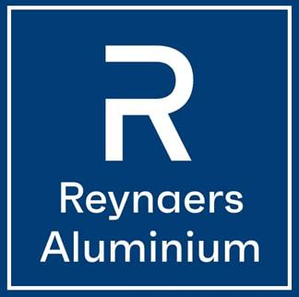


PREMIUM SYSTEMS
Built With Europe’s Best
AluK
Paesani Group
Reynaers
Eko-Okna
Effezeta (FZ)
ITALY
ITALY
BELGIUM
POLAND
ITALY
Aluminium systems - 70+ years
Aluminium - 100% Made in Italy
European leader - curtain walls
PVC & aluminium - 40+ markets
Roller shutters - insect screens - sun protection
ART SER - Company Portfolio
08

Slide 9
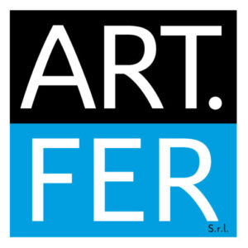



COLLABORATIONS
Trusted Collaborations
Over more than 26 years, ART SER has collaborated with established Italian aluminium companies - contributing to production, assembly, installation and projects on a residential and industrial scale, according to the technical specifications of each project.
ART FER SRL
CORRADINI SRL
MASSIGNANI & C.
SOAVE SERRAMENTI
MANUFACTURING
CONSTRUCTION
MANUFACTURING
WINDOWS & DOORS
ART SER - Company Portfolio
09

Slide 10
COMPLIANCE
Certifications & Safety
External Window & Door Installation
Prevention & Protection Officer (RSPP)
Work at Height & Cat. III PPE
01
02
03
O.P.N. Italia Lavoro / CNL
UESE Italia / E.N.Bi.Form.
UESE Italia / A.N.P.I.
Aerial Platform Operation (PLE)
First Aid
Fire Safety - Level 1
04
05
06
UESE Italia / A.N.P.I.
UESE Italia / E.N.Bi.Form.
O.P.N. Italia Lavoro / CNL
All certifications issued in 2023 - Italy
ART SER - Company Portfolio
10

Slide 11
WHY ART SER
Mission & Vision
Mission
Vision
We deliver dependable aluminium window and door solutions through craftsmanship precision and field expertise. We support every phase of production, assembly and installation while upholding the highest standards of quality, safety and technical reliability — ensuring living comfort, energy savings and the peace of mind of a turnkey project.
To become the definitive benchmark in the aluminium window and door industry, anticipating the evolution of modern architecture through advanced technologies, attention to detail and solutions that improve people’s lives.
Precision
Reliability
Safety
Technical Expertise
ART SER - Company Portfolio
11

Slide 12
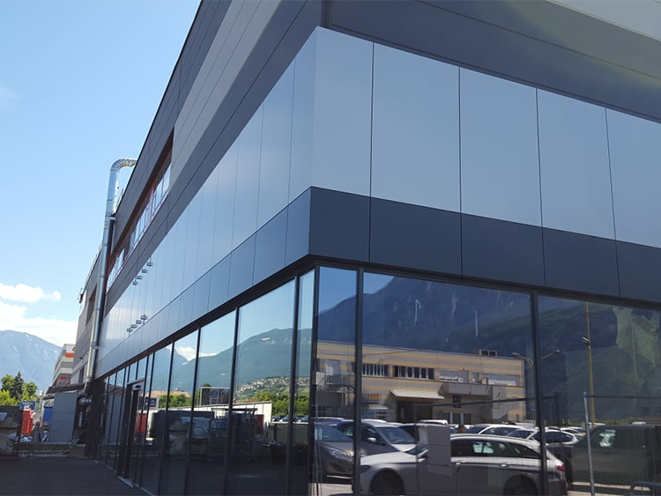
Let’s Build Together
Engineering Excellence, Delivered.
EMAIL
art_ser@outlook.it
PHONE
+39 0348 240 2248
PEC
khaan@pec.buffetti.it
REGISTERED OFFICE
Via XX Settembre 86, 37036 San Martino Buon Albergo (VR), Italy
ART SER - Company Portfolio
12

