Slide 1

COVIDgilance Tracker Paul Kazalski, Flomo Kokro, Will Giordano, Maria-Elena Gorini, Meghna Agnish

Slide 2
Our Objective
We want to see if we can use machine learning algorithms in order to predict the peak and fall of COVID cases and deaths by United States counties.
Tools:
Jupyter Notebook
Scrapy
TensorFlow
One ML program
TWO ML program
THREE ML program ha, ha, ha

Slide 3

Machine Learning: the Perfect Recipe
Producing a Machine Learning model is like developing the perfect meal
Good data = good ingredients
Pay for Premium or short-order?
Algorithms = source of heat
Expertly cooked steak or sushi?
So what makes or breaks the perfect recipe?

Slide 4

The Preparation
Fresh and from the finest sources:
Census
Cut everything uniformly:
Good data has come by state, county, and zip code.
We chose county (~ 3,000 data points)
Mix well:
Some information is dependent on each other (e.g. population vs. population density)
Choose data sets that are completely independent of one another.

Slide 5
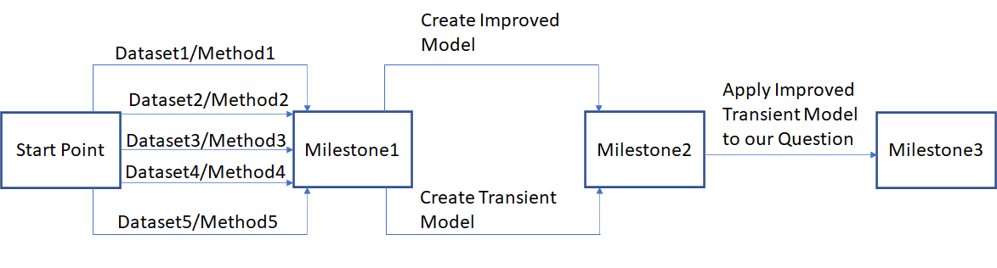
The Process

Slide 6
Brainstorm: What Data Do We Need?
Numbers surrounding COVID-19
Total Cases
Deaths
Risk factors for contracting COVID-19 by county
Age
Elderly
Gender
Male
Health
Comorbidities - Diabetes, Lung Disease, Cancer, Immunodeficiency, Heart Disease, Hypertension, Asthma, Kidney Disease, GI / Liver Disease
Access and Quality of Healthcare
Nursing homes and long-term care facility
Location
Population Density
Mass Transit Usage
Social Distancing
When implemented and how stringently followed

Slide 7
Data Found
Numbers surrounding COVID-19
Total Cases New York Times GitHub
Deaths New York Times GitHub
Risk factors for contracting COVID-19 by county
Age 2018 Census Data
Elderly
Gender 2018 Census Data
Male
Health County Health Rankings and Road Maps: A Robert Wood Johnson Foundation Company
Comorbidities - Diabetes, Lung Disease, Cancer, Immunodeficiency, Heart Disease, Hypertension, Asthma, Kidney Disease, GI / Liver Disease
Access and Quality of Healthcare
Nursing homes and long-term care facility
Location 2018 Census Data, American Public Transport Association
Population Density
Mass Transit Usage
Social Distancing* Unacast
When implemented and how stringently followed

Slide 8
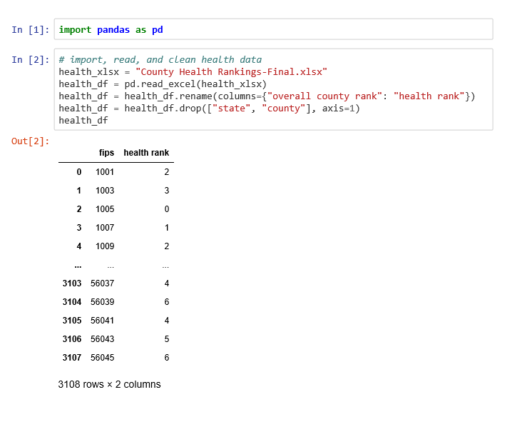
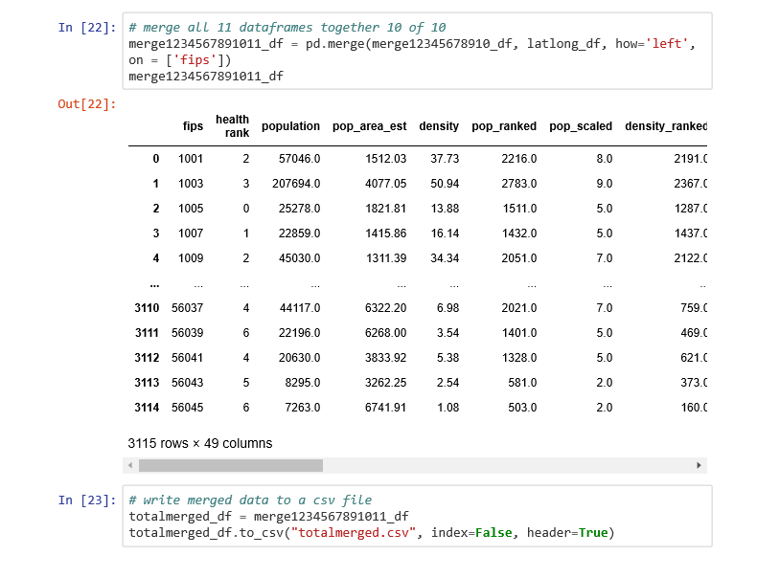
Cleaning Data
Cleaning the data was accomplished in Excel and Jupyter Notebook with pandas

Slide 9

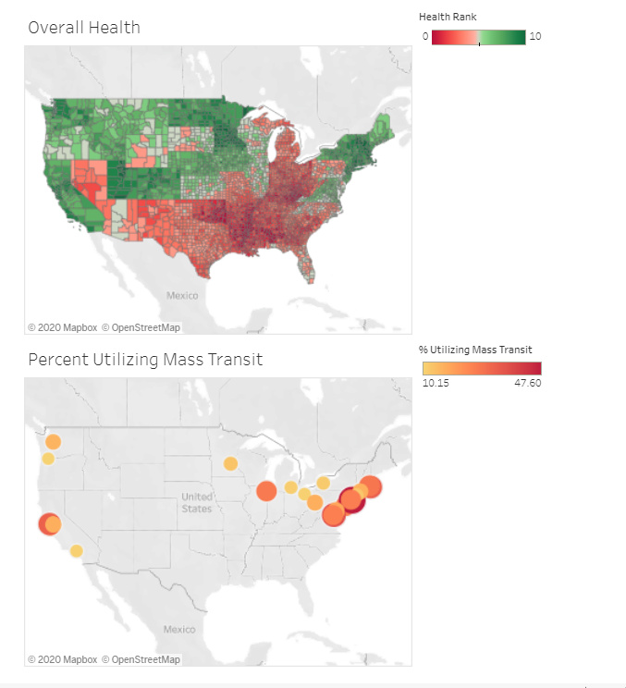
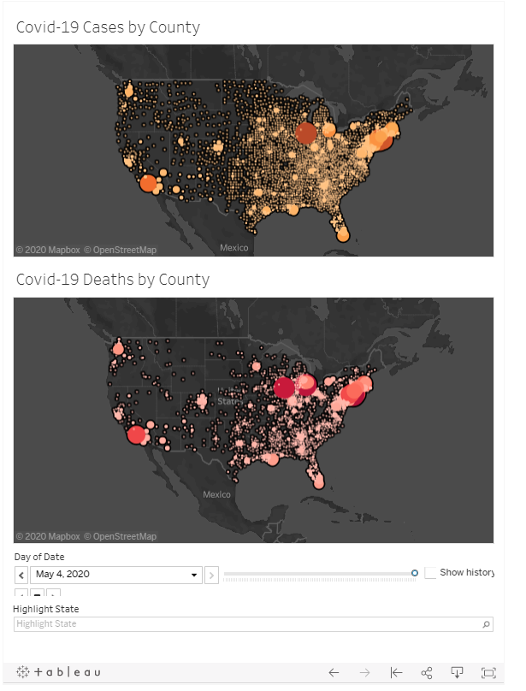
Created Tableau Visuals
Attributes by County
COVID-19 Cases and Deaths Per County by Date

