Slide 1
Secure Execution in Embedded Systems
Custom ISA + Compiler Binding
Final Defense Presentation
Author: Maria Ayub
University Name (replace)
Jan 21, 2026

Slide 2
Problem
Physical access allows firmware replacement
Debug interfaces give full control
Secure boot does not stop post-boot abuse

Slide 3
Goal
Only authorized users can program or debug
Device decides locally (not just the host)
Keys stay protected from normal memory reads

Slide 4
Core Idea
Add a custom instruction: kc
kc triggers a protected key check
A small FSM enables or blocks execution/debug

Slide 5
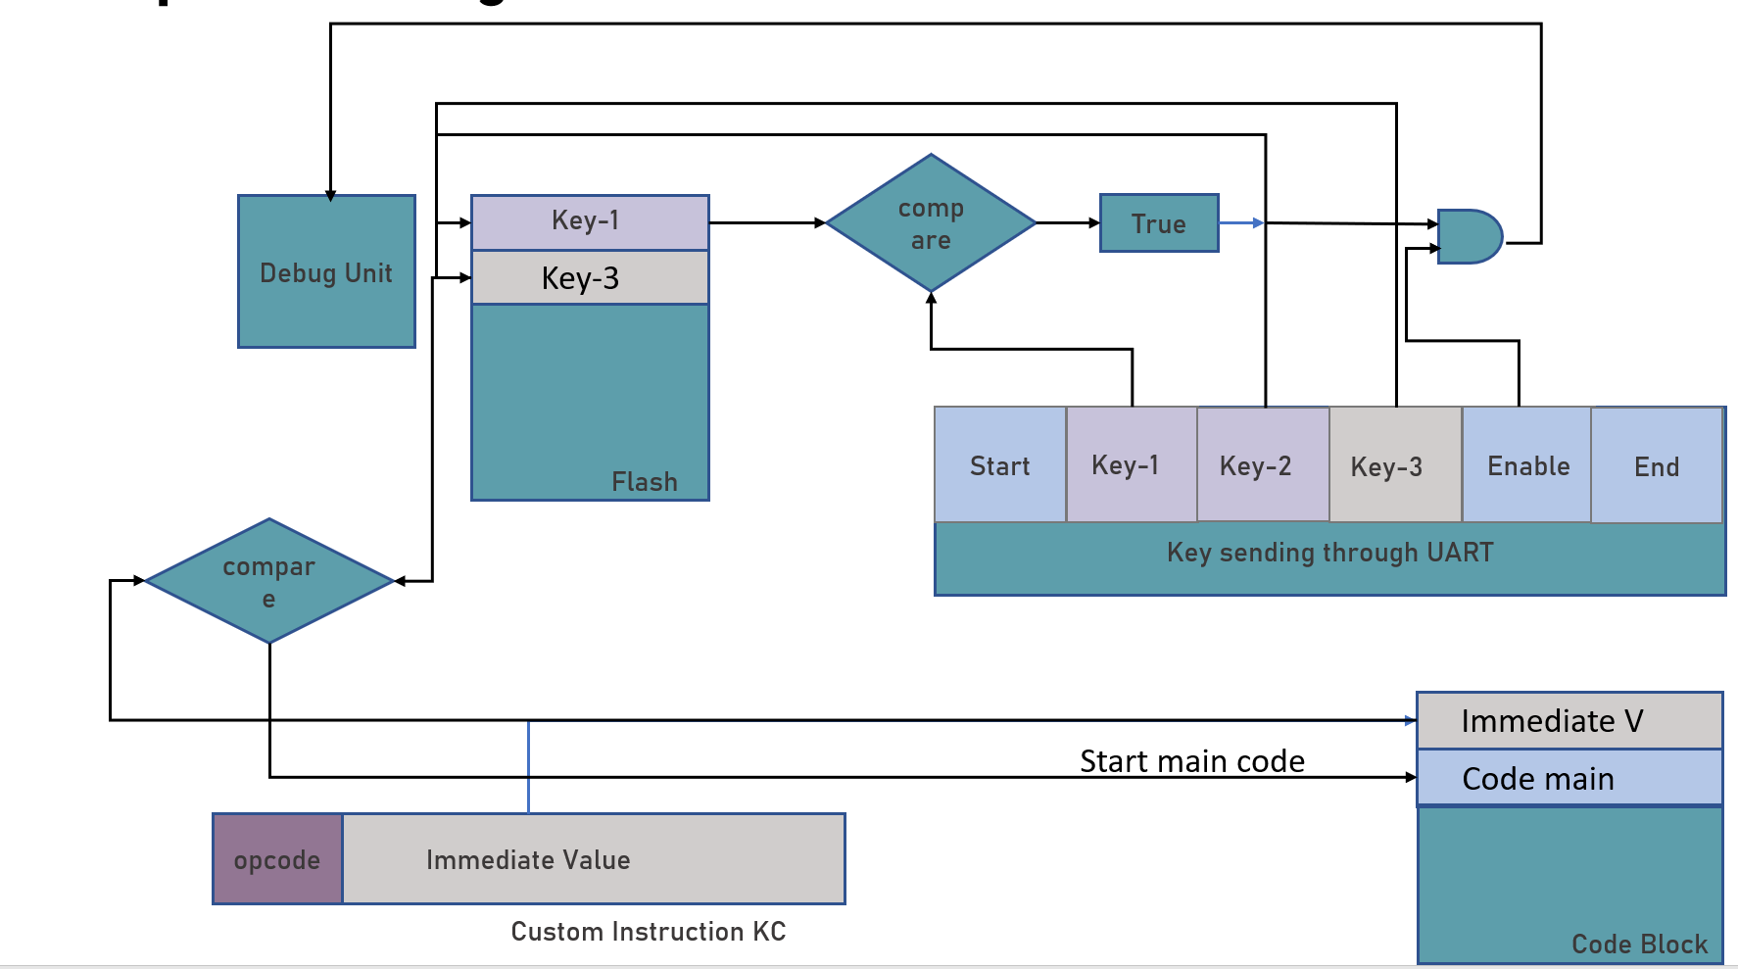
System Architecture

Slide 6
Authorization Steps
1) Start sequence from host
2) Send key parts
3) kc triggers device check
4) Match = enable, mismatch = halt

Slide 7
Toolchain Support
Custom GCC/binutils emit kc
Works with standard build flow
No manual binary patching

Slide 8
Host Workflow
Compile
Hex viewer
Key match
Connect and program
Logs for traceability

Slide 9
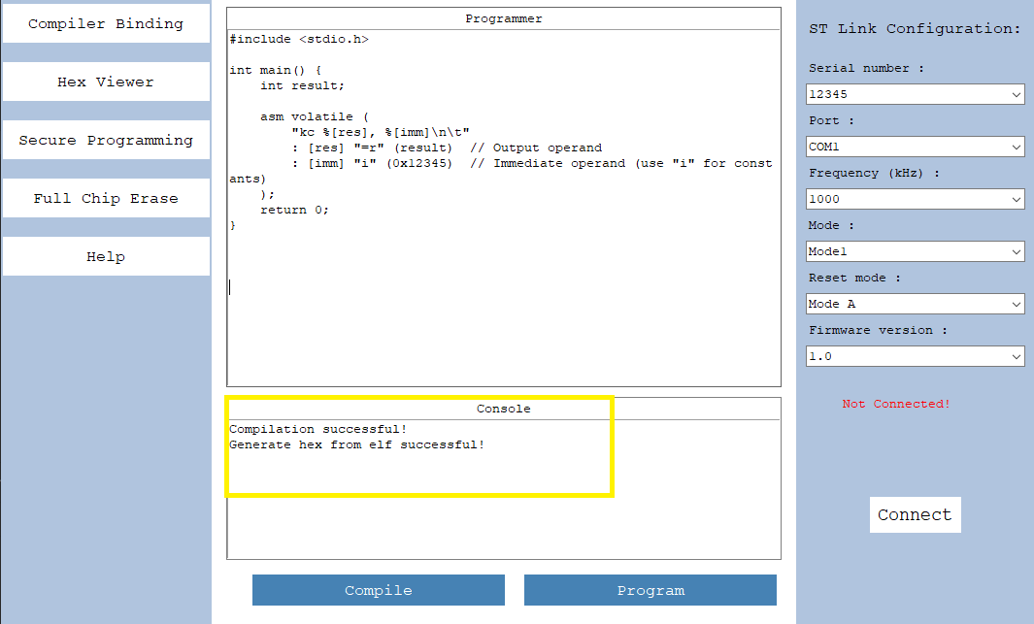
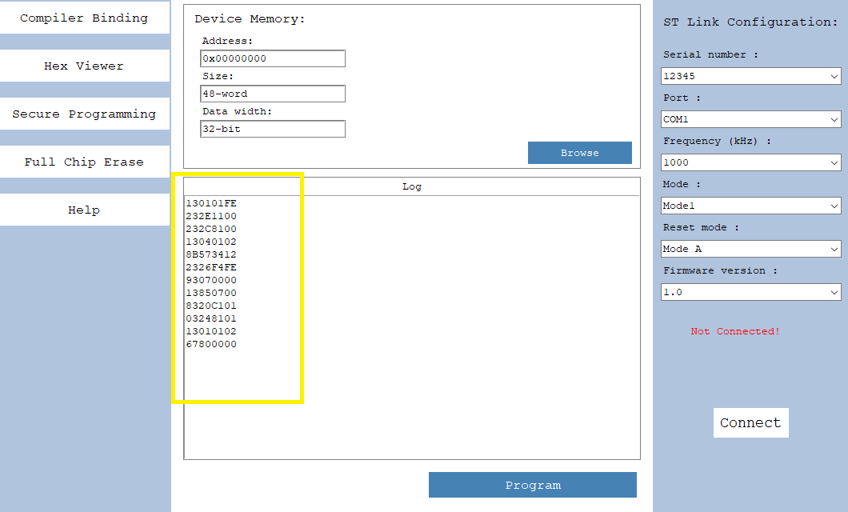
Results: Toolchain and Hex

Slide 10
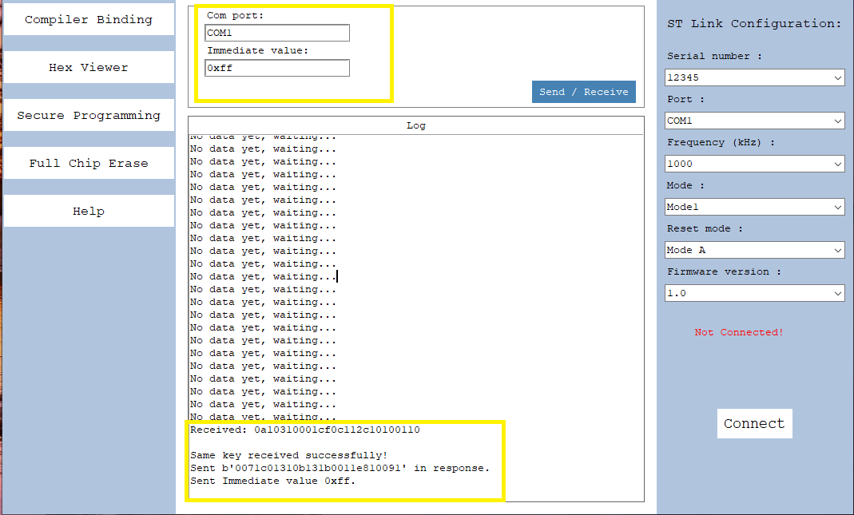
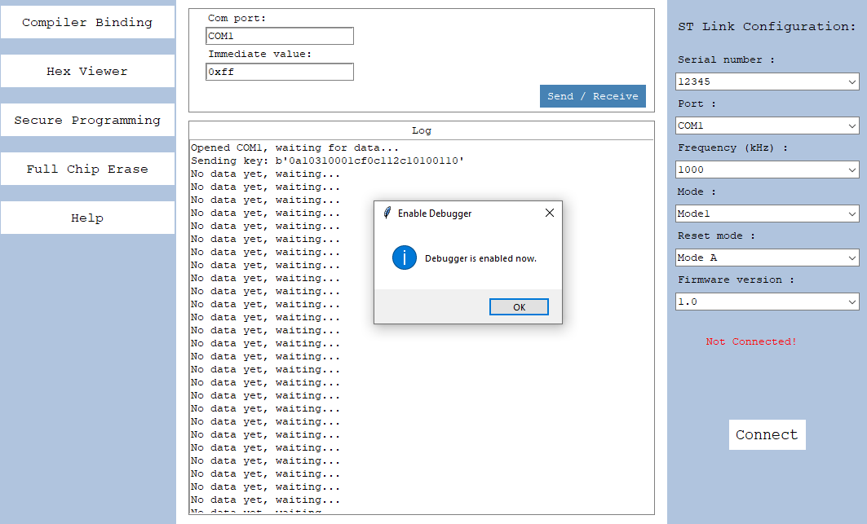
Results: Authorization

Slide 11
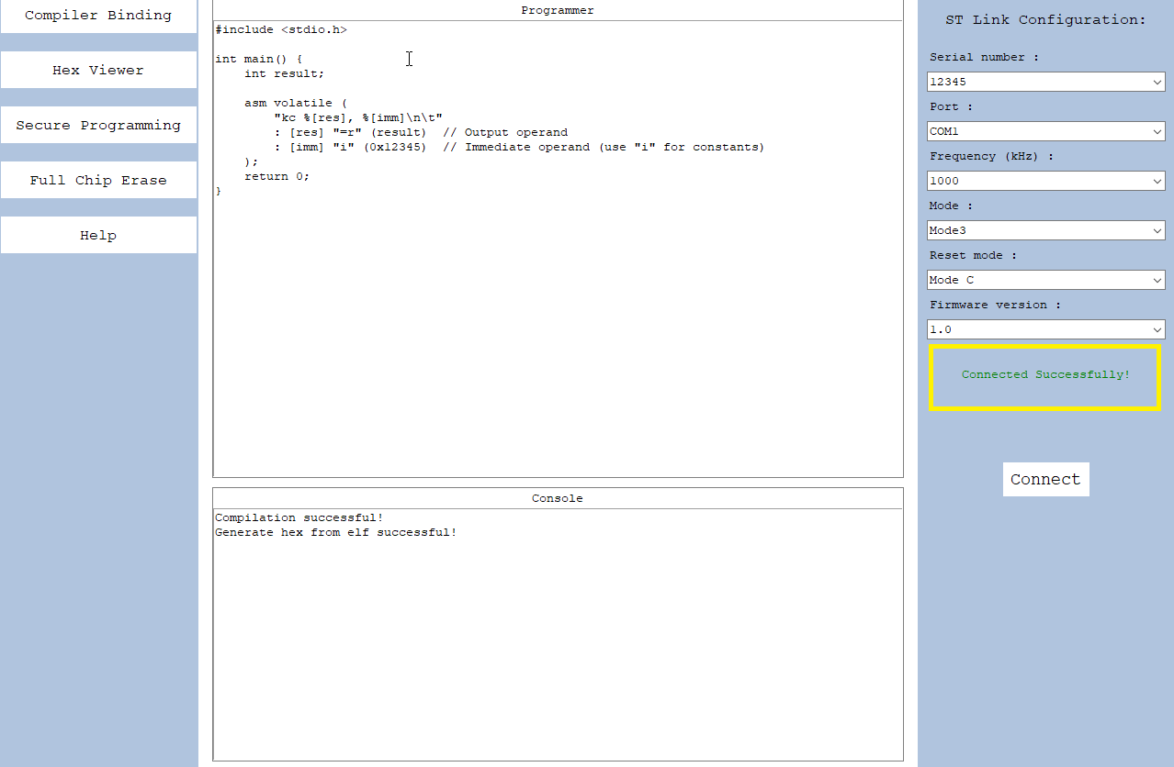
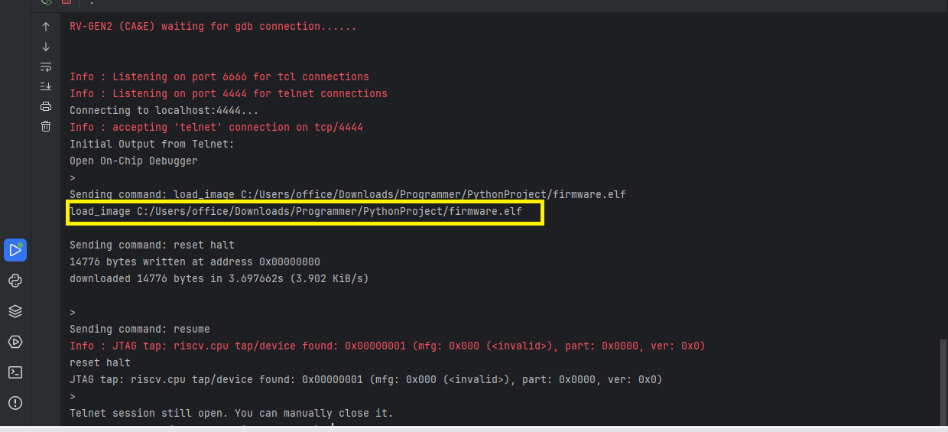
Results: Programming

Slide 12
Conclusion
Instruction-triggered authorization works
Execution and debug stay locked until verified
End-to-end workflow is practical
Questions?

