Slide 1

Device-Local Authorization for Secure Execution and Debug in Embedded Systems
Master's Thesis Defense
[Your Name]
[Supervisor Name]
[Department / University]

Slide 2
Outline
Motivation and problem
Related work
Methodology
Implementation
Experiments and results
Conclusion and future work

Slide 3

Introduction
Embedded systems operate in critical and exposed environments
Physical access enables firmware replacement and invasive debug
Secure boot protects only the initial image
Post-boot authorization must be enforced on-device

Slide 4
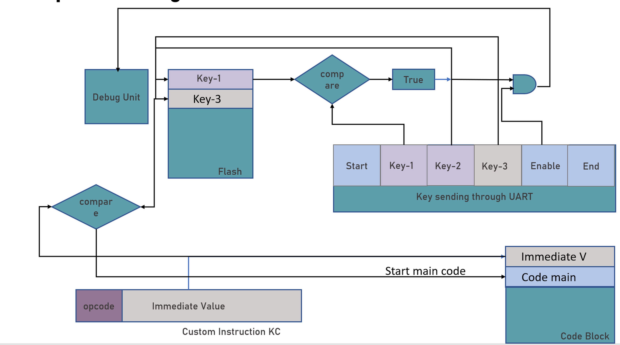

System Overview
Host toolchain and UART authorization sequence
Protected NVM and comparator on-device
FSM gates execution and debug enablement

Slide 5

Problem Statement
Post-boot debug/program access can bypass policy
Key material must not be exposed via normal memory
Host-side controls are insufficient after reflashing

Slide 6
Key Contributions
ISA-level authorization trigger (kc)
Protected key storage with constant-time comparison
FSM gating with fail-stop behavior
Toolchain and host workflow integration

Slide 7
Related Work

Slide 8
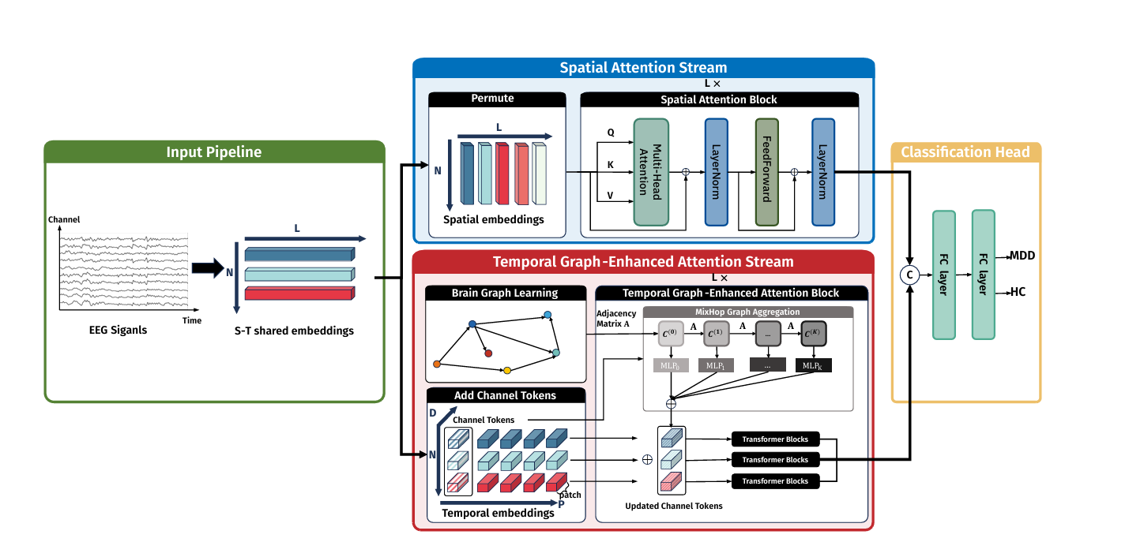
Secure Boot and Boot-Chain Protection
BootROM validates initial firmware image
Boot-chain protection extends integrity across stages
Post-boot authorization still required

Slide 9
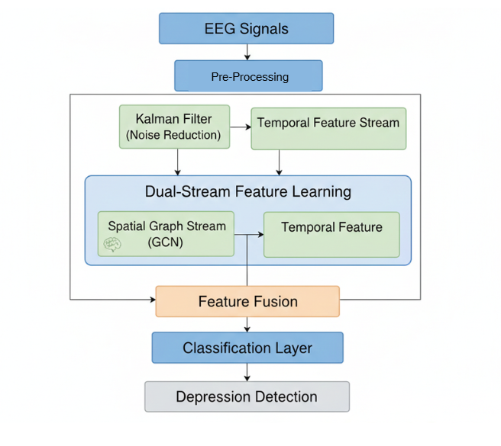
Debug Interface Security
JTAG and test interfaces provide invasive access
Authenticated debug reduces exposure
Need execution-bound authorization on-device

Slide 10
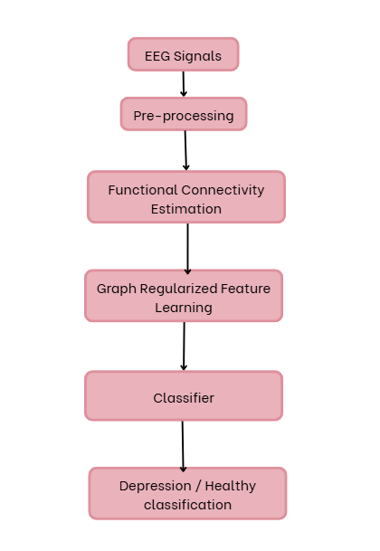
Trusted Execution and Minimal TCB
TEEs and minimal TCB reduce trusted code
Isolation does not automatically gate debug
Authorization complements trusted execution

Slide 11
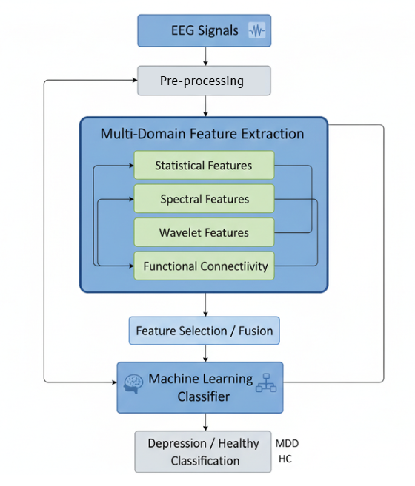
Runtime Attestation and CFI
Attestation provides evidence of runtime integrity
CFI/LO-FAT report control flow correctness
Evidence alone does not prevent debug misuse

Slide 12
Software-Only Hardening
CFI, obfuscation, and ROP defenses add resistance
Software-only methods can be bypassed by reflashing
Hardware enforcement is required for strong control

Slide 13
Toolchain and ISA Extensibility
LLVM enables analysis and instrumentation
RISC-V supports custom instruction extensions
Toolchain emission enables auditability

Slide 14

Research Gap
Post-boot authorization not enforced on-device
Debug gating not tied to execution state
Need ISA-visible trigger with protected key storage

Slide 15
Research Objectives
Define kc and the authorization protocol
Implement protected key storage and FSM gating
Integrate into toolchain and host workflow
Validate end-to-end enforceability

Slide 16
Methodology

Slide 17
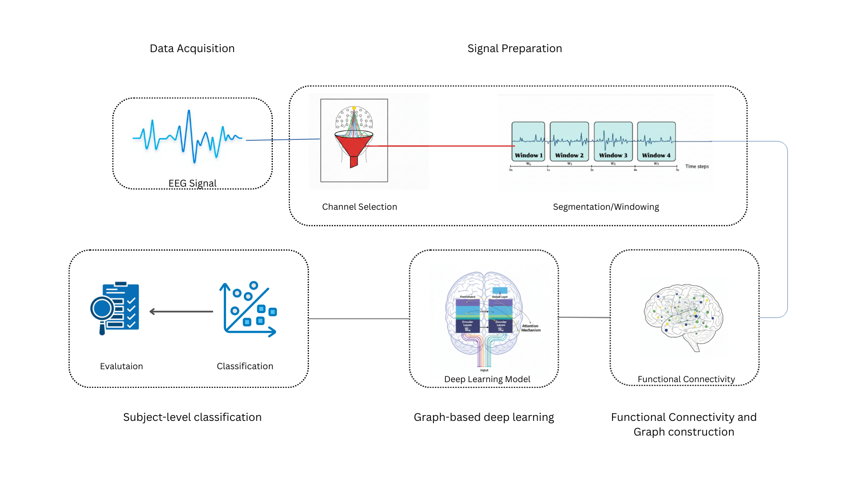
Overall Framework
Host derives key and sends UART sequence
Device verifies key with constant-time comparator
FSM releases execution and debug on match

Slide 18
Key Derivation and Binding
Key derived from host and device identifiers
Nonce provides freshness
Reference stored in protected NVM

Slide 19

Protected Key Storage
Not memory-mapped in normal address space
Accessible only via verification datapath
Comparator exposes only a match bit

Slide 20
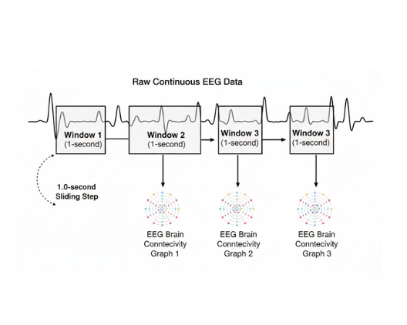
Authorization Sequence (UART)
Start, Key-1, Key-2, Key-3, Enable, End
Strict ordering and delimiter checks
Any mismatch triggers HALT

Slide 21
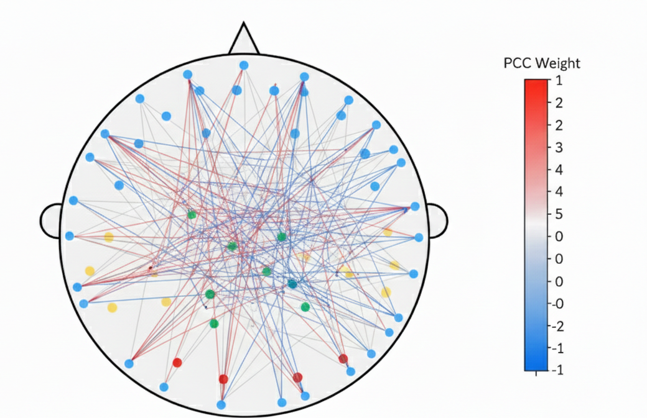
Authenticator FSM and Gating
States: LOCKED, VERIFY, AUTHORIZED, HALT
Reset begins in LOCKED
VERIFY entered on kc_event
match=1 -> AUTHORIZED
match=0 -> HALT
exec_enable/debug_enable only in AUTHORIZED

Slide 22
ISA Extension (kc)
Custom I-type instruction
Triggers verification datapath
Binds authorization to execution point

Slide 23
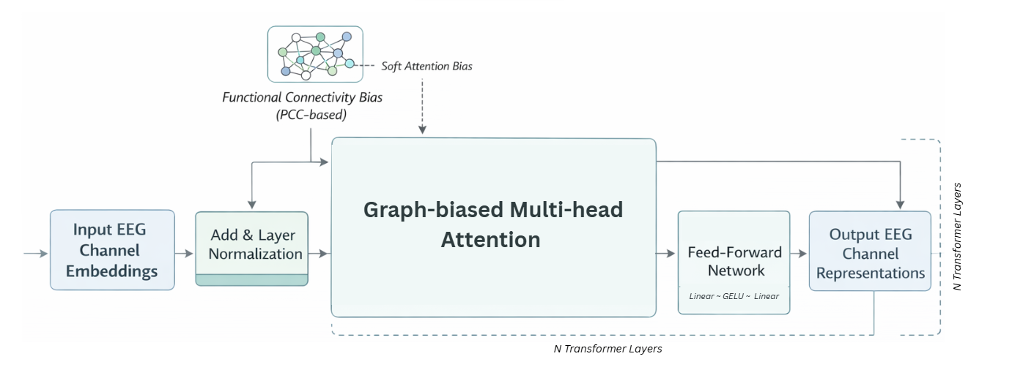
Toolchain Integration
Compiler emits kc from C/assembly
Linker preserves opcode placement
ELF to HEX keeps instruction
Disassembly shows kc for audit

Slide 24
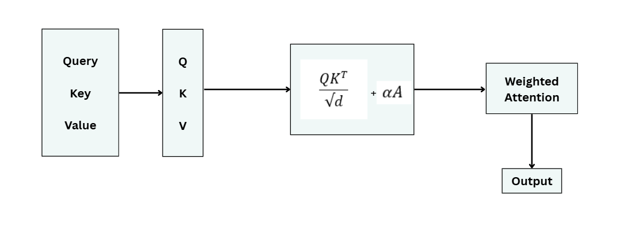
Authorization Dataflow
Provision key in protected NVM
Host sends UART sequence
Comparator validates fragments
FSM releases gates on match

Slide 25
Experiments and Results

Slide 26
Evaluation Protocol
Functional validation over benchmarks
Verify kc preserved in build artifacts
Verify gating and fail-stop behavior

Slide 27
Experimental Setup and Artifacts
Customized toolchain and host application
Device with protected NVM and FSM
Evidence from logs and screenshots

Slide 28
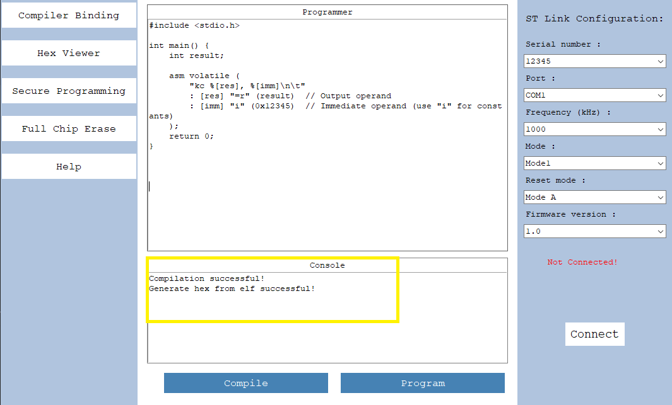
Toolchain Validation

Slide 29
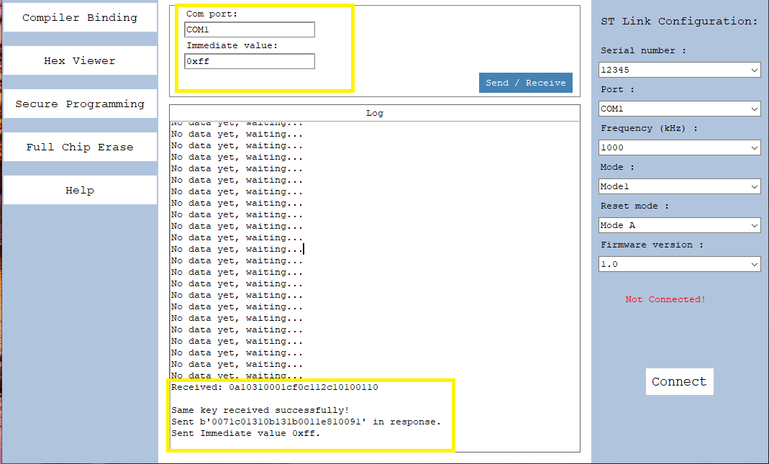
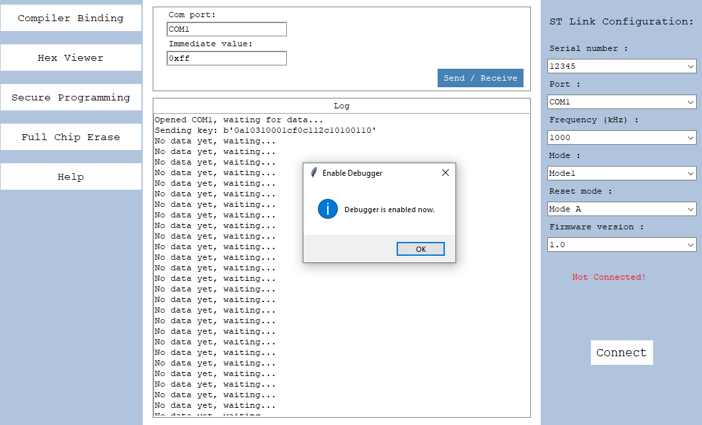
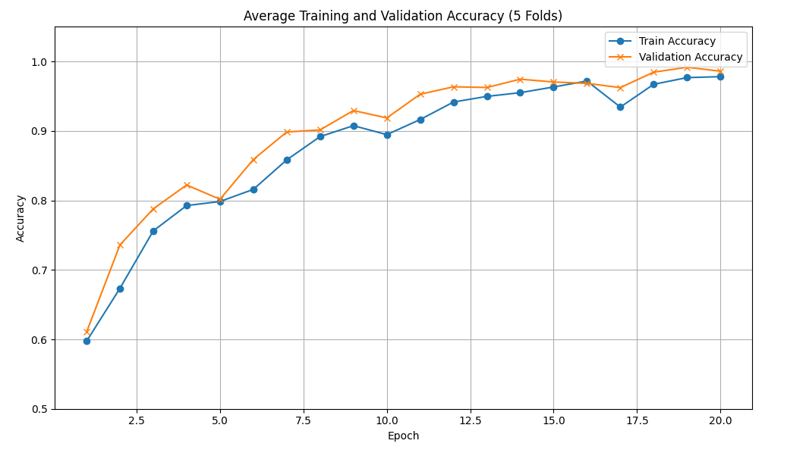
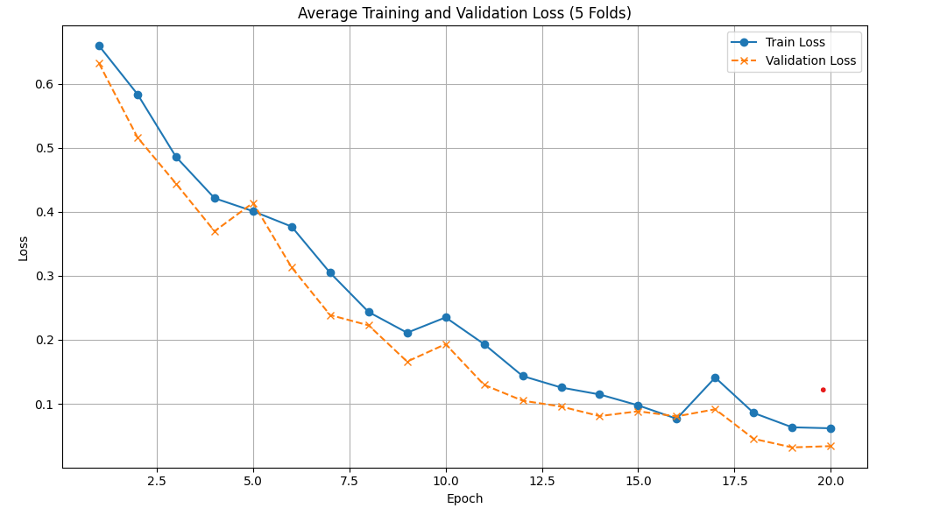
Authorization Evidence

Slide 30
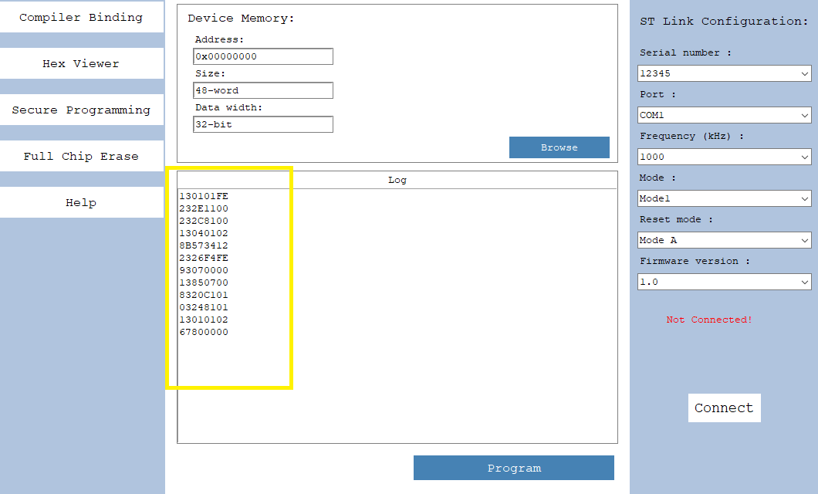
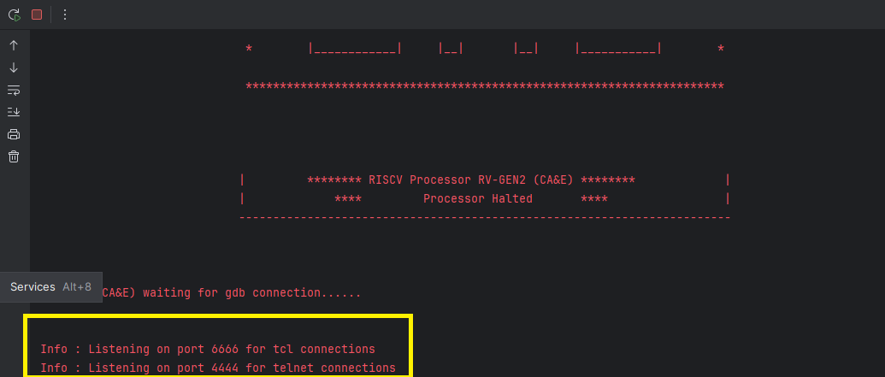
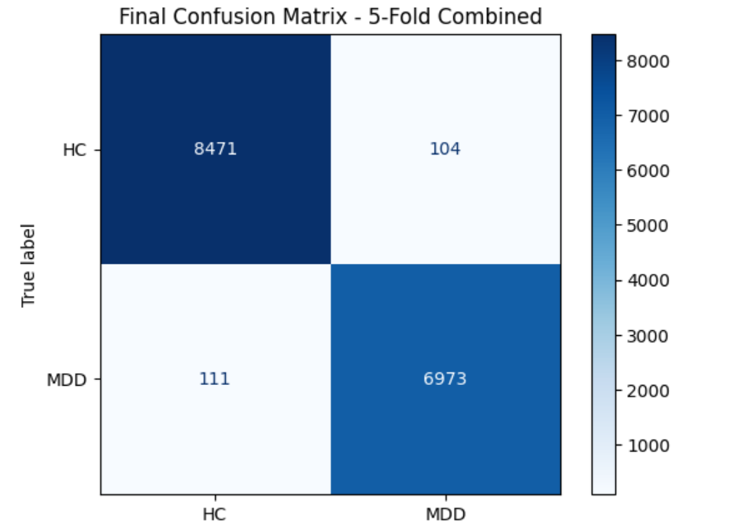
Firmware Inspection and Fail-Stop

Slide 31
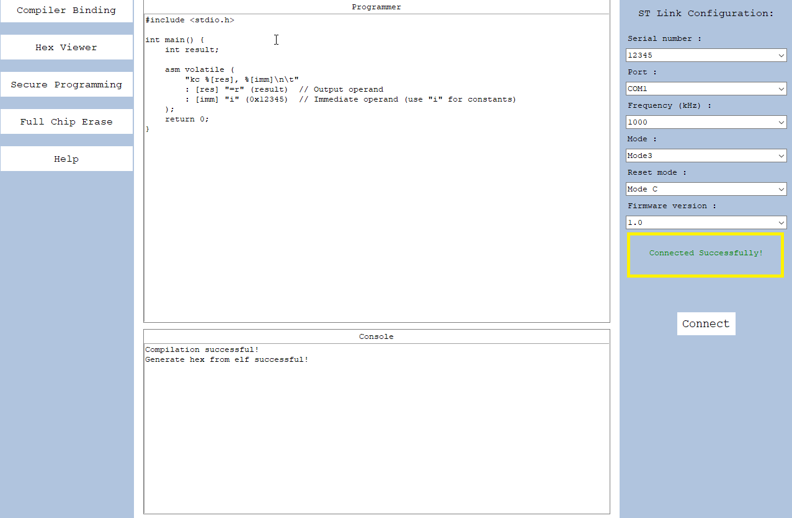
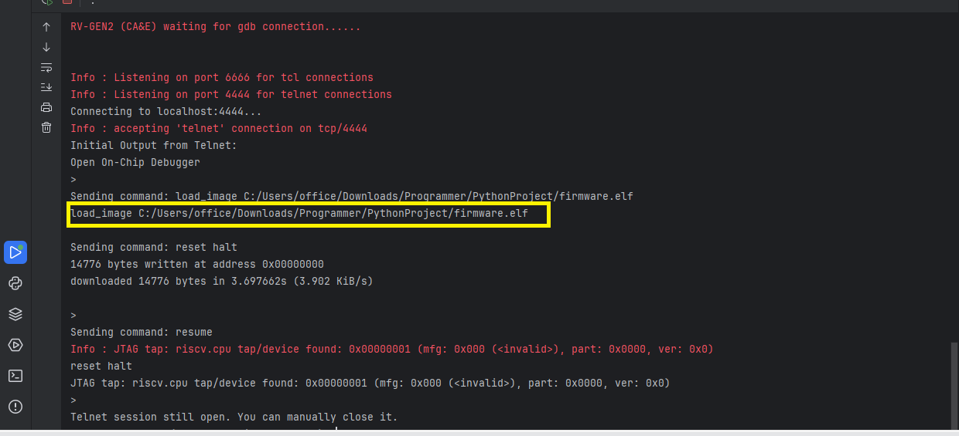
Programming Workflow Evidence

Slide 32
Conclusion

Slide 33
Conclusion
Device-local authorization closes the post-boot gap
Minimal ISA extension and protected storage are practical
Toolchain integration enables auditability

Slide 34

Future Work
Measure area, power, and latency overheads
Key rotation and revocation policies
Fault and side-channel evaluation
Formal verification of FSM and toolchain tests

Slide 35
References
IEEE Std 1149.1 (JTAG)
BootROM secure boot design (Bin et al., 2020)
JTAG authentication IP (Lapeyre et al., 2022)
RISC-V ISA Manual (Waterman et al., 2014)
C-FLAT control-flow attestation (Abera et al., 2016)

Slide 36
Thank you

