Slide 1
Compiler Binding
compare
Debug Unit
Flash
True
Key-1
Key-3
Start
Enable
Key sending through UART
End
Key-1
Key-2
Key-3
compare
Immediate V
Code Block
Immediate Value
Start main code
Code main
Code main
Immediate Value
opcode
Custom Instruction KC

Slide 2
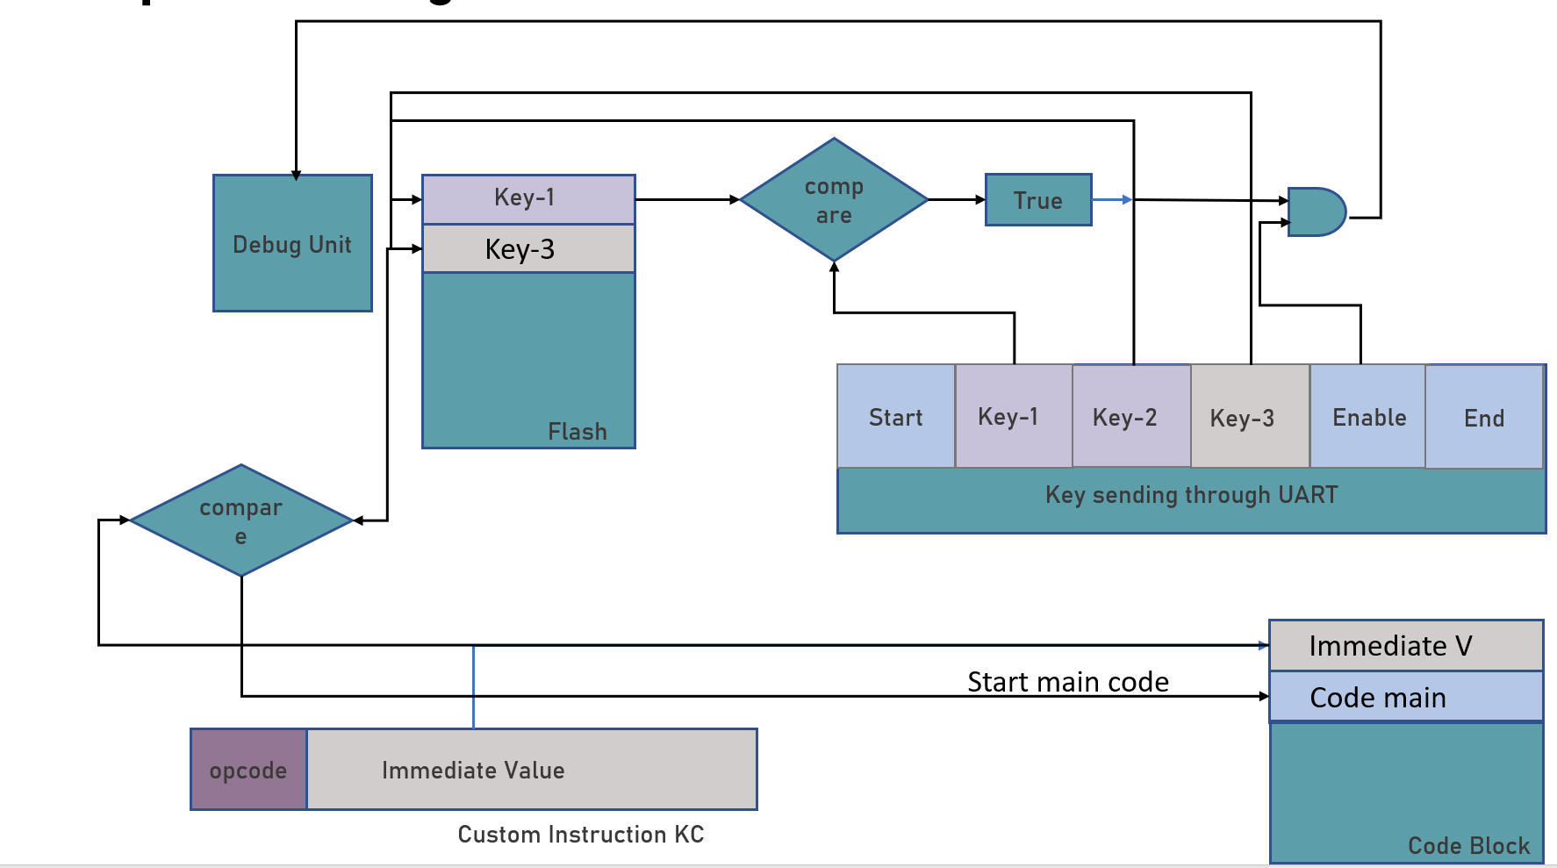
Application
Core Instruction Insertion
Security Logic
Debug, FLASH Mem, UART Controller
Protocol (SPI, UART) controlled by software
Interface/Physical Layer

