Slide 1
STRIVE
COMPILER BINDING
Directorate of Computer architecture & Engineering

Slide 2
Objective
“To Bind a PC to a Microcontroller in such a way that only a registered user is able to program it”

Slide 3
Justification
An attacker can erase a microcontroller program on a PCB and install a malicious program on it
This can compromise the mission and no trace would be found of who programmed it
Solution:
Since we have the control of chip manufacturing, we can implement a mechanism in the hardware which would not allow any program to run on it unless it is compiled by our own compiler

Slide 4
NECOP Secure Compiler
Novel Key Sharing Mechanism
Debug unit accessibility controlled via key verification
Hardware Security Features
Processor locked to a specific PC for execution
Enhanced protection against unauthorized code execution by a custom instruction

Slide 5
Architecture
Security
Flash memory that stores the keys is not connected to the system bus. It is only accessible by a compare unit which is triggered by a custom instruction
Debug is only enabled when the Authenticator allows it to
Authenticator needs the last key in order to access the flash memory.
Core
Debug Unit
Flash Memory
compare
Custom Instruction
uart
Authenticator
uart
PC

Slide 6
compare
Flash memory
Debug Unit
Key-1
My custom Key
Start
Key-1
Key-2
Key-3
Enable
End
Imm value
Code Block
compare
Code main
opcode
Imm Value
Compiler Binding
My custom instruction

Slide 7
Key Binding
Key Generation
A 26-bit key is generated dynamically.
Components: Timestamp, Machine ID, UUID, Random Selection.
Database Management
A centralized database stores key bindings.
Enables tracking of secure execution and maintains integrity.
Log Tracking
The system can retrieve the last log entry for security purposes.

Slide 8
Custom Instruction
Instruction Details
Kc is successfully added as first class instruction in RISCV ISA so It can be used in C/assembler programs and supported by GCC + binutils
Name kc
Syntax Kc rd imm20
Format I-Type
Encoding Imm[20 bits] rd[5]

Slide 9
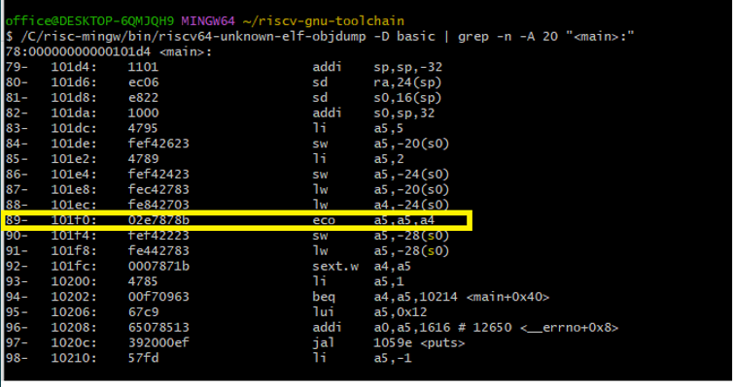
Testing my GCC
Windows Executable
Addition of Instruction

Slide 10
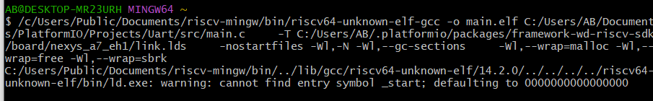
Testing my code with custom GCC

Slide 11
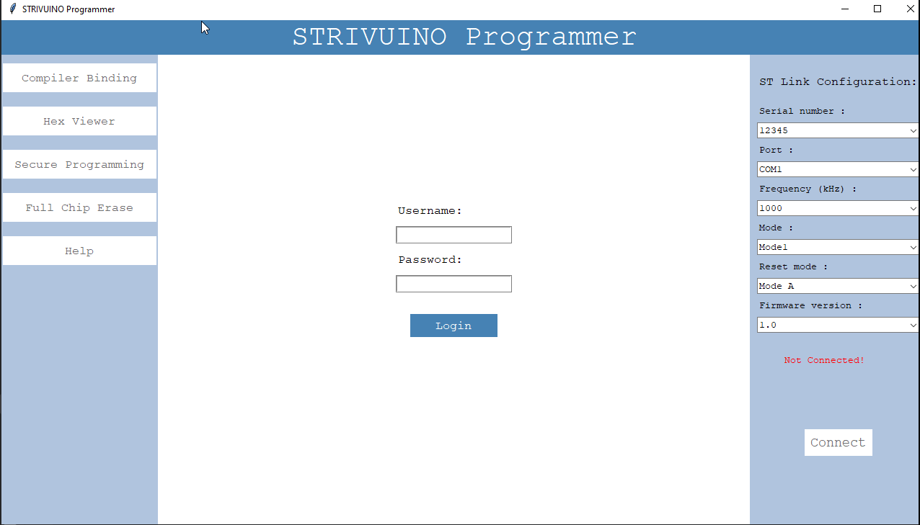
GUI

Slide 12
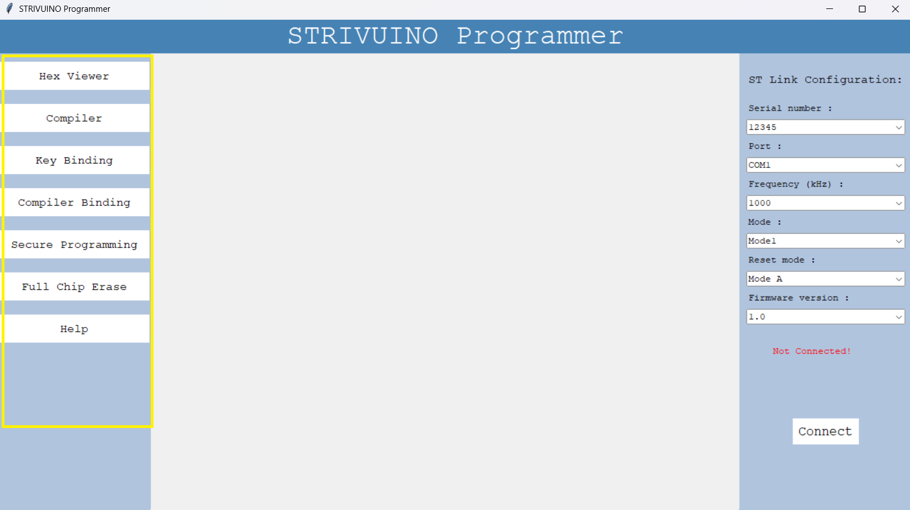
Application Features

Slide 13
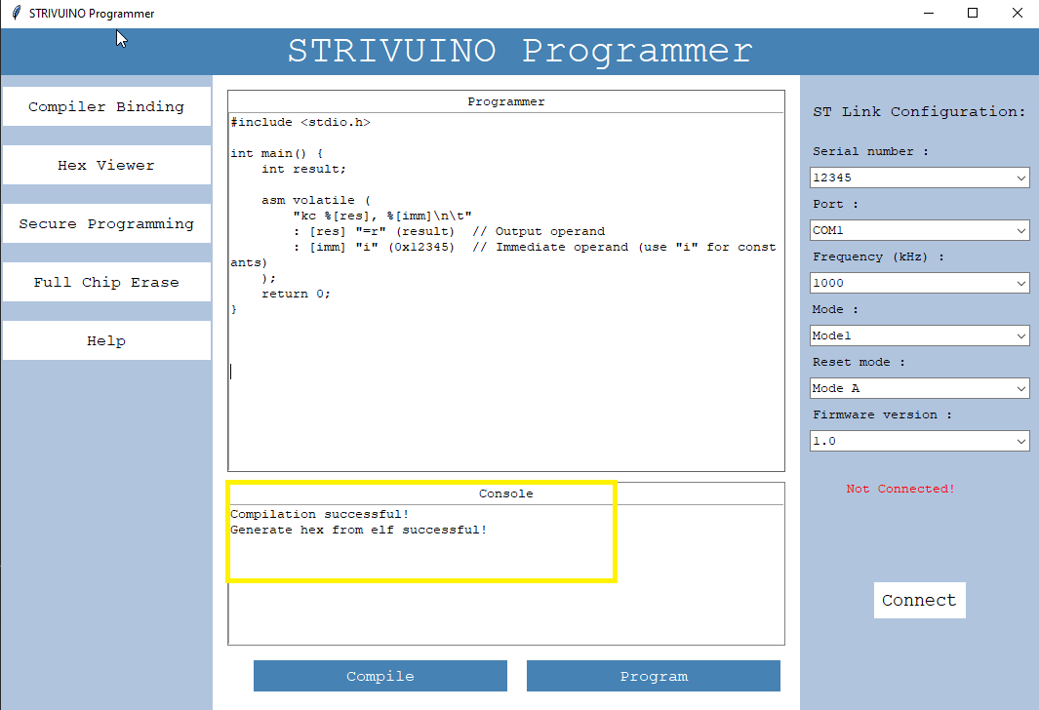
Code Compiling

Slide 14
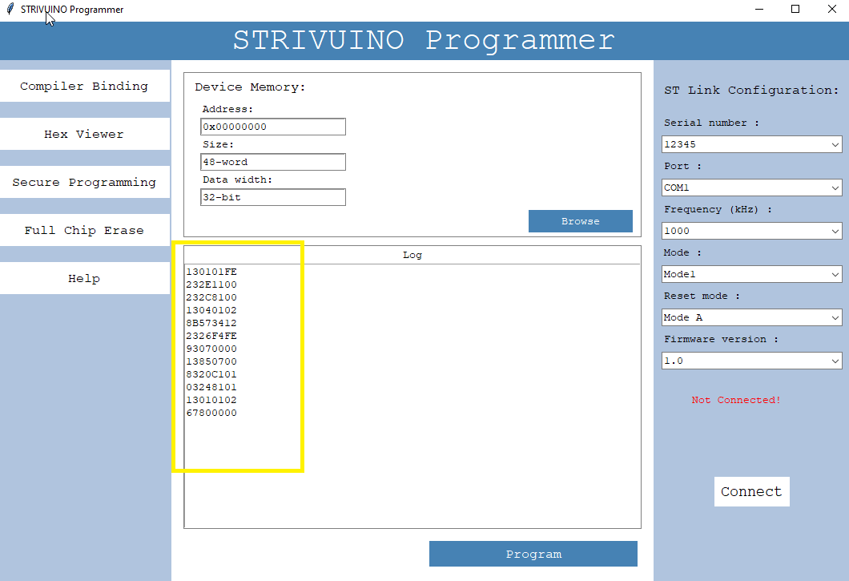
Hex Viewer

Slide 15
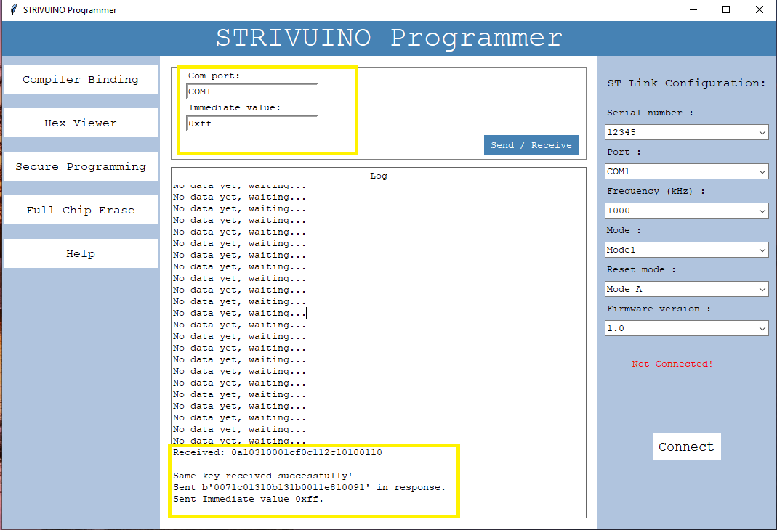
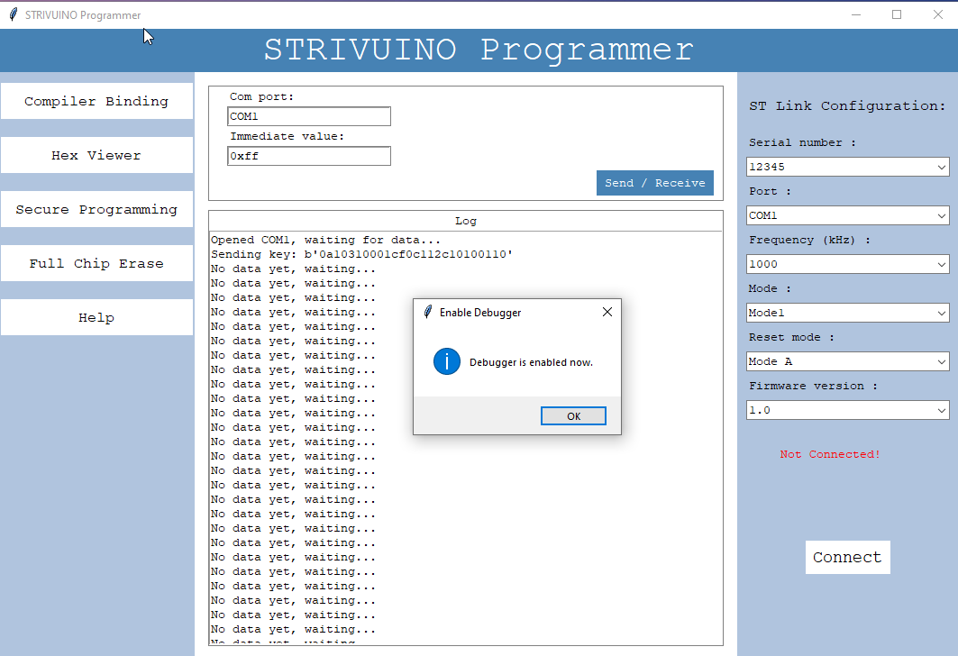
Key Matching

Slide 16
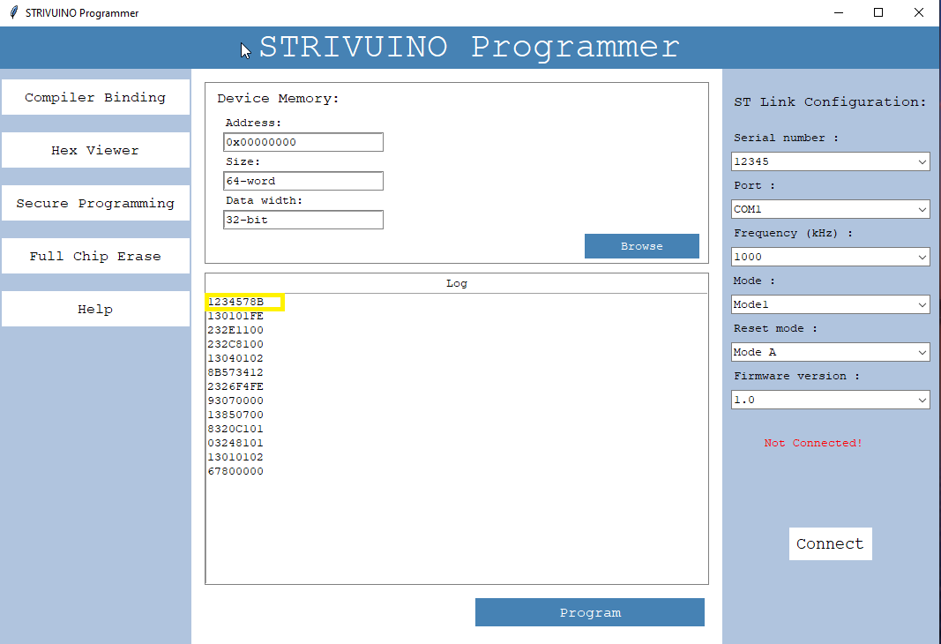
Updated Hex

Slide 17
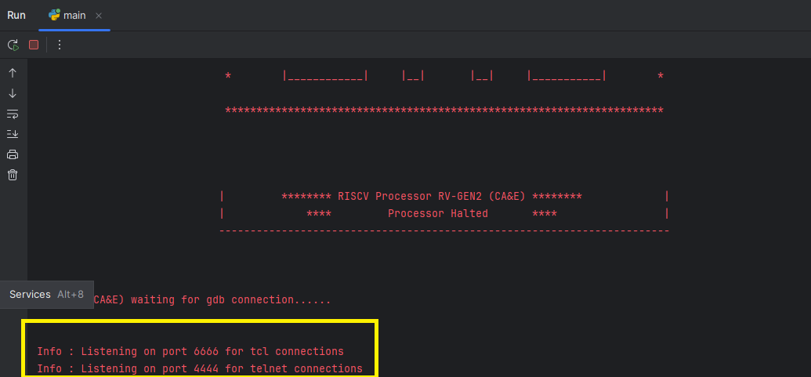
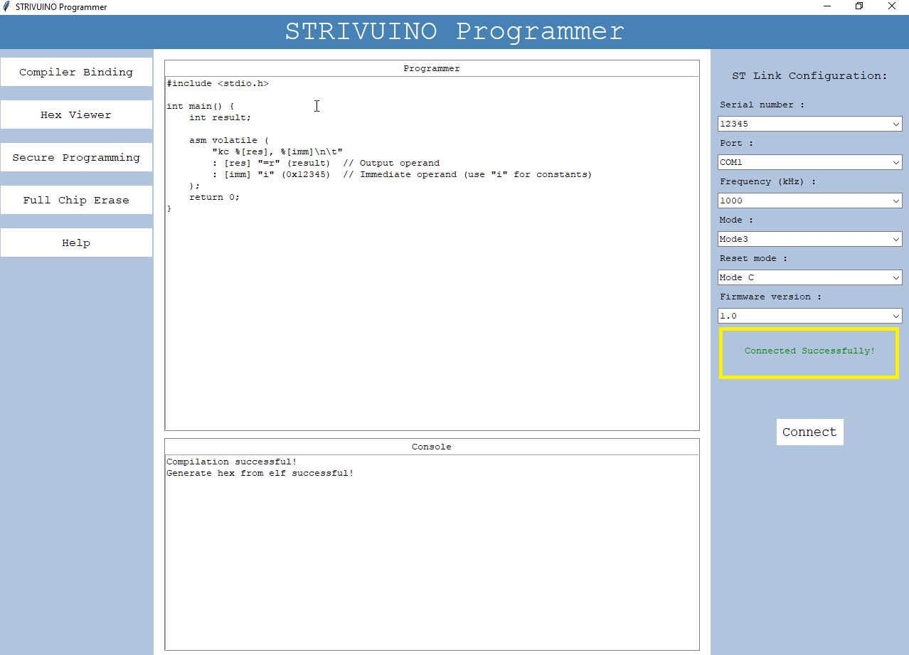
Connect Button

Slide 18
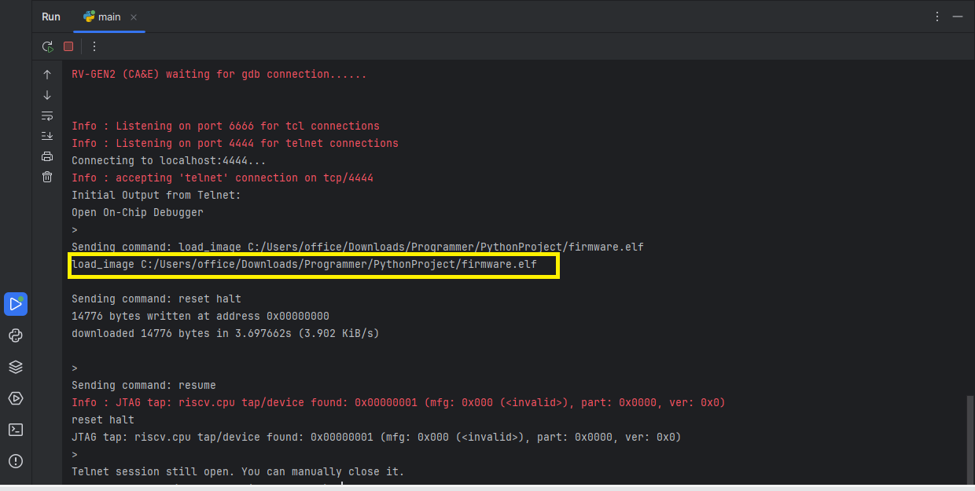
Program Button

