Slide 1
A Novel Approach to Secure Execution in Embedded Systems: Custom ISA and Compiler Binding
Student: Maria Ayub
Institute: CEME NUST

Slide 2
Guidance and Evaluation Committee
Supervised by: Dr. Asad Mansoor Khan
Co-supervised by: Dr. Sajid Gul Khawaja
GEC Members:
  Dr. Muhammad Usman Akram
  Dr. Arsalan Shoukat

Slide 3
Sequence
Introduction (Domain introduction & Motivation)
Literature Review
Research Gaps
Problem Statement
Aims and Objectives
Proposed Methodology
Tentative Timeline

Slide 4
Introduction

Slide 5
Context & Motivation
Embedded systems are increasingly deployed in security-critical applications like IoT, automotive, and healthcare.
However, they are vulnerable to physical access attacks, unauthorized code execution, and reverse engineering.
Traditional security solutions are either too heavy or inflexible for resource-constrained embedded devices.
Notes:
"Before proposing our new approach, let's briefly talk about traditional methods used to secure embedded systems.
Common methods include software-based encryption libraries, secure bootloaders, and external hardware security modules (HSMs).
However, these methods have problems in embedded environments:
Software encryption can be bypassed by physical attacks or fault injection.
External security chips add cost, complexity, and require more board space — which embedded devices often can't afford.
Therefore, there is a clear need for a security solution that's lightweight, processor-integrated, and cost-effective.

Slide 6
Our Approach
Introduce a custom security instruction directly inside the processor’s instruction set.
Enforce execution control and secure debugging tied to cryptographic key validation.
Bind program execution to flash-stored cryptographic data, verified at runtime.
Achieve hardware-level protection without external security modules or heavy software encryption.
Notes:
"In this work, we embed security mechanisms directly into the processor’s architecture.
We introduce a custom security instruction into the instruction set. This instruction is responsible for controlling whether program execution and debugging are allowed, based on cryptographic validation.
The validation relies on cryptographic keys securely stored in flash memory. When the processor starts or when certain sensitive operations occur, it verifies these keys in real-time.
If the key verification is successful, normal program execution continues and secure debugging is enabled. Otherwise, access is denied at the hardware level.
This method removes reliance on external hardware security modules or software-only encryption solutions.
By tightly binding security into the processor itself, we achieve hardware-enforced execution control with minimal performance and resource overhead — ideal for embedded systems."

Slide 7
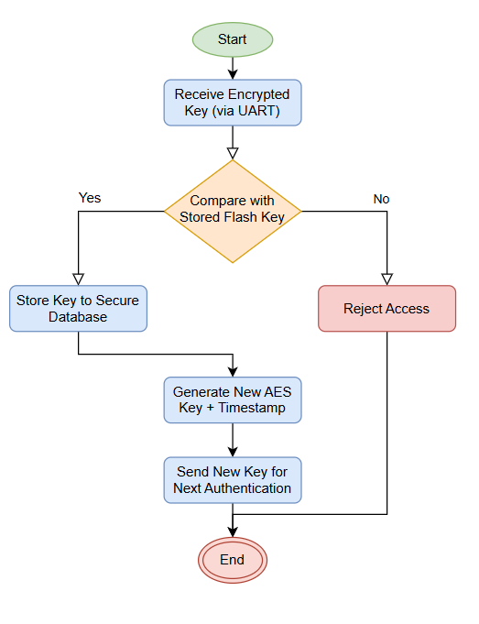
Key binding
Notes:
"In this work, we embed security mechanisms directly into the processor’s architecture.
We introduce a custom security instruction into the instruction set. This instruction is responsible for controlling whether program execution and debugging are allowed, based on cryptographic validation.
The validation relies on cryptographic keys securely stored in flash memory. When the processor starts or when certain sensitive operations occur, it verifies these keys in real-time.
If the key verification is successful, normal program execution continues and secure debugging is enabled. Otherwise, access is denied at the hardware level.
This method removes reliance on external hardware security modules or software-only encryption solutions.
By tightly binding security into the processor itself, we achieve hardware-enforced execution control with minimal performance and resource overhead — ideal for embedded systems."

Slide 8
WHY RISCV?
RISC-V is an open-source ISA, making it ideal for research and customization.
Its modular design allows seamless integration of custom instructions without violating ISA standards
Notes:
Another advantage is RISC-V’s modular design. It has a small, clean base instruction set, with optional extensions.
This modularity makes it very easy to integrate custom instructions — like our security instruction — without violating the ISA standards or breaking compatibility with existing tools and compilers.
As a result, RISC-V offers both technical flexibility and strong community support, which greatly benefits our work."

Slide 9
Key Idea
Execution of critical operations and enabling of debug features are tightly bound to key verification logic, ensuring secure boot and runtime environment.

Slide 10
Literature Review
Metadata | Details
Title | Research and design of Bootrom supporting secure boot mode
Authors | Niu Bin ,LU Zhangjian
Affiliation | Smart-chip Microelectronics Technology
Methods | Highlights vulnerabilities in embedded system boot processes. Proposes a secure BootROM that verifies system image authenticity at startup. Emphasizes the critical role of BootROM in preventing unauthorized or fake firmware execution.
Results | Stronger defense against early-stage attacks. Ensures only trusted code is executed from boot. Lays foundation for trusted runtime environments.
Research gaps | Focused on image verification, lacks fine-grained execution control. Doesn’t address instruction-level access control or debugging security.
Notes:
"In this paper, the authors focus on improving security at the very first stage of system operation — the boot process.
They propose enhancing the BootROM to verify the authenticity of the system image before allowing the processor to load and run the operating system.
This ensures that only trusted firmware is loaded, significantly strengthening the system's defense against early-stage attacks.
While this solution is effective for image-level authentication, it does have some limitations.
The focus remains mostly at the boot image level — it does not control what happens at the instruction level after boot, nor does it manage debug port security.
This leaves a gap where malicious commands could potentially still be injected after boot, or unauthorized debugging could occur.
Building on this idea, our contribution addresses these gaps.
We propose adding a custom instruction in the BootROM itself, tied to a secure key stored in flash memory.
Only after successful key matching will the processor allow command execution and enable debug access.
This approach secures not just the boot process but also the processor’s runtime operations and hardware interfaces, offering a more complete defense

Slide 11
Literature Review
Metadata | Details
Title | Secure boot of Embedded Applications
Authors | Karthikeyan A, Assistant Professor (Senior), SENSE, VIT University Rashmi R V M.Tech Student ,SENSE VIT University, Vellore
Affiliation | VIT University, Vellore
Purpose | To analyze secure boot techniques across different embedded applications to protect OS kernels from security threats.
Method | Focuses on Trusted Computing: using hardware-software co-design to ensure security. Discusses secure boot processes that authenticate OS images against trusted hardware credentials. Surveys different implementations of secure boot across various smart connected devices.
Results | Secure boot ensures only trusted OS images are loaded at startup. Protects devices like medical implants, banking terminals, and industrial control systems from malware injection.
Research gaps | Focuses mainly on OS-level protection, not on instruction-level execution control. Does not address fine-grained key-based command authorization inside the processor itself.

Slide 12
Literature Review
Metadata | Details
Title | Embedded Software Security through Key-Based Control Flow Obfuscation
Authors | Rajat Subhra Chakraborty, Seetharam Narasimhan, Swarup Bhunia
Affiliation | IIT Kharagpur, India and Case Western Reserve University, USA
Purpose | To develop a lightweight, key-based control flow obfuscation technique to protect embedded software from piracy, reverse engineering, and malicious modification.
Method | Introduces a non-cryptographic key-matching mechanism embedded in program control flow. Keys are dynamically generated based on execution traces and must match expected values during runtime to ensure correct execution. Includes optional watermarking for software ownership verification.
Results | Achieves high resistance to static and dynamic analysis attacks. Simulation on MIPS assembly programs shows low computational overhead and approximately 10% increase in code size.
Research gaps | Focuses on control flow obfuscation but does not address broader system-level security measures or integration with secure boot or hardware-enforced protections.

Slide 13
Literature Review
Metadata | Details
Title | Securing Boot of an Embedded Linux on FPGA
Authors | Florian Devic, Lionel Torres, Benoît Badrignans
Affiliation | LIRMM Laboratory, France
Purpose | To secure the embedded Linux boot process on FPGA systems against bitstream tampering and replay attacks.
Method | Implements a trusted computing approach by verifying the authenticity and freshness of the FPGA bitstream and operating system kernel during boot using cryptographic techniques (including asymmetric encryption).
Results | Achieved enhanced security against boot-level attacks with an area overhead between 0% to 40%, depending on the FPGA design choices.
Research gaps | Focuses only on boot-time security; runtime integrity verification and protection against side-channel attacks are not addressed.

Slide 14
Problem Statement
“Secure boot validates system images but fails to prevent unauthorized command execution and insecure debug access.A deeper, instruction-level binding mechanism is essential for complete embedded system security”

Slide 15
Aims And Objectives
To design and implement a secure execution mechanism in embedded processors by introducing a custom instruction tied to key verification.
Develop a custom RISC-V instruction for security key matching during boot.
Modify the BootROM to support execution only after successful key verification.
Integrate debug control (enable/disable) based on key match outcome.
Validate the solution through simulation and functional testing.

Slide 16
Proposed Methodology
• Custom Instruction Design:
Design a new RISC-V instruction that triggers secure key matching during early execution phases.
• BootROM Modification:
Integrate the custom instruction into the BootROM code to verify a secret key stored in flash memory at startup.
• Key Matching Logic:
Implement hardware logic to compare the operand of the custom instruction with the stored secure key.
• Execution Control:
Allow normal program execution only if key verification is successful; else, halt processor or reset.
• Secure Debug Activation:
Bind debug enable signals (e.g., JTAG access) to successful key matching, preventing unauthorized debugging.
• Validation and Testing:
Simulate processor behavior with and without correct key match, analyze debug access control, and verify execution gating.

Slide 17
compare
Flash memory
Debug Unit
Key-1
Key-3
My custom Key
Start
Key-1
Key-2
Key-3
Enable
End
Imm value
Code Block
cmpoare
Code main
opcode
Imm Value
Compiler Binding
My custom instruction

Slide 18
Thesis Timeline
.
Q1
Q3
Integrating software with core (processor).
Q4
Testing and validation.
Final Step
Intermediate Step
Customizing compiler.
Documentation and result analysis.
Literature review and understanding of base papers.
Q2
Architecture design and implementing key control mechanism.
Making necessary changes in boot rom.

Slide 19
Thank you

