Slide 1
Presentation on
“Dengue Outbreaks in Bangladesh: Strategies for Sustainable Prevention and Control“
Prepared By
Maria Afroz
Batch-48

Slide 2
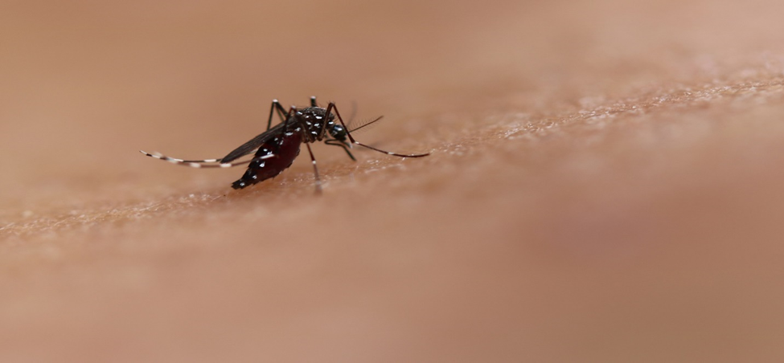
Introduction *Dengue fever, a mosquito-borne viral disease *It emerged as a significant public health concern in Bangladesh. *Rapid urbanization, and dense population, the country provides a conducive environment for the proliferation of Aedes mosquitoes, the primary vectors of dengue.

Slide 3
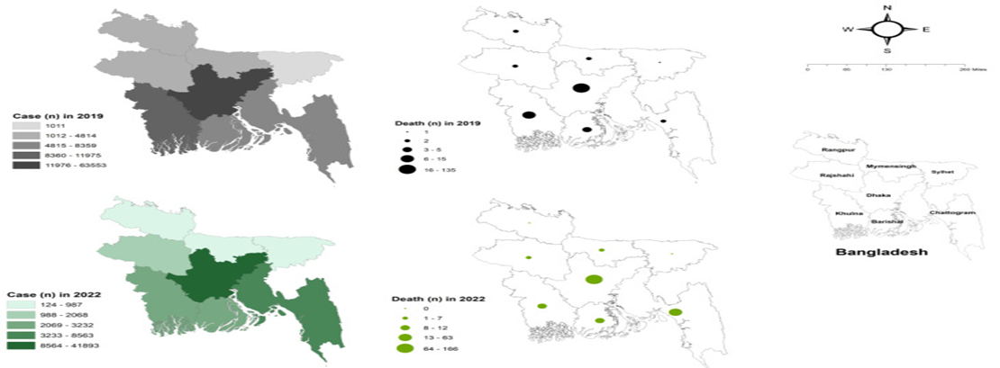
Dengue case and dengue-related death reported in 2019 and 2024 in different divisions of Bangladesh.

Slide 4
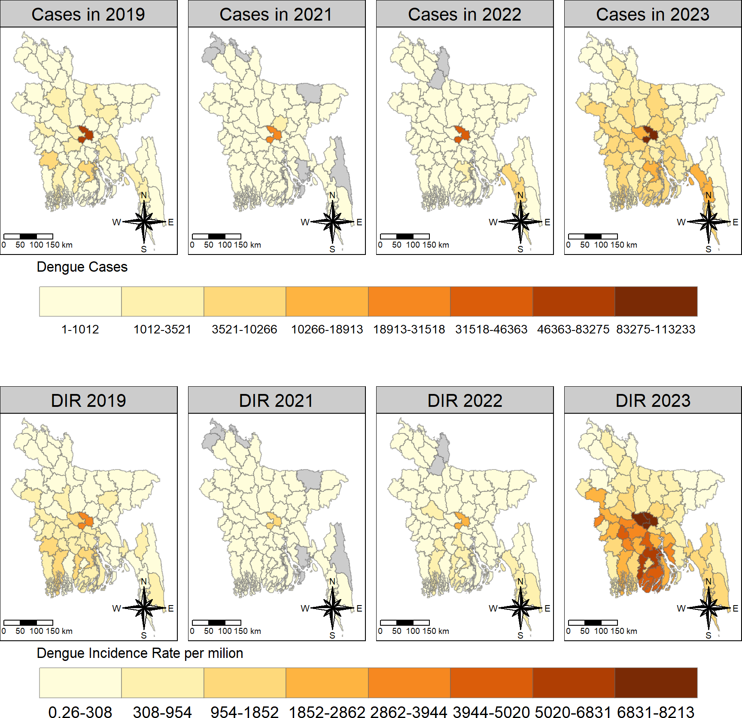
The spatial distribution of districtwide dengue cases and dengue incidence rate (DIR) per million in Bangladesh in 2019–2023.

Slide 5
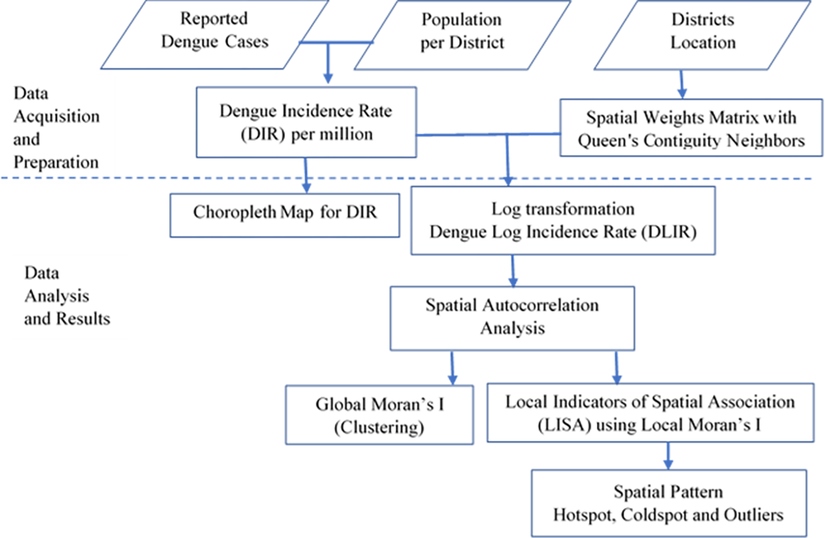
Implications for targeted control strategies:

Slide 6
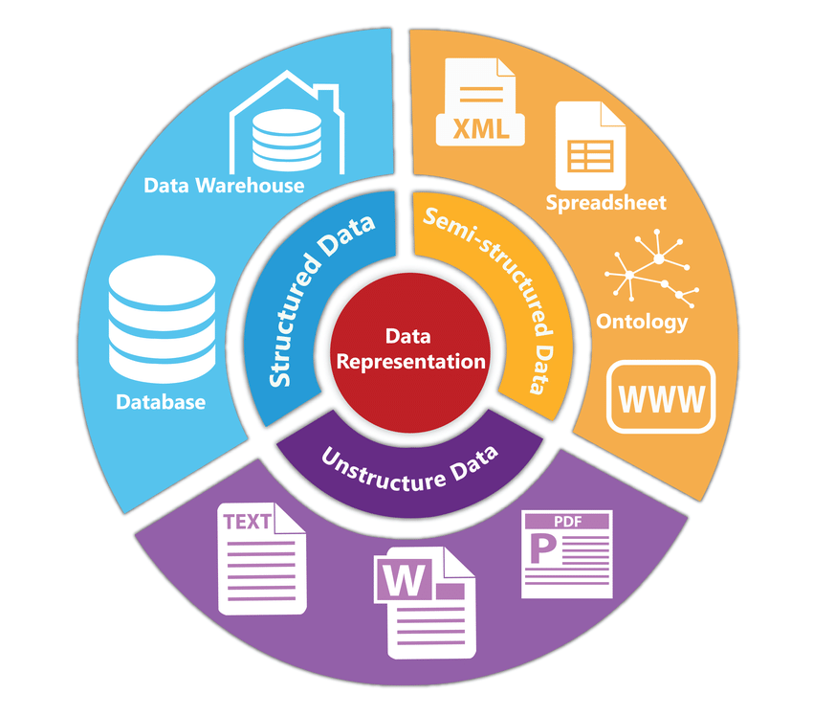
Popular data representation techniques for dengue information: Unstructured, Semi-structured, and Structured data.

Slide 7
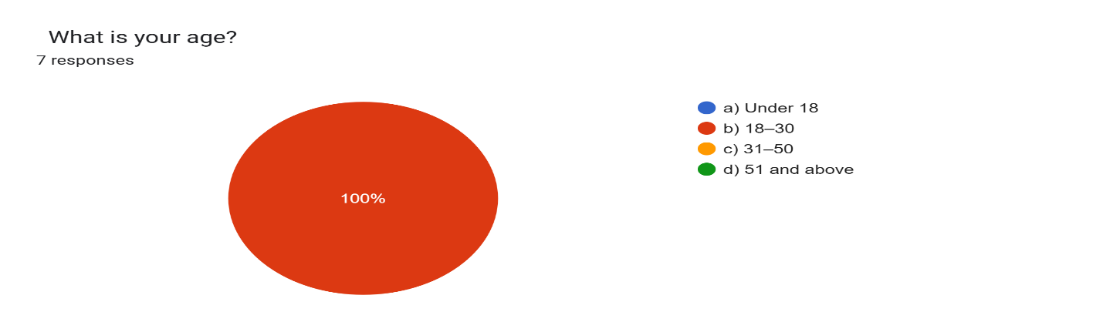
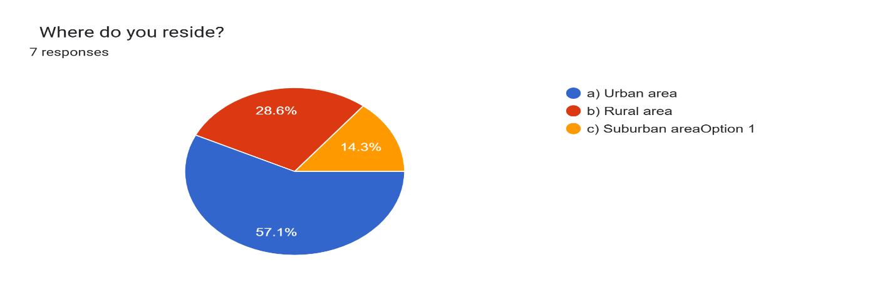
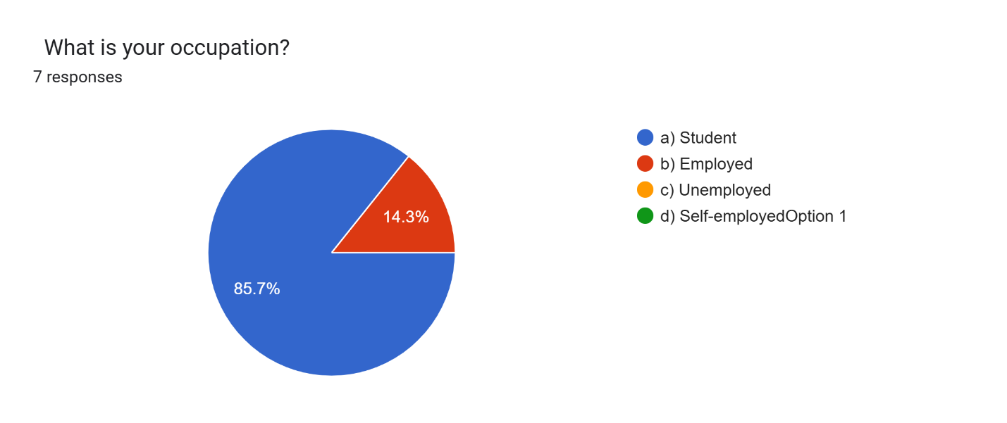
Survey Results
Socio-demographic characteristics

Slide 8
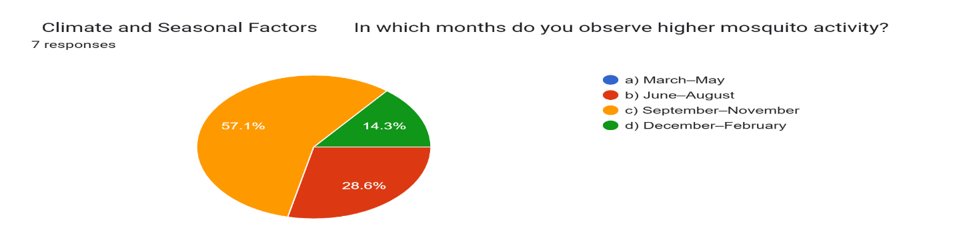
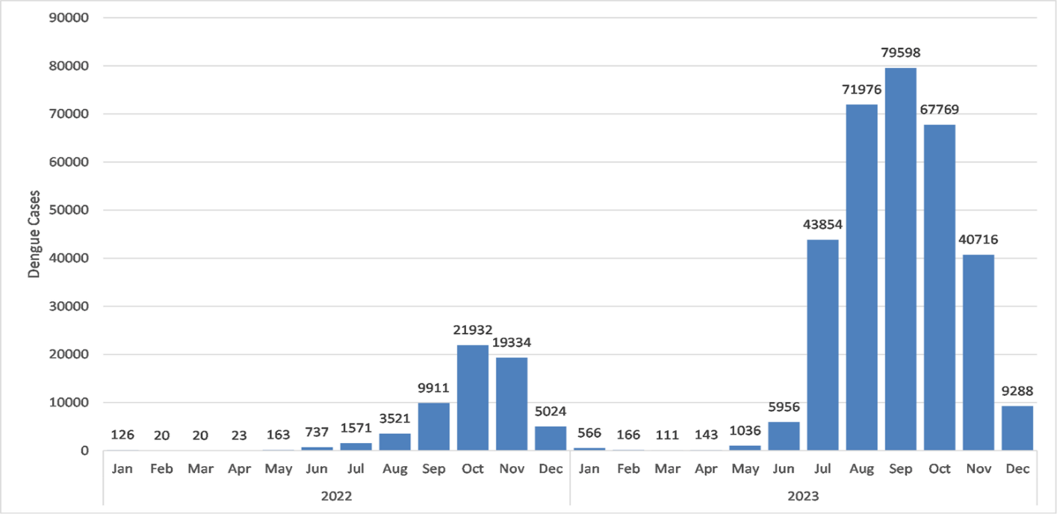
Monthly distribution of dengue cases across Bangladesh in 2022–2024

Slide 9
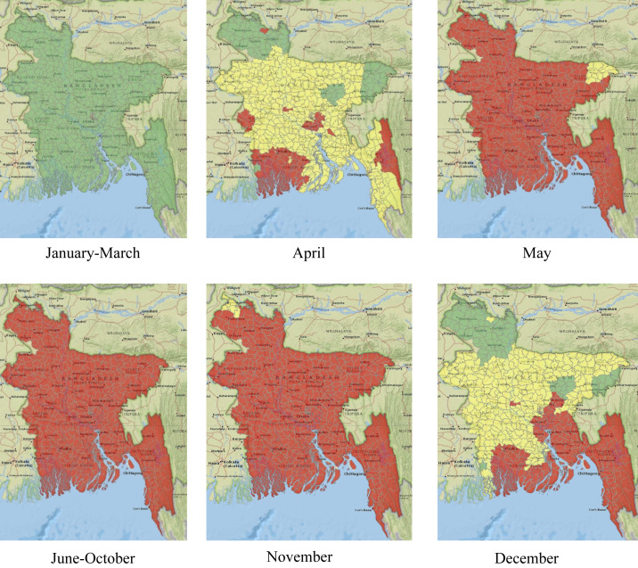
The map represents suitability in the following manner: green (lowly suitable), yellow (moderately suitable), and red (highly suitable).

Slide 10
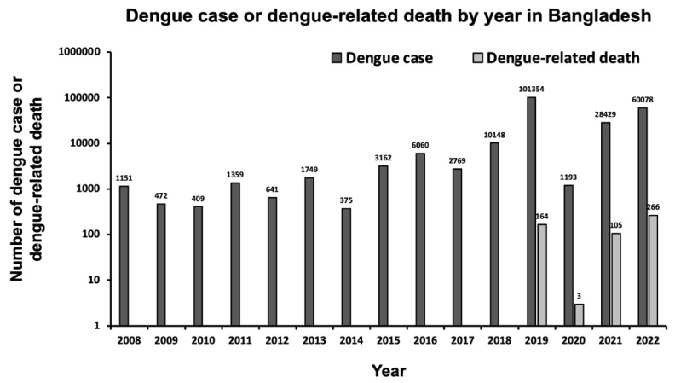
Number of reported dengue case and dengue-related death per year in Bangladesh between 2008 and 10 December 2024.

Slide 11
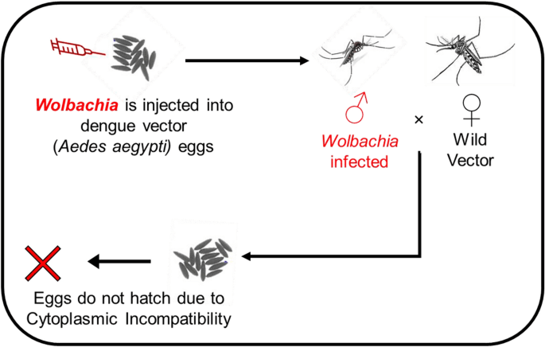
Methods of Biological Prevention and Control:
To combat the prevalence and spread of dengue disease, biological methods are the most environmentally favorable and sustainable options.

Slide 12
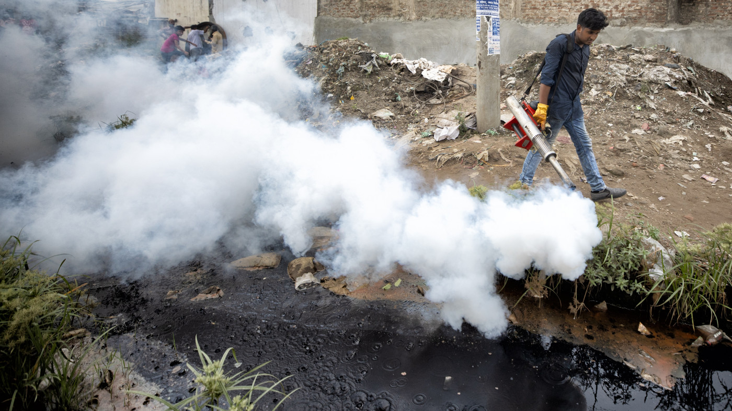
Methods of Chemical Prevention and Control:
Fogging, a chemical prevention system, is implemented in numerous countries across Asia and South America.

Slide 13
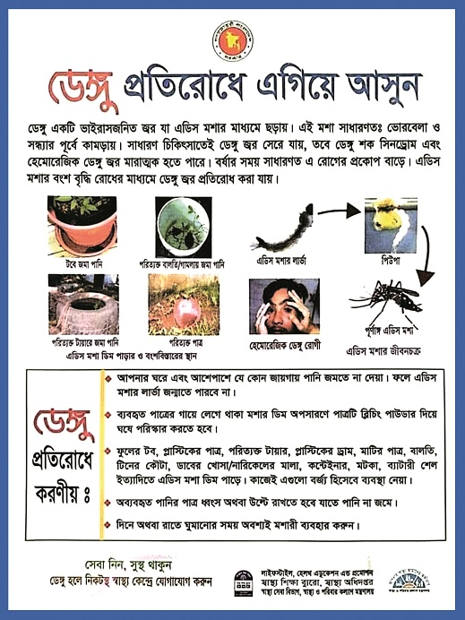
Methods of Community-Based Prevention:
The community-based prevention method is the most effective and efficient for a wide range of a number of reasons.

Slide 14
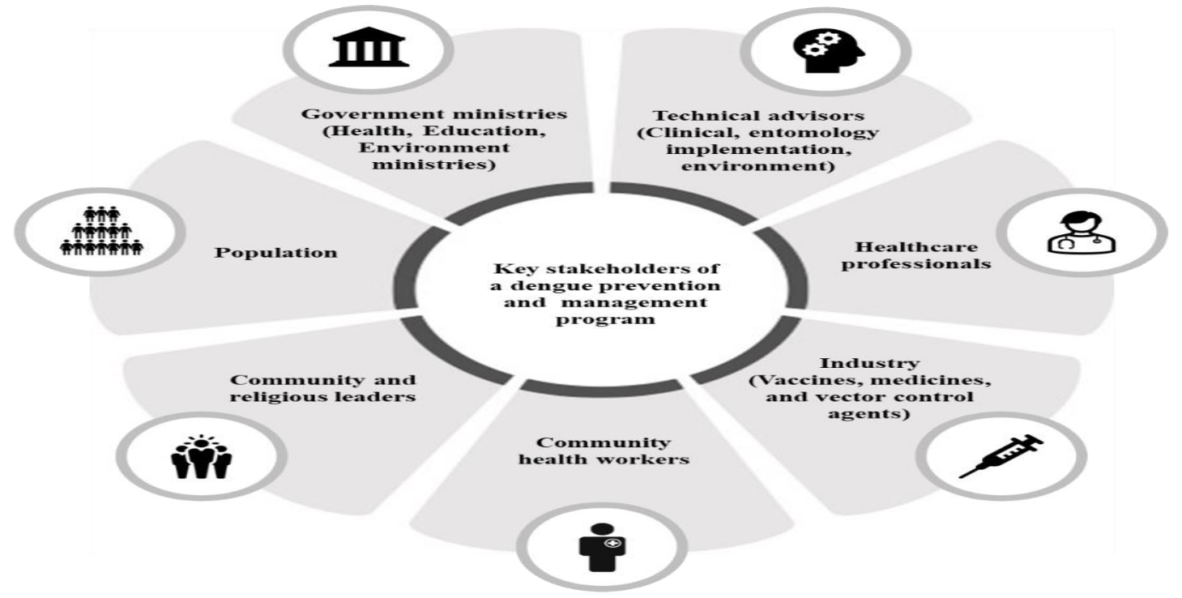
Sustainable Dengue Prevention and Management:

Slide 15
Thank You

