Slide 1

Introduction
Dr Maria Prokofieva

Slide 2
What we will cover
Why LLM
Environment setup: Google Colab and Python
Python Basics

Slide 3
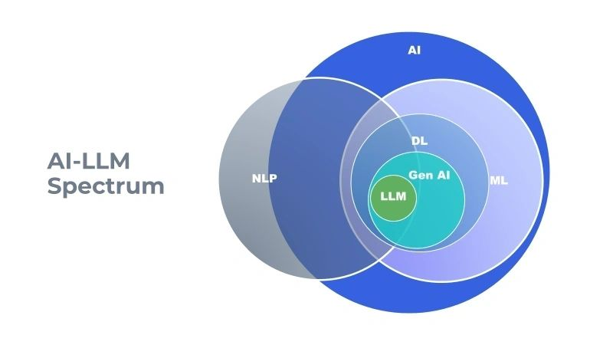
Where LLM fits?
Notes:
AI is a broad field that involves creating machines and systems capable of performing tasks that typically require human intelligence. This includes areas such as perception, reasoning, learning, and problem-solving. AI is the overarching discipline under which all the other concepts fall.
Machine Learning is a subset of AI that focuses on the development of algorithms that allow computers to learn from and make predictions or decisions based on data. ML involves training models on data so that they can improve over time without being explicitly programmed for every task.
Deep Learning is a subset of machine learning that uses neural networks with many layers (hence "deep") to model complex patterns in data. DL is particularly powerful for tasks like image and speech recognition, and it forms the foundation of many modern AI applications, including those that use LLMs.
NLP is a field of AI focused on the interaction between computers and human (natural) languages. It involves enabling machines to understand, interpret, and generate human language in a way that is valuable. While NLP heavily relies on ML and DL, it also includes rule-based methods and other techniques.
LLMs are a specific type of deep learning model that are trained on large amounts of text data to generate and understand human language. They are the engines behind many generative AI applications, such as chatbots and text generation systems. LLMs like GPT-3, BERT, and others have made significant advancements in NLP.
Generative AI refers to AI systems that can generate new content, such as text, images, or music. LLMs are a major part of generative AI, particularly in generating human-like text. Generative AI can create new content that was not part of its training data, making it useful in creative applications, content creation, and more.
Summary of Relationships:
AI is the broadest field, encompassing all other concepts.
ML is a subset of AI that focuses on learning from data.
DL is a more specific subset of ML, using deep neural networks.
NLP overlaps with AI and ML, focusing specifically on language processing.
LLM represents a specific type of model within the domain of generative AI, heavily reliant on deep learning techniques.
Gen AI includes LLMs and refers to AI systems that generate new content.

Slide 4
What is NLP?
NLP is a field of AI that focuses on the interaction between computers and human language.
Goal: Enable machines to read, interpret, and generate human language.
Example: Google Search, Chatbots, Sentiment Analysis.

Slide 5
NLP in Social Sciences
Applications - uncover insights from unstructured text :
Analysing large volumes of text data (e.g., social media, survey responses).
Automating content analysis (e.g., identifying themes, sentiment).
Enhancing qualitative research with computational tools.

Slide 6
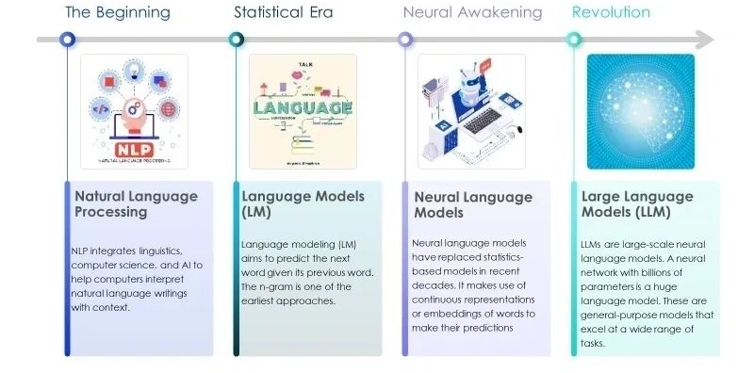
Evolution of NLP

Slide 7

Why NLP is rising
Massive growth in textual data and need for automation:
Social media, digital communication
Technical advancements and breakthrough in ML/AI:
Conceptual advancements (e.g. in deep learning)
Computational advances (e.g. speed of processing, GPUs)
Wide applicability across industries:
Business (customer support, healthcare, finance)
Democratization of AI tools:
Open source libraries
Accessibility of computational resources

Slide 8
Key NLP Tasks
Text Classification: Categorizing text into predefined labels (e.g., sentiment analysis).
Named Entity Recognition (NER): Identifying and classifying entities (e.g., names, places) within text.
Text Summarization: Automatically generating concise summaries of longer texts.
Question Answering: Answering questions based on a given text.

Slide 9
Basic NLP workflow
Text Preprocessing: Cleaning and preparing text (e.g., tokenization, removing stop words).
Feature Extraction: Converting text into numerical data (e.g., Bag of Words, TF-IDF).
Modeling: Applying machine learning or deep learning models to make predictions or extract information.

Slide 10
Text Preprocessing Techniques
Tokenization: Splitting text into words or phrases.
Stop Words Removal: Removing common words that add little meaning (e.g., "and", "the").
Stemming/Lemmatization: Reducing words to their base or root form.
Example: Sentence -> Tokens -> Cleaned Tokens.

Slide 11
NLP tasks:
Sentiment Analysis
Text Classification
Word Embeddings
Text Summarization
Named Entity Recognition (NER)
Machine Translation
Text Summarization
Text Generation
Question Answering
Notes:
Sentiment Analysis
Definition: Determining the sentiment or emotion expressed in a piece of text, often classified as positive, negative, or neutral.
Example: The sentence "I love this movie!" would likely be classified as having a positive sentiment.
Text Classification
Definition: Assigning predefined categories or labels to text. This can include tasks like spam detection, topic classification, or sentiment analysis.
Example: Classifying an email as "spam" or "not spam".
Word Embeddings
Definition: Representations of words in a continuous vector space, where semantically similar words are closer together in the space.
Example: Word2Vec, GloVe, and FastText are popular word embedding techniques that capture the meanings and relationships between words based on their context in a corpus.
Text Summarization
Named Entity Recognition (NER)
Definition: Identifying and classifying named entities in text into predefined categories such as people, organizations, locations, dates, etc.
Example: In the sentence "Barack Obama was born in H
Machine Translation
Definition: Automatically translating text from one language to another.
Example: Translating "Bonjour" from French to "Hello" in English.
Text Summarization
Definition: Producing a concise summary of a longer text document while preserving the main ideas.
Example: Summarizing a news article into a few sentences that capture the key points.
Text Generation
Definition: Automatically generating coherent and contextually relevant text.
Example: GPT-3 is an example of a model that can generate paragraphs of text given a prompt.
Question Answering
Definition: Building systems that can answer questions posed in natural language.
Example: A system that can answer "Who is the president of the United States?" by retrieving and presenting the correct answer.
Information Retrieval
Definition: Finding and retrieving relevant information from a large dataset, often in response to a query.
Example: Search engines use information retrieval techniques to find the most relevant web pages based on user queries.

Slide 12
Modeling Techniques
Traditional Machine Learning Approaches
Advanced Machine Learning Approaches
Deep Learning Approaches

Slide 13

Traditional Machine Learning Approaches
Statistical methods that require manual feature extraction from data
Structured data
Linear Regression
Logistic Regression
Decision TreesSupport
Vector Machines (SVM)
K-Nearest Neighbors (KNN)
Notes:
Traditional Machine Learning (ML) approaches involve statistical methods that require manual feature extraction from data. These methods are often applied to structured data and are well-understood with clear theoretical foundations.
Common Algorithms:
Linear Regression: Used for predicting a continuous outcome based on input variables.
Logistic Regression: Suitable for binary classification tasks.
Decision Trees: A tree-like model of decisions and their possible consequences, used for classification and regression.
Support Vector Machines (SVM): Effective for classification and regression, particularly in high-dimensional spaces.
K-Nearest Neighbors (KNN): A simple, instance-based learning algorithm used for classification and regression by comparing data points.
Applications:
Predictive modeling (e.g., housing price prediction)
Classification tasks (e.g., spam detection)
Anomaly detection (e.g., fraud detection)

Slide 14

Advanced Machine Learning Approaches
More sophisticated algorithms
Structured data
Ensemble Methods
Random Forest
Gradient Boosting Machines (GBM)
Conditional Random Fields (CRFs)
Latent Dirichlet Allocation (LDA)Support Vector Machines with Kernels
Clustering (e.g., K-Means, DBSCAN)
Dimensionality Reduction (e.g., PCA)
Notes:
Advanced ML approaches involve more sophisticated algorithms that often incorporate ensemble methods or non-linear techniques to improve predictive performance and model robustness.
Key Techniques:
Ensemble Methods: Techniques that combine multiple models to improve overall performance and robustness.
Random Forest: An ensemble of decision trees that aggregates their predictions for classification or regression tasks.
Gradient Boosting Machines (GBM): A sequential ensemble method that builds models iteratively, correcting errors from previous models to improve accuracy.
Conditional Random Fields (CRFs): A type of probabilistic model used for structured prediction, commonly applied in sequence labeling tasks like named entity recognition
Latent Dirichlet Allocation (LDA): A generative probabilistic model used for topic modeling, which discovers latent topics in a collection of documents.
Support Vector Machines with Kernels: An extension of SVMs that uses kernel functions to handle non-linear relationships in the data.
Clustering (e.g., K-Means, DBSCAN): Methods for grouping data points into clusters based on similarity, where K-Means partitions data into k clusters, and DBSCAN finds clusters based on density.
Dimensionality Reduction (e.g., PCA): Techniques that reduce the number of variables in a dataset while preserving essential information, with PCA being a common method that projects data onto a lower-dimensional space.rving essential information.
Applications:
Complex classification tasks (e.g., medical diagnostics)
Predictive analytics with improved accuracy (e.g., stock price prediction)
Image segmentation and object recognition.

Slide 15
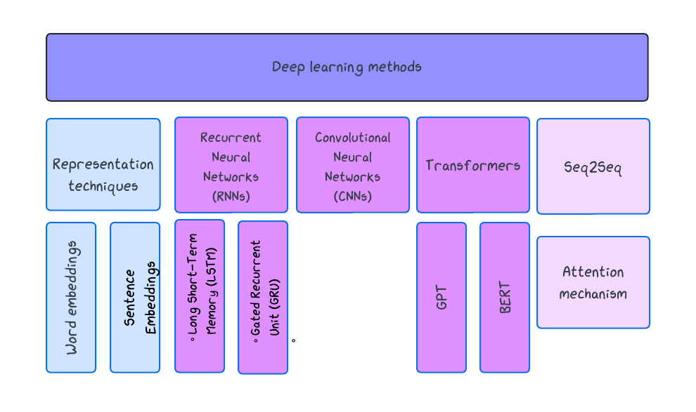
Deep Learning Approaches
Notes:
Deep Learning Models: The top-level category representing all deep learning approaches in NLP.
Word Representation Techniques: This includes methods for representing words as vectors, which are often used as the first step in NLP pipelines before feeding data into more complex models.
Core Architectures: These are the foundational deep learning architectures that power various NLP models.
RNNs: A fundamental architecture for processing sequences, with LSTM and GRU being advanced types of RNNs that address specific challenges like long-term dependencies.
CNNs for Text: Originally designed for images but adapted for tasks like text classification in NLP.
Transformers: A more recent and powerful architecture that processes sequences in parallel, leading to several advanced models.
Specialized Models and Applications: These are specific models or techniques that build on the core architectures.
BERT and GPT: Both are based on the Transformer architecture but are specialized for different tasks—BERT for understanding and GPT for generating text.
Seq2Seq Models: Use architectures like RNNs or Transformers to map sequences to sequences, such as in translation or summarization.
Attention Mechanism: A key technique within models like Transformers and Seq2Seq, allowing the model to focus on specific parts of the input sequence.

Slide 16
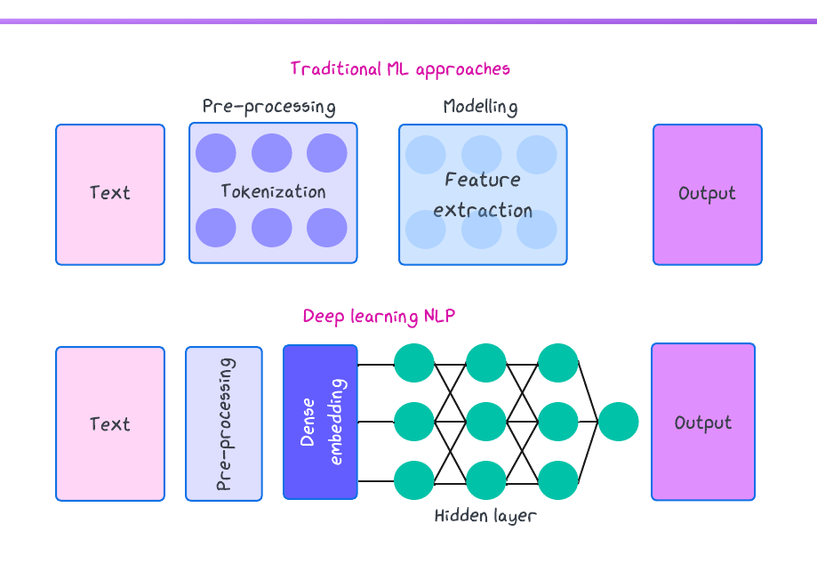

Slide 17
Modern NLP with Transformers
Transformers: A type of deep learning model that has revolutionized NLP.
Key Models: BERT, GPT, RoBERTa.
Applications: State-of-the-art results in wide application:
- Industry
- Research
- Education

Slide 18
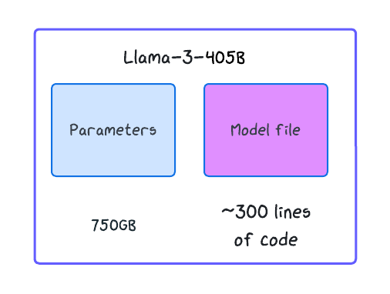

LLM: what are they
Llama 3.1 (Meta)

Slide 19


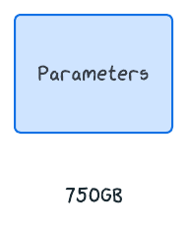
Zip’ing the Internet
15 trillion tokens of data from publicly available sources
7.7M GPU hours of computation

Slide 20
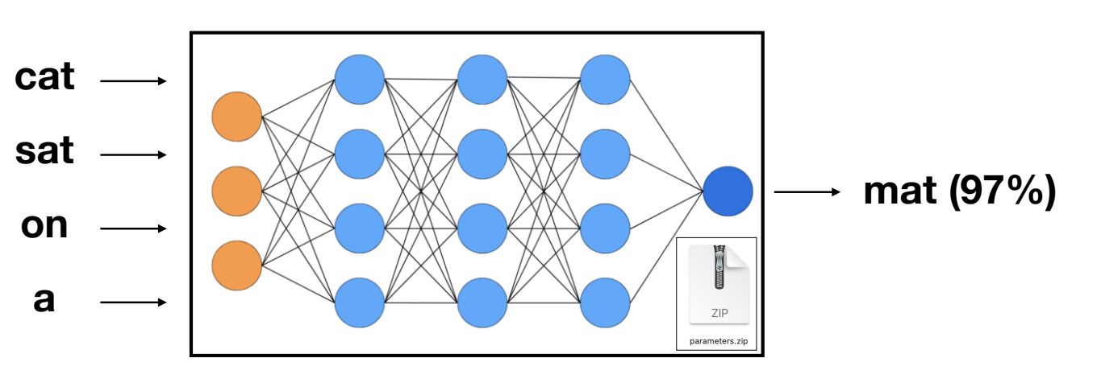
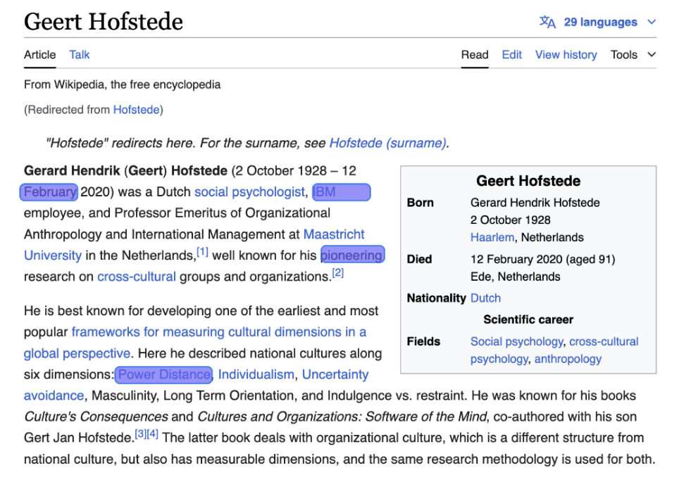
Predict next word

Slide 21
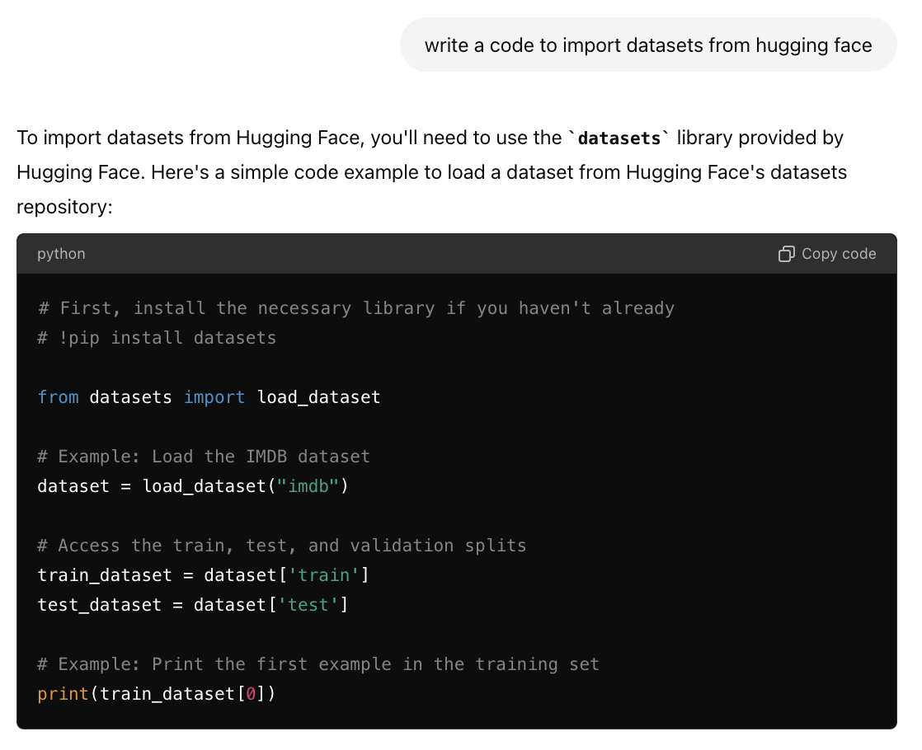
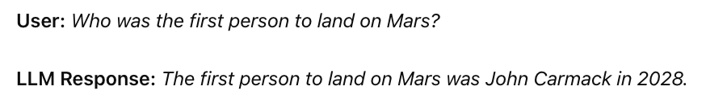
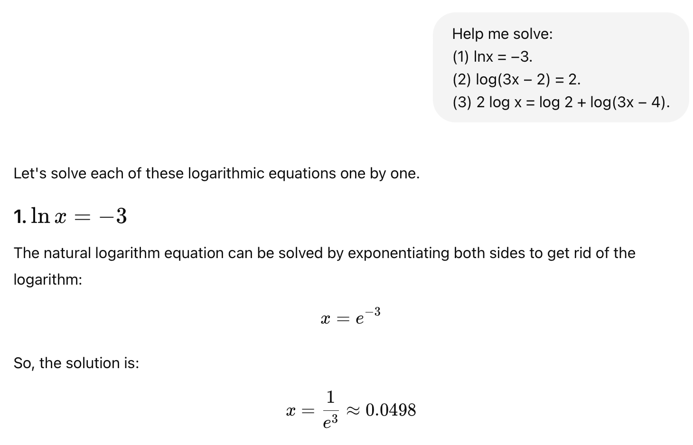
LLM dreams the document

Slide 22
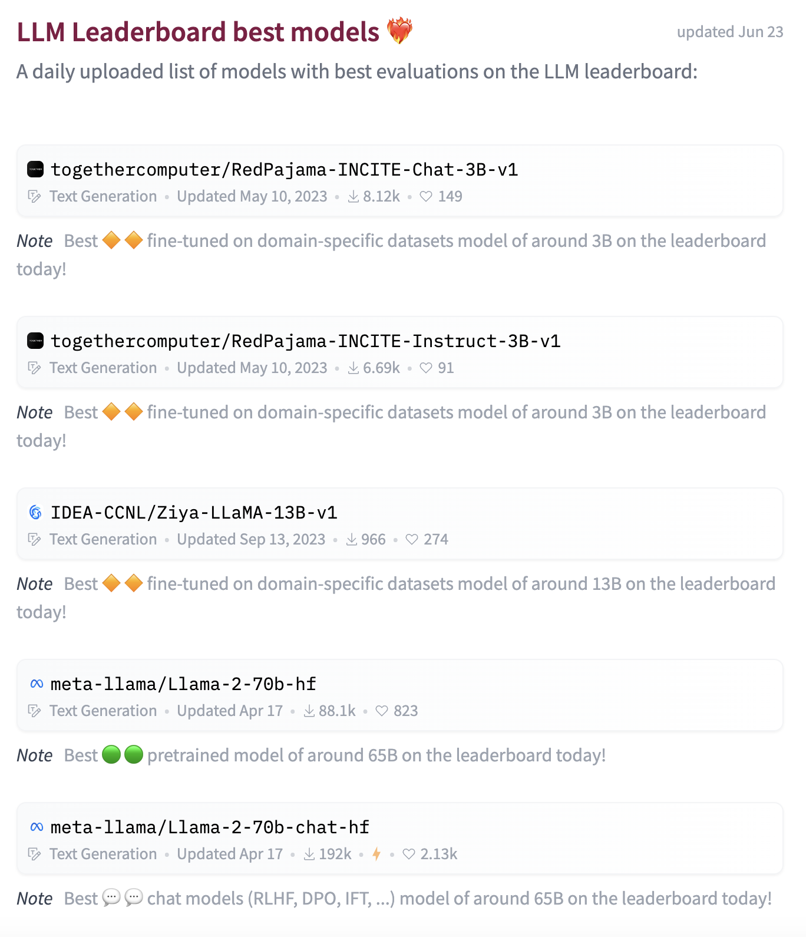
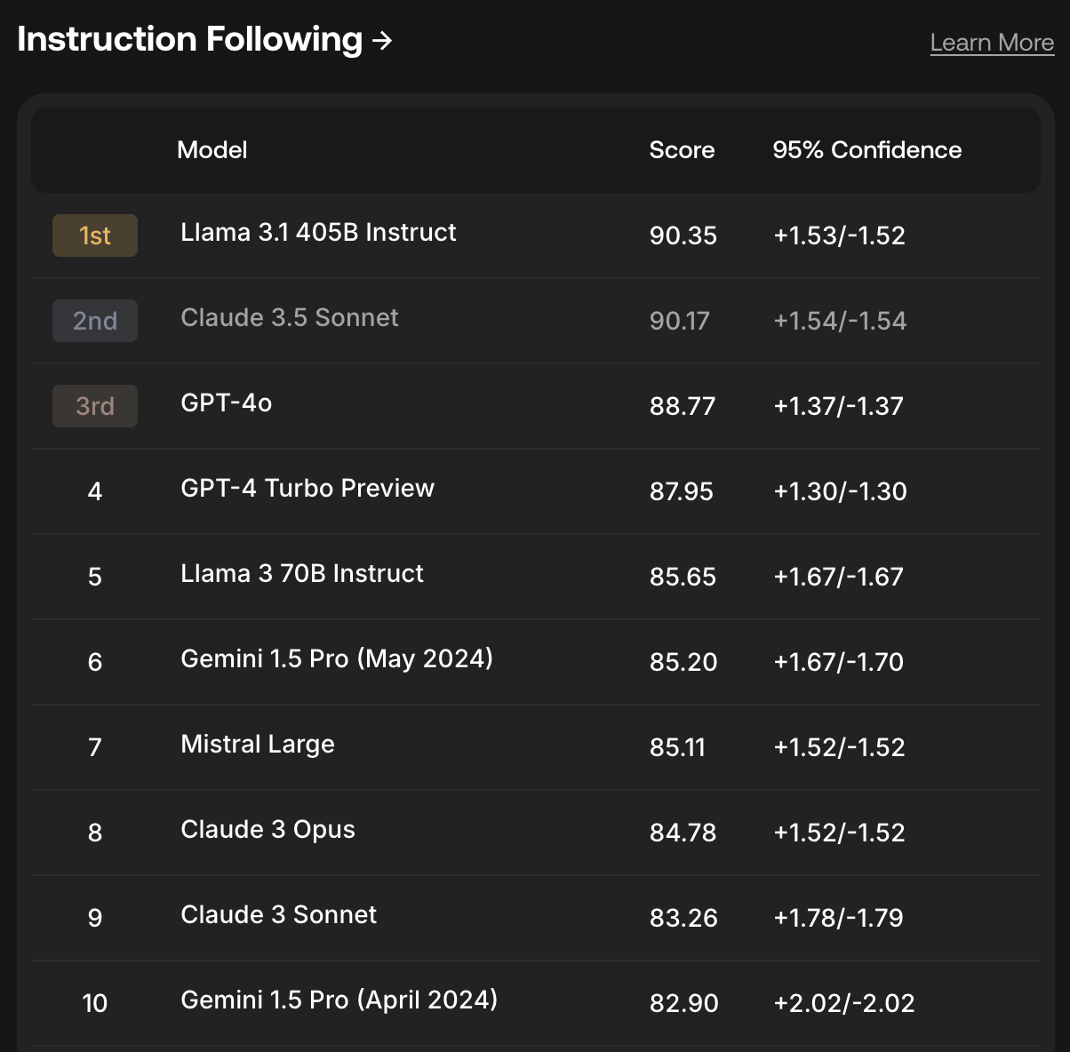
LLMs leaderboard
https://scale.com/leaderboard
Hugging Face leaderboard (open-source)

Slide 23
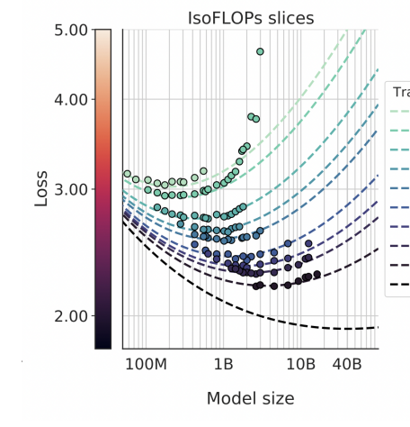
LLM Scaling Laws
Performance of LLMs is a smooth, well-behaved, predictable function of:
- N, the number of parameters in the network
- D, the amount of text we train on
And the trends do not show signs of “topping out”
We can expect more intelligence “for free” by scaling

Slide 24
Ethical considerations
Bias in NLP Models: Models may reflect and amplify societal biases present in training data.
Privacy Concerns: Handling sensitive information in text data (e.g., personal data in social media).
Example: Discuss a case where NLP models showed bias (e.g., gender bias in word embeddings).

Slide 25

Real-World Applications in Social Sciences
Sentiment analysis in social media to gauge public opinion.
Using NER to track mentions of organizations in news articles.
Applying text classification to categorize survey responses.

Slide 26

Tools and libraries for NLP
Python Libraries:NLTK: Basic NLP tasks and preprocessing.
SpaCy: Advanced NLP tasks, faster processing.
Hugging Face Transformers: State-of-the-art pre-trained models.

Slide 27
Takeaways
NLP enables computers to understand and analyze human language.
Key tasks include text classification, NER, and summarization.
Preprocessing and feature extraction are critical steps in NLP pipelines.
Ethical considerations are important in applying NLP in social sciences.

