Slide 1

Introduction to NLP and LLM
Dr Maria Prokofieva

Slide 2

What we will cover
NLP: brief history, tasks and overview
LLM: evolution, what it is
Main concepts

Slide 3
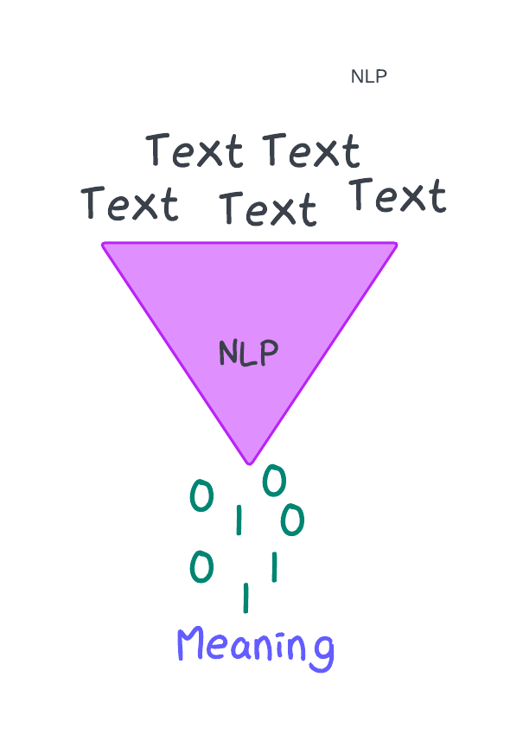
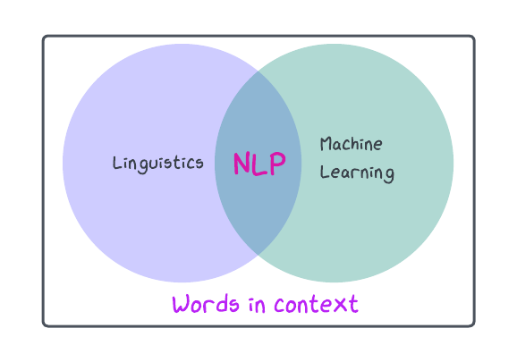
NLP
Use of computational methods to analyse and interpret human language
Powered by large amounts of textual data
Notes:
Benefits to Social Sciences:
Scale: Analyze vast amounts of text that would be impossible manually.
Insight: Uncover patterns, trends, and insights from unstructured data.
Efficiency: Automate and speed up qualitative data analysis.

Slide 4
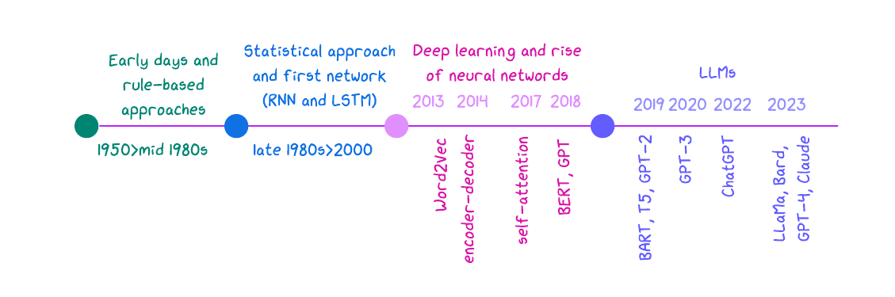
NLPs evolution
Notes:
1. Early Days of NLP:
1950s-1980s: Rule-based systems and symbolic AI. Early methods relied on handcrafted rules and simple statistical models.
Limitations: Limited scalability, difficulty in handling complex language nuances, and high dependency on domain-specific knowledge.
2. Statistical NLP:
1990s-2000s: Introduction of probabilistic models like Hidden Markov Models (HMMs) and Statistical Machine Translation (SMT).
Shift to Data-Driven Approaches: Emphasis on using large text corpora for training models.
Limitations: Still struggled with context, polysemy (multiple meanings of words), and long-range dependencies.
3. Neural Networks and Deep Learning:
2010s: The rise of deep learning brought models like Word2Vec, which learned word embeddings capturing semantic meaning.
Recurrent Neural Networks (RNNs) and LSTMs: Improved handling of sequences but were still limited by the vanishing gradient problem.
Attention Mechanisms: Introduced in models like Transformers, enabling the handling of long-range dependencies more effectively.
4. The Transformer Revolution:
2017: Introduction of the Transformer model by Vaswani et al., which replaced RNNs with self-attention mechanisms.
Why Transformers? They allow for parallelization, better handling of context, and scalability in training large datasets.
Birth of Pre-trained Models: Models like BERT, GPT, and T5 emerged, pre-trained on vast amounts of data and fine-tuned for specific tasks.
5. Emergence of Large Language Models (LLMs):
2020s: LLMs like GPT-3, GPT-4, BERT, and others grew in scale, trained on billions of parameters.
Why LLMs?
Contextual Understanding: LLMs can capture nuanced meanings and context over long text sequences.
Few-shot/Zero-shot Learning: Ability to perform tasks with minimal or no specific training data.
Versatility: LLMs can be applied across diverse NLP tasks, from translation to summarization and beyond.

Slide 5
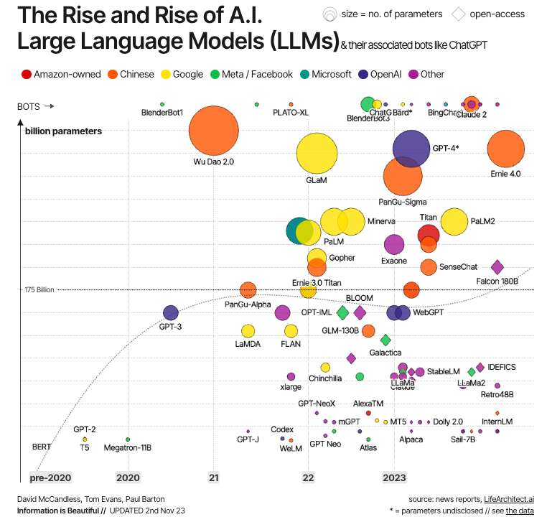
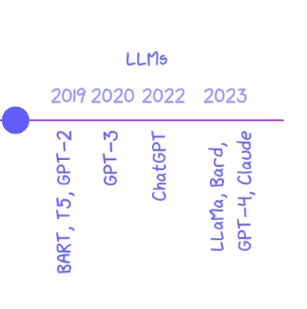
LLMs evolution
Notes:
1. Early Foundations of Language Models
Pre-Deep Learning Era: Before the rise of LLMs, language models were largely based on statistical methods, such as n-grams, which predicted the probability of the next word in a sequence based on the previous words.
Limitations: These early models were limited by their inability to capture long-range dependencies and contextual meaning, leading to a lack of depth in understanding language.
2. Introduction of Neural Networks
Neural Networks: The introduction of neural networks, particularly Recurrent Neural Networks (RNNs) and Long Short-Term Memory (LSTM) networks, marked a significant shift in language modeling. These models could handle sequences of words and retain context over longer text passages.
Challenges: Despite improvements, RNNs and LSTMs struggled with long-term dependencies and were computationally intensive, limiting their scalability.
3. The Transformer Model (2017)
Vaswani et al.'s Transformer: The introduction of the Transformer model by Vaswani et al. in 2017 was a game-changer. It replaced RNNs with self-attention mechanisms, allowing models to process entire sequences of text at once rather than word by word.
Self-Attention Mechanism: This mechanism enabled models to focus on different parts of the input sequence simultaneously, greatly enhancing the ability to capture context and dependencies across the entire text.
Parallelization: Transformers allowed for more efficient parallelization during training, making it possible to train much larger models on vast datasets.
4. The Rise of Pre-trained LLMs
Pre-training and Fine-tuning Paradigm: The shift to pre-training models on large, diverse datasets and then fine-tuning them on specific tasks became the standard. This paradigm allowed models to learn general language patterns and then adapt to particular tasks with minimal additional data.
BERT and GPT: BERT (Bidirectional Encoder Representations from Transformers) and GPT (Generative Pre-trained Transformer) were among the first LLMs to leverage this approach effectively, with GPT focusing on generative tasks and BERT on understanding tasks.
5. Scaling Up: The Era of LLMs (2020-Present)
Exponential Growth in Model Size: Starting around 2020, there was a significant trend toward scaling up LLMs in terms of the number of parameters. GPT-3, released by OpenAI, had 175 billion parameters, setting a new benchmark for model size.
Model Capabilities: As models grew, their capabilities expanded. LLMs like GPT-3 and GPT-4 could perform tasks with minimal or no task-specific training data, engaging in tasks like code generation, creative writing, and complex problem-solving.
6. The Impact of LLMs Beyond NLP
Cross-Domain Applications: LLMs are now being applied beyond traditional NLP tasks, including in areas like code generation (e.g., GitHub Copilot), scientific research (e.g., AI-assisted drug discovery), and creative arts (e.g., AI-generated music and art).
Ethical and Societal Implications: The rise of LLMs has sparked significant discussions around ethics, bias, privacy, and the societal impact of AI. The scale and power of these models raise questions about responsible use, regulation, and the potential for misuse.
Democratization of AI: Open-access LLMs, such as those from Hugging Face, have played a key role in democratizing AI, making powerful models accessible to researchers, developers, and enthusiasts globally.

Slide 6

Key termonology
Sequential tasks and sequence2sequence approaches
LLM characteristics
LLM tasks

Slide 7
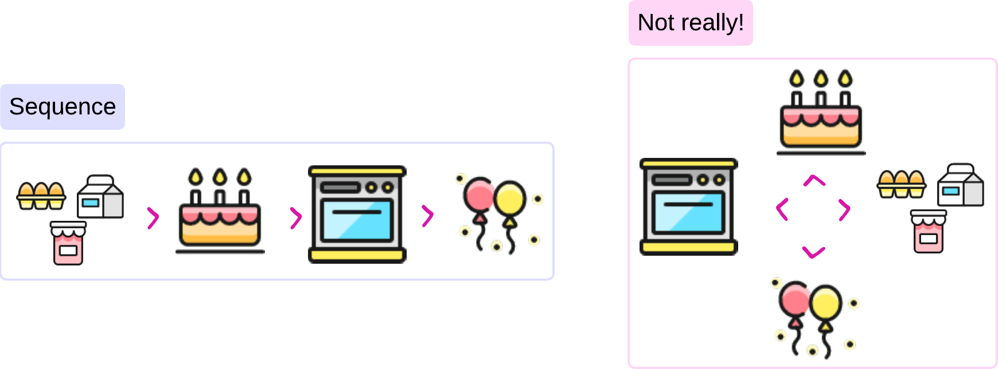
Sequential tasks
Tasks that involve processing data
specific, ordered sequence,
where the relationship and order of the elements are critical

Slide 8
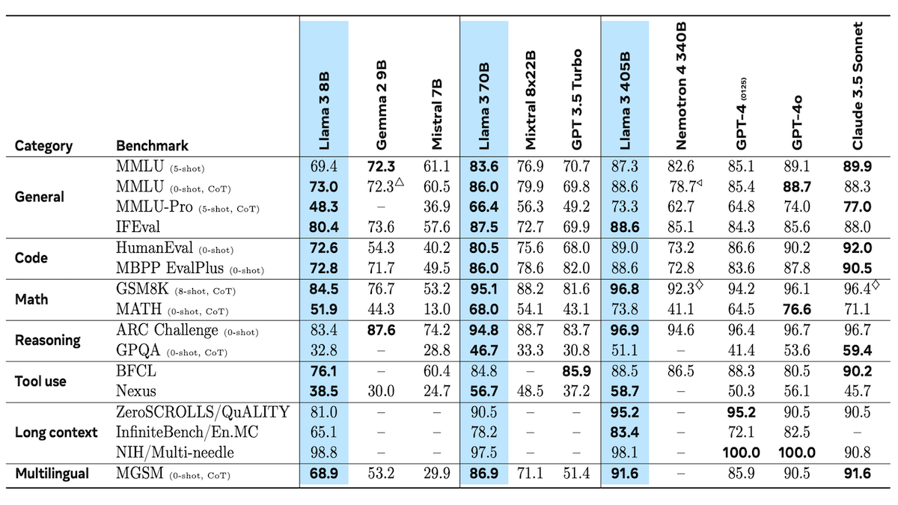
Large than life…

Slide 9

Model Size
Number of Parameters
More parameters = better prediction = more computational power requirements
Notes:
Number of Parameters
Definition: Parameters are the internal variables that a model learns during the training process. They include weights and biases within the network that adjust as the model learns from data.
Role in Model Capacity: The number of parameters is often a proxy for the model’s capacity to learn and represent data. More parameters generally mean the model can capture more complex patterns, making it more powerful for a wide range of tasks.
Scalability: Modern LLMs, like GPT-3 or GPT-4, have hundreds of billions of parameters, which allows them to perform at state-of-the-art levels on diverse tasks. However, managing and optimizing such a large number of parameters can be challenging.
Diminishing Returns: Beyond a certain point, increasing the number of parameters may yield diminishing returns in performance improvement while significantly increasing resource consumption.

Slide 10
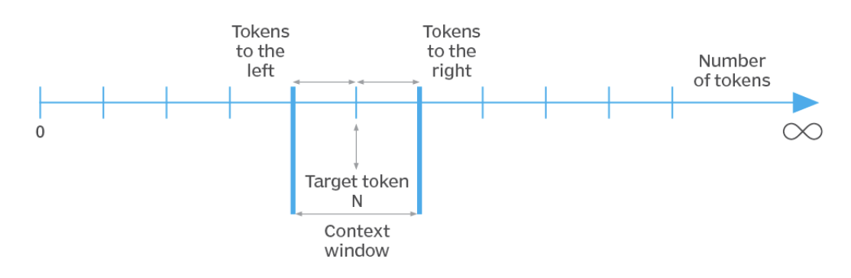
Context Window
Or Context Length
maximum amount of text (or tokens) that the model can consider at once when making predictions or generating output
Large context window = better performance
Notes:
Context Window (Context Length)
Definition: The context window refers to the maximum amount of text (or tokens) that the model can consider at once when making predictions or generating output. It determines how much input data the model can process simultaneously.
Importance of Context: A larger context window allows the model to better understand and generate content that requires consideration of long-range dependencies, such as summarizing long documents or generating coherent paragraphs.
Limitations: Traditional models had limited context windows, which restricted their ability to maintain coherence over longer sequences of text. Transformer models have extended this capability, but they still face practical limits due to computational costs.
Advancements: Some modern models and techniques (like those used in GPT-4) are pushing the boundaries of context windows, allowing for much longer sequences to be processed efficiently. This is critical for applications requiring the analysis of long documents, conversations, or codebases.

Slide 11

Model Training and Fine-Tuning
Data sources and volume
Training complexity
Ability to ”adapt” to different tasks
Ethics and intended use
Notes:
Training Complexity: As models grow in size, training them requires massive datasets, significant computational power, and extended time. Fine-tuning these large models for specific tasks also demands substantial resources.
Hardware Requirements: Training large models often requires specialized hardware, such as GPUs or TPUs, to handle the computational load. The scale of hardware needed scales with the number of parameters and context length.
Distributed Training: For extremely large models, training is often distributed across multiple servers or data centers to manage the computational burden.

Slide 12


GPU vs CPU
CPU (Central Processing Unit):
GPU (Graphics Processing Unit):
Advantages:
Cost
Flexibility
Power Consumption
Disadvantages:
Speed
Efficiency
Advantages:
Parallel Processing
Speed
Efficiency
Disadvantages:
Cost
Availability
Power Consumption
Notes:
CPU
Advantages:
Cost: More cost-effective and widely available.
Flexibility: Suitable for a wide range of tasks beyond deep learning.
Power Consumption: Lower power consumption compared to GPUs.
Disadvantages:
Speed: Slower for training and inference of large models due to limited parallel processing capabilities.
Efficiency: Less efficient for handling the high computational demands of transformer models.
GPU
Advantages:
Parallel Processing: GPUs are designed for parallel processing, making them much faster for tasks involving large-scale matrix operations, which are common in deep learning.
Speed: Significantly reduces the time required for training and inference of large models.
Efficiency: Better suited for handling the high computational demands of transformer models.
Disadvantages:
Cost: GPUs are generally more expensive than CPUs.
Availability: Not all environments have access to GPUs.
Power Consumption: Higher power consumption compared to CPUs.

Slide 13

Comparing LLMs
Generative Capabilities
Understanding Nuance and Context
Scalability and Deployment
Notes:
Impact of Model Size and Context on Applications
Generative Capabilities: Larger models with longer context windows are better at generating coherent, contextually relevant text over long passages. This is crucial for applications like long-form content generation, complex question answering, or generating code that requires understanding of an entire codebase.
Understanding Nuance and Context: A large number of parameters combined with a significant context window enables the model to capture more nuanced meanings and context, which is vital for applications in legal, medical, or technical domains where precision is key.
Scalability and Deployment: The practical aspects of deploying large models in real-world applications require balancing the model size with the infrastructure available. This includes considerations for edge computing, cloud deployment, and real-time processing needs.

Slide 14
Most common tasks
Classification (whole sentence or each word in a sentence)
Generating text
Knowledge extraction

Slide 15
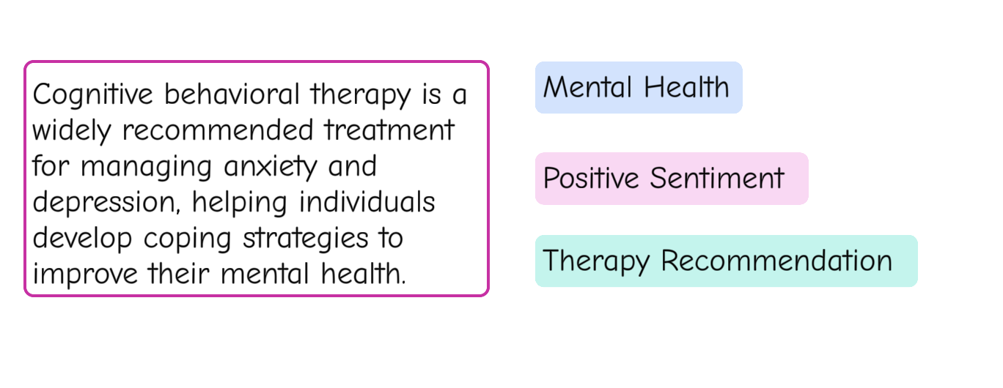
Text classification
Zero-shot text classification
model to classify text into requested categories without any specific training on categories
Notes:
Zero-shot text classification in LLMs allows the model to classify text into categories without any specific training on those categories. The model uses its broad, pre-trained knowledge to understand the task described in the prompt and makes predictions based on context. Users provide a description of the classification task and possible labels, and the LLM assigns the most appropriate label to the text based on its understanding, even if it has never seen examples of that task during training. This approach enables flexible and rapid deployment across diverse tasks without the need for labeled data.

Slide 16
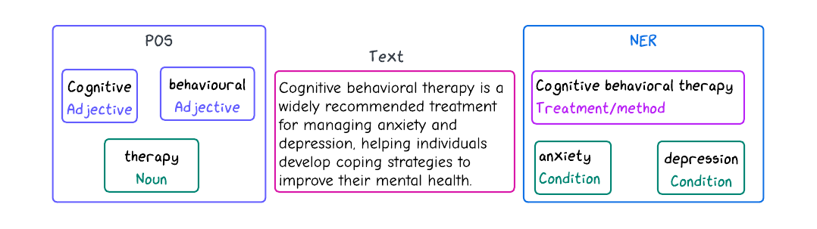
Classifying words in a sentence
Part of speech (POS) tagging
identifying and labelling each word in a sentence with its corresponding grammatical category, such as noun, verb, adjective, etc.
Named Entity Recognition (NER)
identifying and classifying proper nouns or specific entities within text into predefined categories such as people, organizations, locations, dates, etc.

Slide 17

Knowledge extraction
Automatically identifying and extracting structured information (such as facts, relationships, entities, and events) from unstructured or semi-structured text.
Goal: transform textual data into a more organized, machine-readable format to be used for further analysis

Slide 18
Key Components of Knowledge Extraction
Entity Recognition: Identifying key entities such as people, organizations, locations, etc.
Relation Extraction: Identifying relationships between entities, such as "John works at Company X."
Event Extraction: Detecting events and the entities involved, such as "Conference held in Paris."
Fact Extraction: Extracting specific facts or assertions from text, like "The Eiffel Tower is in Paris."

Slide 19

Text generation
a model produces human-like text based on given input.
The input can be anything from a simple prompt to structured data
The output is a coherent, contextually relevant sequence of words or sentences
Challenges in Text Generation:
Coherence
Contextual Relevance
Factual Accuracy
Bias & Ethics
Diversity
Notes:
What is Text Generation?
Definition:
Text generation is a natural language processing (NLP) task where a model produces human-like text based on given input. The input can be anything from a simple prompt to structured data, and the output is a coherent, contextually relevant sequence of words or sentences.
Goal:
The primary goal of text generation is to produce meaningful and fluent text that adheres to the input's context or constraints, often mimicking human language patterns.
2. Key Applications of Text Generation:
Chatbots & Virtual Assistants:
Generating responses to user queries in real-time, making conversations more natural.
Content Creation:
Automatically generating articles, blog posts, summaries, or creative writing, assisting human writers.
Machine Translation:
Converting text from one language to another, generating accurate translations.
Summarization:
Producing concise summaries of long documents, extracting essential information.
Code Generation:
Automatically writing code based on descriptions, useful in software development.
Question Answering:
Generating detailed answers to specific questions, often using information from large databases.
3. Approaches to Text Generation:
Rule-Based Systems:
Early methods using predefined rules and templates. Limited flexibility and creativity.
Statistical Methods:
Methods like N-grams, which generate text based on statistical probabilities of word sequences. Improved fluency but still limited context understanding.
Neural Network Models:
Modern approaches using deep learning models like Recurrent Neural Networks (RNNs), Long Short-Term Memory (LSTM), and more recently, Transformers.
Transformers:
Powerful models like GPT (Generative Pre-trained Transformer), BERT (Bidirectional Encoder Representations from Transformers), and BART (Bidirectional and Auto-Regressive Transformers) have revolutionized text generation by understanding and generating text in a highly contextual and coherent manner.
4. Challenges in Text Generation:
Coherence:
Ensuring that the generated text makes sense throughout and maintains logical consistency.
Contextual Relevance:
Keeping the output relevant to the input or prompt, especially when generating longer texts.
Factual Accuracy:
Avoiding the generation of incorrect or misleading information, often referred to as "hallucinations."
Bias & Ethics:
Addressing potential biases in generated content and ensuring ethical use, particularly in sensitive contexts.
Diversity:
Generating varied and creative outputs without repetition or redundancy.

Slide 20

Let’s practice

