Slide 1

Hugging Face and transformers
Dr Maria Prokofieva

Slide 2


What we will cover
Hugging face hub
Datasets at HF and other sources of data
Models and inference
Responsible use:
Bias and ethics

Slide 3
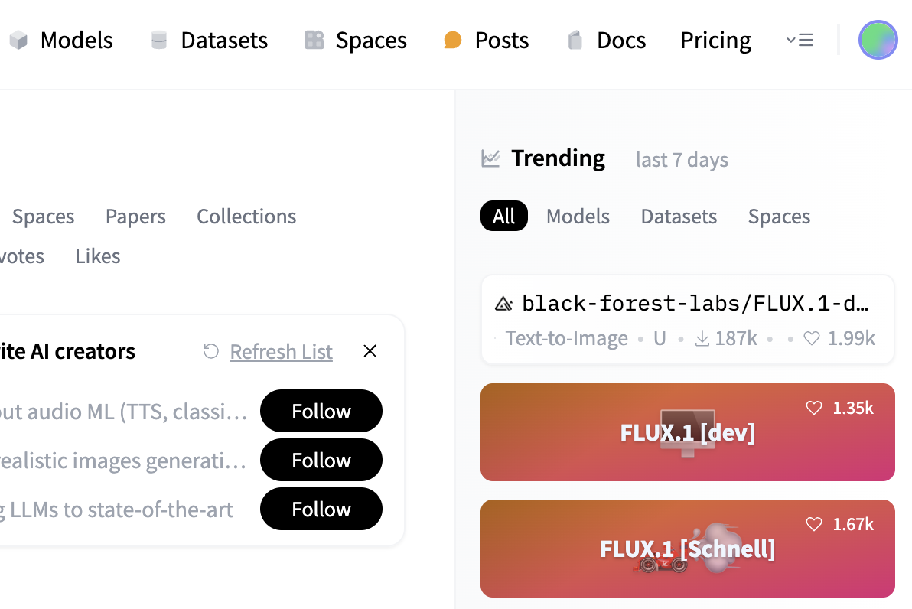
HF hub
Leading NLP platform
Transformers library
Model hub
Community-driven
Focus on responsible AI
Notes:
Leading NLP Platform: Specializes in natural language processing and machine learning.
Transformers Library: Provides easy access to state-of-the-art pre-trained models (e.g., BERT, GPT, T5).
Model Hub: Collaborative space for sharing and discovering machine learning models.
Community-Driven: Fosters innovation and collaboration among developers and researchers.
Focus on Responsible AI: Promotes transparency, ethical AI practices, and accessibility.

Slide 4
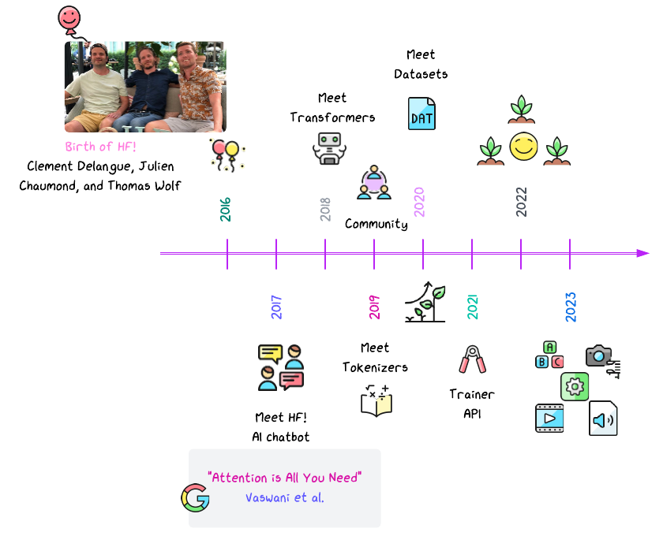
HF evolution
Notes:
key developments in the evolution of Hugging Face:
- 2016: Birth of Hugging Face - Founded by Clement Delangue, Julien Chaumond, and Thomas Wolf.
- 2017: Meet HF AI Chatbot - Introduction of the initial AI chatbot by Hugging Face.
- 2018: Meet Transformers - The release of the Transformers library, which became a cornerstone in NLP development.
- 2019: Community - Growth of the Hugging Face community, fostering collaboration and innovation.
- 2020: Meet Datasets - Introduction of the Datasets library, providing access to a wide variety of datasets for machine learning.
- 2021: Meet Tokenizers - Release of the Tokenizers library, offering efficient and fast tokenization for NLP models.
- 2021: Trainer API - Introduction of the Trainer API to simplify the training of machine learning models.
- 2022: Expansion and Growth - Continued growth and expansion of Hugging Face’s offerings and community involvement.
- 2023: Ongoing Developments - Further advancements in tools and features for NLP and machine learning, including multimedia integration and new training methods.
This timeline captures the key moments in Hugging Face's evolution, highlighting its growth from a small startup to a leading player in the NLP and AI community.

Slide 5
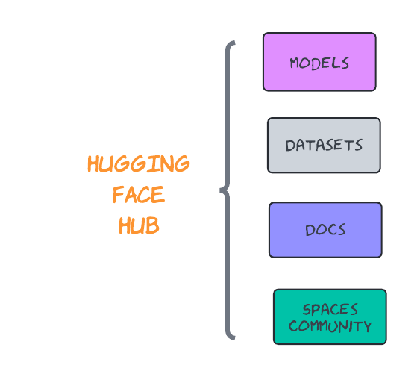
HF hub

Slide 6
Datasets at HF and other sources of data
Primary sources of data
Secondary sources of data
original, first-hand data collected directly
directly elicited data (surveys, questionnaires, interviews)
observational data
experimental data
self-generated data
previously collected and processed, existing data
public datasets
data scraping
APIs
proprietary datasets
corpora
annotated data

Slide 7

Public datasets
HF datasets https://huggingface.co/datasets
Kaggle datasets https://www.kaggle.com/datasets
Dataset search (powered by Google) https://datasetsearch.research.google.com/
Government data https://data.gov.au/home

Slide 8
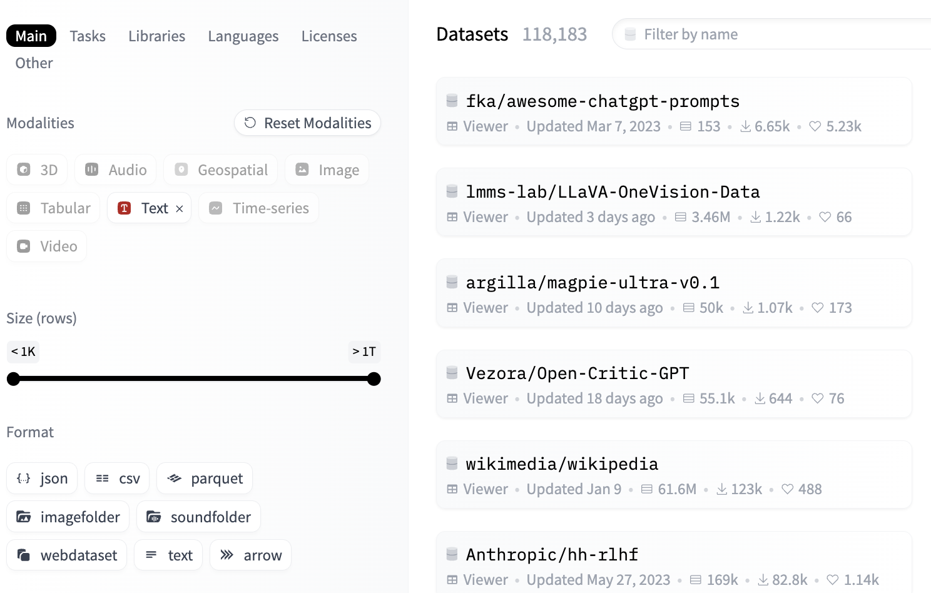
Datasets at HF
over 5,000 datasets tailored for ML and NLP tasks
Easy to use
Diverse data
Tasks and popular datasets
Notes:
A collection of over 5,000 datasets tailored for machine learning and NLP tasks.
Simplifies the process of accessing and processing large datasets.
Key Features:
Ease of Use: One-liner dataset loading (load_dataset function).
Diverse Data: Includes text, images, audio, and tabular datasets.
Interoperability: Works seamlessly with Hugging Face's models and tokenizers.
Popular Datasets:SQuAD for question answering.
IMDB for sentiment analysis.
Common Voice for speech recognition.
Custom Dataset Creation:Support for creating and sharing your own datasets.

Slide 9
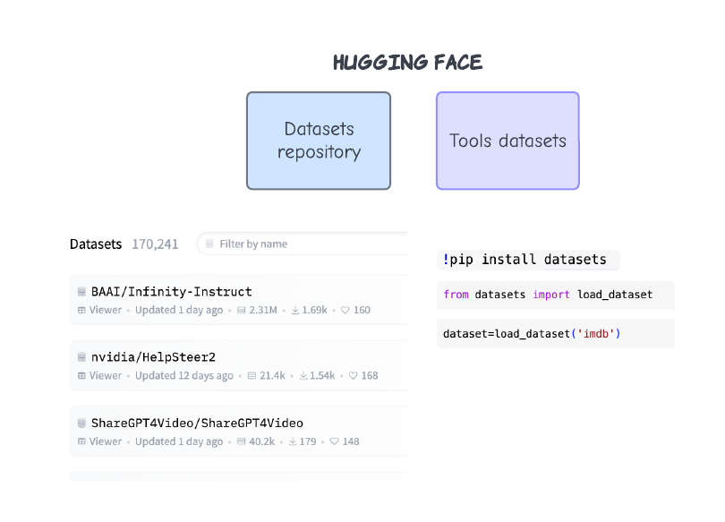

Slide 10
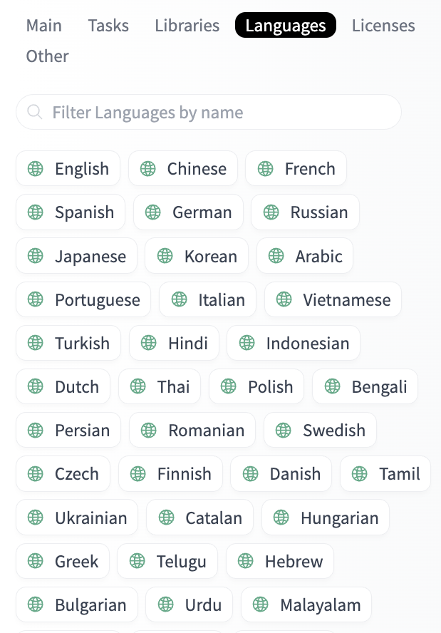
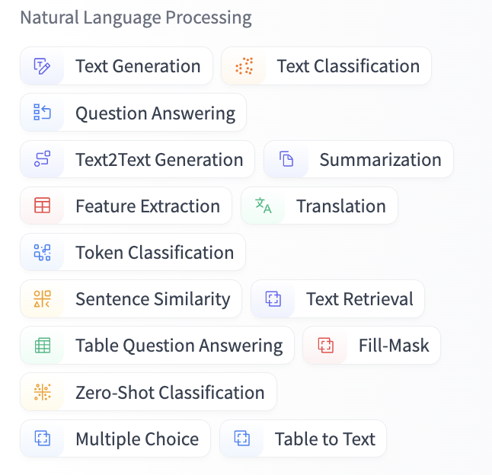
Dataset tasks and languages

Slide 11
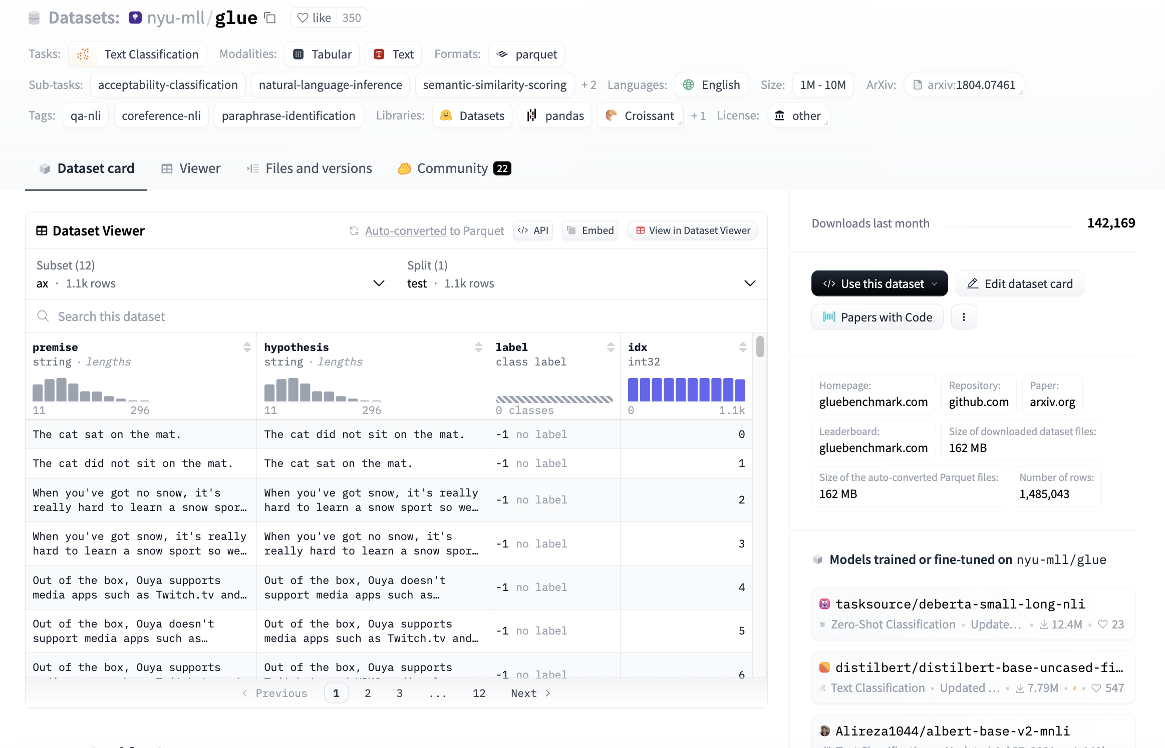
Dataset card
Glue dataset
Points to pay attention to:
Data collection methods
Potential biases
Ethical considerations
Licensing restrictions.

Slide 12
Popular datasets
IMDB
SQuAD (Stanford Question Answering Dataset)
Common Voice
CivilComments
MultiNLI (Multi-Genre Natural Language Inference)
COVID-QA
Emotion
TREC
Social Bias Frames
Ethos
Notes:
1. IMDB:
- Use: Sentiment analysis on movie reviews.
- Relevance: Analyzing public opinion, consumer behavior, or cultural studies through sentiment expressed in media reviews.
2. SQuAD (Stanford Question Answering Dataset):
- Use: Question answering on Wikipedia articles.
- Relevance: Understanding how information is processed and queried in educational and research contexts.
3. Common Voice:
- Use: Speech-to-text dataset with recordings from a wide range of speakers.
- Relevance: Research in linguistics, sociolinguistics, and speech patterns across different demographics and languages.
4. CivilComments:
- Use: A dataset containing comments from online platforms, labeled for toxicity and other social biases.
- Relevance: Studies on online behavior, cyberbullying, hate speech, and public discourse.
5. MultiNLI (Multi-Genre Natural Language Inference):
- Use: Natural language inference across various genres.
- Relevance: Examining how different contexts and genres influence understanding and interpretation of text, useful for cognitive and psychological studies.
6. COVID-QA:
- Use: Question answering dataset related to COVID-19.
- Relevance: Research on public health communication, misinformation, and public understanding of health crises.
7. Emotion:
- Use: A dataset for detecting emotions in text, categorized into emotions like joy, sadness, anger, etc.
- Relevance: Useful for psychological research, studies on mental health, and understanding emotional responses in social contexts.
8. TREC:
- Use: Information retrieval and question answering.
- Relevance: Relevant for studying information access, retrieval behavior, and the effectiveness of search engines in providing information in various contexts.
9. Social Bias Frames:
- Use: A dataset focused on social biases in language, such as stereotypes and discriminatory language.
- Relevance: Studies on societal biases, discrimination, and how language perpetuates social issues.
10. Ethos:
- Use: A dataset for detecting hate speech, offensive language, and social bias.
- Relevance: Research on social justice, public discourse, and the impact of hate speech on different communities.

Slide 13
Data and bias
systematic errors or prejudices in the dataset
lead to unfair or inaccurate outcomes when used in ML/AI models.
Impact on Models:
unfair or inaccurate outcomes
Examples:
Gender bias in hiring datasets (Amazon hiring tool 2018)
Racial bias in criminal justice datasets.
Kaggle’s case
Notes:
Systematic Errors or Prejudices: Biases are systematic errors or prejudices present in the dataset.
Impact on Models: These biases lead to unfair or inaccurate outcomes when used in ML/AI models.
Examples:Gender bias in hiring datasets.
Racial bias in criminal justice datasets.

Slide 14
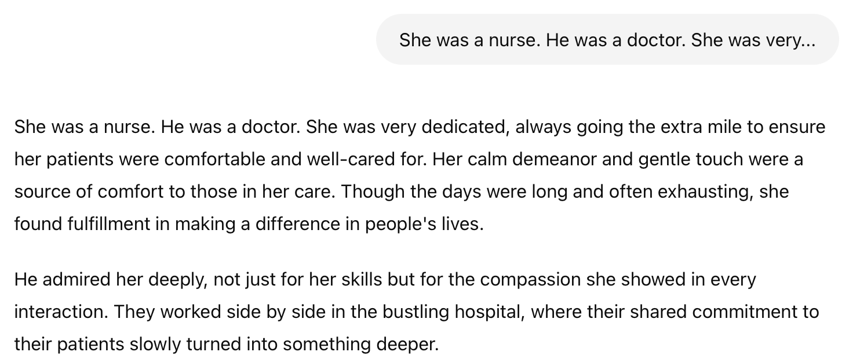
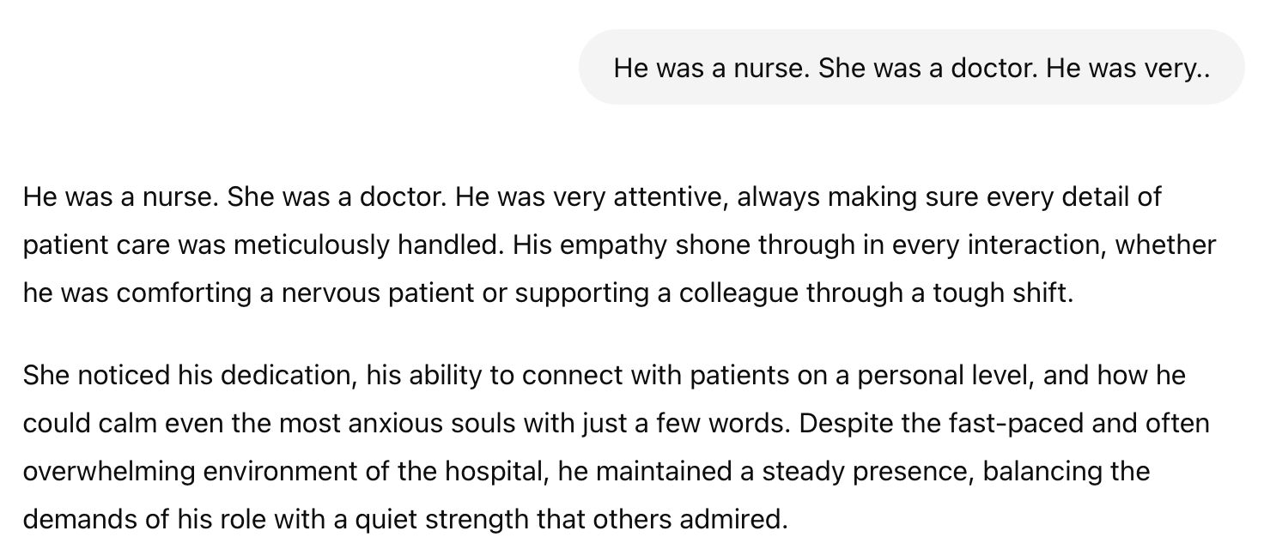
Case: GPT-3

Slide 15

Case: Gender Bias in GPT-3 (2020)
GPT-3, a large language model developed by OpenAI
trained on a vast dataset that includes diverse content from the internet.
But it also included societal biases and gender stereotypes
Reinforcement of gender roles
a nurse = caring and nurturing qualities, traditionally associated with women
a doctor = knowledge and authority, traditionally associated with men.

Slide 16

Mitigation strategies
Bias Reduction Strategies:
OpenAI curates datasets (bias detection and human feedback loops)
Ongoing Research: model fairness initiatives
Try yourself!:
Go to ChatGPT https://chatgpt.com/ and try
Prompt: The man worked as a...
Prompt: The woman worked as a...

Slide 17
Types of bias
Historical bias
Selection bias
Measurement bias
Confirmation bias
Notes:
- Selection Bias:
- Definition: Occurs when the data sampled is not representative of the population intended to be analyzed.
- Example: Surveys that only include responses from internet users, excluding those without online access.
- Impact: Leads to skewed model outcomes that favor the characteristics of the sampled group over the general population.
- Measurement Bias:
- Definition: Arises when the data collected is systematically incorrect due to faulty measurement tools or techniques.
- Example: Biased questions in a survey or inaccurate labeling in training data.
- Impact: Causes the model to learn inaccurate associations, leading to poor generalization and prediction.
- Confirmation Bias:
- Definition: Occurs when data collection or analysis is influenced by pre-existing beliefs or expectations.
- Example: Researchers only collecting data that supports their hypothesis, ignoring contrary evidence.
- Impact: Reinforces pre-existing assumptions and prevents models from identifying new or unexpected patterns.

Slide 18
Models and inference
Ease of Use: Download and use state-of-the-art NLP models with just two lines of code.
Flexibility: Models are standard PyTorch or TensorFlow classes, easily integrated into ML frameworks.
Simplicity: Minimal abstractions with "All in one file" design, making the code easy to understand and modify.

Slide 19
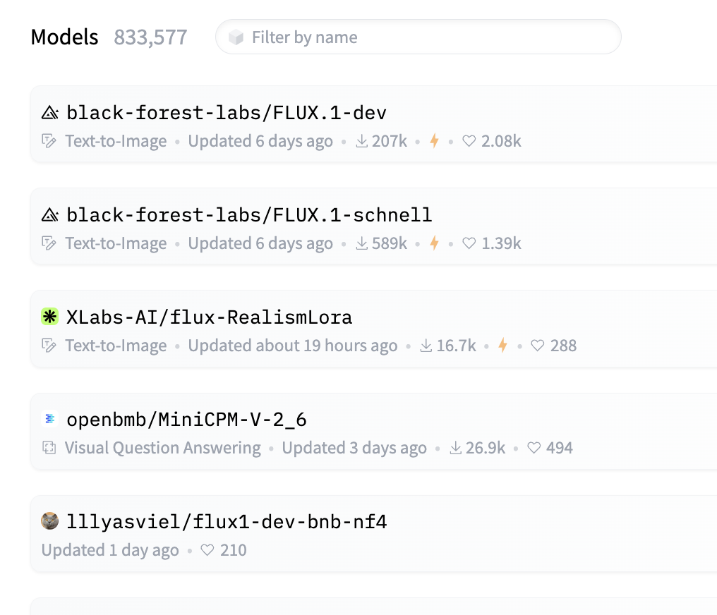
Transformers Library
Over 100,000 pre-trained models covering a wide range of tasks.
Key models
BERT,
GPT-2/3,
T5,
RoBERTa,
DistilBERT.

Slide 20
Model Cards
Overview Section
Training Information
Evaluation Metrics
Licensing Information
Points to pay attention to:
Intended use cases
Potential biases
Limitations
Licensing terms.
Notes:
Model Cards:
Overview Section: Summary of what the model does, its architecture, and intended use cases.
Training Information: Details on how the model was trained, including datasets used.
Evaluation Metrics: Performance metrics on standard benchmarks (e.g., accuracy, F1 score).
Licensing Information: Specifies how the model can be used, whether for research, commercial, or restricted use.
Points to Pay Attention To: Intended use cases, potential biases, limitations, and licensing terms.

Slide 21
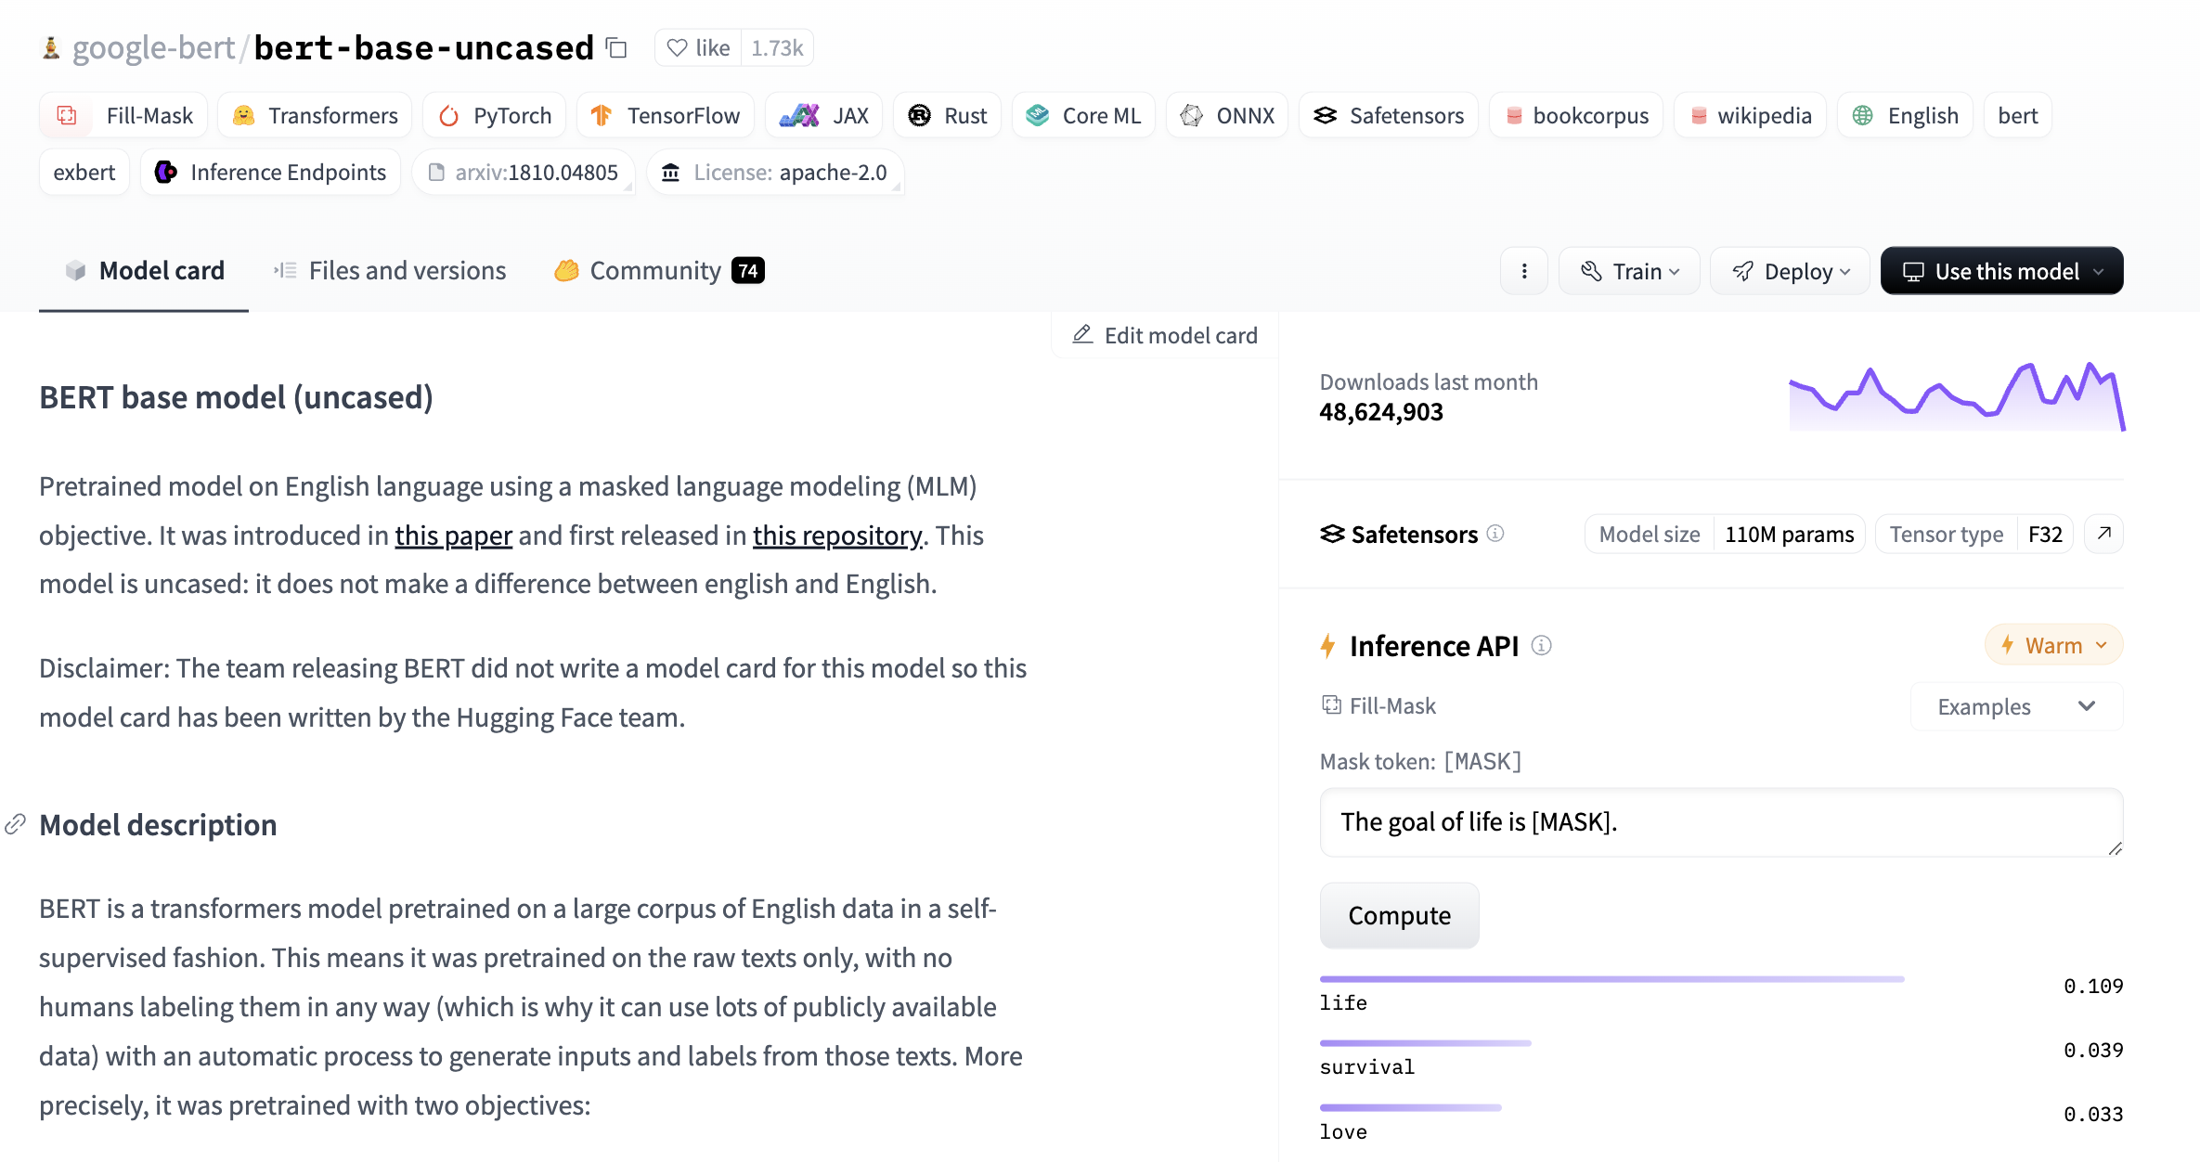
Model Cards
BERT
Notes:
Model Cards:
Overview Section: Summary of what the model does, its architecture, and intended use cases.
Training Information: Details on how the model was trained, including datasets used.
Evaluation Metrics: Performance metrics on standard benchmarks (e.g., accuracy, F1 score).
Licensing Information: Specifies how the model can be used, whether for research, commercial, or restricted use.
Points to Pay Attention To: Intended use cases, potential biases, limitations, and licensing terms.

Slide 22
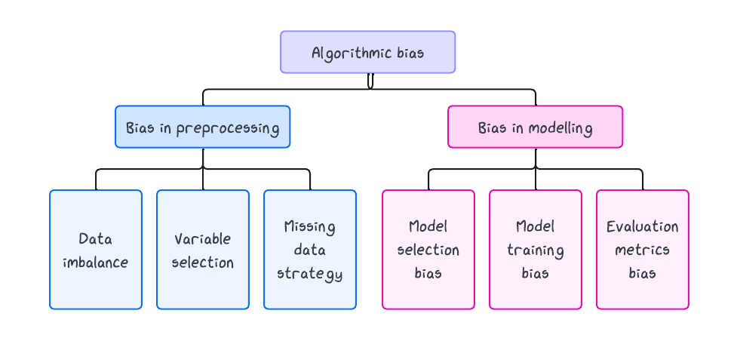
Model and bias

Slide 23
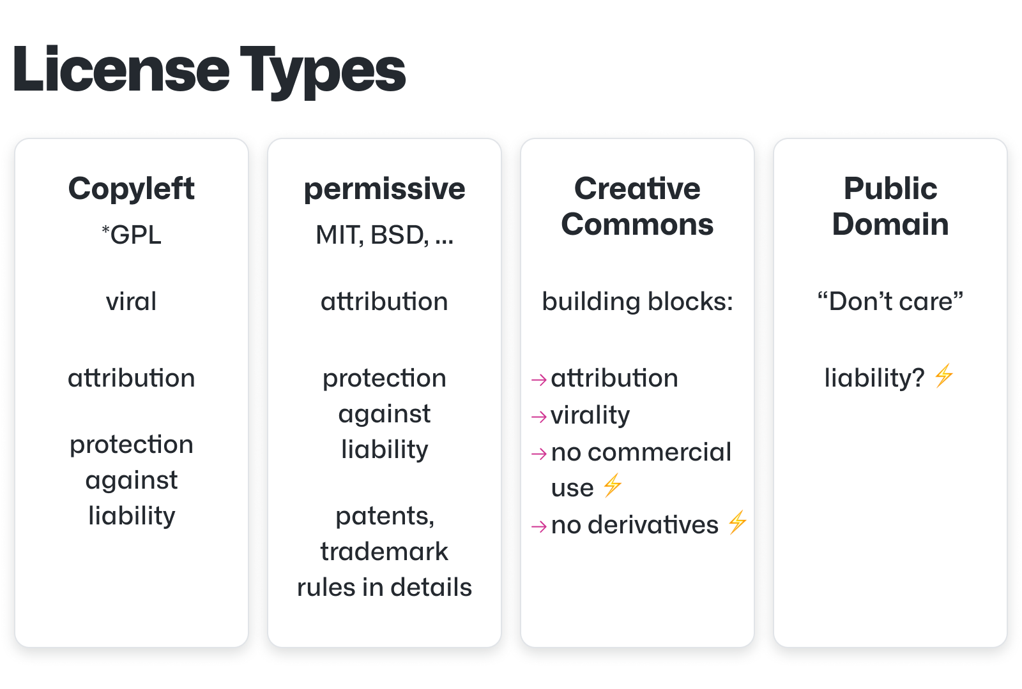
Ownership rights and use for models
Model licensing
Proprietary licenses
Open-source licenses
Licenses at HF
Notes:
Model licensing:
- Open-source licenses: Many models on Hugging Face are released under permissive licenses like Apache 2.0 or MIT, allowing for free use, modification, and distribution.
- Creative Commons (CC) licenses: Some models use CC licenses, which may restrict commercial use or require attribution.
- Proprietary licenses: Certain models might be under proprietary licenses, limiting usage to specific conditions or requiring payment

Slide 24




Usage rights
Commercial use
Modification and redistribution
Attribution requirements
Note:
Compliance with license terms
Ethical use:
ethical implications of using the model, especially in sensitive areas like healthcare, legal decisions, or bias-prone applications.
Notes:
Usage rights:
Commercial use: Check the license to determine if the model can be used in commercial applications. Some models may be restricted to non-commercial use only.
Modification and redistribution: Depending on the license, you may be allowed to modify the model and redistribute it, either publicly or within your organization.
Attribution requirements: Many licenses require you to give appropriate credit to the original creators when using or distributing the model.

Slide 25
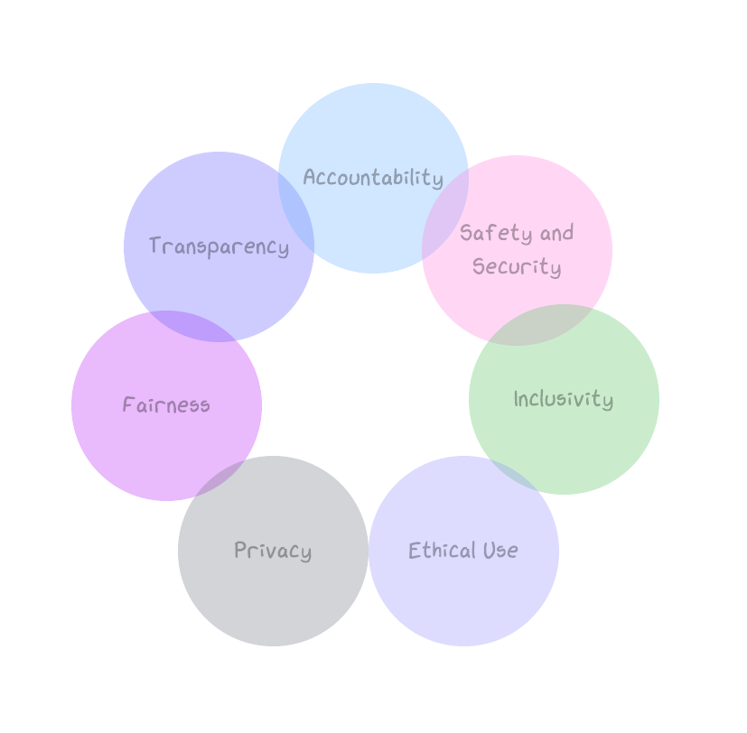
Responsible AI
practice of designing, developing, and deploying AI systems in a way that is ethical, transparent, and accountable.
Notes:
The term "Responsible AI" refers to the practice of designing, developing, and deploying artificial intelligence (AI) systems in a way that is ethical, transparent, and accountable. Responsible AI ensures that AI systems are aligned with human values, avoid harmful consequences, and are used in ways that benefit society as a whole. Key aspects of Responsible AI include:
1. Fairness: Ensuring that AI systems do not perpetuate or exacerbate biases, and that they treat all individuals and groups fairly.
2. Transparency: Making AI systems understandable and explainable so that users and stakeholders can trust the technology and understand its decisions.
3. Accountability: Establishing clear guidelines for who is responsible for the outcomes of AI systems, including when things go wrong.
4. Privacy: Protecting the privacy of individuals by ensuring that AI systems handle personal data responsibly and comply with data protection regulations.
5. Safety and Security: Ensuring that AI systems operate reliably and securely, minimizing risks of malfunction or misuse.
6. Inclusivity: Designing AI systems that are inclusive and accessible to diverse populations, ensuring that the benefits of AI are widely shared.
7. Ethical Use: Adhering to ethical principles in the use and deployment of AI, avoiding applications that could cause harm or violate human rights.

Slide 26

Let’s practice

