Slide 1


INNOV8
PRESENTS
MEDI-TRACK
AI
INTELLIGENT HOSPITAL EQUIPMENT TRACKING
AND MANAGEMENT SYSTEM
TEAM NAME: INNOV8
BY AMEYA JOSE CHAZHOOR, MARIA ANN MATHEW, NIRANJANA PP, LALKRISHNA VJ

Slide 2




INNOV8
PROBLEM STATEMENT(NO.14 : MEDICAL EQUIPMENT TRACKING)
The real challenge is knowing where medical equipment is,
whether it is available, and whether it is ready when urgently required.
• Mobile equipment is often difficult to locate.
• Real-time availability and usage status are unclear.
• Equipment may remain unused while another department needs it.
• Delayed maintenance and emergency access can affect operations.
Core problem: no unified system connects identification, usage, location and intelligent management.

Slide 3


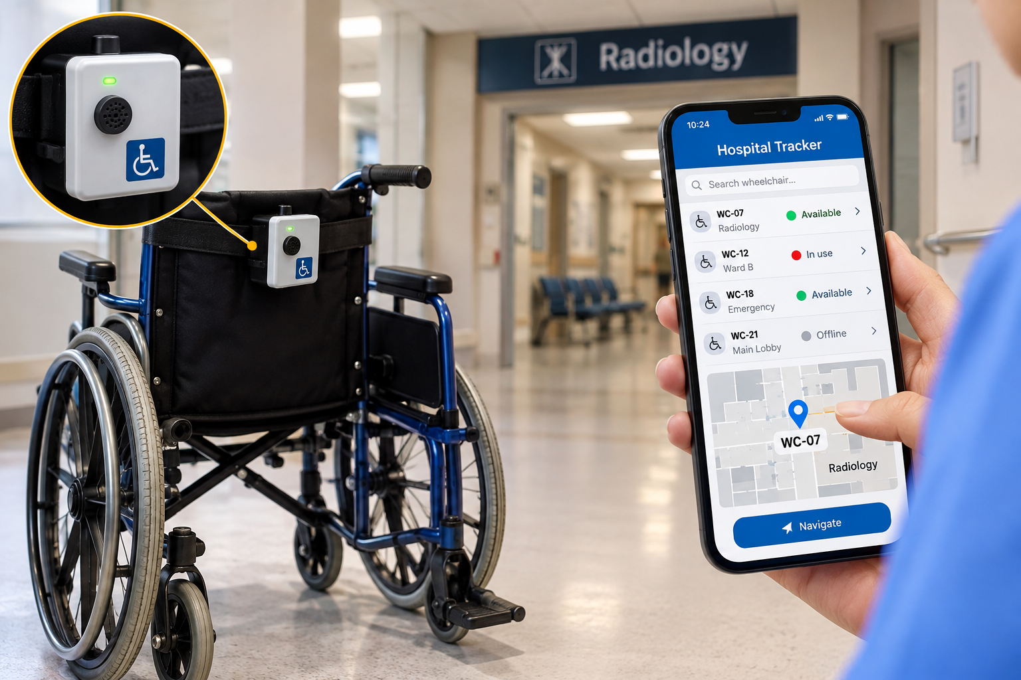

INNOV8
PROPOSED SOLUTION
Introducing MediTrack AI
An integrated IoT + AI platform that monitors, locates and intelligently manages hospital medical equipment.
• ESP32-based tracking module
• RFID equipment identification
• PIR-based usage detection
• Wi-Fi-connected centralized dashboard
• AI-assisted allocation, maintenance and demand analysis
Hardware Tracking + Website + AI Intelligence

Slide 4



INNOV8
IDEA & INNOVATION
What makes MediTrack AI different?
• Automated status detection using motion sensing.
• Unique RFID identity for every registered equipment item.
• Manual + automatic status control.
• Digital hospital map for equipment visibility.
Connected monitoring replaces manual equipment tracking.
• AI-assisted allocation and predictive maintenance.
• Centralized inventory, hardware monitoring and analytics.

Slide 5
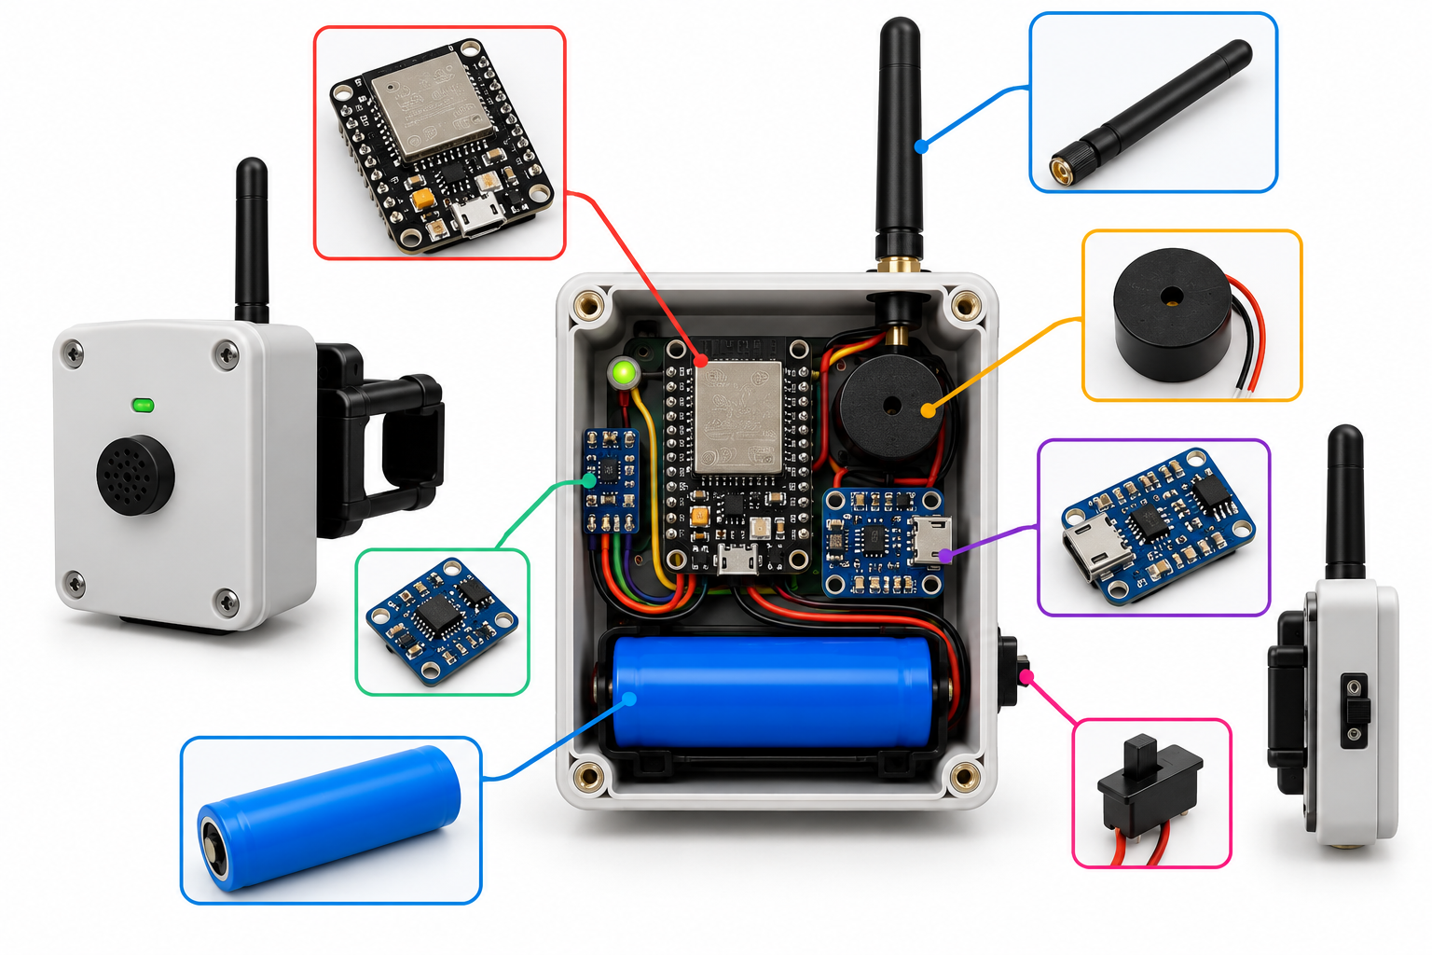
INNOV8
SYSTEM ARCHITECTURE
Hardware Layer
ESP32 • RFID RC522 • PIR • Buttons • LED • Buzzer
Communication Layer
Wi-Fi • HTTP API • WebSocket
Backend + Data Layer
FastAPI • Equipment • Usage • Movement • Maintenance
AI + Application Layer
Smart allocation • Maintenance • Forecasting • Emergency priority
Dashboard • Hospital map • ESP32 Lab • AI Insights

Slide 6
INNOV8
WORKFLOW
1 IDENTIFY
RFID scan identifies registered equipment.
2 DETECT
PIR detects motion and updates usage.
3 CONTROL
Buttons allow manual start, stop or temporary unavailability.
4 TRANSMIT
ESP32 sends status through Wi-Fi.
5 UPDATE
Backend updates dashboard and map.
6 ANALYZE
AI processes data for allocation, maintenance, forecasting and emergency priority.
LED + buzzer provide local hardware feedback.

Slide 7
INNOV8
AI / ML IMPLEMENTATION
01 SMART ALLOCATION
Availability • Location • Department • Priority • Condition
02 PREDICTIVE MAINTENANCE
Usage hours • Equipment age • Faults • Temperature • Health
03 DEMAND FORECASTING
Historical usage • Department requirements • Usage patterns
04 EMERGENCY PRIORITIZATION
Emergency level • Availability • Location • Clinical priority
Objective: faster and more informed equipment management decisions.

Slide 8
INNOV8
TECHNOLOGY STACK
MICROCONTROLLER + HARDWARE
ESP32 • Arduino IDE / C++ • RFID RC522 • PIR sensor
COMMUNICATION
Wi-Fi • HTTP API • WebSocket
BACKEND + DATA
Python • FastAPI • SQLite
FRONTEND + AI
HTML • CSS • JavaScript • SVG
Technology integration: IoT → backend → web platform → AI modules

Slide 9

INNOV8
KEY FEATURES
Equipment Management
• Centralized inventory
• RFID identification
• Status + health information
Live Hospital Tracking
• Interactive floor map
• Department-wise locations
• Movement visualization
ESP32 Lab + AI Insights
• Hardware monitoring • RFID/PIR testing
• AI allocation • maintenance • forecasting

Slide 10

INNOV8
IMPLEMENTATION
Hardware Development
• ESP32 + RFID + PIR integrated
• Buttons, LED and buzzer connected
• Automatic/manual status controls
Backend Development
• FastAPI services
• Equipment/status handling
• Database + real-time communication
Frontend + AI
• Dashboard • map • ESP32 Lab • AI Insights
• Allocation • maintenance • forecasting

Slide 11
INNOV8
WORKING PROTOTYPE
Hardware Demonstration
• RFID scanning identifies registered equipment.
• PIR detects motion and triggers usage updates.
• Buttons provide manual status control.
• LED and buzzer provide local feedback.
Website Demonstration
• Hardware synchronization
• Equipment inventory + live status
• Hospital map + ESP32 Lab
RFID → Detection → Wi-Fi → Backend → Website

Slide 12
INNOV8
RESULTS & EVALUATION
Prototype Results
Evaluation Parameters
• ESP32 initialized and operated successfully.
• RFID equipment identification demonstrated.
• PIR motion detection demonstrated.
• Manual start/stop and temporary-unavailable controls implemented.
• Hardware-to-website synchronization demonstrated.
• Hospital map and ESP32 Lab interfaces developed.
• RFID: tag recognition
• PIR: sensor response
• Status: correct updates
• Connectivity: synchronization
• Location: map visualization
• AI: output validation
Accuracy, response time and prediction performance should be reported only after measurement.

Slide 13
INNOV8
CHALLENGES & SOLUTIONS
Multiple hardware components
Hardware communication
ESP32 as central controller
Wi-Fi API communication
Equipment identification
Website synchronization
Backend + real-time updates
RFID-based identification
Location visualization
Usage detection
Interactive hospital map
PIR motion sensing
Correct status
Different hospital needs
Manual start/stop controls
AI-assisted management

Slide 14
INNOV8
IMPACT & USE CASES
Use Cases
Expected Impact
• Emergency departments: locate critical equipment.
• ICUs: monitor availability and usage.
• General wards: track shared equipment.
• Radiology: monitor imaging equipment.
• Equipment teams: inventory, movement and maintenance.
• Administration: centralized operational insights.
• Less search time • better visibility • improved utilization • organized maintenance

Slide 15
INNOV8
FUTURE SCOPE
Hardware Enhancements
• Compact low-power modules
• Improved indoor positioning
• More sensors + longer-range communication
AI Enhancements
• Failure prediction
• Advanced demand forecasting
• Allocation optimization
Platform + Scalability
• Mobile app • HIS integration
• Hospital-wide asset intelligence network

Slide 16
INNOV8
MEDI-TRACK
AI
Making Hospital Equipment Management
Smarter and More Connected
• Identify equipment through RFID.
• Detect usage through motion sensing.
• Monitor status through ESP32.
• Track equipment through a digital hospital map.
• Analyze equipment information using AI.

Slide 17
INNOV8
THANK YOU

