Slide 1
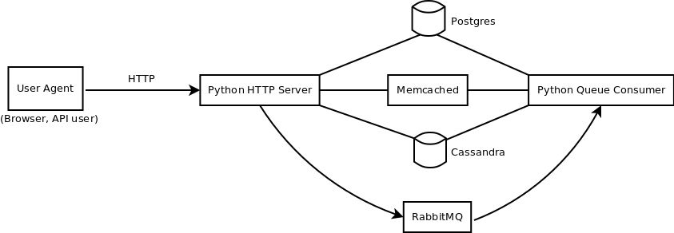
Logical View
Activity Diagram

Slide 2
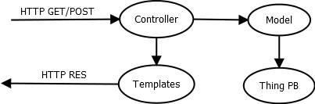
Logical View
HTTP Server expansion

Slide 3
Logical View
Database on Reddit
Thing DB
thing_id | up | down | is_delete | is_spam | date
… | … | … | … | … | …
Data DB
thing_id | key | value | kind
… | … | … | …

Slide 4
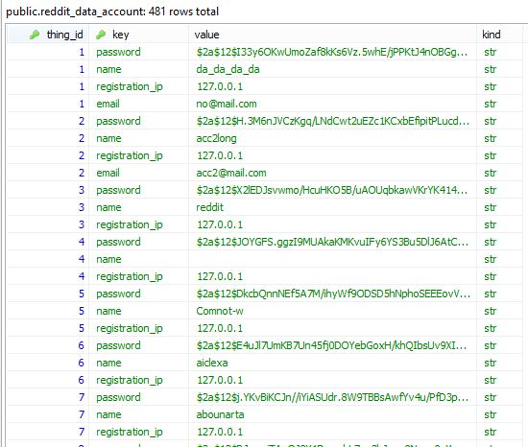
Data DB

Slide 5
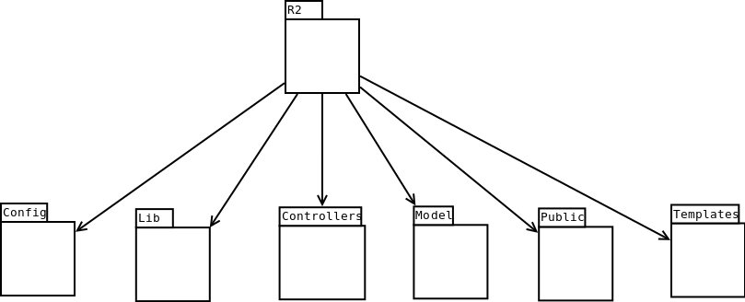
Logical View
Package Diagram

Slide 6
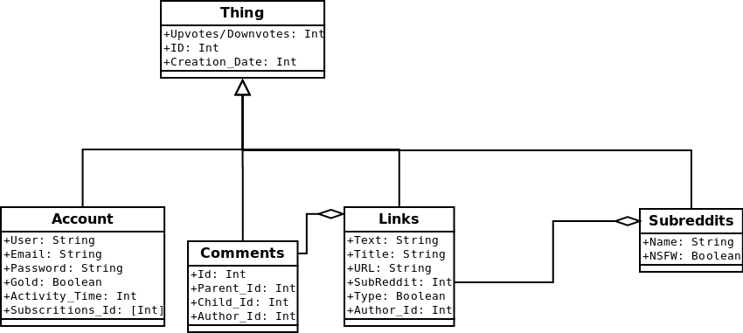
Logical View
Class Diagram

Slide 7
Logical View
How URL paths enter specific python code
URL path | Class controller | Class method
/ | HotController | GET_listing
/submit | FrontController | GET_submit
/r/{subreddit} | ????Controller | GET_????
/user/{username} | UserController | GET_listing
/api/{action} | ApiController | GET_{action} or POST_{action}
/api/vote | ApiController | POST_vote

Slide 8
Legenda
Letra | Significado
U | User Agent
H | HTTP Server
M | Memcached
C | Cassandra
P | Postgres
Co | Consumer
Pe | Permacache
Q | Queue

Slide 9
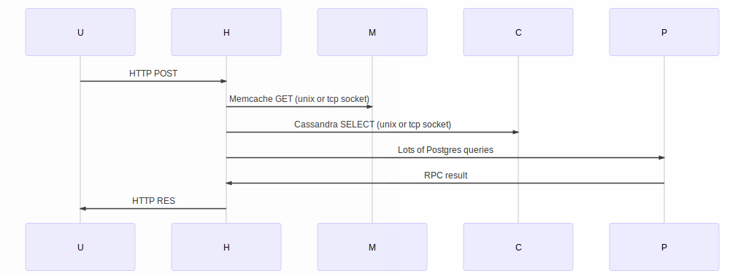
Process View
Submit Post use case

Slide 10
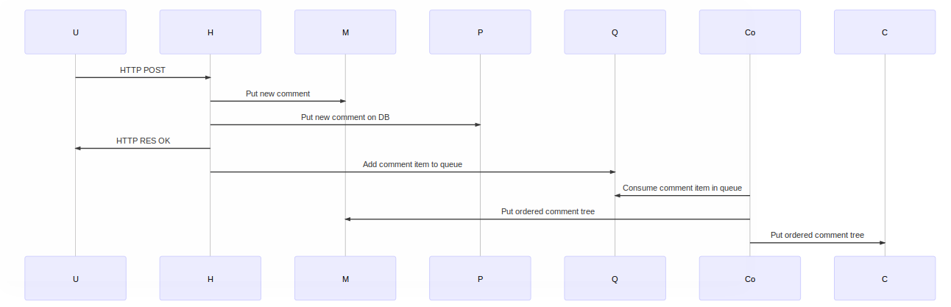
Process View
Submit Comment use case

Slide 11
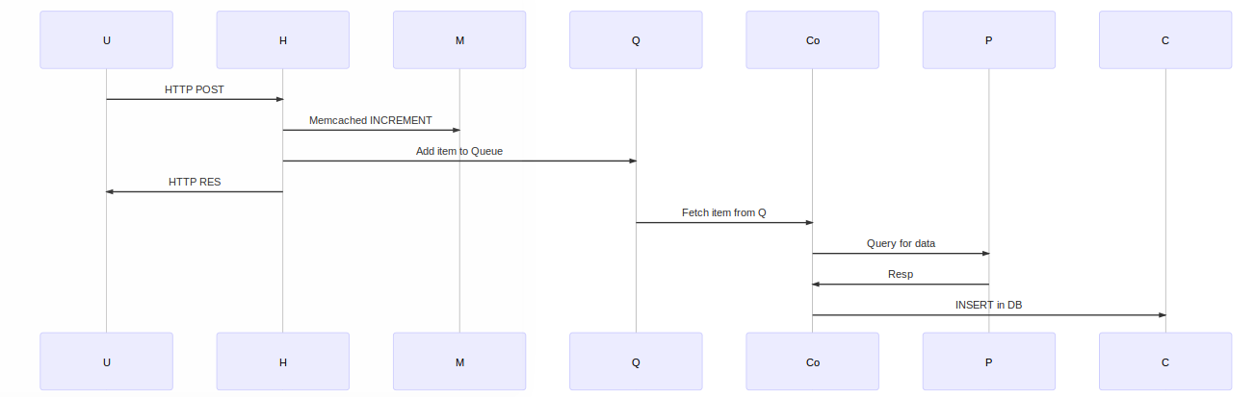
Process View
Upvote/Downvote use case

