Slide 1
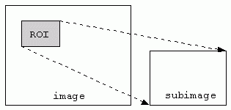
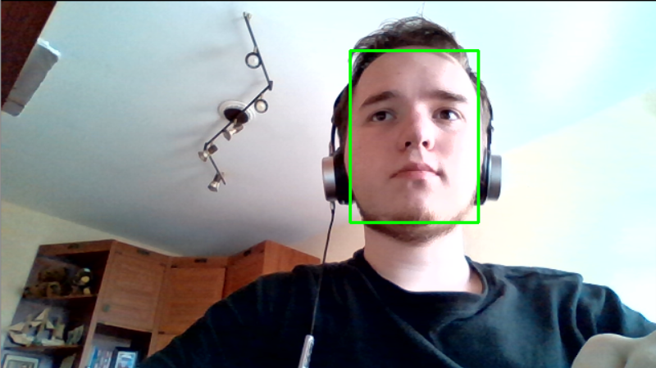
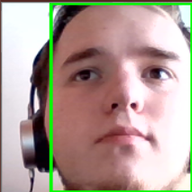
Face detection and Region of interest (ROI)
Using face-detection-adas-0001 model (Network operation time = 25 ms) and then select ROI

Slide 2
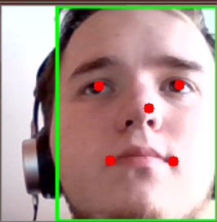


Face landmarks detection and eye regions
Using landmarks-regression-retail-0009 model (Network operation time = 2 ms) and then select eye regions

Slide 3


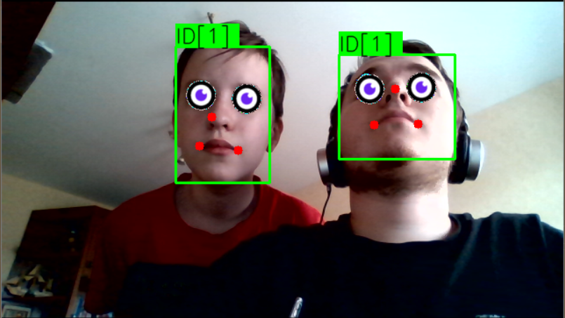
Replacing eyes with an image and final image
Overlay the image of the eye on our eye region
The final result

Slide 4

