Slide 1

Docker Introduction

Slide 2
Contents
1. What is Docker? What is it used for?
2. Example
    2.1. Docker images
    2.2. Dockerfile – builds custom image
    2.3. Docker-compose
    2.4. Networking in Docker
    2.5. Volumes in Docker
3. Benefits of containerisation
    3.1. Isolation of components
    3.2. Universal and easy deployment

Slide 3
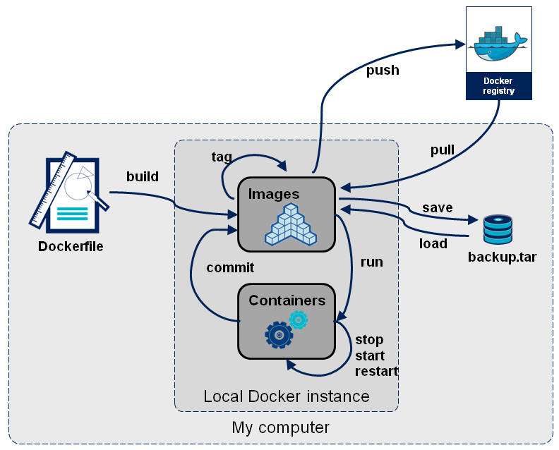
1. What is Docker?

Slide 4
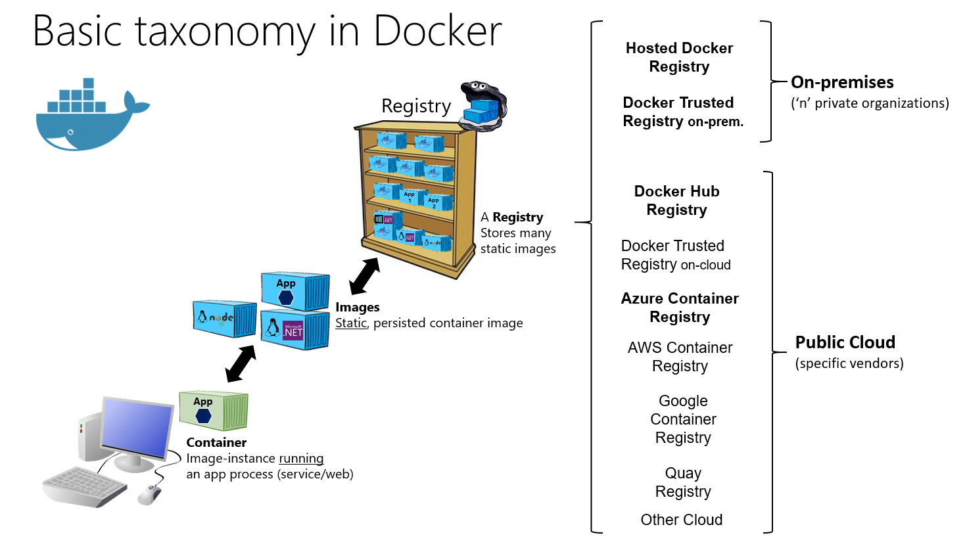
Images
Docker Hub

Slide 5
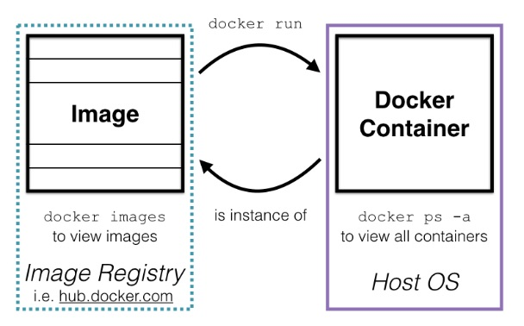
Image vs Container
An image is the template for the environment you want to run. When you run an image, you get a container.

Slide 6
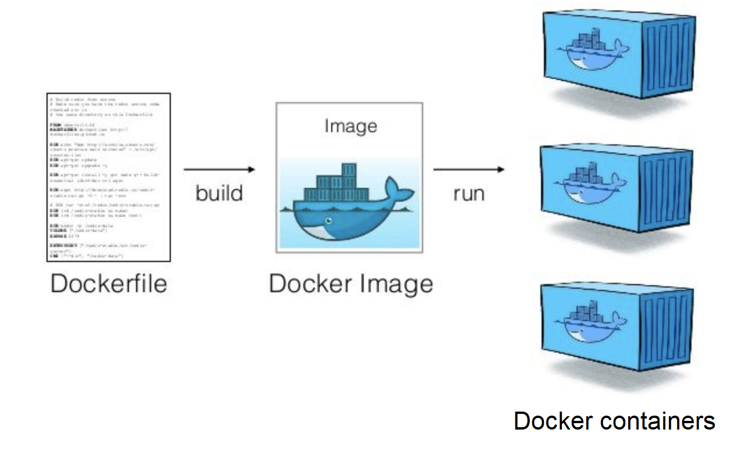
Running Docker containers

Slide 7
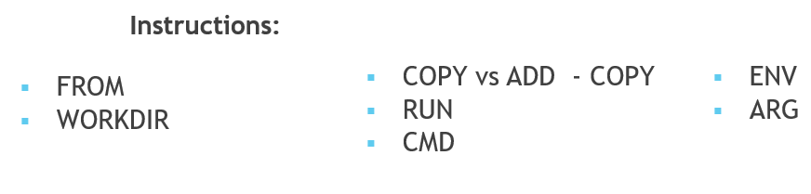
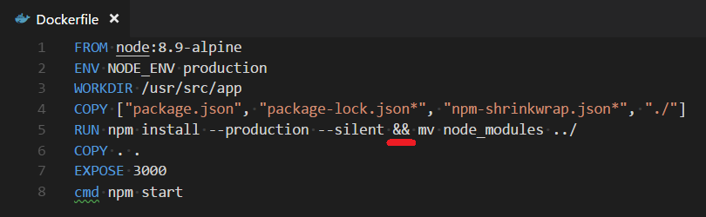
Dockerfile
Layers

Slide 8
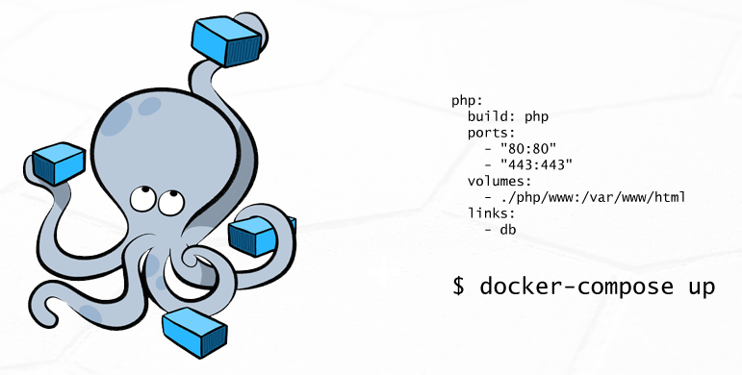
Docker-compose file

Slide 9
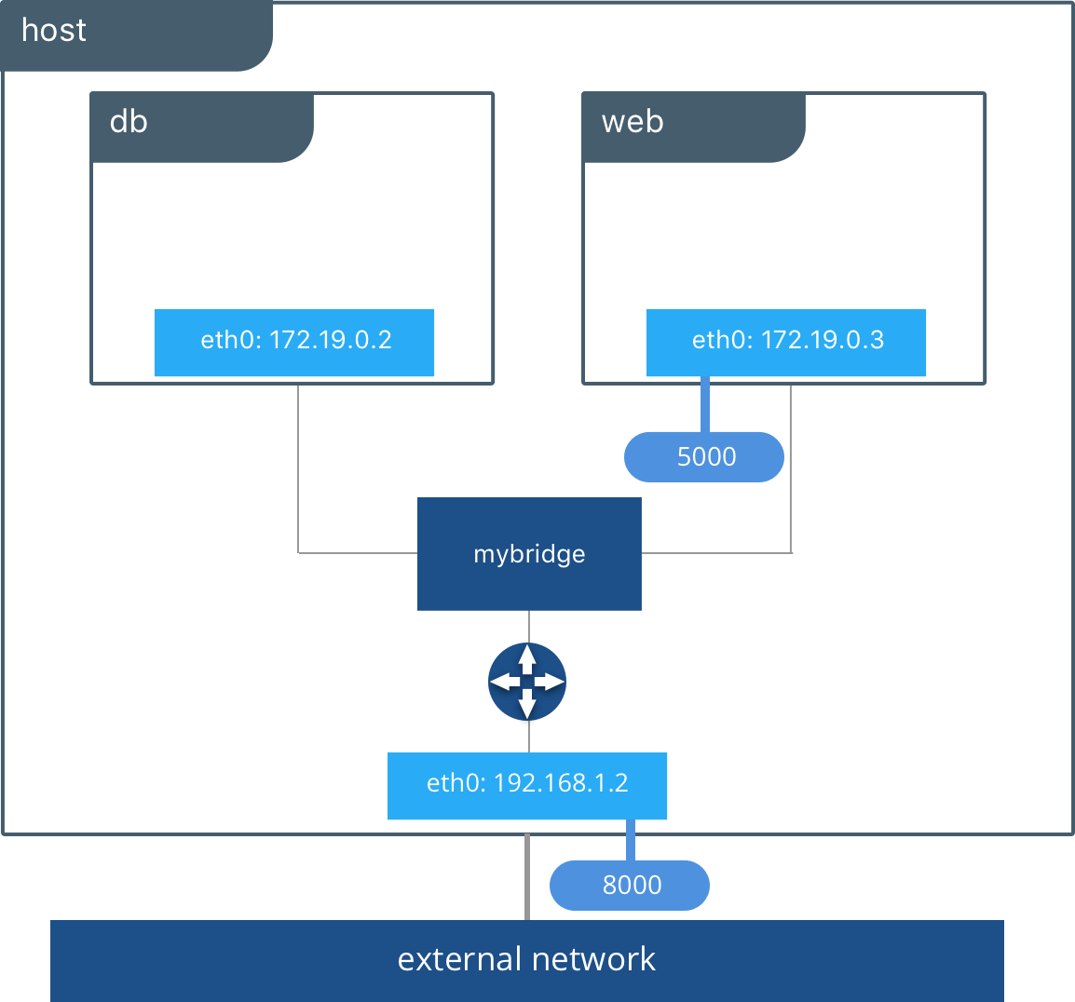
Networking

Slide 10
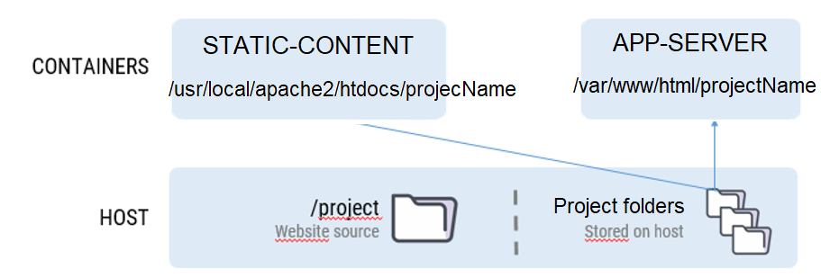
Volumes

Slide 11
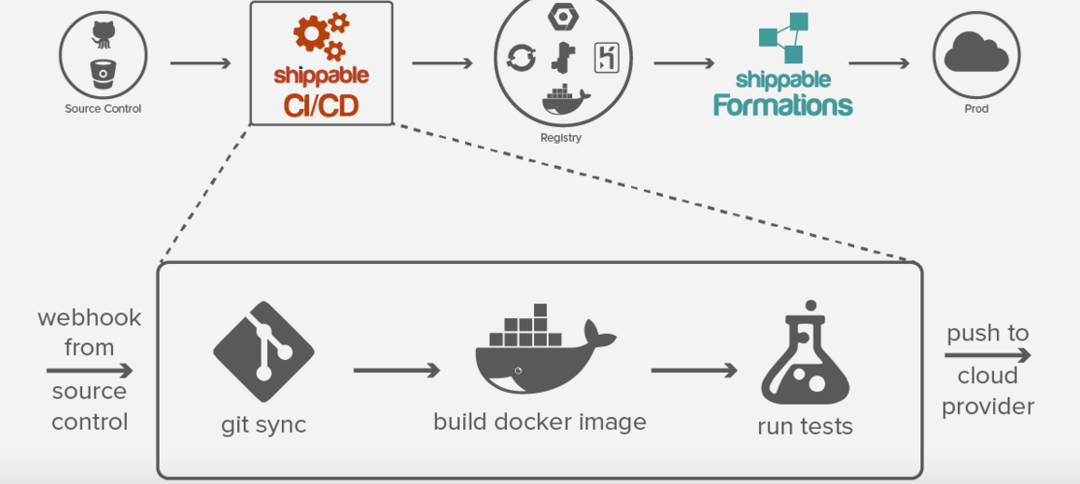
Benefits of containerisation

Slide 12
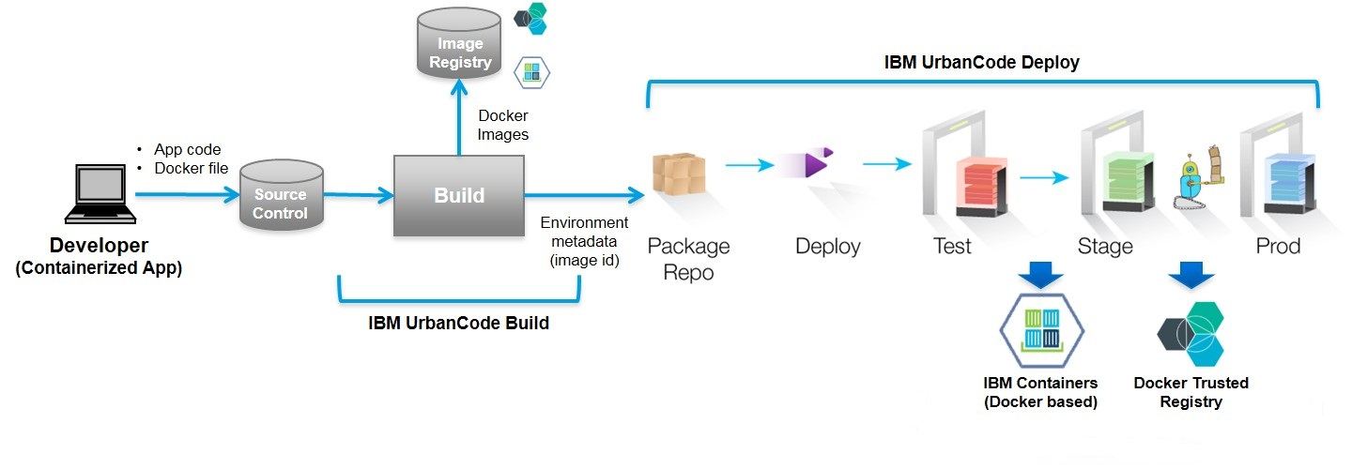
Docker in DevOps
Addresses the “it works on my machine” problem in an efficient way

Slide 13
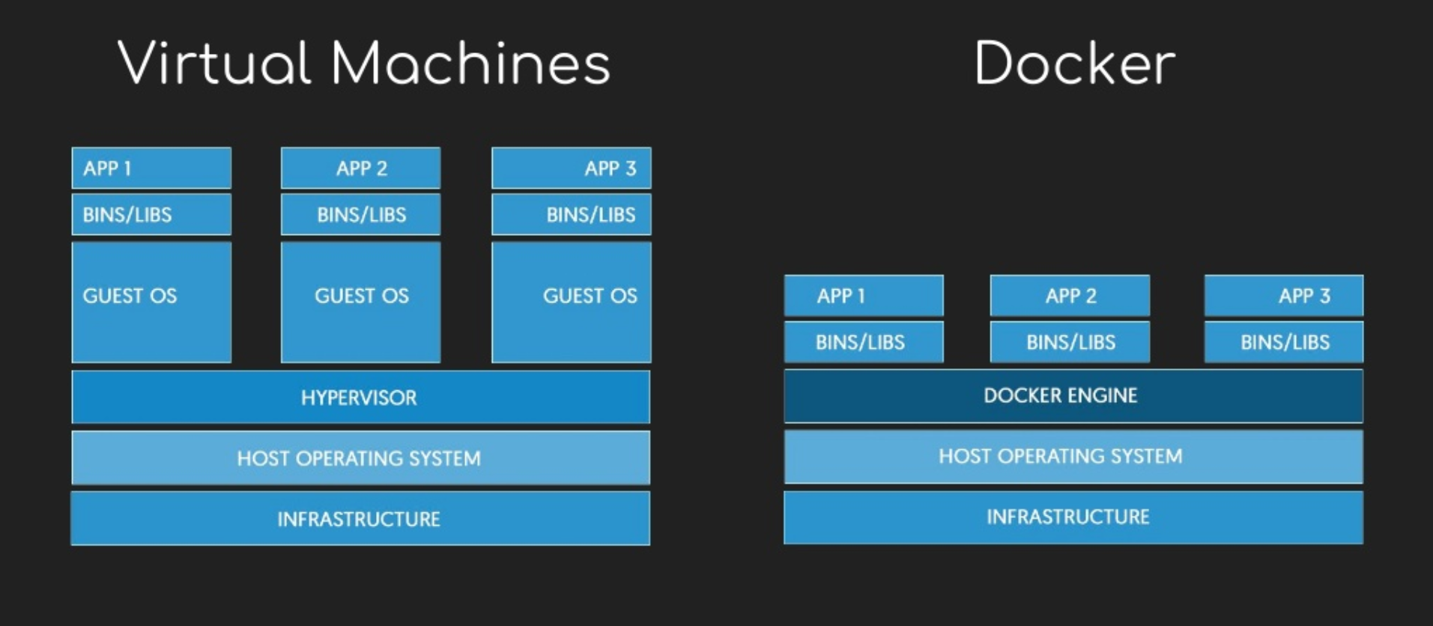
Isolated like VMs but more lightweight

Slide 14
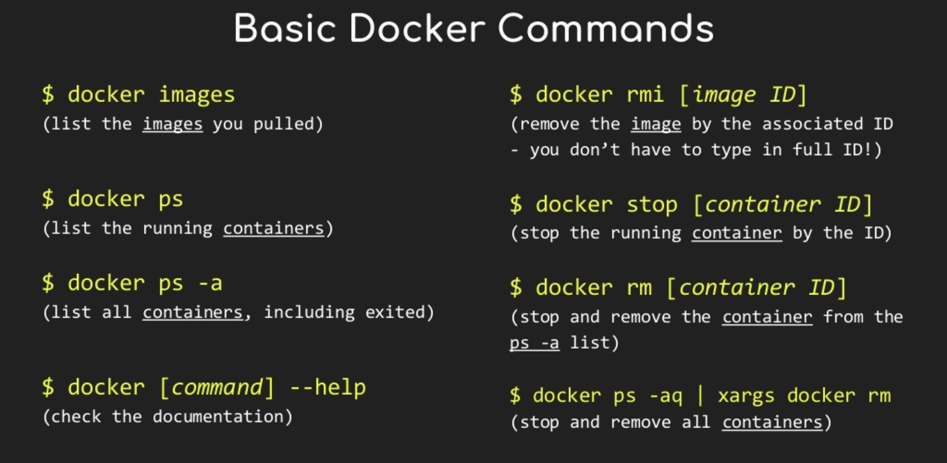

Slide 15
Resources
https://searchitoperations.techtarget.com/definition/application-containerization-app-containerization#commenting
https://www.accenture.com/us-en/blogs/blogs-reshma-shinde-docker-containerization-devops

