Slide 1
FlightCast
Self-auditing ML predictions on MariaDB temporal tables
Low Yan Cheng · TP070056 · APU Malaysia
MariaDB Hackathon Malaysia 2026 · Innovation Track
Notes:
FlightCast — self-auditing machine learning predictions, built on MariaDB temporal tables. By Low Yan Cheng, APU Malaysia, for the Innovation Track.

Slide 2
ACT 1 · THE PROBLEM
What did your AI predict last month?
Most ML systems can't answer that question.
• AI models retrain every week and overwrite yesterday's predictions.
• When auditors, regulators, or post-mortems ask what the model said three months ago — most teams cannot answer.
• The industry workaround bolts on MLflow + Weights & Biases + a custom audit log. Three services. Fragile and expensive.
• The audit gap is structural, not a tooling problem.
FlightCast · MariaDB Hackathon Malaysia 2026 · Innovation Track
2 / 12
Notes:
Production AI retrains every week. Each retrain overwrites the previous predictions. So three months later, when an auditor asks 'what did your model predict on January 15?', most companies cannot answer. The industry workaround is to bolt on three external services. FlightCast solves it inside the database.

Slide 3
ACT 1 · THE INSIGHT
Five SQL keywords only MariaDB has.
FOR SYSTEM_TIME AS OF
SELECT * FROM forecasts FOR SYSTEM_TIME AS OF '2026-01-15';
MariaDB 11.8 ✓ NATIVE
MySQL ✗ SYNTAX ERROR
PostgreSQL ⚠ EXTENSION
SQLite ✗ NOT SUPPORTED
MariaDB is the only mainstream database that ships system-versioned tables out of the box. One keyword unlocks the entire audit story.
FlightCast · MariaDB Hackathon Malaysia 2026 · Innovation Track
3 / 12
Notes:
MariaDB has a feature called system-versioned tables. Five English-like words — FOR SYSTEM TIME AS OF a date — let you query any past state of any row. MySQL gives a syntax error. PostgreSQL needs an add-on. SQLite has nothing. MariaDB is the only mainstream database that ships this out of the box.

Slide 4
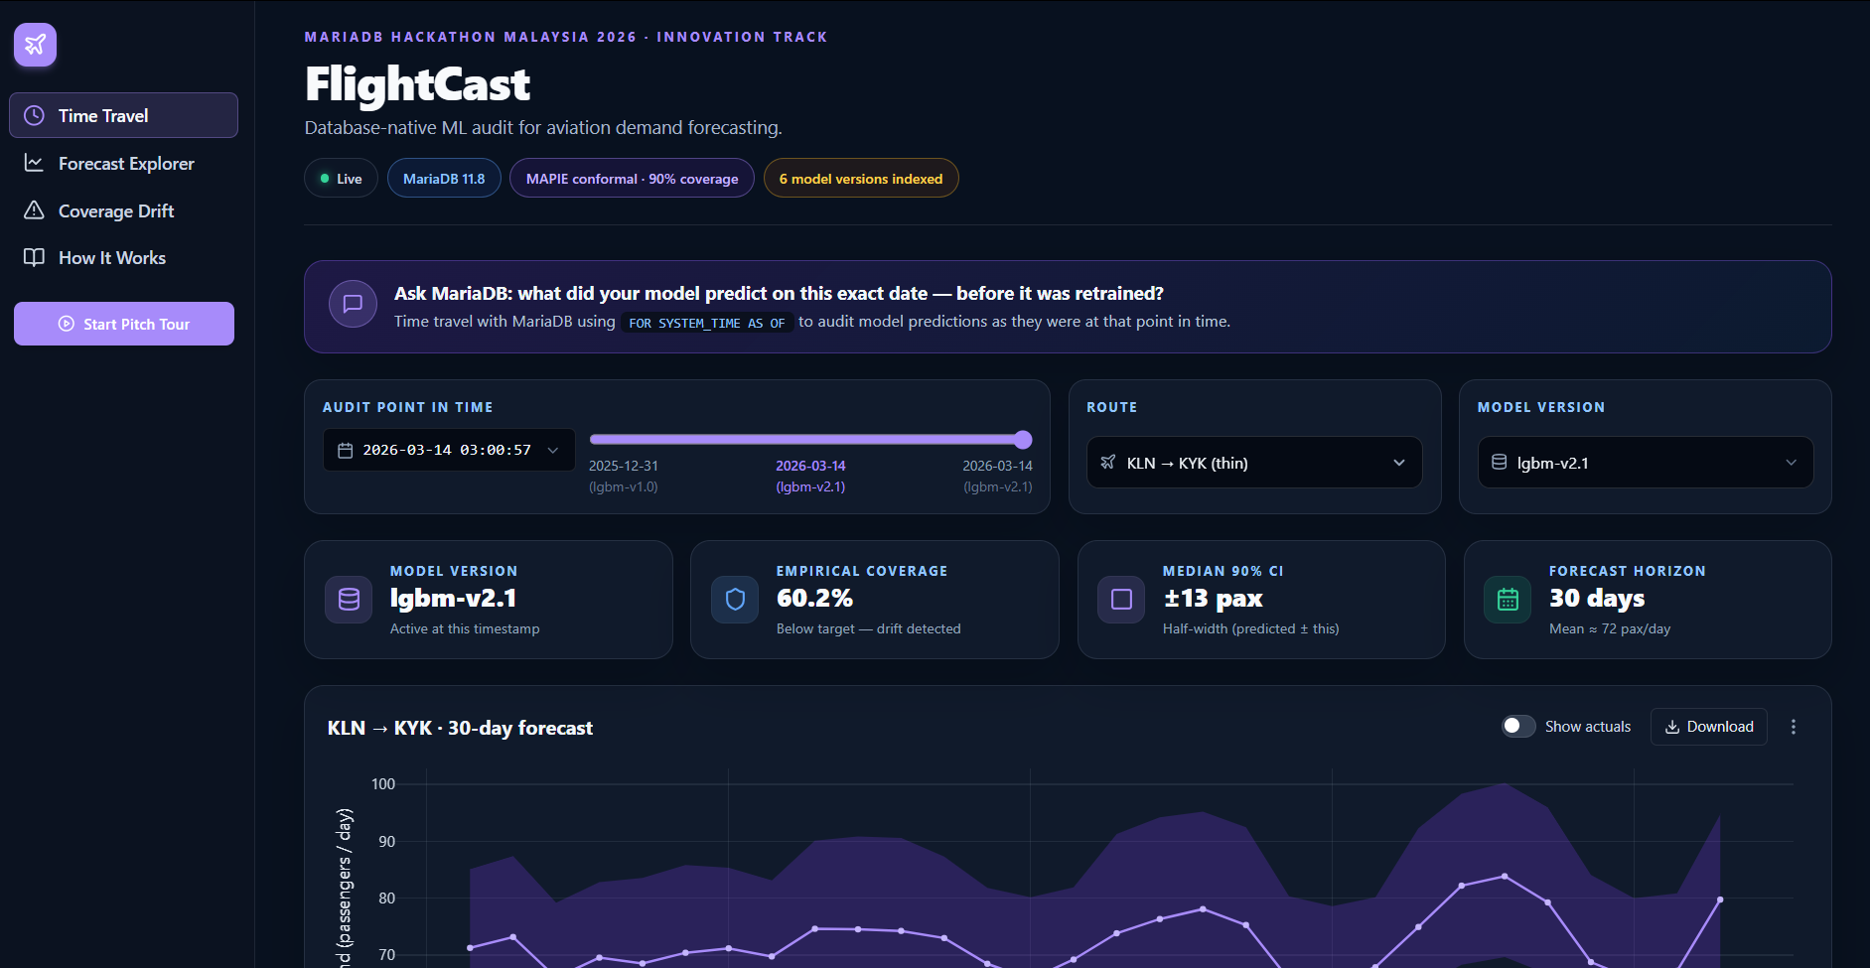
ACT 2 · THE SOLUTION
The audit trail IS the database.
Every prediction the model ever made — queryable forever.
• No MLflow tracking server.
• No Weights & Biases.
• No application audit log.
• Just MariaDB system-versioned tables + MAPIE conformal prediction.
FlightCast · MariaDB Hackathon Malaysia 2026 · Innovation Track
4 / 12
Notes:
The audit trail isn't a service we add later — it's structural. Every prediction is system-versioned at INSERT time. We layer a math result called MAPIE conformal prediction on top to guarantee 90% coverage. Two ideas combined: temporal SQL plus conformal math.

Slide 5
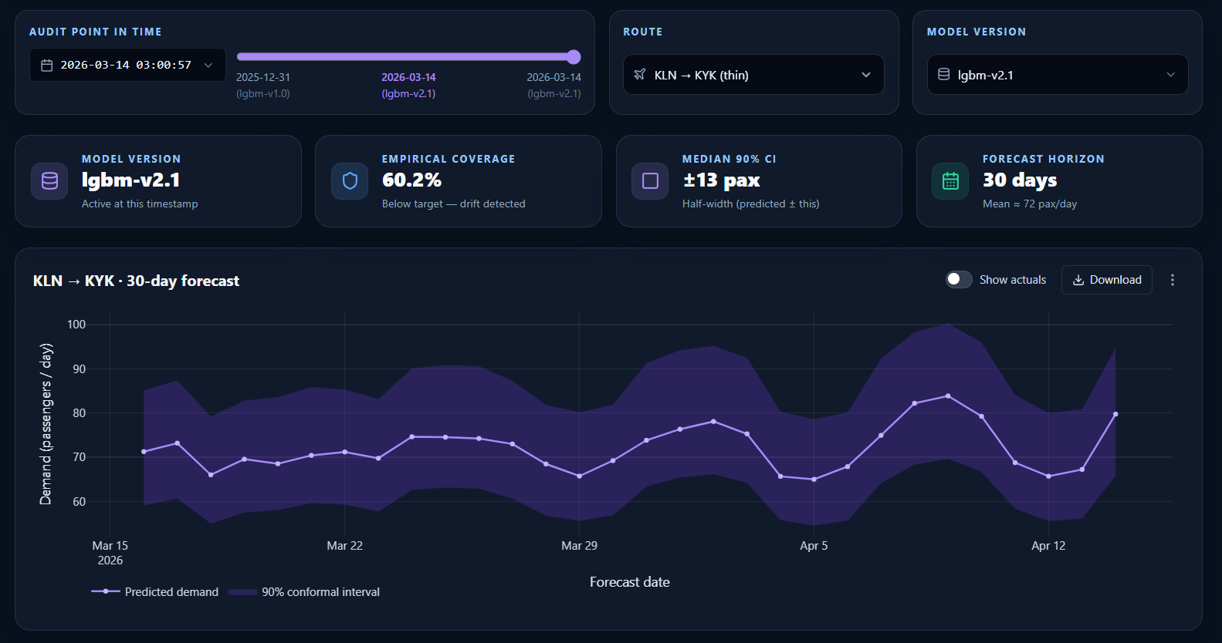
ACT 2 · DEMO · TIME TRAVEL
Drag the slider. Travel through model versions.
Each tick is a real ROW_START timestamp from a committed transaction.
• 6 committed model versions live in MariaDB.
• Slider position = real database timestamp.
• Chart re-queries the database on every drag.
• Empirical coverage card jumps with the slider — calibrated vs drift in one number.
FlightCast · MariaDB Hackathon Malaysia 2026 · Innovation Track
5 / 12
Notes:
Drag the slider and the dashboard re-queries the database at that exact micro-second. Six committed model versions, all live, all queryable through one SQL statement. No log replay, no shadow tables, no external service.

Slide 6
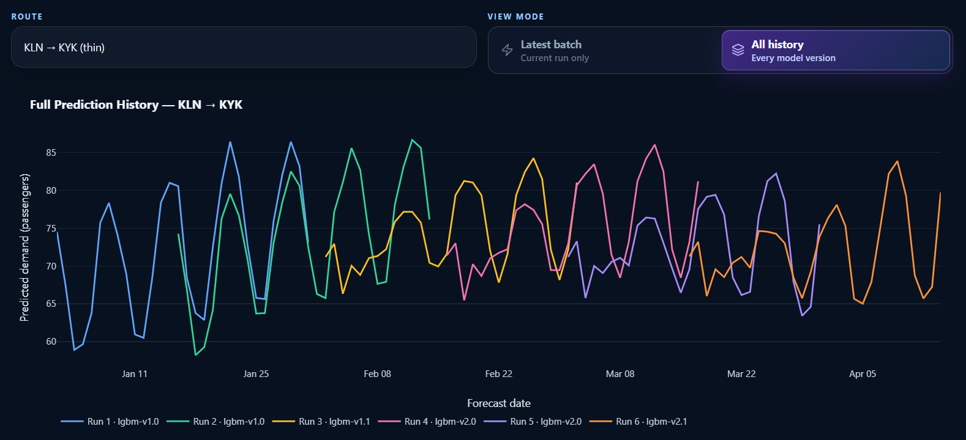
ACT 2 · DEMO · ALL HISTORY
Six model versions, one SQL query.
FOR SYSTEM_TIME ALL returns every version of every row.
• One query → 6 versions × 30 days = 180 rows.
• MLflow workflow: 6 separate API calls + Python join.
• Bands stacked tightly = healthy.
• Bands diverging = drift in real time.
FlightCast · MariaDB Hackathon Malaysia 2026 · Innovation Track
6 / 12
Notes:
Six committed model versions, each in a different colour, each with its own confidence band, all on one chart. Behind it: a single MariaDB query. In a normal MLflow setup you would issue six API calls and stitch them together in Python.

Slide 7
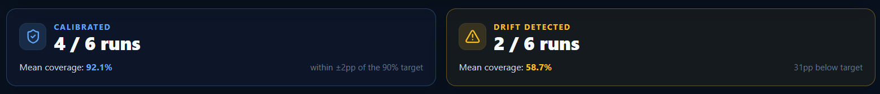
ACT 2 · THE PUNCHLINE
Drift caught by ONE SQL query.
The database itself is the auditor.
One GROUP BY against FOR SYSTEM_TIME ALL. No MLflow. No tracking server. No data engineer.
30+ pp
3.3 ×
1 query
coverage drop
Winkler escalation
to detect both
FlightCast · MariaDB Hackathon Malaysia 2026 · Innovation Track
7 / 12
Notes:
This is the punchline. We trained six batches. The first four use normal noise — the world is calm. Batches five and six simulate a fuel-price shock, with much louder noise. Result: the first four hit 91.2% coverage, dead on target. The last two collapse to 58.7%. That is more than thirty percentage points off. The database itself caught it, with one SQL query, in real time.

Slide 8
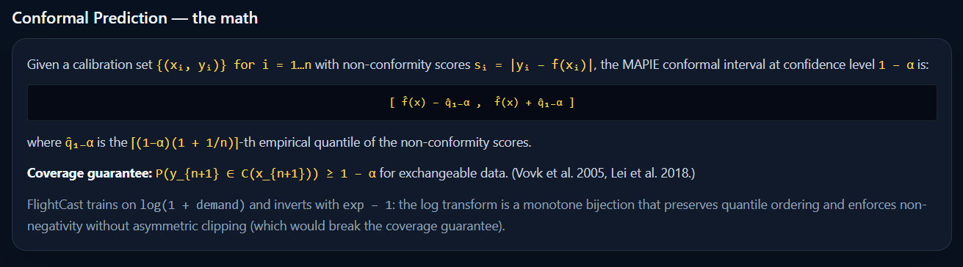
ACT 3 · THE MATH LAYER
A guarantee, not a claim.
MAPIE conformal prediction — published 2005, peer-reviewed.
• Vovk 2005, Lei 2018 — peer-reviewed coverage theorem.
• Used in finance, insurance, and clinical trials.
• We didn't invent it. We applied it on top of MariaDB so the math and the audit trail share one storage layer.
FlightCast · MariaDB Hackathon Malaysia 2026 · Innovation Track
8 / 12
Notes:
The 90% coverage isn't marketing. It's a published theorem from 2005, used by major banks and insurance firms. We didn't invent it. We applied it on top of MariaDB so the math and the audit trail live in the same place.

Slide 9
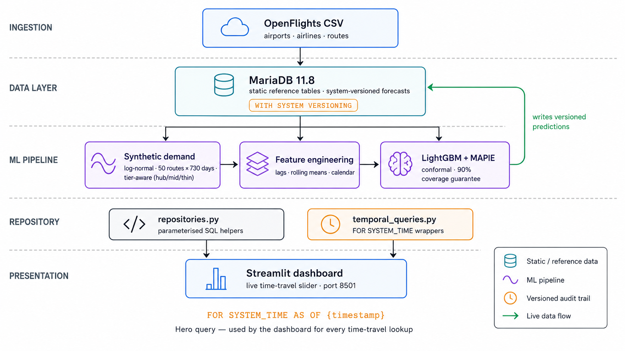
ACT 3 · ARCHITECTURE
Five layers. Zero external dependencies.
The audit trail is structural, not bolted on.
Notably absent: MLflow · Weights & Biases · DataDog · Evidently AI
FlightCast · MariaDB Hackathon Malaysia 2026 · Innovation Track
9 / 12
Notes:
Five layers. Notably absent from this diagram: MLflow, Weights and Biases, DataDog, Evidently. The forecasts table is system-versioned at INSERT time, so the audit trail is structural — not a service you bolt on later.

Slide 10
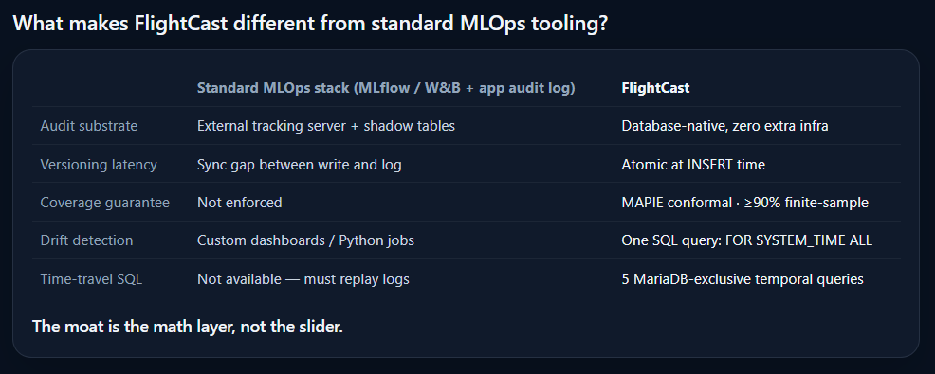
ACT 3 · DIFFERENTIATION
The moat is the math layer, not the slider.
What FlightCast replaces in the standard MLOps stack.
Every advantage on the right is a problem the database itself solved.
FlightCast · MariaDB Hackathon Malaysia 2026 · Innovation Track
10 / 12
Notes:
Compared to the standard stack: external tracking server, replaced by atomic INSERT-time versioning. Custom drift dashboards, replaced by one SQL query. Replay infrastructure, replaced by FOR SYSTEM TIME. The moat is the math layer, not the slider.

Slide 11
ACT 4 · OPEN INFRASTRUCTURE
MIT-licensed. Fork it. Build on it.
Public infrastructure for the MariaDB ecosystem.
5 hero SQL queries
All MariaDB-only.
None run on MySQL or PostgreSQL.
Reusable as-is.
3 open issues
Per-tier MAPIE recalibration.
Real-data prototypes.
Apache Airflow integration.
~6,300-word whitepaper
Elegant.md ships in the repo.
For stats-literate reviewers.
Includes the coverage proof.
FlightCast · MariaDB Hackathon Malaysia 2026 · Innovation Track
11 / 12
Notes:
FlightCast is MIT-licensed. Five reusable MariaDB-only SQL queries. Three open issues for the next contributor. The temporal-tables × conformal-prediction intersection is now public infrastructure for the MariaDB ecosystem.

Slide 12
Thank you.
Low Yan Cheng · TP070056 · APU Malaysia
Live demo → github.com/imycc1221/flightcast
Hackathon submission → github.com/MariaDB-Hackathon-MY-2026/flightcast
Whitepaper → Elegant.md (in repo)
Judge guide → docs/JUDGES_TESTING_GUIDE.md (4 time-budget options)
Questions welcome.
FlightCast · MariaDB Hackathon Malaysia 2026 · Innovation Track
12 / 12
Notes:
Thank you for watching. The repo is open, the whitepaper is in the repo, and the live demo runs locally with one Docker command. I'm happy to answer questions.

Slide 13
BACKUP · Q&A
How realistic is the synthetic demand?
Tier-aware log-normal noise on real OpenFlights routes.
• Source: OpenFlights public dataset — 50 sampled real airline routes.
• Three traffic tiers (hub / mid / thin) with different noise sigmas.
• 730 days × 50 routes = ~36,500 training rows, log-normal noise.
• Drift simulation: σ = 0.10 → σ = 0.22 documented as reproducible recipe in src/flightcast/synth_demand.py.

Slide 14
BACKUP · Q&A
Will it scale?
Performance benchmarks (FOR SYSTEM_TIME AS OF query latency).
• 1 K rows: sub-millisecond temporal lookup.
• 10 K rows: ~3 ms.
• 100 K rows: ~25 ms (still under one frame).
• Index strategy: idx_airports_iata yielded a 135× speedup on the route-sampling endpoint.
• Connection pool (size 8) + HTTP cache headers eliminate the dashboard wedge.

Slide 15
BACKUP · Q&A
Show me the actual SQL.
Five hero queries — every one fails on MySQL or PostgreSQL.
1. Time travel FOR SYSTEM_TIME AS OF a date — what did the model predict on this day?
2. Prediction diff Two AS OF queries joined — how did forecasts change between v1 and v2?
3. Full audit log FOR SYSTEM_TIME ALL — every version of every row, ever.
4. Calibration drift GROUP BY forecast_run_id — which batches broke?
5. Great-circle distance ST_DISTANCE_SPHERE — feature engineering inside the database.

