Slide 1

Module 1 Lesson 4 – Data Cleaning in R Part 1/2
Mental Health Dashboard Building
Module 1 - Basic Data Visualization in Tableau
Maria Tomasso, M.S.
met48@txstate.edu
August 2023

Slide 2
LAST TIME
We installed R and RStudio and wrote our first “Hello World!” program

Slide 3
IN THIS VIDEO
File import
Dealing with missing values, including replacing placeholders with NAs
Dropping excess columns
Removing excess whitespace
Duplicate detection
Adding/removing leading values (e.g., state labels in FIPS) and merging columns
Correcting capitalization

Slide 4
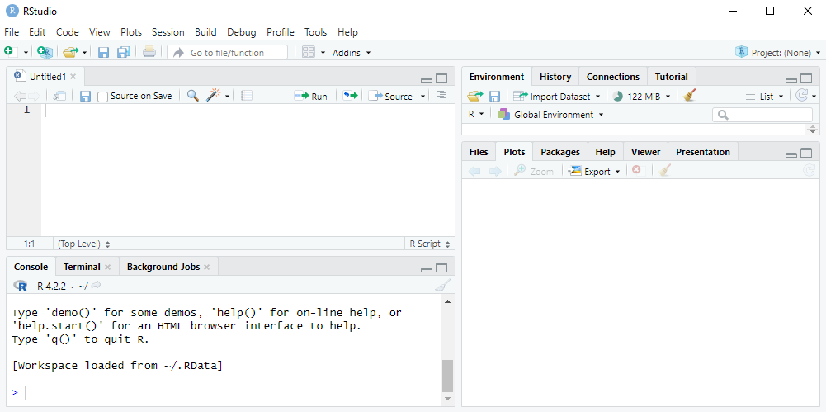
FILE IMPORT
We will use the “import dataset” function for this tutorial.

Slide 5
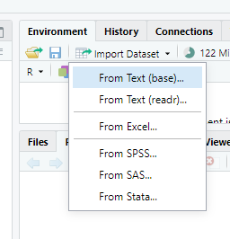
FILE IMPORT
After clicking “file import”, you may choose from a selection of file types.
We will focus on text (base) and Excel.
Text (base) is good for .csv and .txt file types, while Excel work for .xls and xlsx.

Slide 6
FILE IMPORT – TEXT (BASE)

Slide 7
MISSING VALUES

Slide 8
DROPPING EXCESS COLUMNS

Slide 9
REMOVING EXCESS WHITESPACE

Slide 10
DUPLICATE DETECTION

Slide 11
LEADING VALUES

Slide 12
MERGING COLUMNS

Slide 13
CORRECTING CAPITALIZATION

Slide 14
RECAP

Slide 15
WHAT’S NEXT?

Slide 16





FOLLOW US
https://public.tableau.com/app/profile/translational.health.research.center
https://twitter.com/txst_thr
https://healthresearch.txst.edu/
https://www.linkedin.com/company/texas-state-university-translational-health-research/
https://www.youtube.com/@txst_THR

