Slide 1
THRC Research Impact Factor AI Model
July 2024

Slide 2
Objective
To create a tool for use within THRC to (1) assess the impact of individual THRC-affiliated publications against Texas State University publications with an index and (2) autogenerate radar charts based on text-mining that assess the publications relevance to each of the 17 United Nations Sustainable Development Goals

Slide 3
Model Inputs - Index
Bibliometrics – views, cites
Social media direct link shares
Twitter, Threads, and LinkedIn
News Media
Articles
Journal Impact Factor
Policy citations
Patent citations

Slide 4
Model Inputs – SDG Radar Chart
Article text – to be analyzed for themes matching each SDG. Rankings will be assigned in each theme relative to the corpus of TXST research articles

Slide 5
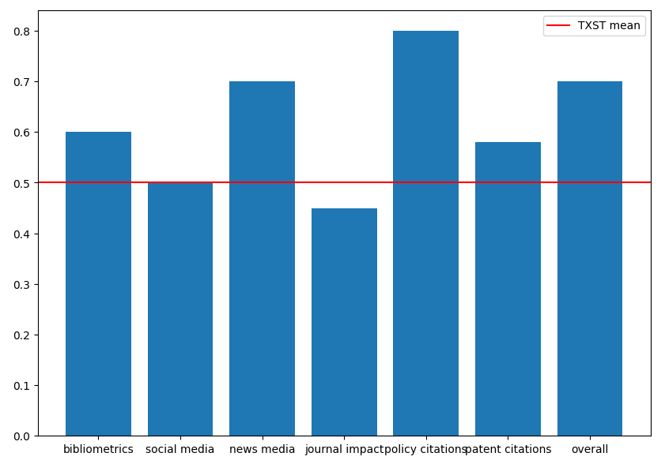
Simulated Outcome 1

Slide 6
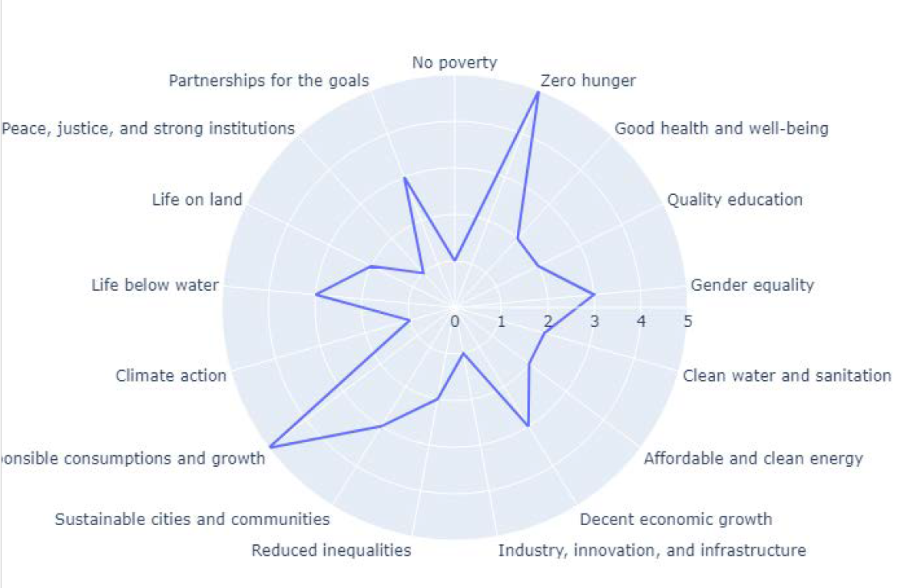
Simulated Outcome 2

Slide 7
Challenges
The main challenge anticipated will be data collection for news media.
Each news site may need to be text-mined separately, which would be labor intensive to code and time intensive to run. We would also need to run this on every paper in the TXST training corpus to establish a baseline to compare THRC work against.
We will explore efficient ways to collect this data using open-source tools as well as paid options (i.e., Altmetric API access).
Social media API access may also present challenges.

Slide 8
Sources
“Generating Impact Narratives with AI.”. Sean Newell & Charity Elefritz. Elsevier. 2024. https://uknowledge.uky.edu/cgi/viewcontent.cgi?article=1036&context=research_events2
M. Bamberger, “Introduction to Mixed Methods in Impact Evaluation”.
S. Morton, “Progressing research impact assessment: A ‘contributions’ approach,” Research Evaluation, vol. 24, no. 4, pp. 405–419, Oct. 2015, doi: 10.1093/reseval/rvv016.

