Slide 1
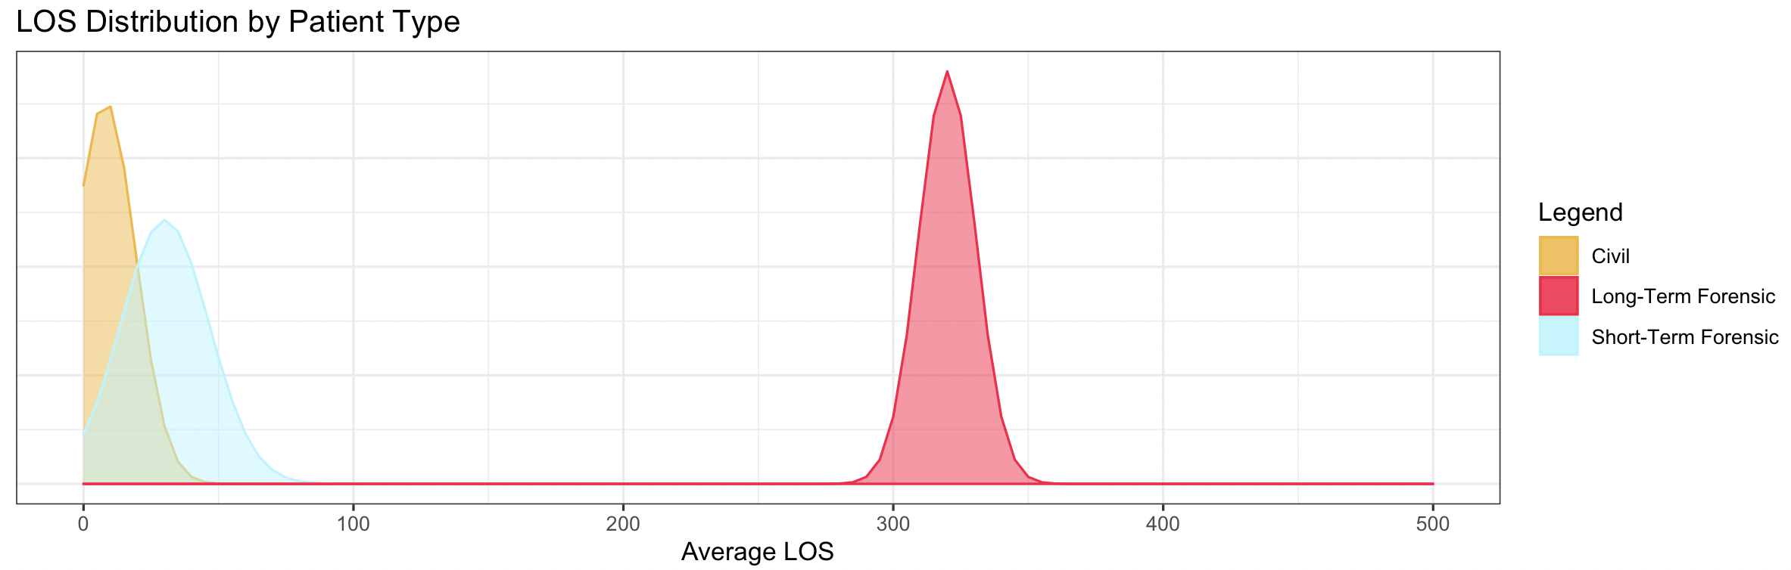
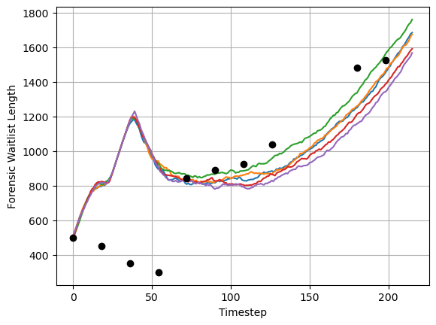
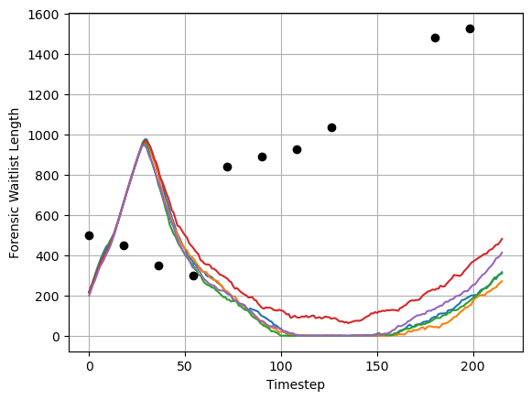
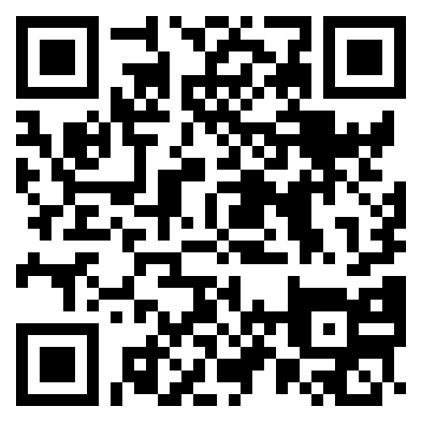
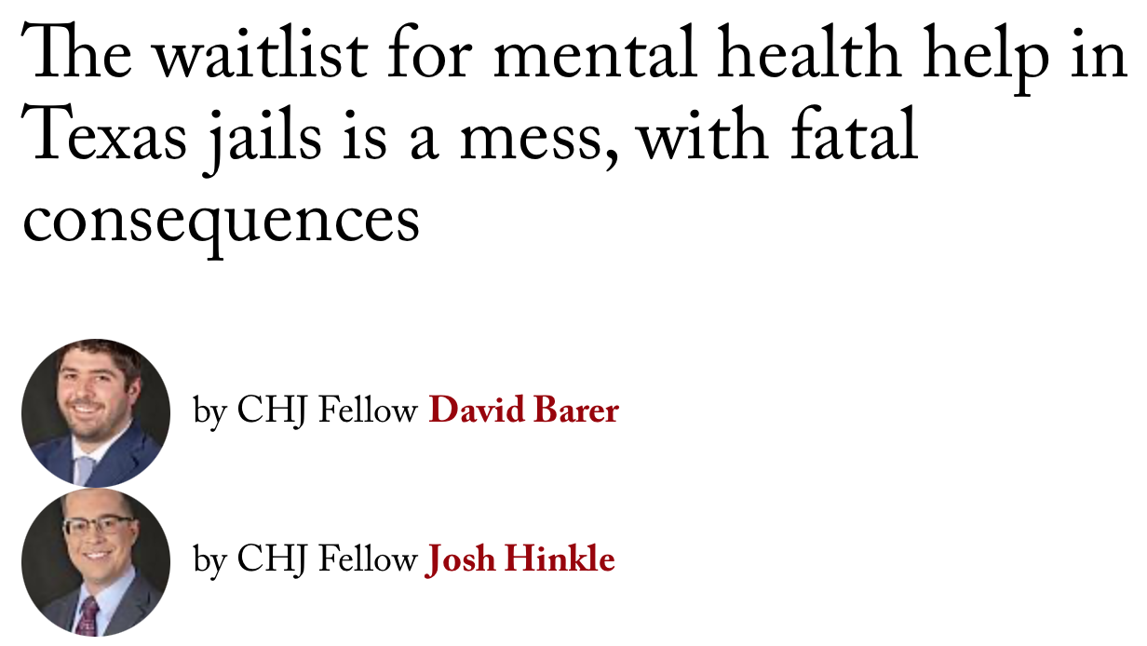
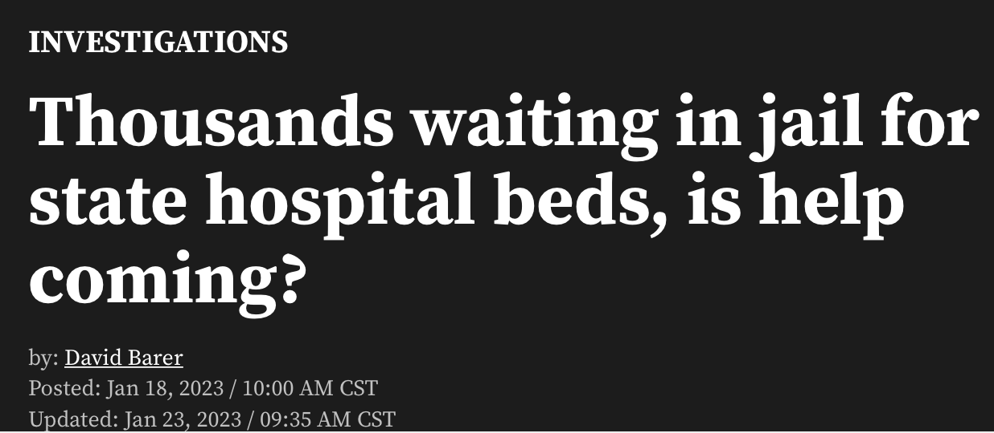
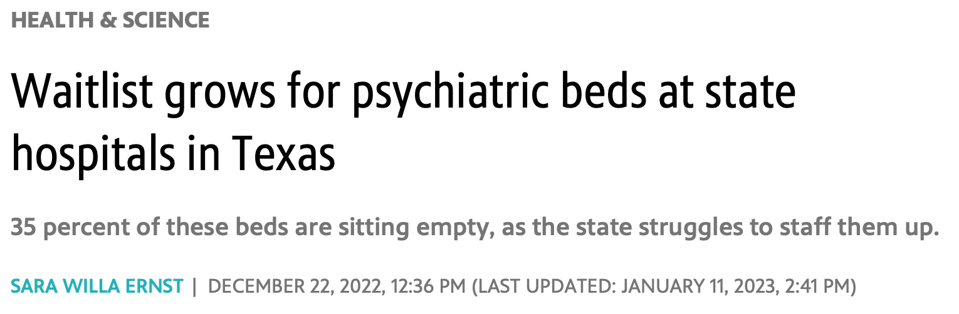
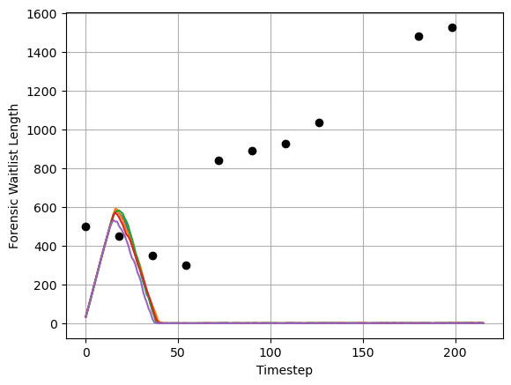
TOWARDS A HYBRID DISCRETE EVENT SIMULATION AGENT-BASED MODEL FOR THE TEXAS STATE MENTAL HOSPITAL SYSTEM
Maria Tomasso
Department of Computer Science, Texas State University
Introduction
The state mental hospitals of Texas treat two primary populations:
Forensic patients, who are defendants charged with a crime but found incompetent to stand trial, or individuals who have been found not guilty by reason of insanity
Forensic patients can be further classified into short-term and long-term
Civil patients, who have not been charged with a crime but may be seeking mental health services on their own or due to a court order
In recent years, the waitlist for services in the state mental health system has increased dramatically.
The following issues have contributed to an expanding waitlist:
Insufficient staffing levels leading to beds being taken offline
An increase in long-term stay patients
A growing demand from the forensic system
Forensic patients found incompetent to stand trial often wait in county jails where their conditions may deteriorate further.
This work aims to address the waitlist crisis in the state mental healthcare system by:
Building a hybrid DES-ABM model of the system and training it with real data to ensure it is reasonably representative of reality
Using the model to test the effects of capacity expansion on the waitlists
Methods
Assumptions
The state forensic mental health system has two waitlists: one for maximum security patients, and one for standard forensic admits who may be housed with civil admits. This model focuses on standard forensic admits and civil admits only, excluding maximum security waitlists and beds.
Patients are placed on the waitlist for the treatment center with the shortest expected wait at the time, regardless of geography.
Data
Partial quarterly data on number of patients added to, removed from, and on the forensic waitlist from 2020-2022 [2-5]
The proportion of civil and forensic admits [1]
The total number of beds and online number of beds per facility as reported in June 2022 [6].
The average length of stay (LOS) for civil and long-term forensic patients is roughly known [1], but the average LOS for short-term standard security forensic patients is unclear due to aggregate reporting with maximum security patients.
Model
Timesteps in the model represent 5 days of real time and the number of patients admitted to the waitlist at each timestep is imputed from the reported quarterly data.
Approximate Bayesian computation (ABC) is employed to tune the LOS parameters, which are assumed to follow three distinct normal distributions for civil, short-term forensic, and long-term forensic admits.
Since mean LOS is roughly known for civil and long-term forensic admits, the ABC searches for the mean LOS of short-term forensic admits and the variances for each distribution.
Success in training the model is ascertained by comparing the simulated waitlist lengths with the actual waitlist lengths from 2020-2022.
Results
Using ABC, the mean LOS for short-term forensic patients was determined to be 30.1 timesteps and the variances for civil, short-term forensic, and long-term forensic patients were found to be 11.3, 16.4, and 10.5 timesteps respectively.
Using the tuned LOS parameters, the following scenarios are tested:
Scenario 0: No change from current number of online beds
Scenario 1: All hospitals bring at least 80% of their beds online. Hospitals with greater than 80% of beds online originally do not change.
Scenario 2: All hospitals bring bring all beds online.
Conclusions
As Texas grapples with inflated wait times, DES-ABM modeling, in collaboration with legal and psychiatric experts, provides an avenue to predict demand on the state mental health system and test the effect of resource allocation strategies on simulated waitlists.
The model includes several assumptions that deviate from reality due to data scarcity. Additionally, a more accurate model would necessitate patient-level data, which is not publicly available for privacy reasons. The next phase of this project will involve requesting more in-depth patient population data from the Texas Department of State Health Services, enabling more comprehensive modeling.
Citations
The State of Texas Legislative Budget Board. 2022. “State Hospitals: Mental Health Facilities in Texas.” Legislative Budget Board Staff.
Texas Health and Human Services. April 2020. “Semi-annual Reporting of Waiting Lists for Mental Health Services.” Health and Human Services Commission.
Texas Health and Human Services. October 2020. “Semi-annual Reporting of Waiting Lists for Mental Health Services.” Health and Human Services Commission.
Texas Health and Human Services. April 2021. “Semi-annual Reporting of Waiting Lists for Mental Health Services.” Health and Human Services Commission.
Texas Health and Human Services. November 2021. “Semi-annual Reporting of Waiting Lists for Mental Health Services.” Health and Human Services Commission.
Texas Health and Human Services. May 2023. “Report on Waiting Lists for Mental Health Services.” Health and Human Services Commission.
Code, Data, and Contact
Email: met48@txstate.edu
Code and data: https://github.com/MariaElise-T/WSC_2023
Acknowledgements
Thank you to Dr. Apan Qasem for mentoring this project. Thank you to the Translational Health Research Center of Texas State University for supporting this project.

