Slide 1

Barcelona Graduate School of Economics (BGSE) Master in Data Science Stochastic Optimization Waste Collection and Management problem
María Fernández
Anestis Papanikolaou
Jéssica Leal
18th March 2015
Barcelona, Spain

Slide 2

Structure
Quick view of the Waste Management Industry (WMI)
Motivation and overall objective
Business case
Framework
Modelling the DP case
Methodology and results
Conclusions: Costs comparison and the “value of information”
Extensions: future directions

Slide 3
Quick view of the waste management industry
Huge industry in progress: Economics of the Waste Cycle
Country Income Group | 2010 Cost | 2025 Cost
Low Income Countries | $1.5 billion | $ 7.7 billion
Lower Middle Income Countries | $20.1 billion | $84.1 billion
Upper Middle Income Countries | $24.5 billion | $63.5 billion
High Income Countries | $159.3 billion | $220.2 billion
Total Global Cost (US$) | $205.4 billion | $375 billion
Source: World Bank http://web.worldbank.org/WBSITE/EXTERNAL/TOPICS/EXTURBANDEVELOPMENT/0,,contentMDK:23172887~pagePK:210058~piPK:210062~theSitePK:337178,00.html

Slide 4
Quick view of the waste management industry
Different approaches and optimization objectives
- Waste collection: Family of Vehicle Routing Problems (VRP)
FROM
STATIC AND DETERMINISTIC APPROACH
TO
DYNAMIC AND DEMAND-RESPONSIVE
APPROACH

Slide 5
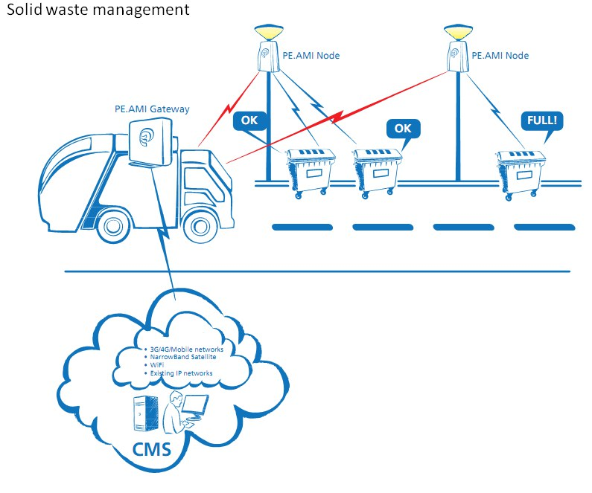
Motivations and overall objective
Use of IT tools to reduce operational costs
WCM Information Systems (WSI)
Feasibility study of introducing a waste management information system
Which is the “value of information” from introducing a WCMIS ?

Slide 6
Business case
Current method: send fixed trucks to each zone to collect waste from ALL bins
1.316 collection points (bins) => 606 if we aggregate them by location
Three different zones depending: market, small and big roads
Single depot and disposal location
Heterogeneous capacity of bins
Stochastic rate generation of waste
Fleet of trucks with homogeneous size

Slide 7
Framework
Information receipt:
Update System Status
Demand Analysis
Introduce uncertainty
Determine optimal routes and policy
Execute operational plan

Slide 8
Modelling the DP case
- Objective: minimize operational costs of WC operator over time by introducing a WIS
Assumptions:
Smart cans
Poisson distributed throwing trash rate
Penalty and fixed operational costs

Slide 9
Modelling the DP case
- Decision variable: U_{k}^{c} ϵ {not-visit,visit}
- State variable: X_{k}^{c} ( current % fulness of bins)
- Dynamics of bins’ fulness (%): depends on U_{k}^{c} , X_{k}^{c} and E_{k}[W_{k+1}^{c}]
- We visit if X_{k}^{c} > threshold (90%)
- The violated-bins determine the optimal path
- We visit all violated cans
- Non-violated cans might be visited depending on comparing costs and benefits: additional distance if we deviate (C) vs. the risk of paying a fine

Slide 10
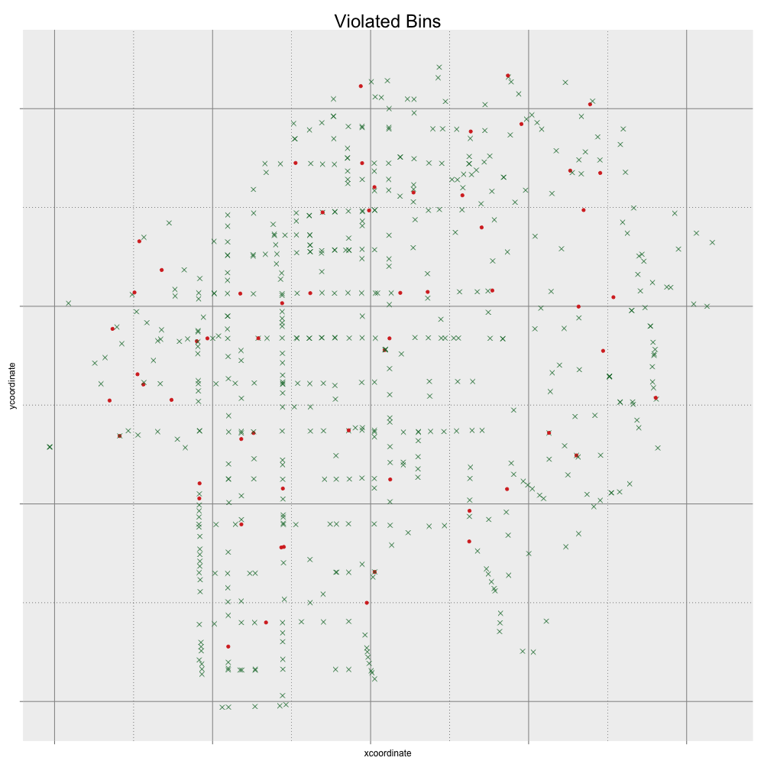
Methodology
Steps of recursive process for optimal control
At time k, we consider the bins that are currently violated
Cluster analysis of collection points above threshold
3. Solve the TSP problem for constructing the “fixed path” per cluster
We assume one truck per cluster (no capacity constraints)
4. Determine if it is worth to deviate for a truck in the cluster
Re-do the TSP with all bins to be visited

Slide 11
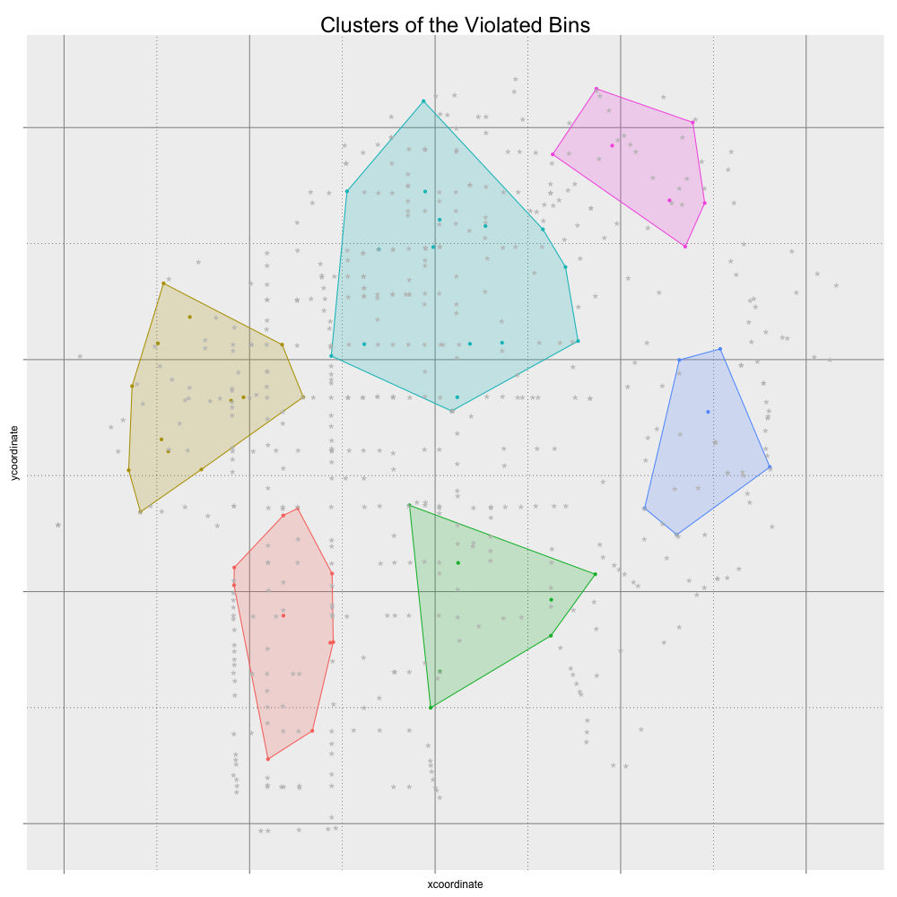
Methodology
Steps of recursive process for optimal control
At time k, we consider the bins that are currently violated
Cluster analysis of collection points above threshold
3. Solve the TSP problem for constructing the “fixed path” per cluster
We assume one truck per cluster (no capacity constraints)
4. Determine if it is worth to deviate for a truck in the cluster
Re-do the TSP with all bins to be visited

Slide 12
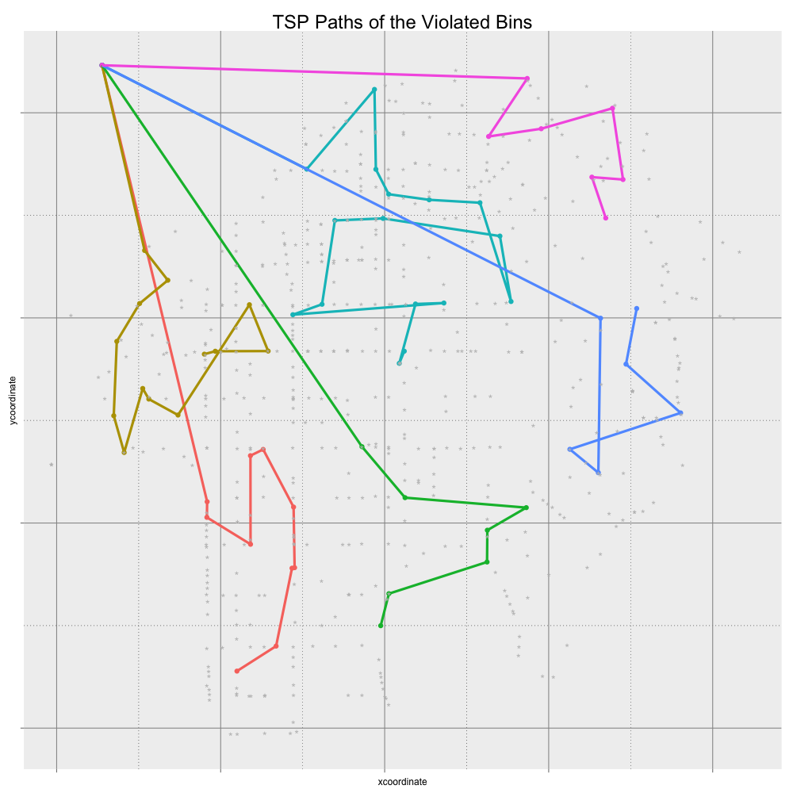
Methodology
Steps of recursive process for optimal control
At time k, we consider the bins that are currently violated
Cluster analysis of collection points above threshold
3. Solve the TSP problem for constructing the “fixed path” per cluster
We assume one truck per cluster (no capacity constraints)
4. Determine if it is worth to deviate for a truck in the cluster
Re-do the TSP with all bins to be visited

Slide 13
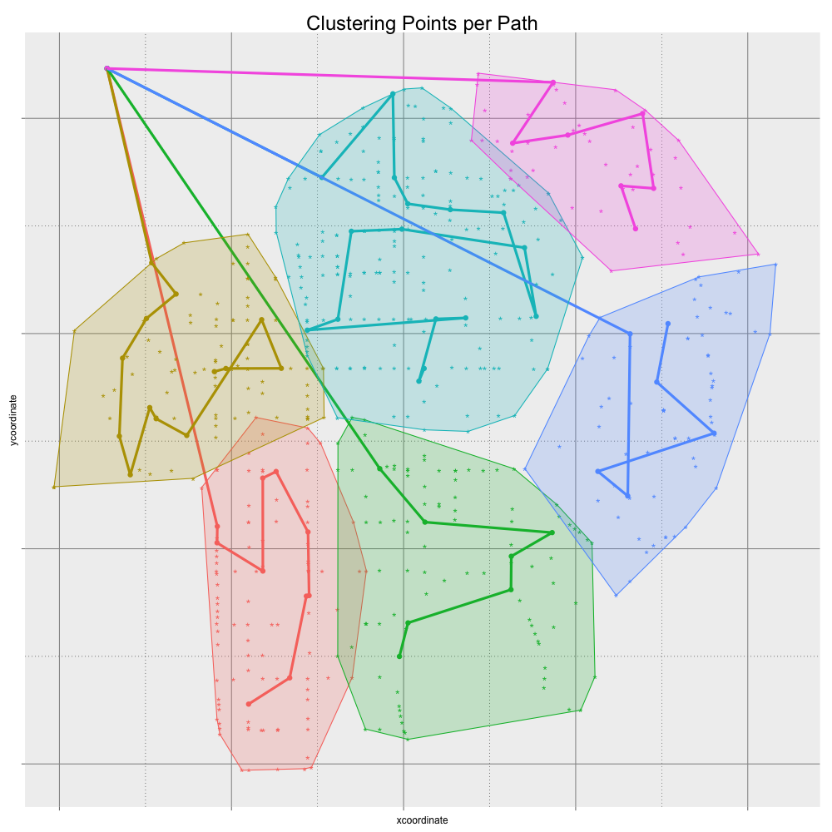
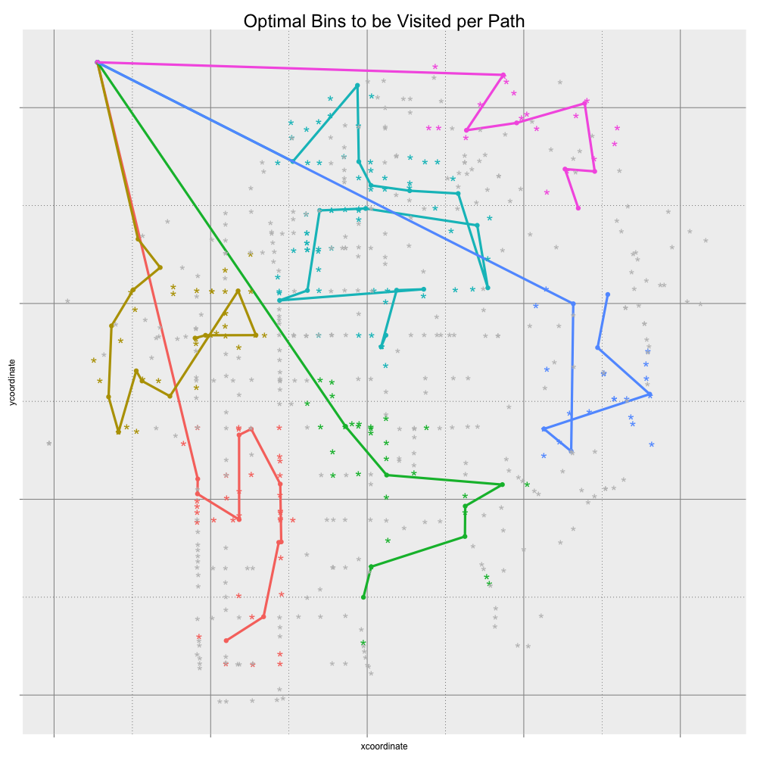
Methodology
Steps of recursive process for optimal control
At time k, we consider the bins that are currently violated
Cluster analysis of collection points above threshold
3. Solve the TSP problem for constructing the “fixed path” per cluster
We assume one truck per cluster (no capacity constraints)
4. Determine if it is worth to deviate for a truck in the cluster
Re-do the TSP with all bins to be visited

Slide 14
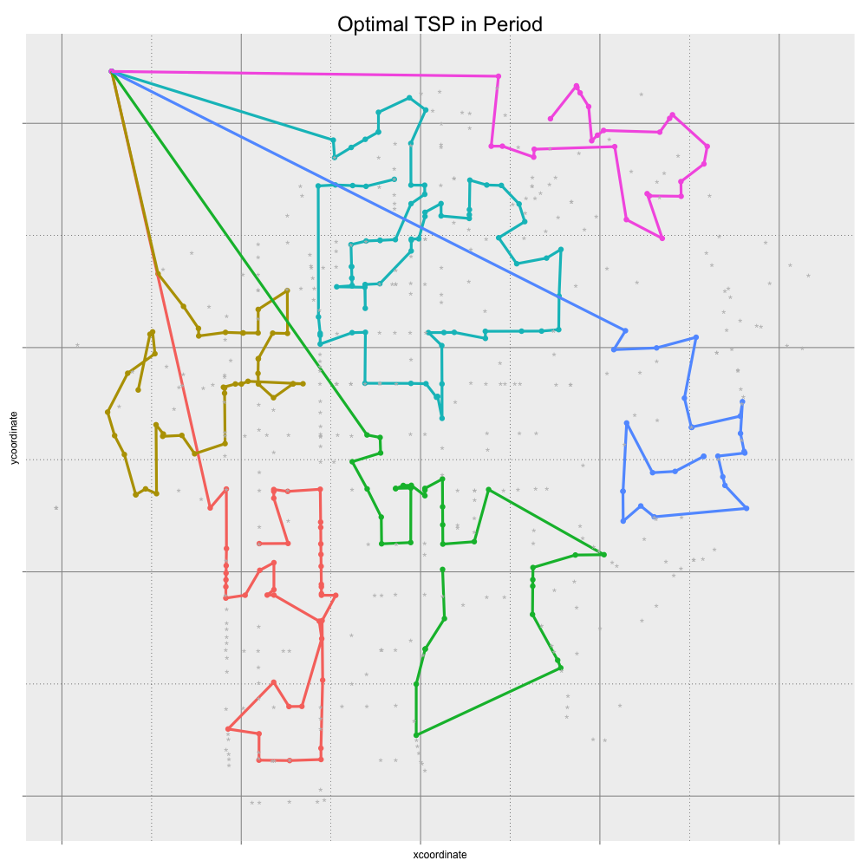
Methodology
Steps of recursive process for optimal control
At time k, we consider the bins that are currently violated
Cluster analysis of collection points above threshold
3. Solve the TSP problem for constructing the “fixed path” per cluster
We assume one truck per cluster (no capacity constraints)
4. Determine if it is worth to deviate for a truck in the cluster
Re-do the TSP with all bins to be visited
The decisions of visiting will affect the rubbish in the cans of next day

Slide 15
Conclusions

Slide 16
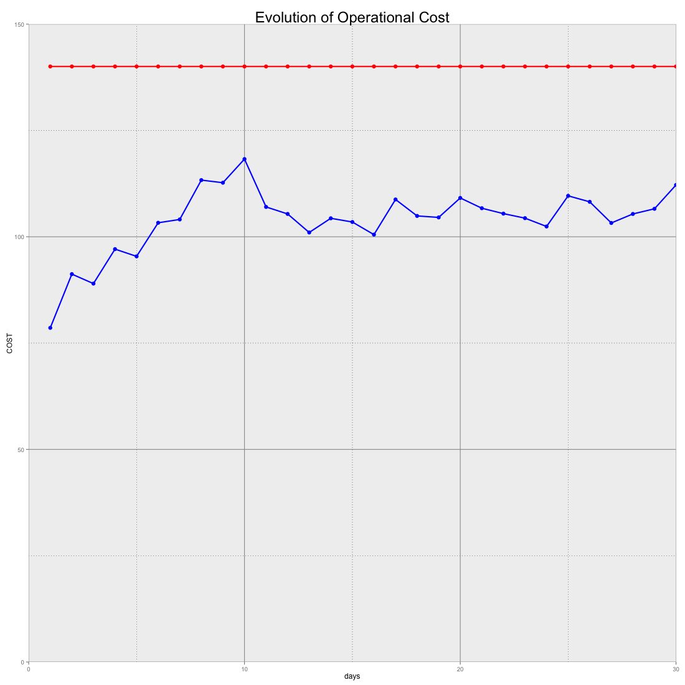
Conclusions

Slide 17
Extensions
Further trucks

Slide 19
Notes
Description of the process
Post-decision state (Powel 2011)
Information arrives at time t and planning is set up for time t’ (t’>t) but before new information arrives

Slide 20
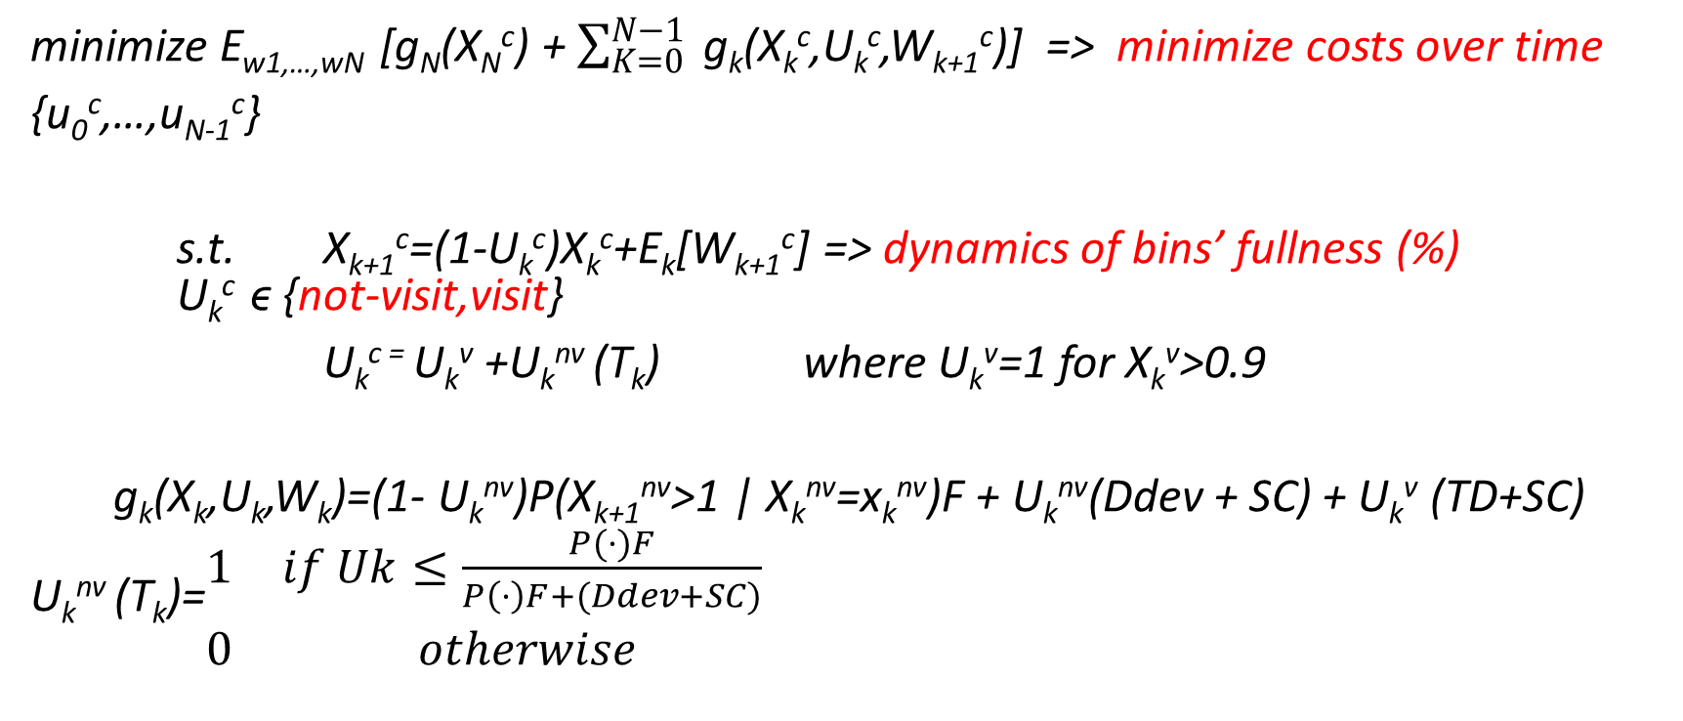
IV. Modelling
minimize E_{w1,…,wN} [g_{N}(X_{N}^{c}) + $\sum_{K=0}^{N−1}{ }$g_{k}(X_{k}^{c},U_{k}^{c},W_{k+1}^{c})] => minimize costs over time
{u₀^{c},…,u_{N-1}^{c}}
s.t. X_{k+1}^{c}=(1-U_{k}^{c})X_{k}^{c}+E_{k}[W_{k+1}^{c}] => dynamics of bins’ fullness (%) U_{k}^{c} ϵ {not-visit,visit}
U_{k}^{c =} U_{k}^{v} +U_{k}^{nv} (T_{k}) where U_{k}^{v}=1 for X_{k}^{v}>0.9
g_{k}(X_{k},U_{k},W_{k})=(1- U_{k}^{nv})P(X_{k+1}^{nv}>1 | X_{k}^{nv}=x_{k}^{nv})F + U_{k}^{nv}(Ddev + SC) + U_{k}^{v} (TD+SC)
U_{k}^{nv} (T_{k})=$\begin{matrix}1 & if Uk≤\frac{P(·)F}{P\left(·\right)F+(Ddev+SC)} \\ 0 & otherwise\end{matrix}$

