Slide 1


Barcelona Graduate School of Economics (BGSE)
Master in Data Science
Stochastic Optimization
Waste Collection and Management problem
María Fernández
Anestis Papanikolaou
Jéssica Leal
18th March 2015
Barcelona, Spain

Slide 2

Outline
The Waste Management Industry (WMI)
Motivation and overall objective
Business case
Methodology - modelling
Results
Conclusions: Costs comparison and the “value of information”
Future directions

Slide 3
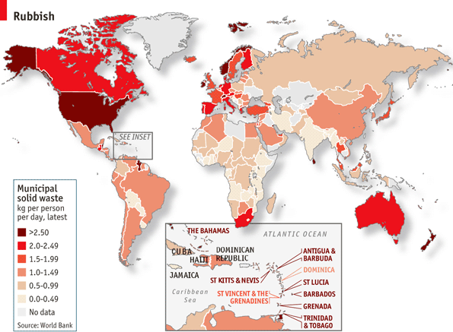
The waste management industry: A rubbish map
Huge industry in progress: Economics of the Waste Cycle
Country Income Group | 2010 Cost | 2025 Cost
Low Income Countries | $1.5 billion | $ 7.7 billion
Lower Middle Income Countries | $20.1 billion | $84.1 billion
Upper Middle Income Countries | $24.5 billion | $63.5 billion
High Income Countries | $159.3 billion | $220.2 billion
Total Global Cost (US$) | $205.4 billion | $375 billion
Source: World Bank http://web.worldbank.org
Source: The Economist

Slide 4
Waste Management: Trends and drivers
Different approaches and optimization objectives
  Type of waste
  Size of areas
  Exact vs. approximate methods
Waste collection: Family of Vehicle Routing Problems (VRP)
GENERAL TREND
FROM
STATIC AND DETERMINISTIC APPROACH
TO
DYNAMIC AND DEMAND-RESPONSIVE
APPROACH

Slide 5
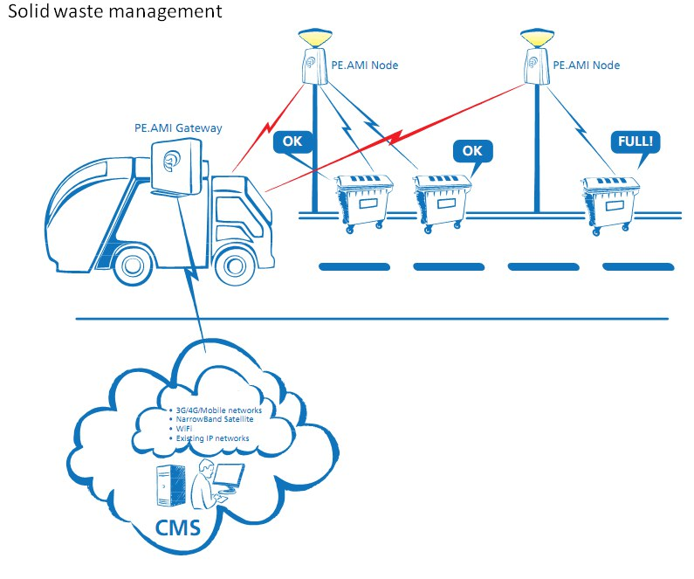
Motivation and overall objective
Use of IT tools to reduce operational costs
WCM Information Systems (WSI)
Feasibility study of introducing a waste management information system
Which is the “value of information” from introducing a WCMIS ?

Slide 6
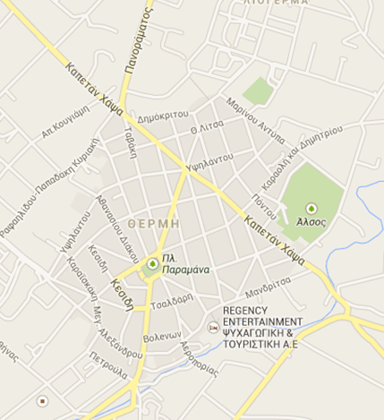
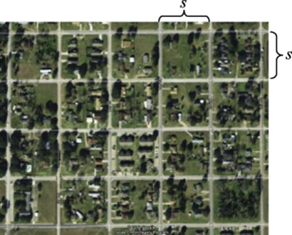
Business case
  A medium size Municipality
  Dimension: 2 Km x 1.6 Km
  Manhattan network structure
  1.316 bins => 606 collection points
  Heterogeneous capacity of bins
  Single depot and disposal location
  Fleet of six (6) trucks with homogeneous size

Slide 7
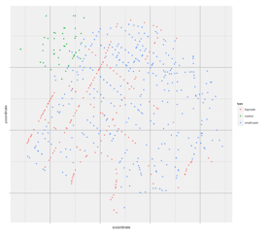
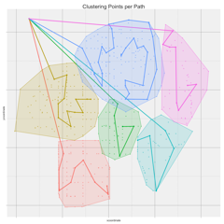
Business case – Cost comparison
  Current method – Business-As-Usual
  Static approach
  Send fixed trucks to each zone to collect waste from ALL bins
  Three different zones depending: market, small and big roads
  Proposal – WCM Information System
  Dynamic approach
  Collect an optimal number of bins per period
  Zones defined dynamically per period
HOW TO SELECT WHICH BINS TO COLLECT?

Slide 8
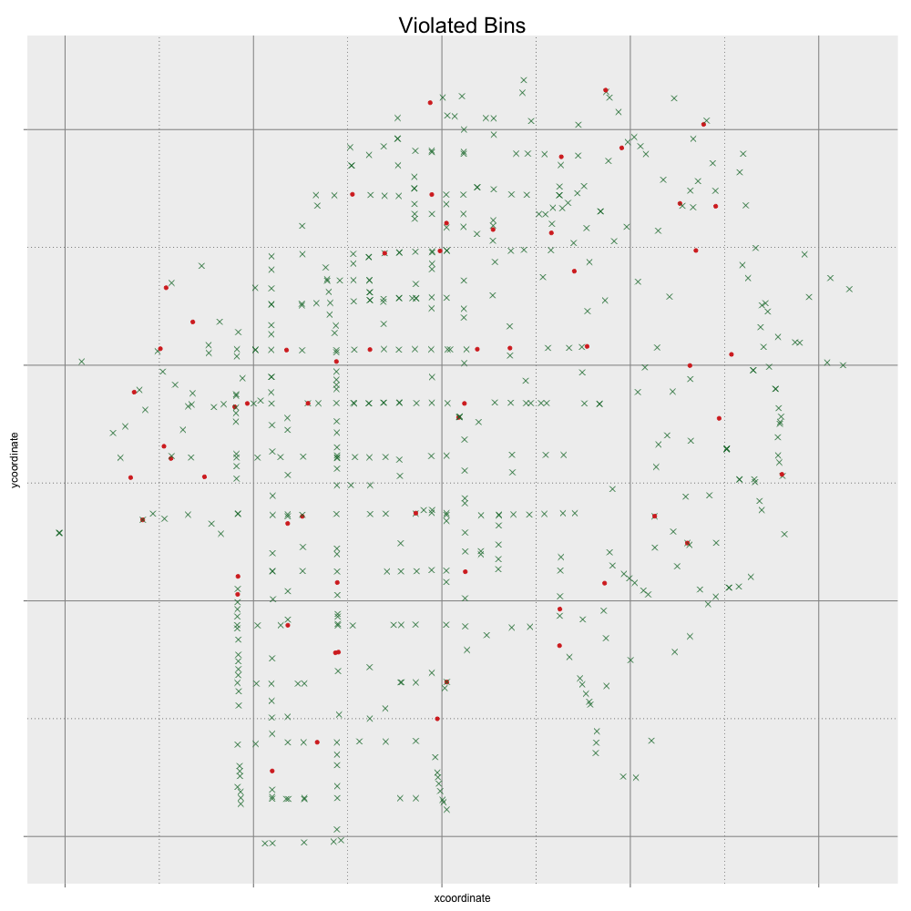
Methodology
Methodological approach
Steps of recursive process for optimal control
At time k, we consider the bins that are currently violated
Cluster analysis of collection points above threshold
3. Solve the TSP problem for constructing the “fixed path” per cluster
4. Determine if it is worth to deviate for a truck in the cluster
Re-do the TSP with all bins to be visited

Slide 9
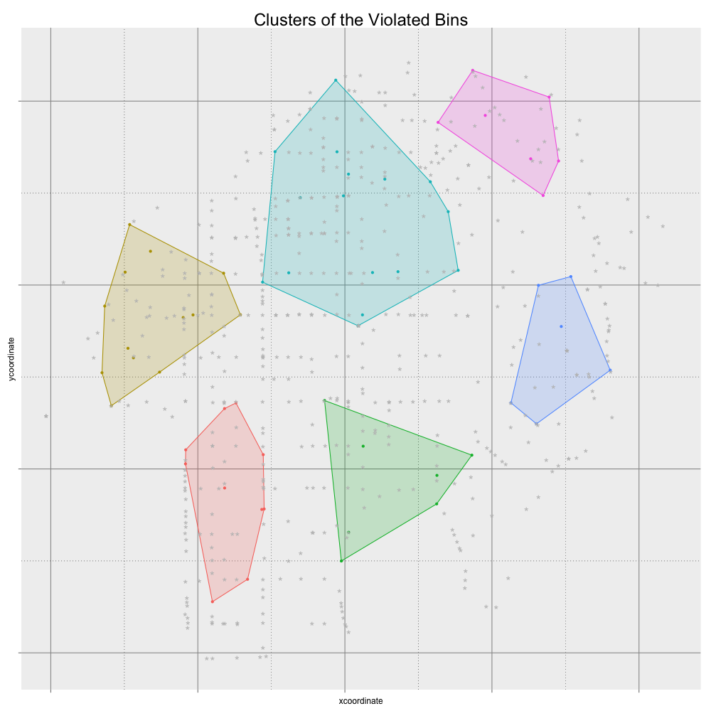
Methodology
Methodological approach
Steps of recursive process for optimal control
At time k, we consider the bins that are currently violated
Cluster analysis of collection points above threshold
3. Solve the TSP problem for constructing the “fixed path” per cluster
4. Determine if it is worth to deviate for a truck in the cluster
Re-do the TSP with all bins to be visited

Slide 10
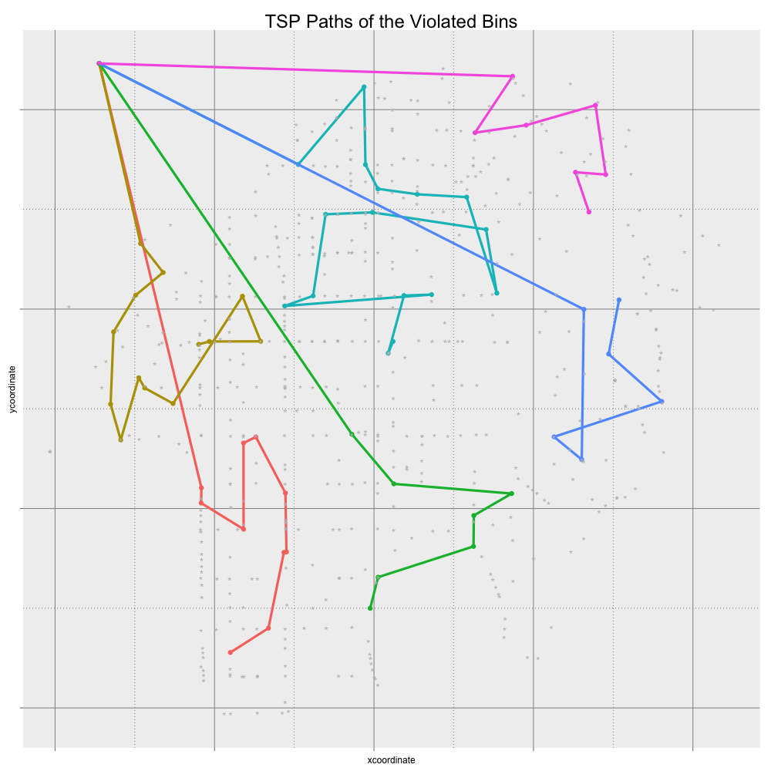
Methodological approach
Steps of recursive process for optimal control
At time k, we consider the bins that are currently violated
Cluster analysis of collection points above threshold
3. Solve the TSP problem for constructing the “fixed path” per cluster
4. Determine if it is worth to deviate for a truck in the cluster
Re-do the TSP with all bins to be visited

Slide 11
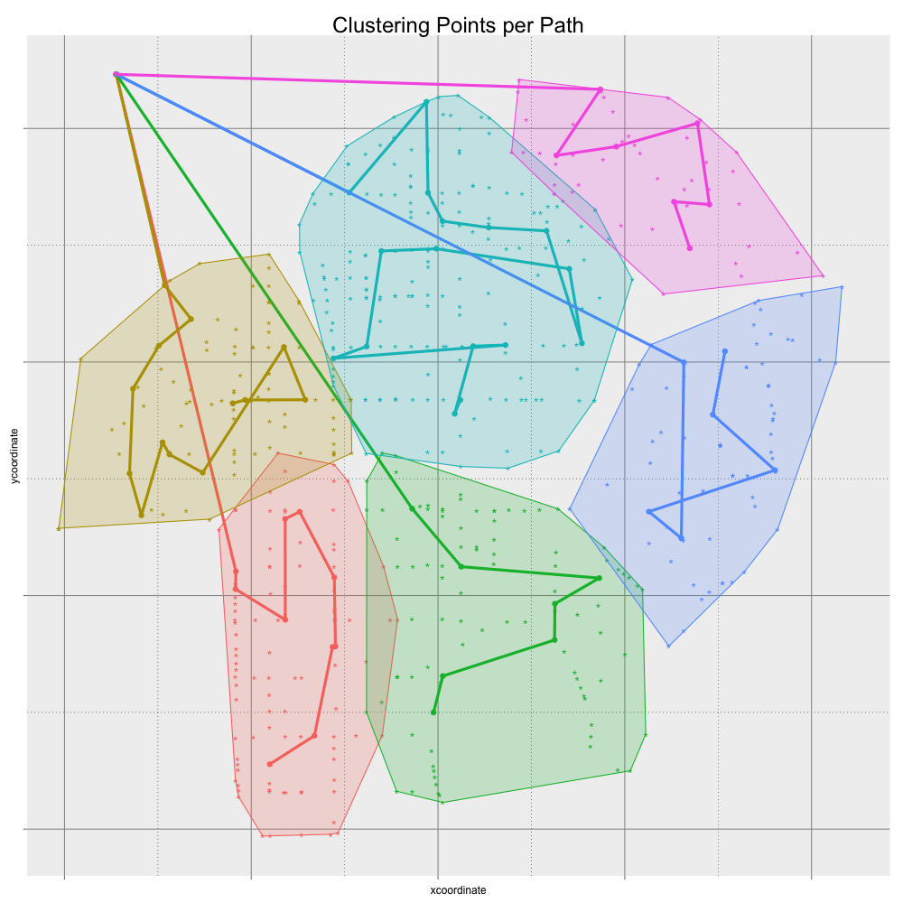
Methodology
Steps of recursive process for optimal control
At time k, we consider the bins that are currently violated
Cluster analysis of collection points above threshold
3. Solve the TSP problem for constructing the “fixed path” per cluster
4. Determine if it is worth to deviate for a truck in the cluster
Re-do the TSP with all bins to be visited

Slide 12
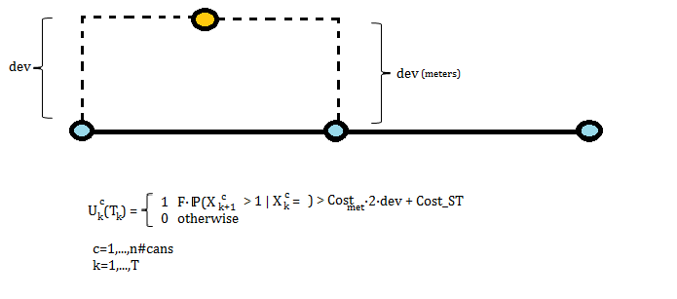
Methodology
Steps of recursive process for optimal control
At time k, we consider the bins that are currently violated
Cluster analysis of collection points above threshold
3. Solve the TSP problem for constructing the “fixed path” per cluster
4. Determine if it is worth to deviate for a truck in the cluster
Re-do the TSP with all bins to be visited
OPTIMAL DECISION
TRADE-OFF BETWEEN EXTRA COST AND “PENALTY”

Slide 13
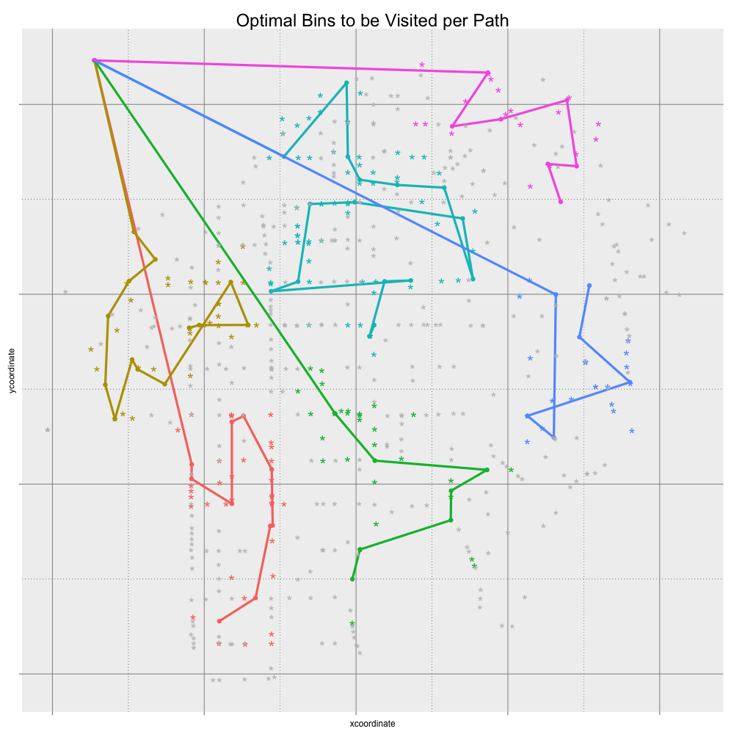
Methodology
Steps of recursive process for optimal control
At time k, we consider the bins that are currently violated
Cluster analysis of collection points above threshold
3. Solve the TSP problem for constructing the “fixed path” per cluster
4. Determine if it is worth to deviate for a truck in the cluster
Re-do the TSP with all bins to be visited

Slide 14
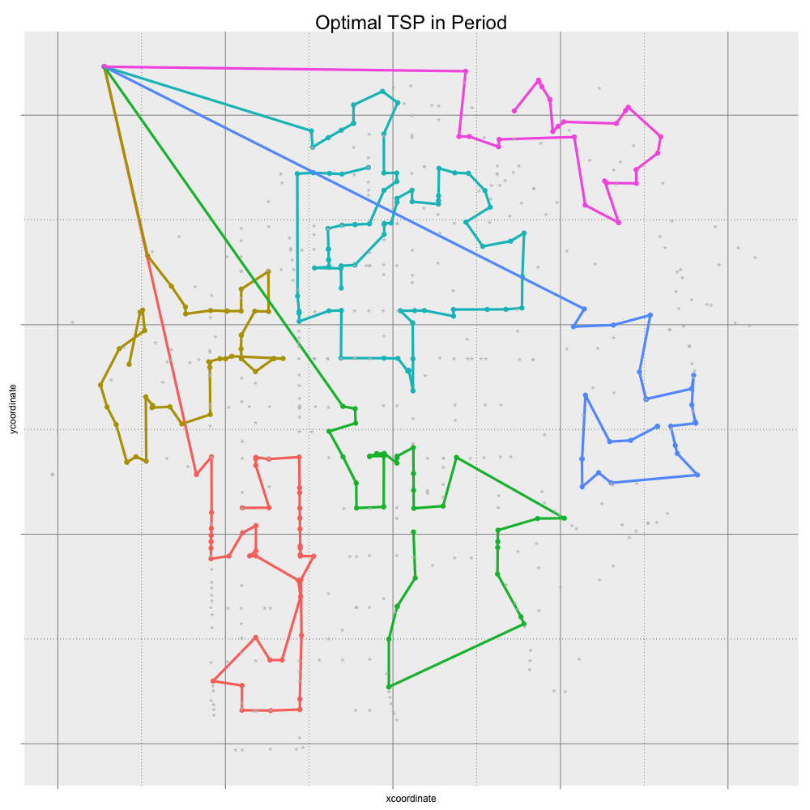
Methodology
Steps of recursive process for optimal control
At time k, we consider the bins that are currently violated
Cluster analysis of collection points above threshold
3. Solve the TSP problem for constructing the “fixed path” per cluster
4. Determine if it is worth to deviate for a truck in the cluster
Re-calculate the TSP with all bins to be visited
The decisions of visiting will affect the rubbish in the cans of next day

Slide 15

Results over 10 days

Slide 16
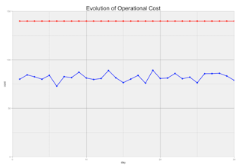
Conclusions
Monthly Cost comparison
Costs (red): 4.200 Euros
Optimal cost (blue): 2.460 Euros
Cost reduction: 48%
“Value of information” from introducing a WCMIS saves an annual cost of ~ 24.000 Euros

Slide 17
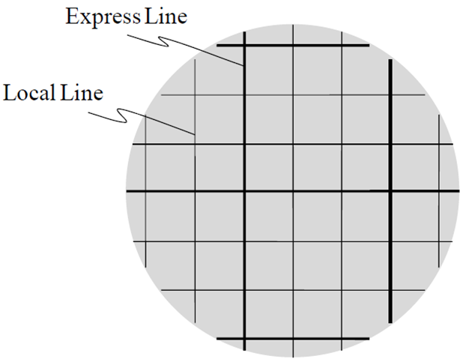
Future directions
Different demand profiles and urban settings
Introduction of hierarchies in the road network
Introduction of traffic conditions
Sensitivity analysis over the parameters (number and size of trucks, area size etc.)

Slide 18
Barcelona Graduate School of Economics (BGSE)
Master in Data Science
Stochastic Optimization
Waste Collection and Management problem
María Fernández
Anestis Papanikolaou
Jéssica Leal
18th March 2015
Barcelona, Spain

Slide 19
Model
- Objective: minimize operational costs of WC operator over time by introducing a WIS
Assumptions:
  Smart cans
  Poisson distributed throwing trash rate
  Penalty and fixed operational costs

Slide 20
Model
- Decision variable: U_{k}^{c} ϵ {not-visit,visit}
- State variable: X_{k}^{c} ( current % fulness of bins)
- Dynamics of bins’ fulness (%): depends on U_{k}^{c} , X_{k}^{c} and E_{k}[W_{k+1}^{c}]
- We visit if X_{k}^{c} > threshold (90%)
- The violated-bins determine the optimal path
- We visit all violated cans
- Non-violated cans might be visited depending on comparing costs and benefits: additional distance if we deviate (C) vs. the risk of paying a fine

Slide 21
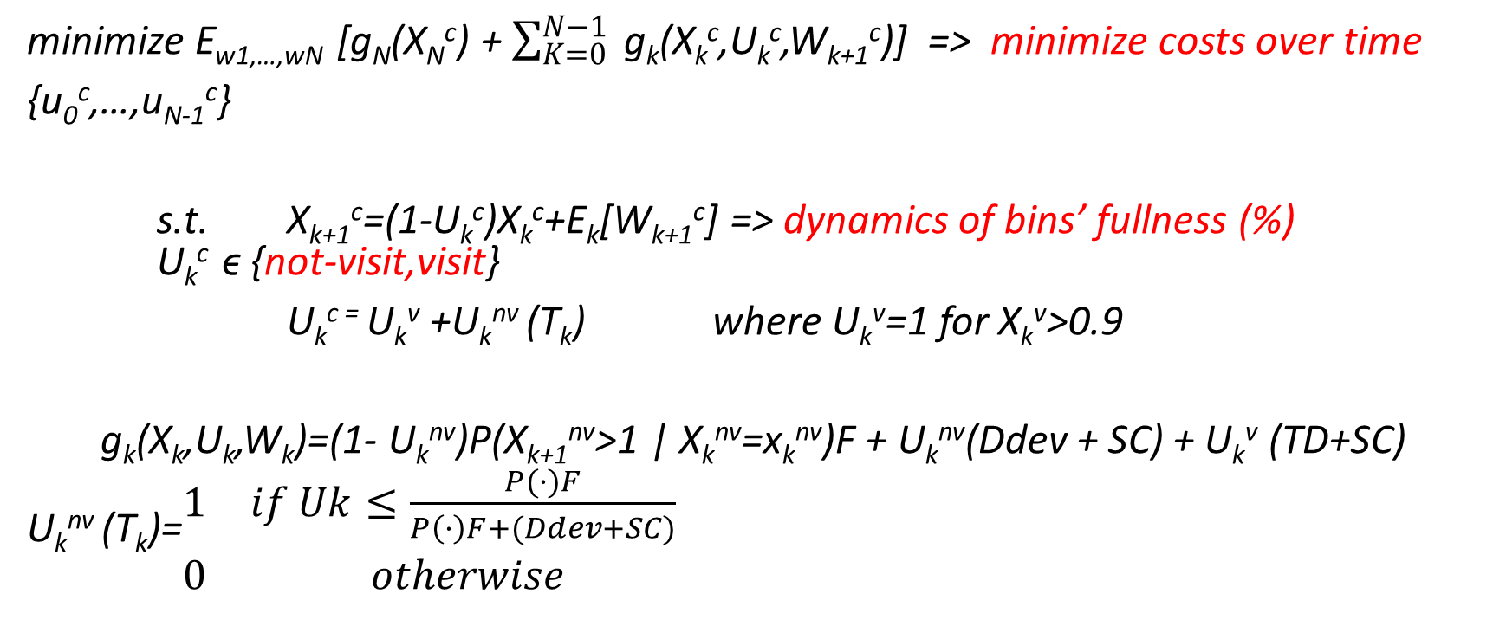
Model
minimize E_{w1,…,wN} [g_{N}(X_{N}^{c}) + $\sum_{K=0}^{N−1}{ }$g_{k}(X_{k}^{c},U_{k}^{c},W_{k+1}^{c})] => minimize costs over time
{u₀^{c},…,u_{N-1}^{c}}
s.t. X_{k+1}^{c}=(1-U_{k}^{c})X_{k}^{c}+E_{k}[W_{k+1}^{c}] => dynamics of bins’ fullness (%) U_{k}^{c} ϵ {not-visit,visit}
U_{k}^{c =} U_{k}^{v} +U_{k}^{nv} (T_{k}) where U_{k}^{v}=1 for X_{k}^{v}>0.9
g_{k}(X_{k},U_{k},W_{k})=(1- U_{k}^{nv})P(X_{k+1}^{nv}>1 | X_{k}^{nv}=x_{k}^{nv})F + U_{k}^{nv}(Ddev + SC) + U_{k}^{v} (TD+SC)
U_{k}^{nv} (T_{k})=$\begin{matrix}1 & if Uk≤\frac{P(·)F}{P\left(·\right)F+(Ddev+SC)} \\ 0 & otherwise\end{matrix}$

