Slide 1

Lab Book 1.0. Waveguides
Student:

Slide 2
Instructions
General
SCRIPTS
From GitHub →
  Fork the repo: cccanvas-upv/pic-upv-lab1
  Clone the repo using VSCode
Run the Jupyter Notebook:
  WAVEGUIDES_Student.ipynb
W (width)
W (width)
Core
Core
h_core
h
(height)
Cladding
Cladding
Slab
h_slab
deep waveguide
shallow waveguide

Slide 3
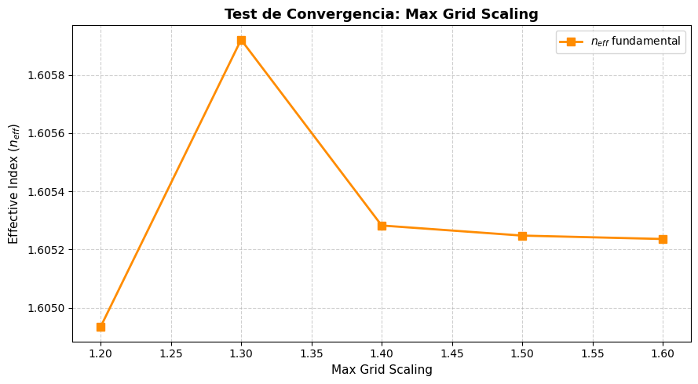
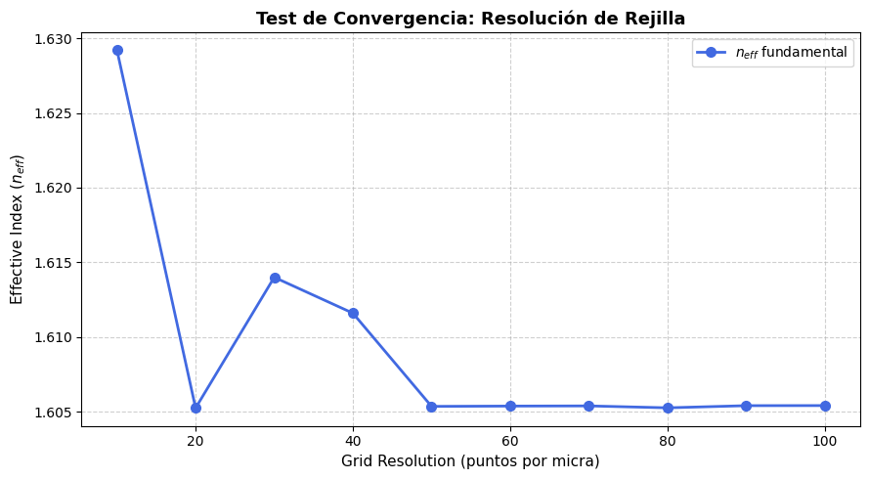
Learning outcome #1 – Convergence tests
DE waveguide, w = 1.2 µm, neff_TE0, wvl 1.55 µm.
deep waveguide
Paste neff_TE0 vs grid_resolution plot here
deep waveguide
Paste neff_TE0 vs max_grid_scaling plot here
Comment results, determine above which grid value the effective index calculation does not change significantly
Se observa qie el indice efectivo constante es a partir de un grid de 50 puntos por micra, y se estabiliza en un valor de 1.605 aproximadamente.
Por otro lado, como este valor de indice se consigue tambien cuando el grid resolution es de 20 se establece que el max grid scaling se calcula a partir de 20. Por otro lado en el max grid scaling se empieza a hacer constante a partit de un max grid de 1.5.

Slide 4
Learning outcome #2 – Width dependence
Width 0.6 - 1.6 µm (step 0.1 µm) – Wavelength 1.55 µm
deep waveguide
Paste plot here
Comment results (neff changes this way with width, polarization behavior, etc…)

Slide 5

Learning outcome #3 – Waveguide compact model
Let’s model the waveguide using a second order polynomial:
$$n_{eff}\left(λ\right)=n_{1}+n_{2}\left(λ−λ_{0}\right)+n_{3}{\left(λ−λ_{0}\right)}^{2}$$
deep waveguide
neff_TE0 vs $λ$ with the second-degree polynomial fit
& neff_TM0 vs $λ$ with the second-degree polynomial fit
shallow waveguide
neff_TE0 vs $λ$ with the second-degree polynomial fit
& neff_TM0 vs $λ$ with the second-degree polynomial fit
slab: 150nm
Find the second-degree polynomial coefficients and relate them with the group index and the dispersion parameter. $\left\{\begin{aligned}n_{eff}=n_{1} \\ n_{g}=n_{1}−n_{2}λ_{0} \\ D=−\frac{2λ_{0}n_{3}}{c}\left[\frac{s^{2}}{m}\right]\end{aligned}\right.$
Comment on the results found for the TE0 and TM0 for both deep and shallow waveguides.

Slide 6
Learning outcome #4 – Bend waveguide radius vs. loss – deep
Find neff_TE0 for wvl 1.55 µm, width 1.0 µm for R=25,50,75,100, 125,150 µm
deep waveguide
Paste dB/90º neff_TE0 & neff_TM0 vs R
$α\left[\frac{dB}{90°}\right]=$ $R\frac{π}{2}α\left[\frac{dB}{µm}\right]$
Comment results, which is the safe radius, consider safe means less than 0.1 dB/90º.

Slide 7

Thank you

