Slide 1
The 5 Before
Info you need to know
Get your Survey Done (in canvas)
Get into our Git Page https://fourfeatherz.github.io/DS2002S25/
Sunday Dinners 6:30ish 2019 Ivy Road – open to anyone
We’ll do a GitLab on Wednesday after Warriors Case
Don’t forget to do your Warriors reading (Canvas has details)

Slide 2

DS-2002: Data Science Systems
A Survey of Data Management Systems
Jason Williamson - Spring 24

Slide 3
Class Mechanics
A Survey of Data Management Systems

Slide 4
Who am I and why do you care?
In addition to UVA, I work for the world’s large enterprise software company – Oracle
I ran Oracle for Startups / Venture Capital and Oracle for Research for 7 years under Larry Ellison
Big Company Alum from: Amazon, GE Capital, Capital One
Small Stuff: Startup Founder, Faith Based NGO, boutique consulting
Startup: Founder of a few startups…latest is TruePathVision – Facial and Location Recognition for Anti-Trafficking -
Academic: BoV at NCCU, Former Prof @McIntire, and UNC-CH Adam’s Fellowship Entrepreneurship Mentor
4 Kids and 1 wife (Anna CAS ’23, Patrick CAS ’24, Lily (Liberty), Jack (Air Force + Liberty ) and Susan COMM ’95)
Spend a lot of non-UVA/Oracle time working with the Tim Tebow Foundation
Wrote some books on data, getting a job in big data, stuff like that…
I love helping students think about and navigate jobs, careers and life --> I’ve Hired 4 people from this program
Sunday Night Dinner! 2019 Ivy Road ~6:30ish to whenever

Slide 5

Class Mechanics: Course Content
Labs/Assignments
Frequent Hands-On Labs
Google and on your machine
1ish Per Week (More Available)
Assignments generally due by Sunday
Labs generally due by Friday

Slide 6

Class Mechanics: Grading
Data Project
Concrete Examples of Implementation
Released long before they’re due
Detailed Instructions will be in Canvas

Slide 7
Class Mechanics: Things You Need to Know
How this course will be conducted: Class Location, Course Materials, Communications
The schedule is prone to updates: I’ll be sure to keep everyone informed!
Everything will be updated on GitHub (Code Examples, Decks, etc) and Canvas(Everything Else): fourfeatherz/DS2002F25 (github.com)
Projects and Grades will be released on Canvas
You can DM me Questions or to Set-up Office Hours, but generally we’ll do it in my office after class.
The rhythm is Monday/Lecture Concept and Wednesday/Hands On and Lab

Slide 8
Learning Objectives
Overview of Data Science, underlying technologies and roles
Develop Robust Facility for Handing Data
Acquire a Strong Understanding of SQL and NoSQL Databases
Understand Systems Options in the Public Cloud
Gain Fluency in Tools, Processes, and Services …and How to Choose Among Them
Data Retrieval
Data Shipping
Data Schemas
Data Ingestion
Data Processing
Data Normalization
Data Analysis

Slide 9
Overview
of the Semester Topics
A Survey of Data Management Systems

Slide 10
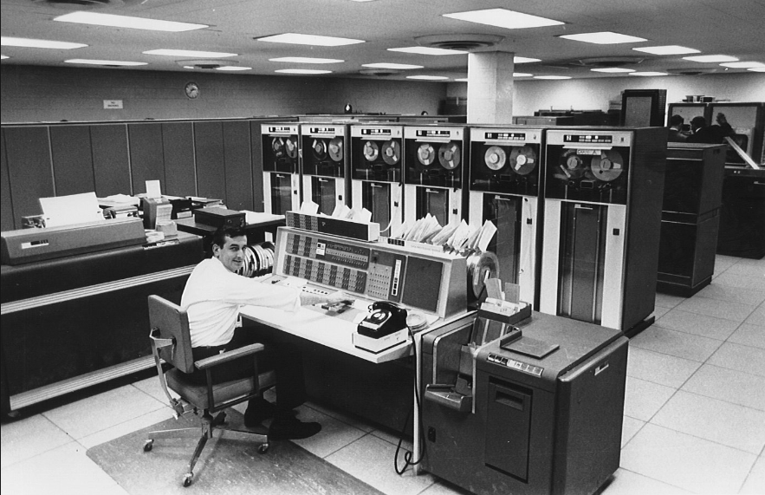
In the Beginning… There Was Mainframe
Data stored in ISAM files (indexed sequential access method)
Flat files having fixed-length fields
Centralized computing and storage resources
“Dumb” terminal clients
Only affordable to large, wealthy enterprises:
Governments
Large Banks

Slide 11
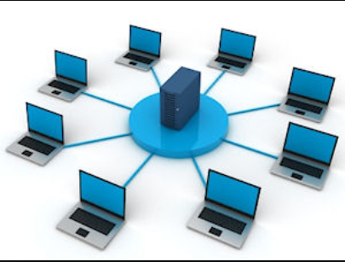
Then Came… Client/Server Networks
Data stored in Relational Database Management Systems (RDBMS):
Oracle
SQL Server
Enterprise Data Centers:
Company owned & managed
Based on commodity hardware
Some computation and storage resources shared by clients

Slide 12
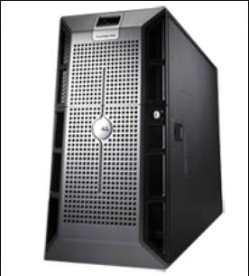
Which Gave Us… SMP Servers
Relational Database Management running on Symmetric Multi-Processing Servers
Dedicated Database Servers:
RDBMS (Relational Database Management Server)
Oracle, SQL Server, DB2, etc.
OLTP (Online Transaction Processing)
High Volume of Small, Discrete Operations
Online Sales, Bank Deposits & Transfers
Highly Normalized Database Schema
OLAP (Online Analytical Processing)
Low Volume of Large Read Operations
Periodic Post-hoc Analysis (What Happened?)
De-Normalized Multi-Dimensional Data Warehouses
Notes:
Back in the days when Mainframe computers ruled the earth, their primary job was to store vast quantities of data upon which to perform statistical analysis. Though many things have changed in the computing ecosystem, this task is as prevalent now as it was at the dawn of the computing era. “Traditionally” these tasks have been performed using Synchronous Multi-Processing (SMP) servers; powerful machines that achieve amazing results by increasing their CPU, Memory and Storage capacities to meet an ever-increasing demand. Not unlike the mainframes of the past, this “scale-up” approach strives to meet growing demand by increasing the data processing capability of a single server instance. Following this approach decades of innovation have rendered increasingly powerful hardware, but everything has its limit. No matter how powerful, computers have a logical upward bound. So what were the data geeks to do next?

Slide 13
Which Gave Us… SMP Servers
Relational Database Management running on Symmetric Multi-Processing Servers
Dedicated Database Servers:
RDBMS (Relational Database Management Server)
Oracle, SQL Server, DB2, etc.
OLTP (Online Transaction Processing)
Characterized by a large volume of transactions each of which affect a small number of rows
Online Sales, Bank Deposits & Transfers
Highly Normalized Database Schema
OLAP (Online Analytical Processing)
Characterized by a small volume of read transactions each of which affect a large number of rows
Periodic Post-hoc Analysis (What Happened?)
De-Normalized Multi-Dimensional Data Warehouse Schema
Notes:
Back in the days when Mainframe computers ruled the earth, their primary job was to store vast quantities of data upon which to perform statistical analysis. Though many things have changed in the computing ecosystem, this task is as prevalent now as it was at the dawn of the computing era. “Traditionally” these tasks have been performed using Synchronous Multi-Processing (SMP) servers; powerful machines that achieve amazing results by increasing their CPU, Memory and Storage capacities to meet an ever-increasing demand. Not unlike the mainframes of the past, this “scale-up” approach strives to meet growing demand by increasing the data processing capability of a single server instance. Following this approach decades of innovation have rendered increasingly powerful hardware, but everything has its limit. No matter how powerful, computers have a logical upward bound. So what were the data geeks to do next?

Slide 14

But Then… An Explosion of Data – “BIG Data”
A Rapid, Exponential Proliferation of New Devices: The Internet of Things (IoT)
olume (Size)
Explosion in social media, mobile apps, digital sensors, RFID, GPS, and more have caused exponential data growth.
ariety (Structure)
Traditionally BI has sourced structured data, but now insight must be extracted from unstructured or poly-schematic data like large text blobs, digital media, sensor data, etc.
eracity (Quality)
The anonymity of the WWW, incredible sources like social networking and duplicate systems bring into question the authenticity of the information being generated and collected.
elocity (Speed)
Sources like social networking and sensor signals create data at a tremendous rate; making it a challenge to capture, store, and analyze that data in a timely or economical manner.

Slide 15
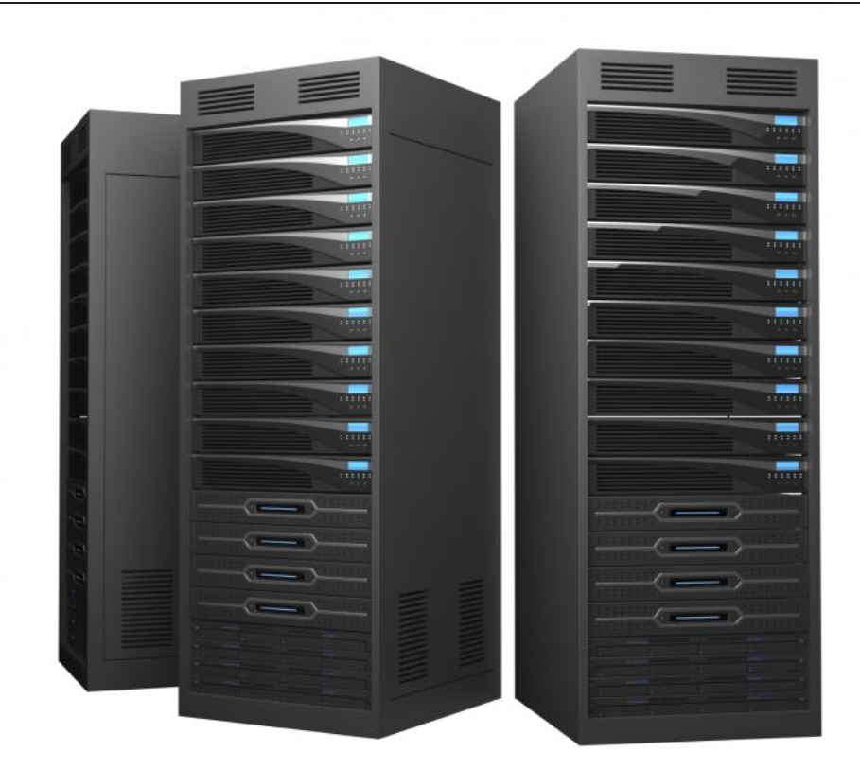
But… How Can We Manage All That Data: Scalability
The Advent of Big Data Drove a Need to Increase Scale to the Petabyte Level: $$$$$
SMP: Symmetric Multi-Processing
MPP: Massively Parallel Processing
This
Became
Scale Up (Limited)
Scale Out (Practically Unlimited)

Slide 16
And Today… Cloud-hosted Databases & Services
Re-centralization of Servers ▪ Based on Commodity HW ▪ Resources Shared by Client
Essential Characteristics
On-Demand Self-Service
Broad Network Access
Resource Pooling
Rapid Elasticity
Measured Service
Service Models
Infrastructure as a Service (IaaS)
Platform as a Service (PaaS)
Software as a Service (SaaS)
Deployment Models
Public Cloud
Private Cloud
Community Cloud
Hybrid Cloud

Slide 17
Service Models: On-Premises vs Cloud-Hosted
Managed by Owner
Managed by Service Provider
On Premises
IaaS
PaaS
SaaS
Applications
Applications
Applications
Applications
Data
Data
Data
Data
Runtime
Runtime
Runtime
Runtime
Middleware
Middleware
Middleware
Middleware
OS
OS
OS
OS
Virtualization
Virtualization
Virtualization
Virtualization
Servers
Servers
Servers
Servers
Storage
Storage
Storage
Storage
Networking
Networking
Networking
Networking

Slide 18
Data Management… In the Cloud
Economies of Scale Afforded by the Cloud Have Enabled Massive Storage & Compute
File-based Storage: Blobs, Queues, Tables, Data Lakes
Relational Database Management Systems:
Online Transaction Processing (OLTP) systems:
IaaS: Cloud-hosted VMs Running RDBMS Software & Databases
PaaS: Managed RDBMS Instance
SaaS: (Database as a Service) – Single Databases or Multi-Database Pools
Online Analytical Processing (OLAP) systems:
Massively Parallel Processing (MPP) Data Warehouse
NoSQL Database Management Systems:
Semi-Structured or Poly-Schematic data
Massively Parallel Processing
Data partitioned and replicated across many server machines (nodes)
Data typically stored in file-based format (e.g., JavaScript Object Notation (JSON)

Slide 19
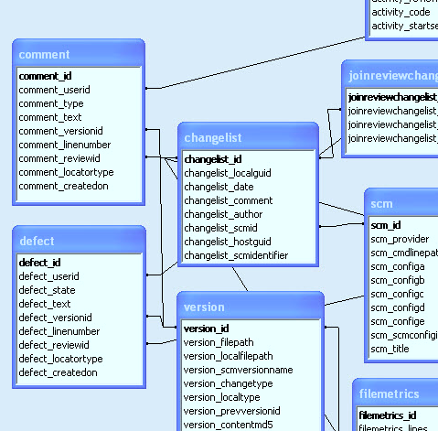
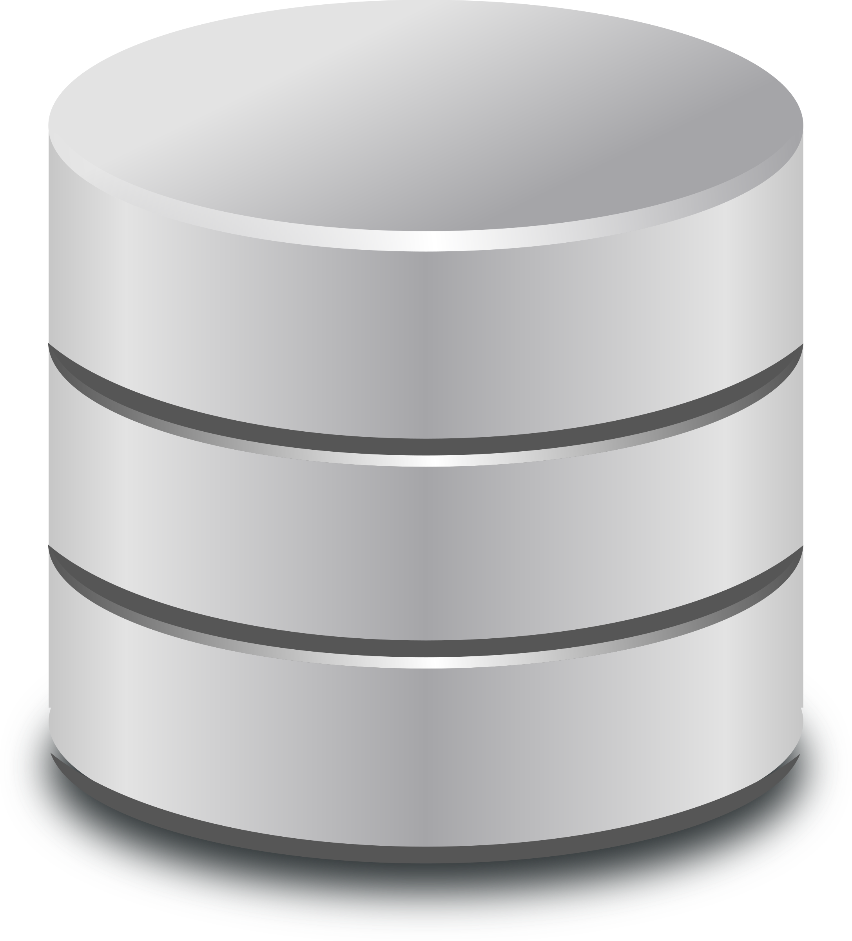

Paradigms: Data Storage and Retrieval
Schema on Write versus Schema on Read
Schema on Write: Stores data in an organized structure (schema)
Client or Process
Writes Data to
Schema
Client or Process
Reads Data from
Schema
RDBMS
Schema on Read: Applies schema only when read, data stored in its original format
Client or Process
Writes Data
To Storage
Client or Process
Reads Data into Schema
From Storage
Data Lake

Slide 20
NoSQL: Not Only SQL
Key-value stores
The simplest NoSQL database; based on “dictionaries” or “maps”.
Items are stored in associative arrays; pairing a name (or "key"), with a value.
Riak, FoundationDB, and Redis
Pairs keys with complex data structures (documents) using XML, JSON or BSON.
Documents may contain key-value pairs, key-array pairs, and nested documents.
MongoDB, MarkLogic, and Apache CouchDB
Graph stores
Stores interrelated networks of data such as social connections, or network topologies.
Optimized for interconnected data elements with an undetermined number of relations.
AllegroGraph, Neo4J and HyperGraphDB.
Column stores
Combines a key, value and timestamp for each item.
Optimized for large datasets by storing columns of data together, rather than in rows.
Cassandra, BigTable and HBase
Document databases
Often called "Not only SQL" because they may also support SQL-like queries. Many NoSQL stores compromise consistency in favor of availability & partition tolerance.

Slide 21
Onward to Data Science
A Brief Overview of How Data Systems are Involved

Slide 22
The Data Science: Hierarchy of Needs
LEARN / OPTIMIZE
AGGREGATE / LABEL
EXPLORE / TRANSFORM
MOVE / STORE
COLLECT
AI, Deep Learning
A/B Testing, Experimentation, Simple ML Algorithms
Analytics, Metrics, Segments, Aggregates, Features, Training Data
Cleaning, Anomaly Detection, Prep
Reliable Data Flow, Infrastructure, Pipelines, ETL, Structured & Unstructured Data Storage
Instrumentation, Logging, Sensors, External Data, User-Generated Content

Slide 23
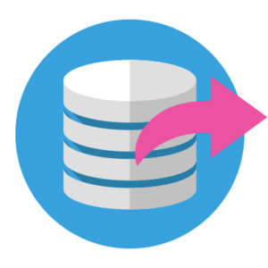


Data Engineering… for Data Science
Frequently, Data Must Be Moved from Sources to a Database and/or Data Lake
Extract
This is the step where sensors wait for upstream data sources to land. Once available, we transport the data from their source locations to further transformations.
Transform
The heart of any ETL job: apply business logic, perform actions such as filtering, grouping, and aggregation to translate raw data into analysis-ready datasets.
Load
Load the processed data and transport to a final destination. Can now be consumed directly by end-users or treated as yet another upstream dependency.

