Slide 1
MET CS 790 · Advanced Computer Vision
Generative AI for Hand OA Disease Simulation
Class-conditional latent diffusion improves rare-grade KL classification on hand X-rays
Group 3 · Track 3
María Martín · Zulal Akarsu · Jai Sharma
April 28, 2026
Notes:
We're Group 3 — Zulal, Jai, and Maria. Track 3: using generative AI to simulate hand osteoarthritis disease progression.

Slide 2
The Problem
13,176
2.9%
50:1
DIP joint X-rays
are severe (KL 3/4)
KL 0 vs KL 4 imbalance
Our approach
Real images
→
Generate synthetic
→
Retrain classifier
→
AUC improved?
CycleGAN (baseline) — binary only
Latent Diffusion (primary) — binary + 5-class
Notes:
Severe hand OA is rare in our dataset. 13,000 DIP joint X-rays, but only 2.5% are severe — KL 3 and 4. That's a 50 to 1 imbalance between healthy and severe. Classifiers trained on this data underperform on exactly the cases that matter most clinically. Our approach: generate synthetic X-rays at specific severity grades, mix them into training, and see if the classifier improves. We used two generative models — CycleGAN as a baseline, which can only do healthy versus diseased, and latent diffusion as our primary model, which can target all 5 KL grades individually.

Slide 3
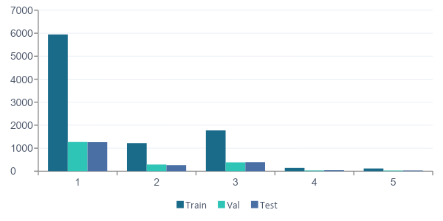

Data Split Breakdown — 3,505 patients • 13,176 DIP images
Split | Patients | Images | %
Train | 2,453 | 9,202 | 69.8%
Val | 526 | 1,995 | 15.1%
Test | 526 | 1,979 | 15.0%
Total | 3,505 | 13,176 | 100%
Split | KL 0 | KL 1 | KL 2 | KL 3 | KL 4
Train | 5,947 | 1,220 | 1,770 | 144 | 118
Val | 1,269 | 288 | 382 | 29 | 25
Test | 1,260 | 261 | 389 | 41 | 28
Total | 8,476 | 1,769 | 2,541 | 214 | 171
KL grade distribution across splits
Key insights
Split ratios are exactly 70/15/15 as planned
KL proportions consistent across all splits — stratification working
KL 3+4 = only 2.9% of data — severe class imbalance for training
KL 3+4 still present in val and test (29+25 and 41+28) — model can be evaluated on rare cases
0
1
2
3
4
Zero data leakage — no patient appears in more than one split

Slide 4
PART 1 · BASELINE GENERATIVE MODEL
CycleGAN
Unpaired domain translation: healthy ↔ diseased

Slide 5
How CycleGAN works
Two generators learn to translate between domains; cycle consistency preserves anatomy
DOMAIN A
Generator A → B (add disease)
DOMAIN B
KL 0–1
KL 2+
Healthy joints
Generator B → A (remove disease)
Diseased joints
7,167 training images
2,032 training images
ARCHITECTURAL CONSTRAINT
CycleGAN translates between two domains only — it cannot generate specific KL grades.
All diseased outputs are labeled "KL 2+". This is fine for binary OA detection — but it's why diffusion (class-conditional) is our primary model for the 5-class task.

Slide 6
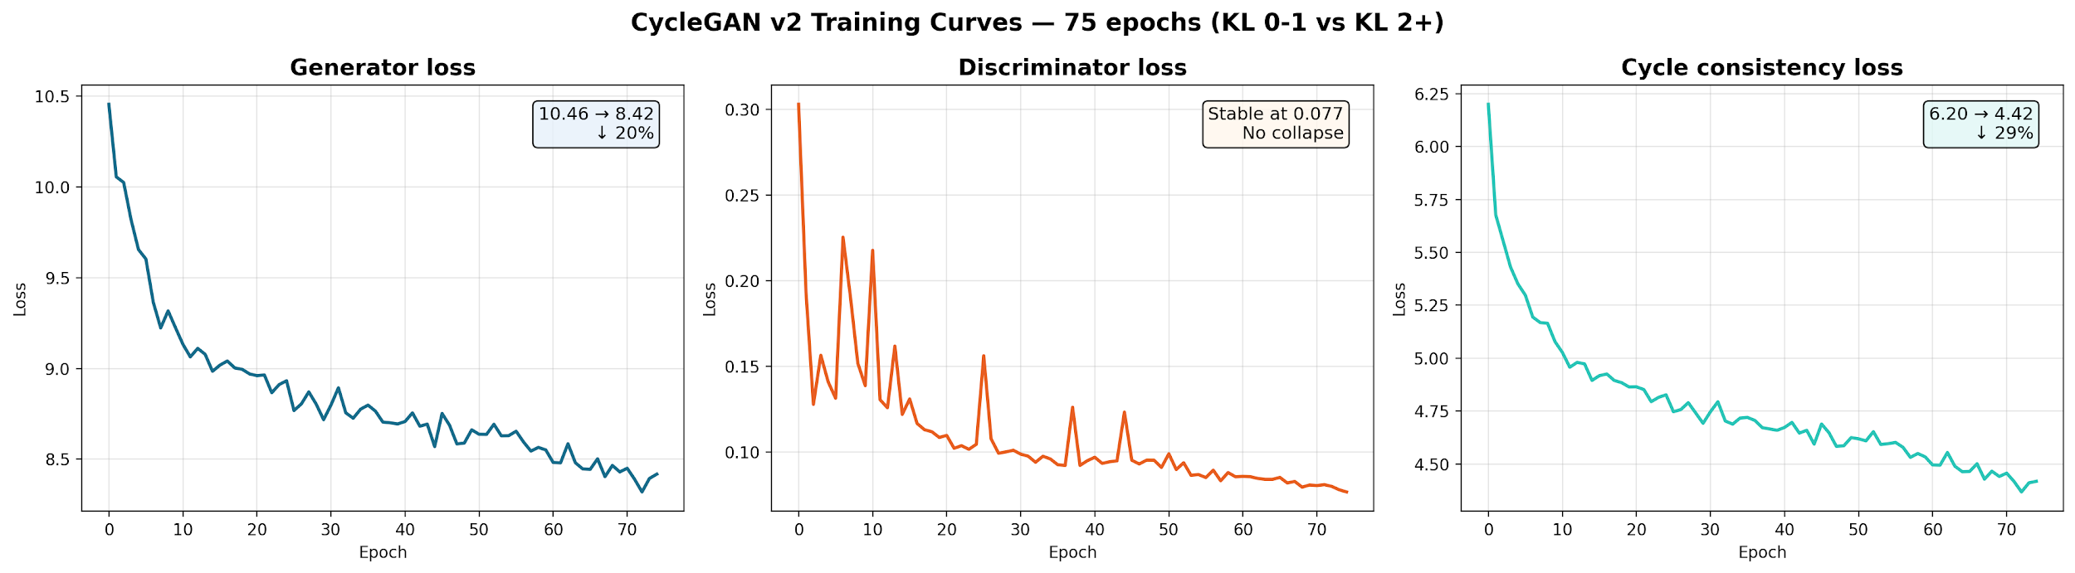
CycleGAN training results
75 epochs · ~3 hrs on RTX 6000 · stable convergence, no mode collapse
75
300
180 px
0.77–0.85
epochs
diseased images
resolution
SSIM
WHAT THE CURVES TELL US
Generator loss ↓ 20%
10.46 → 8.42
model learned disease features
Cycle loss ↓ 29%
6.20 → 4.42
anatomy preserved
Discriminator stable @ 0.077
no collapse — healthy balance

Slide 7
CycleGAN evaluation metrics
Computed on validation set (526 patients, not seen during training)
STRENGTHS
Metric | Value | Target | Status
Cycle SSIM (Healthy) | 0.9212 | > 0.80 | ✓ Pass
Cycle SSIM (Diseased) | 0.9108 | > 0.80 | ✓ Pass
Cycle PSNR (Healthy) | 24.17 dB | > 20 dB | ✓ Pass
Cycle PSNR (Diseased) | 23.49 dB | > 20 dB | ✓ Pass
Translation SSIM (H → D) | 0.8332 | 0.5–0.85 | ✓ Ideal
Translation SSIM (D → H) | 0.7819 | 0.5–0.85 | ✓ Ideal
SSIM > 0.91 — anatomy preserved
PSNR > 23 dB — high fidelity
Translation SSIM 0.78–0.83 — meaningful changes

Slide 8
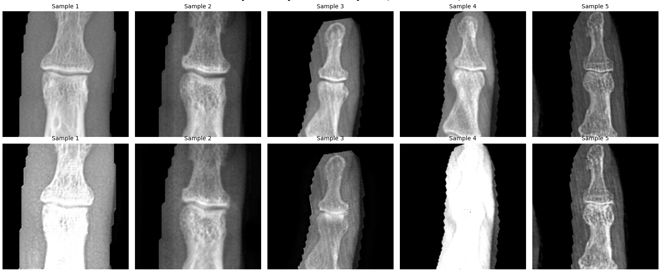
Real v/s CycleGAN Synthetic - DIP Joints (KL 0-1 -> KL 2+)
Top row: real KL 0–1 (healthy) → generated KL 2+
KL 0-1
KL 2+
Visual takeaway: CycleGAN preserves overall bone shape but tends to over-brighten and lose fine texture. Severe-grade outputs show structural distortion, a known failure mode for unpaired translation.

Slide 9
PART 2 · PRIMARY GENERATIVE MODEL
Latent Diffusion Model
Class-conditional generation across all 5 KL grades

Slide 10
Latent diffusion pipeline
Encode to a 67× smaller latent space, denoise there with a class-conditional U-Net, then decode
→
→
→
→
→
Real X-ray
VAE Encoder
Latent z
U-Net Denoiser
VAE Decoder
Generated
180×180
↓ to latent
22×22×8
+ KL class label
↑ to pixels
180×180 X-ray
WHY LATENT DIFFUSION
U-NET - DENOISER
One model handles all 5 KL grades
DDPM is stable: predicts noise, not pixels
Encoding real images preserves rare KL 4 detail
67× spatial compression is cheaper than pixels, 180×180 feasible on a Colab T4
1,000 steps, gradually clean the noise
Compresses to find high-level patterns (bone shape, joint width); expands back to full latent
Conditioned on KL grade — output is grade-specific

Slide 11




VAE Architecture
Encoder
3 stride
3 Conv
Decoder
3 stride
3 Conv
Transpose
180x180x1
180x180x1
90x90x64
90x90x64
45x45x128
45x45x128
22x22x8
22x22x8
Latent z
Latent z

Slide 12
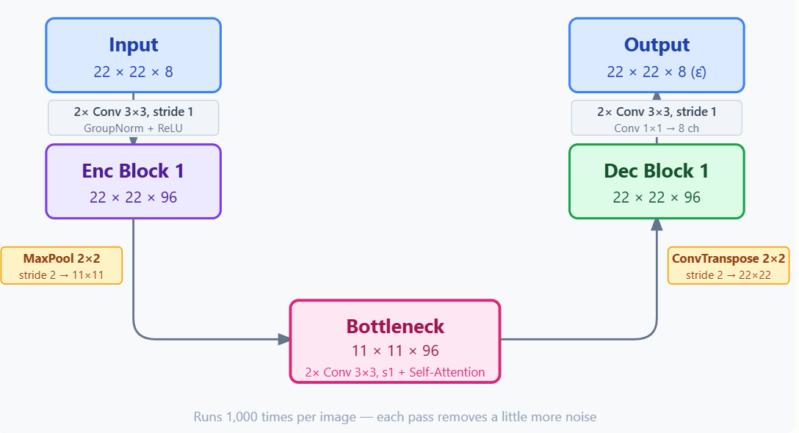
UNet Architecture

Slide 13
Training parameters
Two-stage training: VAE first, then class-conditional U-Net in the latent space
50
150
180×180
VAE epochs
LDM epochs
Resolution
22×22×8
KL 0–4
300/KL
Latent size
5 classes
Samples per grade

Slide 14
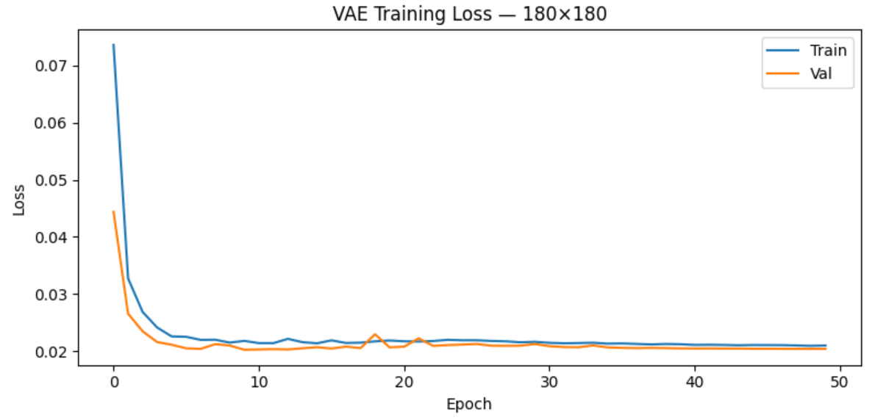
VAE training results
50 epochs · ~3.5 hrs
Inference: Loss plateaus around 0.021 with no train/val gap, and reconstructions retain joint margins and contrast, the latent space is a faithful compression for downstream diffusion.

Slide 15
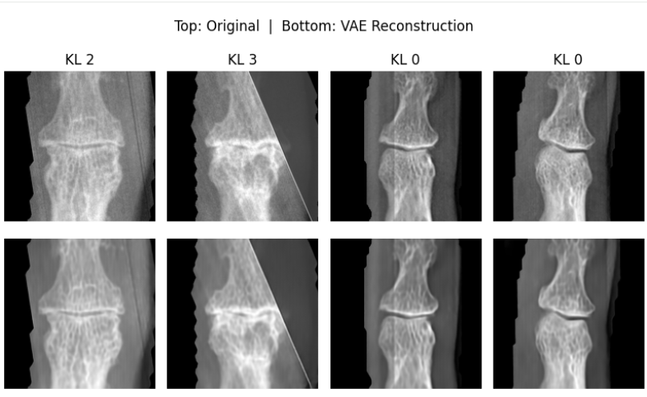
VAE - Training results

Slide 16
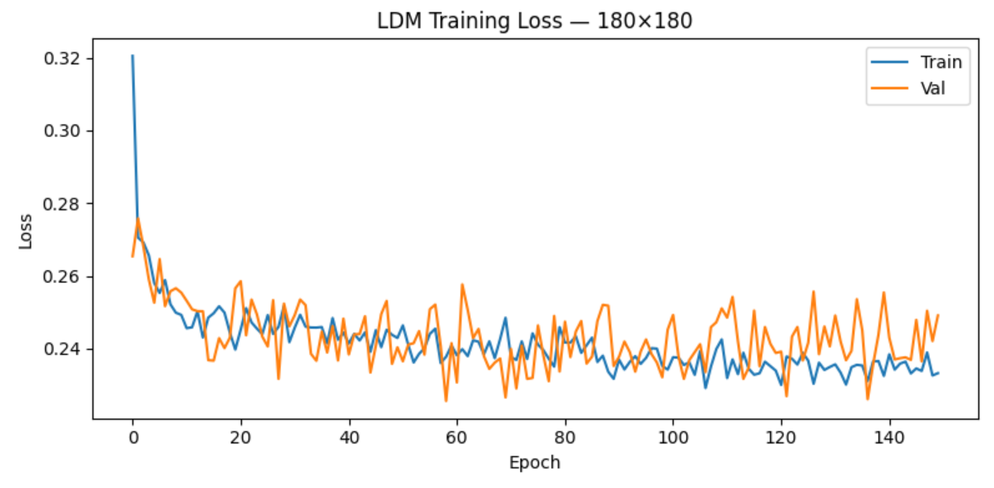
Diffusion training results
150 epochs · ~2.5 hrs in latent space
Noisy? DDPM loss measures noise prediction error at random timesteps t ∈ [1, 1000]. Per-batch fluctuations are inherent. Overall: train and val both drift down together, no overfitting.

Slide 17
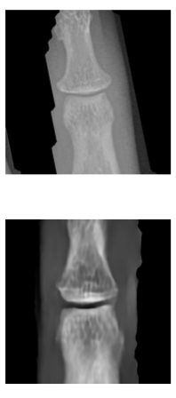
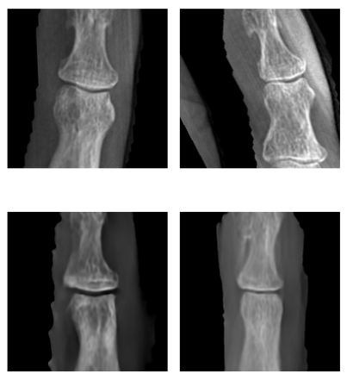
Side by Side Comparison KL 0
Real
Generated

Slide 18
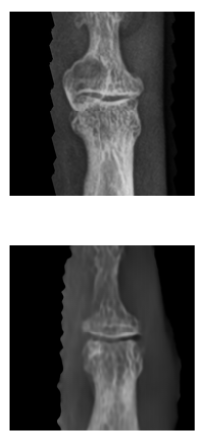
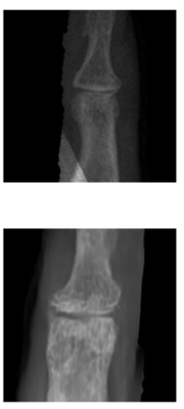
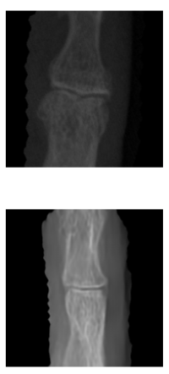
Side by Side Comparison KL 1
Real
Generated

Slide 19
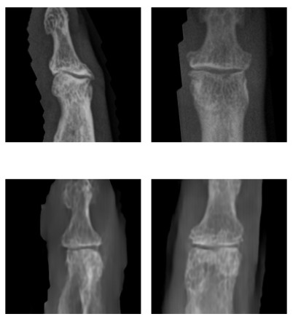
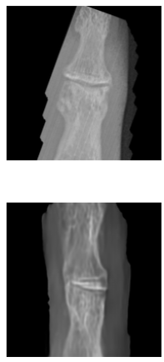
Side by Side Comparison KL 2
Real
Generated

Slide 20
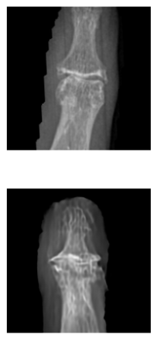
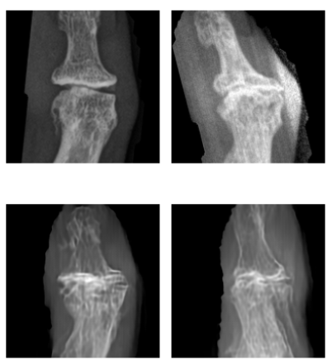
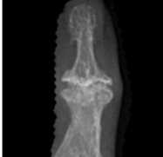
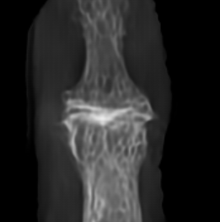
Side by Side Comparison KL 3
Real
Generated

Slide 21
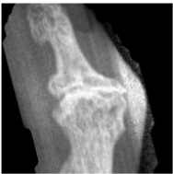
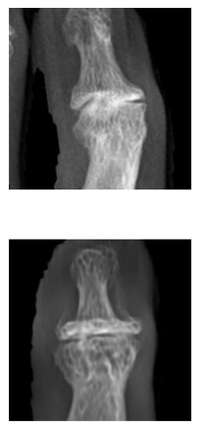
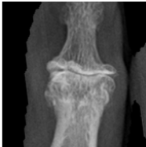
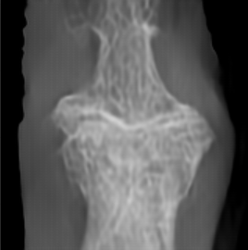
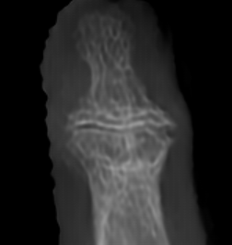
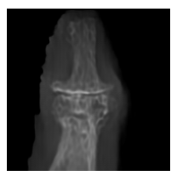
Side by Side Comparison KL 4
Real
Generated

Slide 22
PART 3
Evaluation
Notes:
Now let's move into Part 3 — our evaluation.

Slide 23
How we evaluated
01
02
Generation quality
Classifier baseline
FID per KL grade + visual comparison
ResNet-18 on real data only
Baselines for both Binary + KL-class
03
04
Synthetic ablation
Per-class breakdown
Add synthetic at 10/25/50/100/200% — does AUC rise?
Where in the grade spectrum did the gain land?
51 total runs = CycleGAN binary (15) + Diffusion binary (15) + Diffusion KL-class (15) + Binary baseline (3) + KL-class baseline (3)
Notes:
We have evaluated our results in 4 steps.
First, to confirm the generated images are realistic enough to be useful for downstream tasks, we measured generation quality using FID scores.
Second, we trained a ResNet-18 baseline classifier on real data only to set the bar we aimed to beat.
Third, we ran a synthetic ablation study, mixing in synthetic images at five different ratios from 10 to 200% to see if and when AUC improves.
And lastly, we broke results down per KL grade to understand exactly where synthetic data help hte most.
So total, we ran 51 models across the evaluation, using the same test set and averaged from 3 seeds for every experiment.

Slide 24
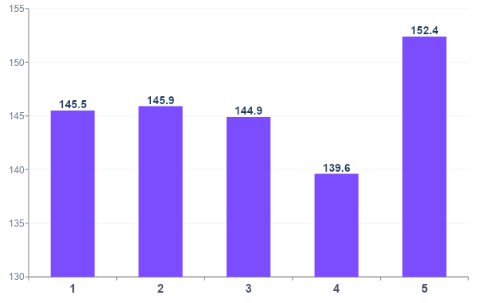
Generation quality & FID scores
lower = more realistic
OBSERVATIONS
Range ~140–152 at full resolution
Consistent across grades — no grade is collapsing
KL 3 has the lowest FID — best quality despite being among the rarest
Generation strategy:
KL 0 / 1 / 2 from noise · KL 3 / 4 seeded from real images
0
1
2
3
4
Notes:
For FID scores - lower means more realistic. Our scores range from 140 to 152 there’s no absolute cross-study comparisons for this metric. What matters for us is consistency: no grade is collapsing, and KL 3 had the lowest FID score, which is one of our rarest classes. And ultimately, the real test is whether these images help the classifier, which we'll see next.

Slide 25
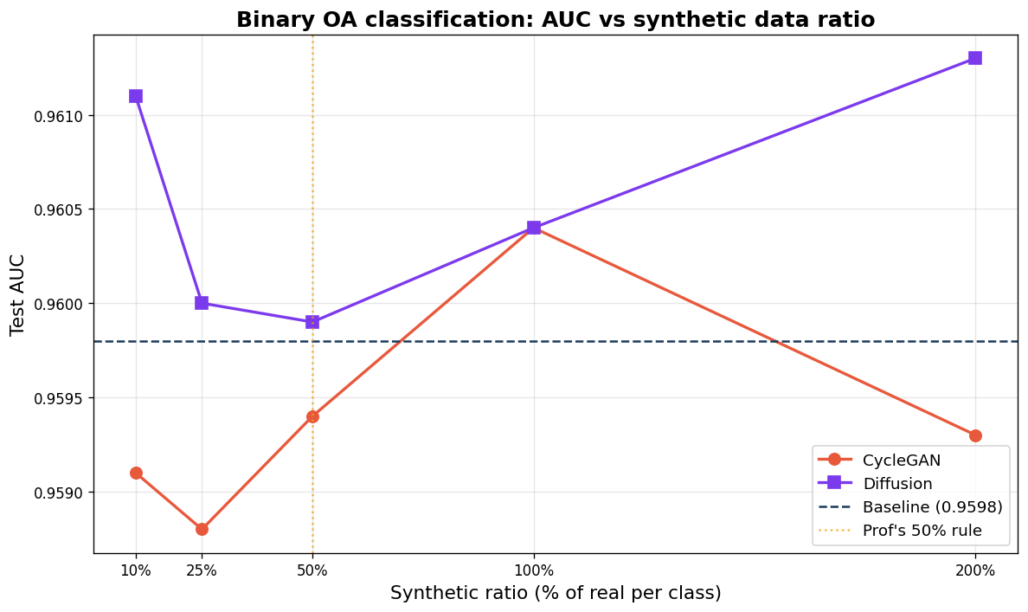
Binary classification · OA vs non-OA
CycleGAN vs Diffusion ablation across synthetic ratios
Ablation: + synthetic at 10 / 25 / 50 / 100 / 200%
RESNET-18 BASELINE
0.9598
AUC ± 0.0014
(3 seeds, real only)
Already near ceiling.
Little room to improve.
CycleGAN: no consistent gain. Synthetic data dilutes the training set rather than enriching.
Diffusion: small but consistent gain at every ratio. Peaking at 200%.
Notes:
Starting with the binary task. Our ResNet-18 baseline on real data already got 0.96 AUC, so there's very little room to improve. Still, we ran the full ablation for both CycleGAN and diffusion.
CycleGAN — the orange line — shows no consistent gain. Mostly it’s actually below baseline, suggesting the CycleGAN images are diluting the training set rather than enriching it.
Looking at our primary model - Diffusion — the purple line — shows a small but consistent gain at every single ratio, peaking at 200%. That's small in absolute terms, but remember the baseline is already at 96%. The fact that diffusion helps the binary classification.

Slide 26
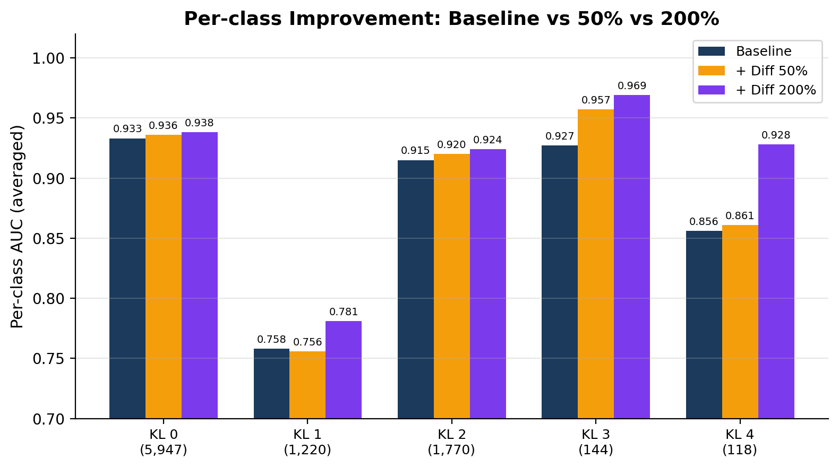
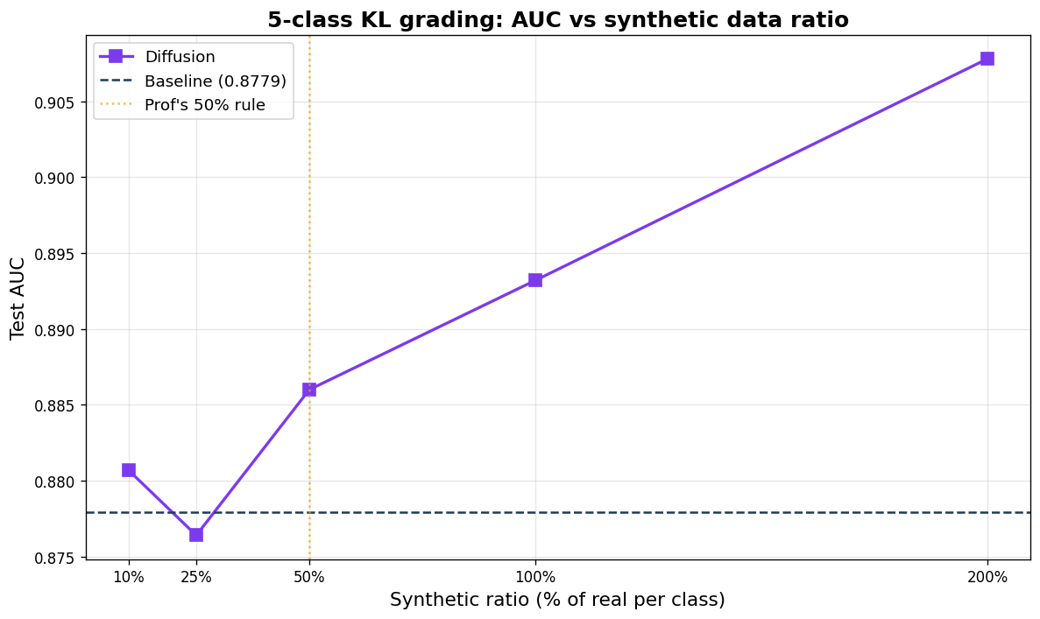
5-class classification · KL 0 to KL 4
KEY FINDING
Diffusion ablation lifts macro AUC to 0.9078 · rare grades gain most
Improvement scales inversely with real training data.
BASELINE → BEST
0.878 → 0.908
KL 4 (118 real imgs) gains the most. KL 0 (5,947 real) gains the least. Synthetic data fills the gap exactly where it is needed.
+0.030 macro AUC
Diffusion at 200% · stable across all 3 seeds (+0.049, +0.028, +0.013)
Notes:
The 5-class grading our baseline macro AUC is 88%. With 200% ablation, we push AUC up to 91%, stable across all three seeds.
The curve shows a clear upward trend as we add more synthetic data. If we look at the class breakdown; we saw an inverse mprovement with how much real data a class has. KL 4 gains the most, KL 0 improves the least. So synthetic data is filling the gap exactly where it's needed.

Slide 27
Summary
Binary OA detection
5-class KL grading
KL 4 (severe OA)
+0.0015
+0.030
+0.072
0.9598 → 0.9613
0.878 → 0.908
0.856 → 0.928
Diffusion at 200%
Near ceiling — modest gain
Diffusion at 200%
Biggest improvement
Per-class AUC
Largest single-grade gain
Bottom line: Synthetic data from latent diffusion improves classification of rare severe OA grades.
Notes:
To summarize our three headline numbers.
Binary detection: a small gain because we were already near ceiling.
Five-class grading: the biggest overall improvement and our main result.
And KL 4 specifically had the largest single-grade gain.
The bottom line: synthetic data from latent diffusion meaningfully improves classification of rare, severe OA grades

Slide 28
Thank you
Questions?
Group 3 · María Martín · Zulal Akarsu · Jai Sharma
Notes:
And that's our results. Happy to take any questions.

