Slide 1
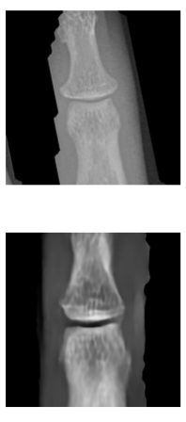
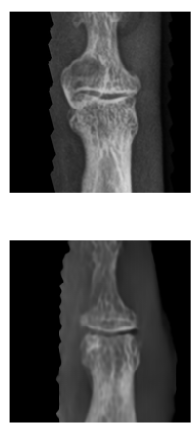
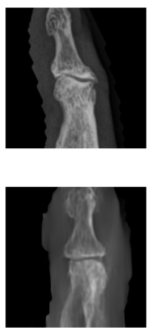
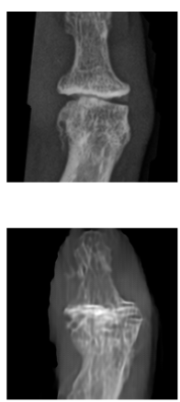
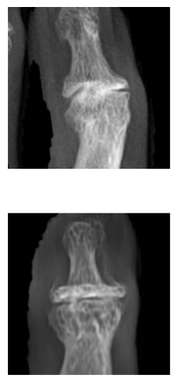
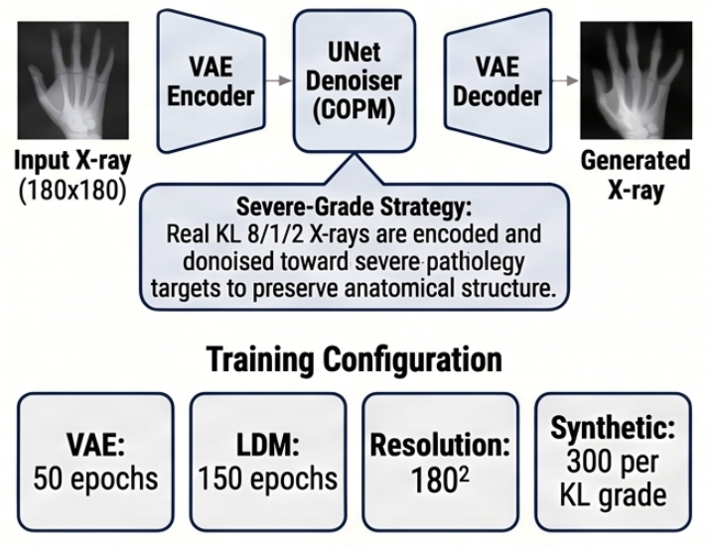
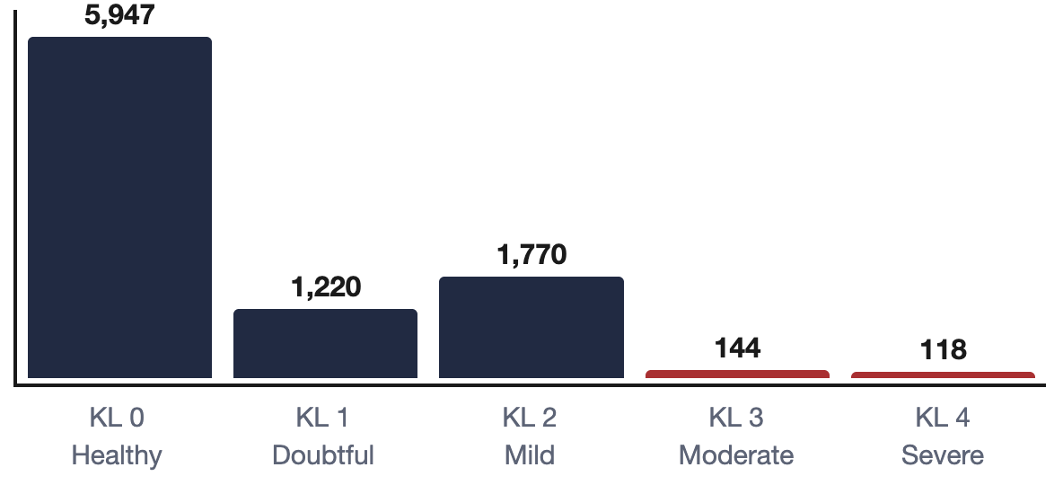
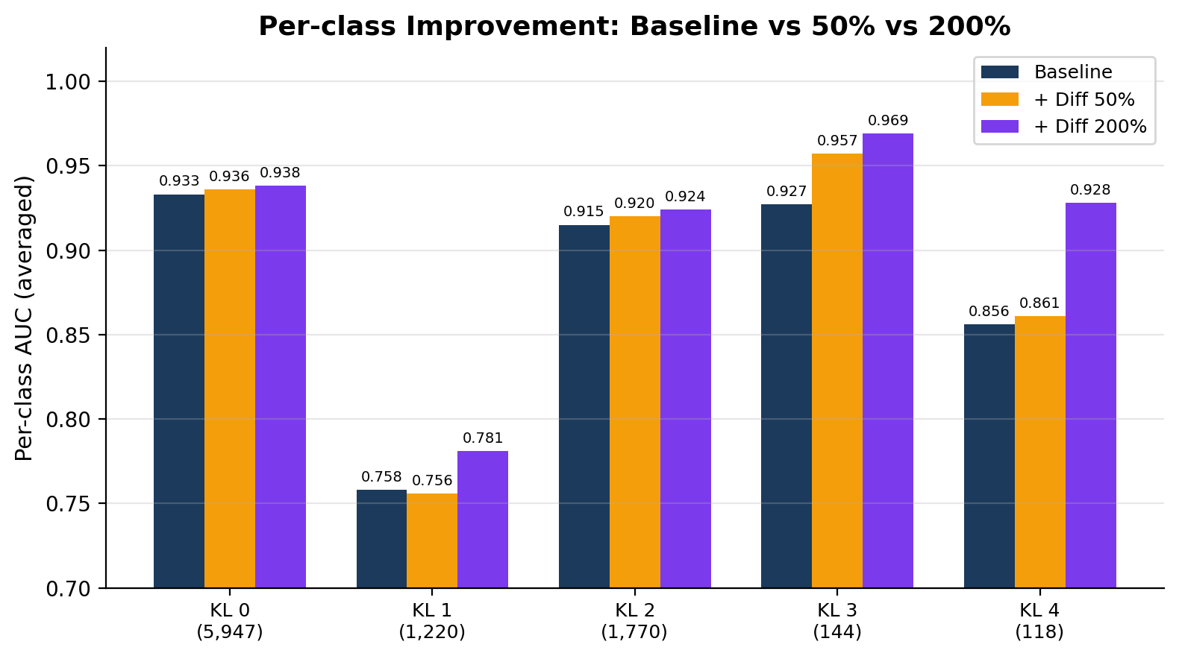
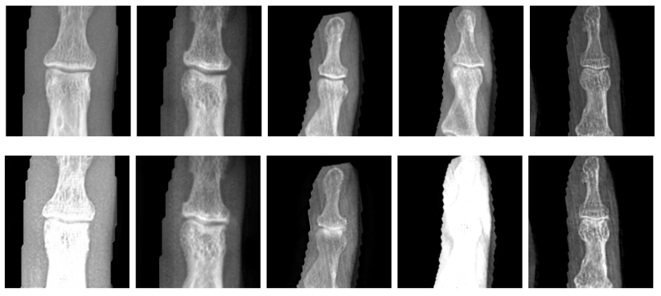
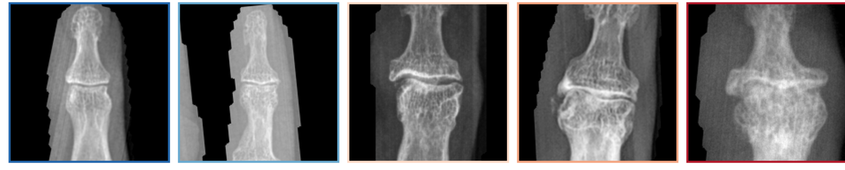
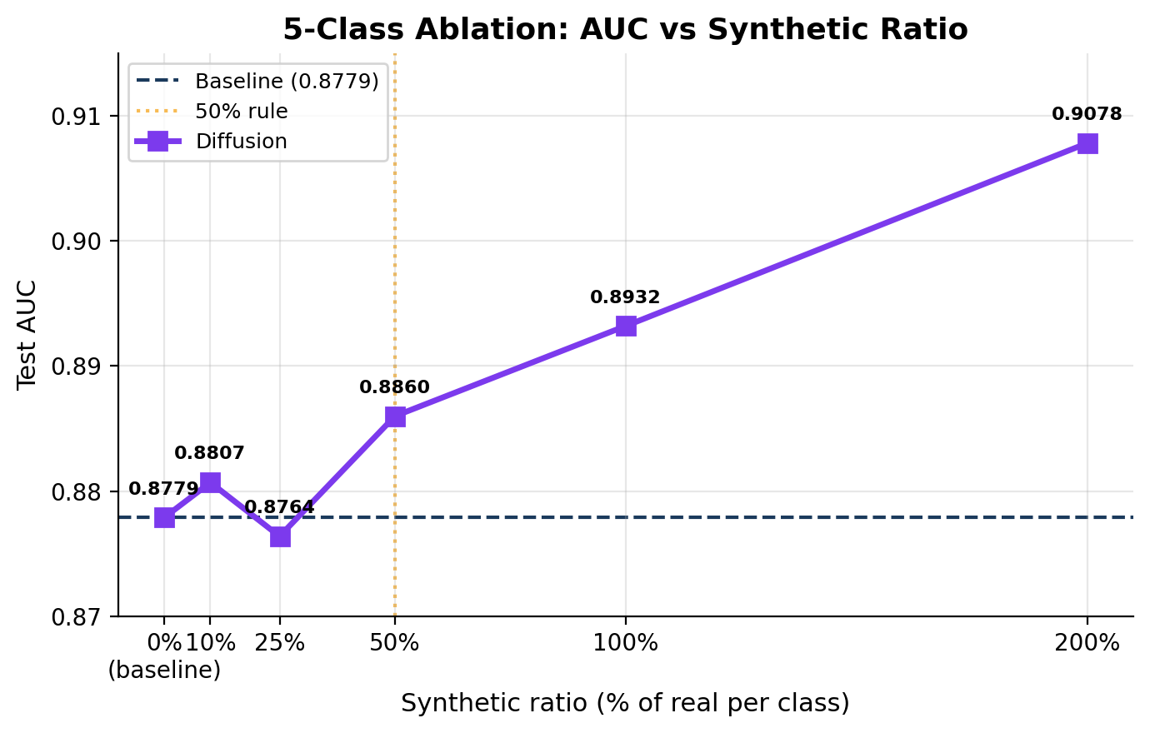
Generative AI for Hand Osteoarthritis Simulation: Improving Rare-Grade KL Classification with Latent Diffusion
Class-conditional latent diffusion improves rare-grade KL classification on hand X-rays
Boston University, Metropolitan College · MET CS 790: Advanced Computer Vision
Maria Martin · Zulal Akarsu · Jai Sharma | Group 3 · Track 3
Prof. Ming Zhang · April 2026
Introduction
Methods
Results
Generated Samples & Findings
2.9% severe-grade scarcity
Hand OA affects ~40% of adults over 70, yet KL 3 & 4 (severe disease) make up only 2.9% of training data — the cases that drive clinical decisions.
CycleGAN
(baseline)
Latent Diffusion (primary)
+0.072 AUC Gain for KL 4
Real vs. Diffusion-Generated
Severity classification for the rarest grade improved from 0.856 → 0.928.
KL 0
KL 1
KL 2
KL 3
KL 4
118 vs 5,947
Only 118 real KL 4 (severe) training images vs 5,947 KL 0 (healthy). A 50× imbalance on the grades that matter most.
Two-domain only:
healthy ↔ diseased
→ Binary task only
Class-conditional:
specific KL grade per image
→ Binary + 5-class tasks
+0.030 Macro AUC Improvement
5-class macro AUC rose from 0.8779 to 0.9078 using 200% synthetic data.
Dataset: 13,176 DIP joint X-rays from 3,505 patients (BU / Tufts Medical Center). Patient-level 70/15/15 splits, zero leakage.
LDM Pipeline: Class-Conditional Embeddings KL 0-4
15x reduction in Variance
Training stability improved significantly, with variance dropping from 0.0148 to 0.0010 across all seeds.
KL Grade Distribution (training set)
0.9598 → 0.9613
LDM-generated X-rays · Visible OA progression: smooth bone margins (KL 0) → osteophytes & joint space narrowing (KL 3) → severe sclerosis & deformity (KL 4).
Per-Class AUC: Baseline vs. Diffusion 50% vs 200%
KL 3 achieves the lowest FID, real-image-sourced generation anchors anatomy. FID values are elevated relative to knee OA literature; the small reference distributions for rare grades (~118 images) inflate FID by design.
CycleGAN
KL 0-1
Research Question
KL 2+
Can class-conditional synthetic X-rays improve classification of rare severe hand OA (KL 3/4)? Does diffusion outperform GAN translation?
Downstream Classifier
Sample DIP X-rays · KL 0 → KL 4
Backbone: ResNet-18, ImageNet pretrained, FC head replaced
Tasks: Binary (KL 0–1 vs KL 2+) and 5-class (KL 0/1/2/3/4)
Imbalance: Weighted cross-entropy + WeightedRandomSampler
Optimizer: Adam (lr 1e-4), cosine annealing, early stop on val AUC
Protocol: 3 seeds (42, 123, 456) · patient-level splits · held-out test
CycleGAN's two-domain architecture cannot do per-grade synthesis. Bone structure degrades with severity in generated outputs, visible distortion absent in LDM samples above. Excluded from 5-class evaluation by design.
KL 0: Normal KL 1: Doubtful KL 2: Mild KL 3: Moderate KL 4: Severe
Improvement is inversely proportional to real data availability: KL 4 (118 images) gains ~14×the AUC of KL 0 (5,947 images). Synthetic data concentrates value where real data is scarcest.
Key Findings
Macro AUC vs. Synthetic Ratio
1. Class-conditional generation is the architectural lever. CycleGAN's two-domain design cannot do per-grade synthesis, diffusion can. That single capability unlocks the 5-class task entirely.
2. Synthetic data follows a dose-response curve. Across all augmentation ratios (10% → 200%) and 3 seeds, 5-class macro AUC scales monotonically from 50% onward. The effect isn't a single lucky configuration, it's a controlled trend.
3. Value concentrates where data is scarcest. KL 4 (118 real images) gained +0.072 AUC; KL 0 (5,947 real images) gained only +0.005. Synthetic data is most useful exactly where new data is hardest to collect.
Why is this clinically important?
CycleGAN (Baseline)
KL 3 / 4 are the grades that change treatment plans — surgical referral, joint injection, disease-modifying intervention. A classifier that misses severe disease at the rate determined by 118 training examples is a clinical liability, not just a benchmark loss.
Domain A Domain B
KL 0-1 -> 7,167 images KL 2-4 -> 2,032 images
Two-generator ResNet + PatchGAN discriminator – 75 epochs
Contributions
Evaluation Framework
First class-conditional LDM applied to hand OA X-ray synthesis (prior work focuses on knees).
Real-image-sourced generation strategy for severe grades, preserves authentic bone anatomy.
Systematic CycleGAN vs LDM ablation across 5 ratios, 3 seeds — 51 total classifier runs.
Empirical evidence that the 50% synthetic cap is conservative for severely imbalanced classes.
1. Visual fidelity. Fréchet Inception Distance (FID) computed per KL grade.
2. Downstream evaluation. ResNet-18 retrained with synthetic mixed into real training set at 10% / 25% / 50% / 100% / 200% ratios per class. Test AUC compared to real-only baseline; each configuration replicated 3×.
Total: 51 classifier runs – 5 synthetic ratios x 3 seeds across all configurations.
Limitations & Future Work. FID 140–152 leaves room for higher fidelity. 180x180 is below clinical resolution. Single-site cohort, multi-site validation and a radiologist reader study are the next steps.
3 / 3 seeds improved. Variance dropped 0.0148 → 0.0010 synthetic data also stabilizes training.
Selected references: Rombach et al. CVPR 2022 (Latent Diffusion) · Wu et al. ECCV 2024 (IC-RDN) · Zhu et al. ICCV 2017 (CycleGAN) · Prezja et al. Sci. Reports 2022 · Butler et al. 2025 · He et al. CVPR 2016 (ResNet). Full bibliography in report.

