Slide 1



SALESFORCE PATHFINDER CAPSTONE
Parker Pizza: B2B CRM Implementation
Architecting an Enterprise Sales Cloud & RevOps Solution for Regional Grocery Distribution
badge
school
auto_graph
ARCHITECT & ADMINISTRATOR
PROGRAM
FOCUS AREA
Maria Naz | Certified Salesforce Admin
Salesforce Pathfinder / ReDI School
Sales Cloud, Flow Builder, RevOps

Slide 2
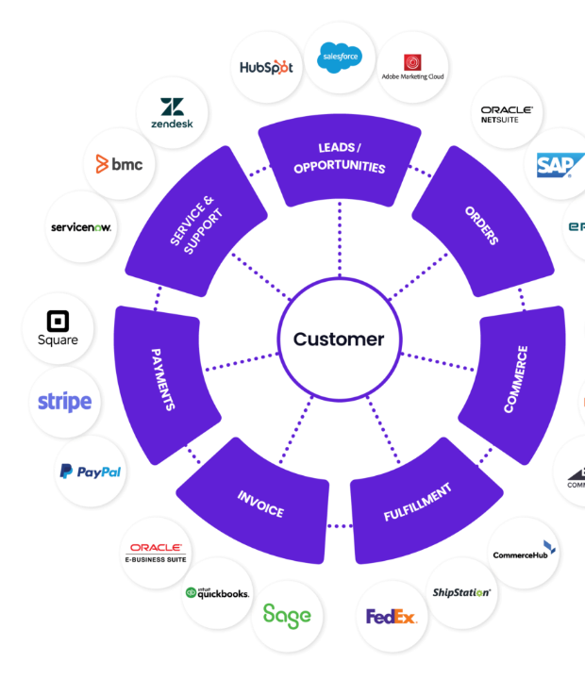
TRANSITIONING TO B2B
Strategic Shift: Customer 360
storefront
D2C to B2B Retail Shift
Parker Pizza shifted from Direct-to-Consumer sales into regional retail grocery distribution, demanding a unified Customer 360 architecture.
hub
Unified Data Architecture
Centralized procurement data across Sales, Service, and Marketing to eliminate operational silos and manage high-volume wholesale relationships.

Slide 3




Retail Expansion Pain Points
Fragmented Accounts
Multi-Stakeholder Deals
Disconnected Collateral
RevOps Blindspots
Retail accounts and regional grocery chains lacked centralized tracking, causing overlap and lost relationship history across buyer locations.
B2B retail procurement cycles involved category managers, store directors, and merchandisers, demanding structured deal stages.
Post-signing in-store marketing support and sampling logistics had zero automated handoffs from the core closing team.
Executive management lacked real-time visibility into high-value B2B pipeline values, distribution bottlenecks, and lead conversions.

Slide 4





B2B Retail Sales Lifecycle
2. Initial Outreach
4. Negotiation
Engage procurement buyers and store leads.
Margin agreements, delivery terms & contracts.
1. Store Discovery
3. Product Pitch
5. In-Store Launch
Identify target grocery chains & store demographics.
Sample presentations & pricing proposal review.
POS collateral & merchandising support.

Slide 5

Process & Architecture Mapping
Business Workflow Step | Standard / Custom Object | Technical Implementation & Business Value
Identify Target Grocery Stores | Account (Standard) | Modeled store headquarters and retail branches with custom B2B hierarchy fields.
Initiate Buyer Outreach | Lead & Contact | Standardized lead conversion rules routing qualified retail buyers directly into pipeline.
Conduct Pitch & Presentations | Opportunity (Stages 1-3) | Custom sales path tracking presentation completion and tasting feedback ratings.
Negotiate Terms & Pricing | Opportunity & Quotes | Standardized product lines, margin calculations, and contract documentation capture.
Launch Retail Support | Campaign & Custom Assets | Custom marketing application for tracking POP displays and in-store sampling kits.

Slide 6
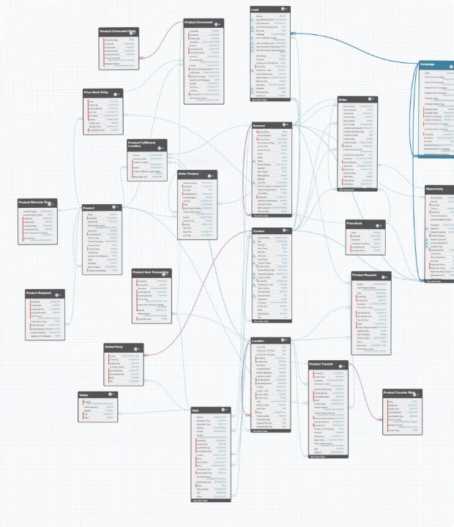
Data Model & Schema Builder
Scalable Relational Architecture
Constructed a resilient data model using 10+ custom objects, fields, and junction relationships tailored to grocery distribution channels.
Enforced data integrity across Accounts, Opportunities, Deliveries, and Marketing Campaigns using master-detail and lookup relationships.

Slide 7

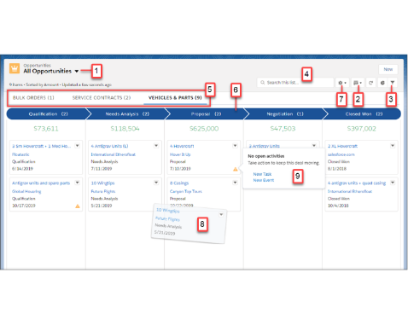
Sales Cloud Pipeline & Kanban
▪
Custom Opportunity Stages: Configured a transparent 5-stage B2B pipeline from Discovery through Contract Finalization.
▪
Path Guidance: Deployed key fields and guidance for sales reps at each stage to accelerate enterprise deal velocity.
▪
Data Governance: Enforced validation rules requiring store delivery volume and pricing tiers before advancing to Negotiation.
▪
Kanban Usability: Provided drag-and-drop agility with real-time aggregated deal amounts across grocery segments.

Slide 8
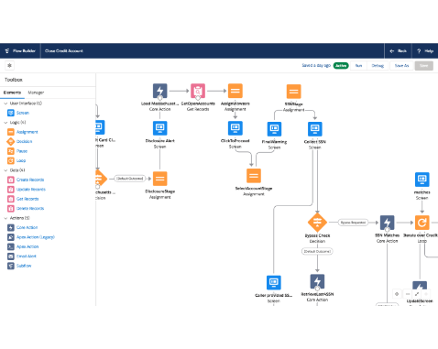
Flow Builder Automation Engine
▪
Standardized Naming Conventions: Record-triggered flow dynamically formats Opportunity names by Account, Region, and Close Date.
▪
High-Value Threshold Alerts: Automated financial notifications route deals exceeding defined limits to RevOps leadership.
▪
Task Generation: Automatically generates post-signing merchandising follow-ups upon Closed-Won contract finalization.
▪
Clean RevOps Governance: Eliminated manual data updates, reducing administrative overhead across the sales cycle.

Slide 9

Security & Governance Framework
Role Hierarchy & Profiles
Permission Sets & FLS
Designed an org-wide access hierarchy reflecting Parker Pizza's organizational structure with 3 custom profiles (Sales Rep, Marketing Specialist, RevOps Executive) and 4 hierarchical roles to safeguard sensitive grocery margin contracts.
Implemented 6 targeted Permission Sets to grant modular privileges (e.g., Campaign Authoring, Discount Approvals) while maintaining strict Field-Level Security (FLS) on financial and wholesale unit cost metrics.

Slide 10
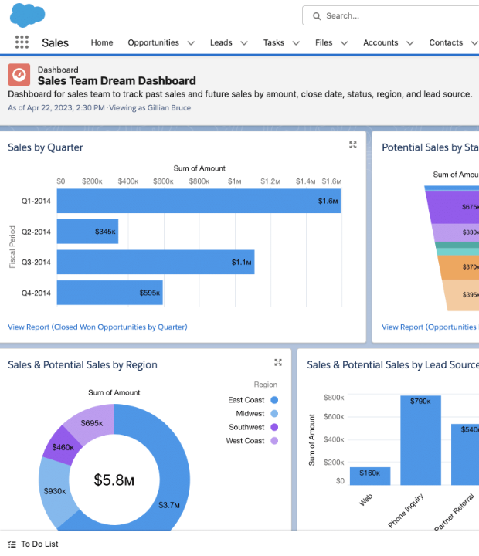
RevOps Analytics & Dashboards
Executive Real-Time Visibility
Engineered 15+ custom tabular and summary reports feeding a 4-component Executive Dashboard for complete pipeline oversight.
Provided stakeholders with real-time visibility into win rates, regional revenue distribution, and pending retail onboarding deadlines.

Slide 11
Implementation Impact & KPIs
extension
alt_route
rocket_launch
Full-Cycle Delivery
Designed and deployed an end-to-end B2B CRM instance from requirements gathering through data cleansing and executive reporting.
10+
Custom Objects Built
3
Automated Flows
cleaning_services
Clean Data Migration
Imported and sanitized legacy account datasets using Data Loader while enforcing strict validation rules and referential integrity.
insights
verified
15+
RevOps Reports
100%
Validated Data Ingestion
Enterprise Discipline
Leveraged 5+ years of banking operations and compliance rigor to build an audit-ready, enterprise-grade Salesforce environment.
shield

Slide 12
TECHNICAL PORTFOLIO
Questions & Discussion
Salesforce Architecture & Revenue Operations Walkthrough
person
ADMINISTRATOR
Maria Naz
verified
CERTIFICATIONS
Salesforce Admin & Agentforce Specialist
location_on
LOCATION
Albertslund, Denmark
stars
TRAILBLAZER PROFILE
salesforce.com/trailblazer/marianaz
workspace_premium
LINKEDIN PROFILE
linkedin.com/in/maria-naz-gondal

