Slide 1
Mobile Handset Cellular Network

Slide 2
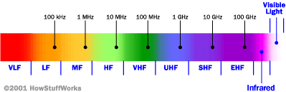
Cellular Network Basics
There are many types of cellular services; before delving into details, focus on basics (helps navigate the “acronym soup”)
Cellular network/telephony is a radio-based technology; radio waves are electromagnetic waves that antennas propagate
Most signals are in the 850 MHz, 900 MHz, 1800 MHz, and 1900 MHz frequency bands
Cell phones operate in this frequency range (note the logarithmic scale)

Slide 3
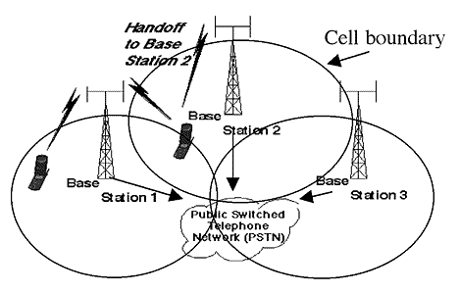
Cellular Network
Base stations transmit to and receive from mobiles at the assigned spectrum
  Multiple base stations use the same spectrum (spectral reuse)
The service area of each base station is called a cell
Each mobile terminal is typically served by the ‘closest’ base stations
  Handoff when terminals move

Slide 4
Cellular Network Generations
It is useful to think of cellular Network/telephony in terms of generations:
  0G: Briefcase-size mobile radio telephones
  1G: Analog cellular telephony
  2G: Digital cellular telephony
  3G: High-speed digital cellular telephony (including video telephony)
  4G: IP-based “anytime, anywhere” voice, data, and multimedia telephony at faster data rates than 3G
  (to be deployed in 2012–2015)

Slide 5
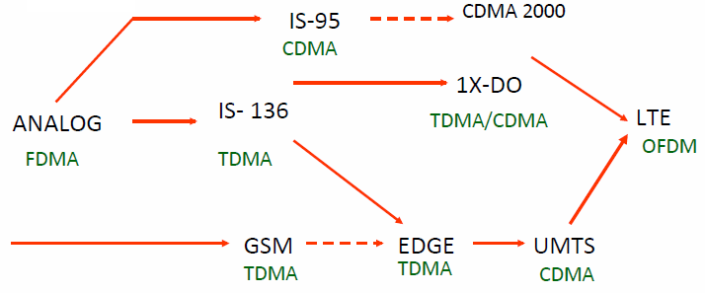
Evolution of Cellular Networks
1G
2G
2.5G
3G
4G

Slide 6
The Multiple Access Problem
The base stations need to serve many mobile terminals at the same time (both downlink and uplink)
All mobiles in the cell need to transmit to the base station
Interference among different senders and receivers
So we need multiple access scheme

Slide 7
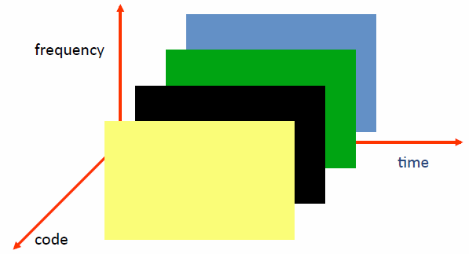
Multiple Access Schemes
3 orthogonal Schemes:
Frequency Division Multiple Access (FDMA)
Time Division Multiple Access (TDMA)
Code Division Multiple Access (CDMA)

Slide 8
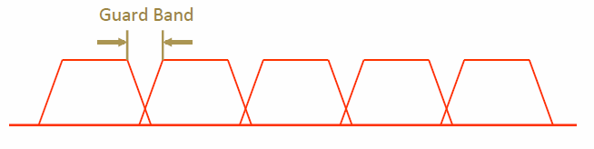
Frequency Division Multiple Access
frequency
Each mobile is assigned a separate frequency channel for the duration of the call
Sufficient guard band is required to prevent adjacent channel interference
Usually, mobile terminals will have one downlink frequency band and one uplink frequency band
Different cellular network protocols use different frequencies
Frequency is a precious and scare resource. We are running out of it
  Cognitive radio

Slide 9
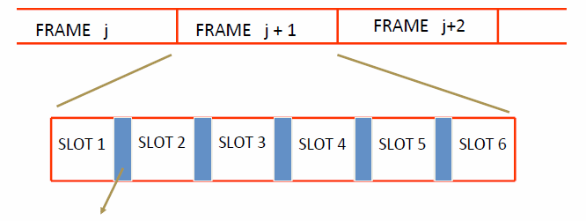
Time Division Multiple Access
Guard time – signal transmitted by mobile terminals at different locations do no arrive at the base station at the same time
Time is divided into slots and only one mobile terminal transmits during each slot
  Like during the lecture, only one can talk, but others may take the floor in turn
Each user is given a specific slot. No competition in cellular network
  Unlike Carrier Sensing Multiple Access (CSMA) in WiFi

Slide 10
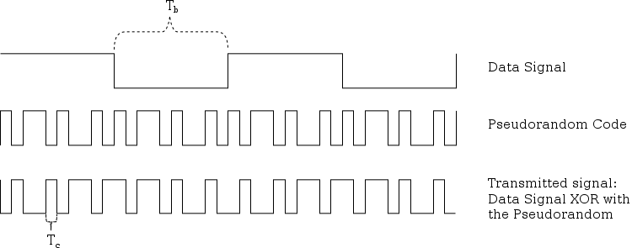
Code Division Multiple Access
Use of orthogonal codes to separate different transmissions
Each symbol of bit is transmitted as a larger number of bits using the user specific code – Spreading
  Bandwidth occupied by the signal is much larger than the information transmission rate
  But all users use the same frequency band together
Orthogonal among users

Slide 11
2G(GSM)

Slide 12
GSM
Abbreviation for Global System for Mobile Communications
Concurrent development in USA and Europe in the 1980’s
The European system was called GSM and deployed in the early 1990’s

Slide 13
GSM Services
    Voice, 3.1 kHz
Short Message Service (SMS)
  1985 GSM standard that allows messages of at most 160 chars. (incl. spaces) to be sent between handsets and other stations
  Over 2.4 billion people use it; multi-billion $ industry
General Packet Radio Service (GPRS)
  GSM upgrade that provides IP-based packet data transmission up to 114 kbps
  Users can “simultaneously” make calls and send data
  GPRS provides “always on” Internet access and the Multimedia Messaging Service (MMS) whereby users can send rich text, audio, video messages to each other
  Performance degrades as number of users increase
  GPRS is an example of 2.5G telephony – 2G service similar to 3G

Slide 14


GSM Channels
Downlink
Channels
Uplink
Physical Channel: Each timeslot on a carrier is referred to as a physical channel
Logical Channel: Variety of information is transmitted between the MS and BTS. Different types of logical channels:
  Traffic channel
  Control Channel

Slide 15
GSM Frequencies
Originally designed on 900MHz range, now also available on 800MHz, 1800MHz and 1900 MHz ranges.
Separate Uplink and Downlink frequencies
  One example channel on the 1800 MHz frequency band, where RF carriers are space every 200 MHz
UPLINK FREQUENCIES
DOWNLINK FREQUENCIES
1710 MHz
1785 MHz
1805 MHz
1880 MHz
UPLINK AND DOWNLINK FREQUENCY SEPARATED BY 95MHZ

Slide 16
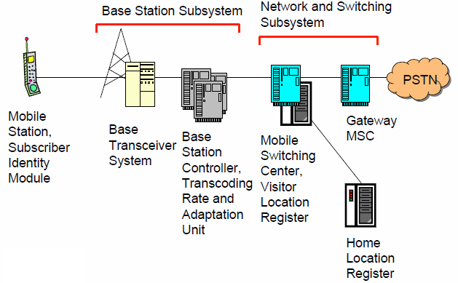
GSM Architecture

Slide 17
Mobile Station (MS)
MS is the user’s handset and has two parts
Mobile Equipment
  Radio equipment
  User interface
  Processing capability and memory required for various tasks
    Call signalling
    Encryption
    SMS
  Equipment IMEI number
Subscriber Identity Module

Slide 18
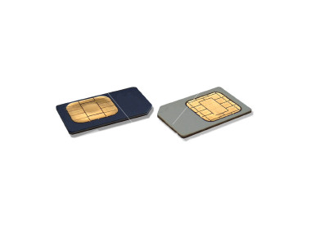
Subscriber Identity Module
A small smart card
Encryption codes needed to identify the subscriber
Subscriber IMSI number
Subscriber’s own information (telephone directory)
Third party applications (banking etc.)
Can also be used in other systems besides GSM, e.g., some WLAN access points accept SIM based user authentication

Slide 19
Base Station Subsystem
Transcoding Rate and Adaptation Unit (TRAU)
  Performs coding between the 64kbps PCM coding used in the backbone network and the 13 kbps coding used for the Mobile Station (MS)
Base Station Controller (BSC)
  Controls the channel (time slot) allocation implemented by the BTSes
  Manages the handovers within BSS area
  Knows which mobile stations are within the cell and informs the MSC/VLR about this
Base Transceiver System (BTS)
  Controls several transmitters
  Each transmitter has 8 time slots, some used for signaling, on a specific frequency

Slide 20
Network and Switching Subsystem
The backbone of a GSM network is a telephone network with additional cellular network capabilities
Mobile Switching Center (MSC)
  An typical telephony exchange (ISDN exchange) which supports mobile communications
  Visitor Location Register (VLR)
    A database, part of the MSC
    Contains the location of the active Mobile Stations
Gateway Mobile Switching Center (GMSC)
  Links the system to PSTN and other operators
Home Location Register (HLR)
  Contain subscriber information, including authentication information in Authentication Center (AuC)
Equipment Identity Register (EIR)
  International Mobile Station Equipment Identity (IMEI) codes for e.g., blacklisting stolen phones

Slide 21
Home Location Register
One database per operator
Contains all the permanent subscriber information
  MSISDN (Mobile Subscriber ISDN number) is the telephone number of the subscriber
  International Mobile Subscriber Identity (IMSI) is a 15 digit code used to identify the subscriber
    It incorporates a country code and operator code
  IMSI code is used to link the MSISDN number to the subscriber’s SIM (Subscriber Identity Module)
  Charging information
  Services available to the customer
Also the subscriber’s present Location Area Code, which refers to the MSC, which can connect to the MS.

Slide 22
Other Systems
Operations Support System
  The management network for the whole GSM network
  Usually vendor dependent
  Very loosely specified in the GSM standards
Value added services
  Voice mail
  Call forwarding
  Group calls
Short Message Service Center
  Stores and forwards the SMS messages
  Like an E-mail server
  Required to operate the SMS services

Slide 23
Location Updates
The cells overlap and usually a mobile station can ‘see’ several transceivers (BTSes)
The MS monitors the identifier for the BSC controlling the cells
When the mobile station reaches a new BSC’s area, it requests an location update
The update is forwarded to the MSC, entered into the VLR, the old BSC is notified and an acknowledgement is passed back

Slide 24
Handoff (Handover)
When a call is in process, the changes in location need special processing
Within a BSS, the BSC, which knows the current radio link configuration (including feedbacks from the MS), prepares an available channel in the new BTS
The MS is told to switch over to the new BTS
This is called a hard handoff
  In a soft handoff, the MS is connected to two BTSes simultaneously

Slide 25
Roaming
When a MS enters another operators network, it can be allowed to use the services of this operator
  Operator to operator agreements and contracts
  Higher billing
The MS is identified by the information in the SIM card and the identification request is forwarded to the home operator
  The home HLR is updated to reflect the MS’s current location

Slide 26
3G, 3.5G and 4G (LTE)

Slide 27
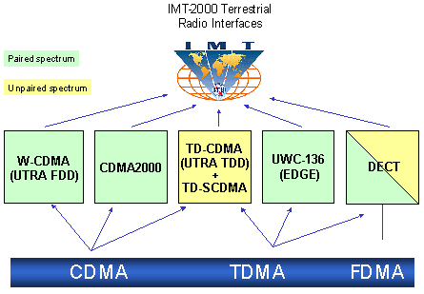
3G Overview
3G is created by ITU-T and is called IMT-2000

Slide 28
Evolution from 2G
2G
IS-95
GSM-
IS-136 & PDC
GPRS
2.5G
IS-95B
HSCSD
EDGE
Cdma2000-1xRTT
W-CDMA
3G
Cdma2000-1xEV,DV,DO
EDGE
TD-SCDMA
Cdma2000-3xRTT
3GPP2
3GPP

Slide 29
Service Roadmap
Improved performance, decreasing cost of delivery
3G-specific services take advantage of higher bandwidth and/or real-time QoS
Broadband
in wide area
Video sharing
Video telephony
Real-time IP
multimedia and games
Multicasting
A number of mobile services are bearer independent in nature
Multitasking
WEB browsing
Corporate data access
Streaming audio/video
MMS picture / video
xHTML browsing
Application downloading
E-mail
Voice & SMS
Presence/location
Push-to-talk
Typical average bit rates
(peak rates higher)
GSM
9.6
kbps
GPRS
171
kbps
EGPRS
473
kbps
WCDMA
2
Mbps
HSDPA
1-10
Mbps
CDMA
2000 1x
CDMA
2000-EVDO
CDMA
2000-EVDV

Slide 30
GSM Evolution to 3G
High Speed Circuit Switched Data
Dedicate up to 4 timeslots for data connection ~ 50 kbps
Good for real-time applications c.w. GPRS
Inefficient -> ties up resources, even when nothing sent
Not as popular as GPRS (many skipping HSCSD)
Enhanced Data Rates for Global Evolution
Uses 8PSK modulation
3x improvement in data rate on short distances
Can fall back to GMSK for greater distances
Combine with GPRS (EGPRS) ~ 384 kbps
Can also be combined with HSCSD
GSM
9.6kbps (one timeslot)
GSM Data
Also called CSD
HSCSD
GSM
GPRS
WCDMA
General Packet Radio Services
Data rates up to ~ 115 kbps
Max: 8 timeslots used as any one time
Packet switched; resources not tied up all the time
Contention based. Efficient, but variable delays
GSM / GPRS core network re-used by WCDMA (3G)
EDGE

Slide 31
UMTS
Universal Mobile Telecommunications System (UMTS)
UMTS is an upgrade from GSM via GPRS or EDGE
The standardization work for UMTS is carried out by Third Generation Partnership Project (3GPP)
Data rates of UMTS are:
  144 kbps for rural
  384 kbps for urban outdoor
  2048 kbps for indoor and low range outdoor
Virtual Home Environment (VHE)

Slide 32
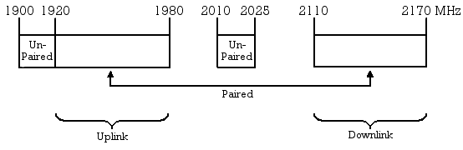
UMTS Frequency Spectrum
UMTS Band
  1900-2025 MHz and 2110-2200 MHz for 3G transmission
  In the US, 1710–1755 MHz and 2110–2155 MHz will be used instead, as the 1900 MHz band was already used.

Slide 33
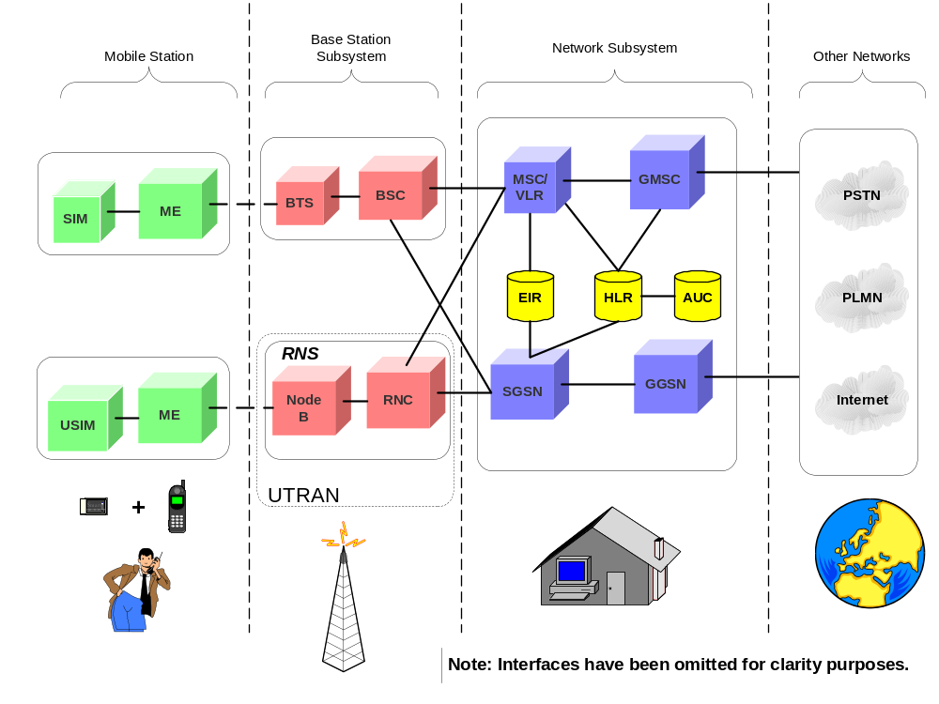
UMTS Architecture

Slide 34
UMTS Network Architecture
UMTS network architecture consists of three domains
  Core Network (CN): Provide switching, routing and transit for user traffic
  UMTS Terrestrial Radio Access Network (UTRAN): Provides the air interface access method for user equipment.
  User Equipment (UE): Terminals work as air interface counterpart for base stations. The various identities are: IMSI, TMSI, P-TMSI, TLLI, MSISDN, IMEI, IMEISV

Slide 35
UTRAN
Wide band CDMA technology is selected for UTRAN air interface
  WCDMA
  TD-SCDMA
Base stations are referred to as Node-B and control equipment for Node-B is called as Radio Network Controller (RNC).
  Functions of Node-B are
    Air Interface Tx/Rx
    Modulation/Demodulation
  Functions of RNC are:
    Radio Resource Control
    Channel Allocation
    Power Control Settings
    Handover Control
    Ciphering
    Segmentation and reassembly

Slide 36
3.5G (HSPA)
High Speed Packet Access (HSPA) is an amalgamation of two mobile telephony protocols, High Speed Downlink Packet Access (HSDPA) and High Speed Uplink Packet Access (HSUPA), that extends and improves the performance of existing WCDMA protocols
3.5G introduces many new features that will enhance the UMTS technology in future. 1xEV-DV already supports most of the features that will be provided in 3.5G. These include:
- Adaptive Modulation and Coding
- Fast Scheduling
- Backward compatibility with 3G
- Enhanced Air Interface

Slide 37
4G (LTE)
LTE stands for Long Term Evolution
Next Generation mobile broadband technology
Promises data transfer rates of 100 Mbps
Based on UMTS 3G technology
Optimized for All-IP traffic

Slide 38
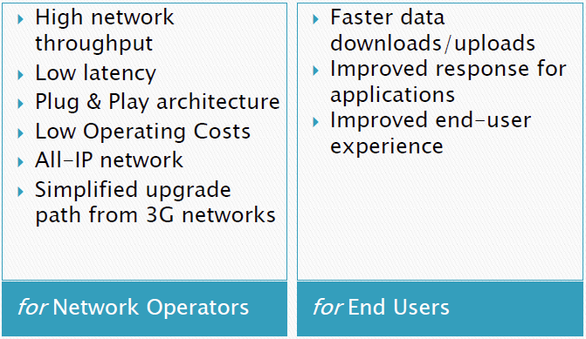
Advantages of LTE

Slide 39
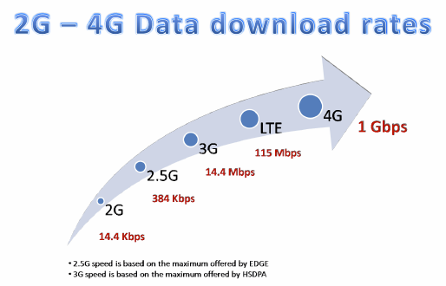
Comparison of LTE Speed

Slide 40
Major LTE Radio Technogies
Uses Orthogonal Frequency Division Multiplexing (OFDM) for downlink
Uses Single Carrier Frequency Division Multiple Access (SC-FDMA) for uplink
Uses Multi-input Multi-output(MIMO) for enhanced throughput
Reduced power consumption
Higher RF power amplifier efficiency (less battery power used by handsets)

Slide 41

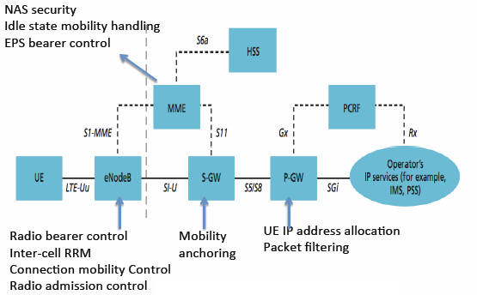
LTE Architecture

Slide 42
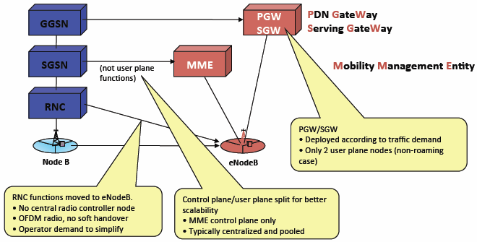
LTE vs UMTS
Functional changes compared to the current UMTS architecture

Slide 43
Case Study
Mobility:
A Double-Edged Sword for HSPA Networks
Fung Po Tso, City University of Hong Kong
Jin Teng, Ohio State University
Weijia Jia, City University of Hong Kong
Dong Xuan, Ohio State University
ACM Mobihoc’10

Slide 44
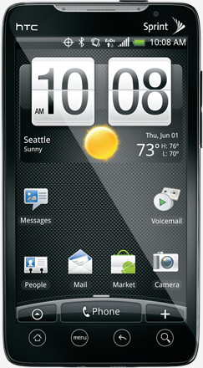
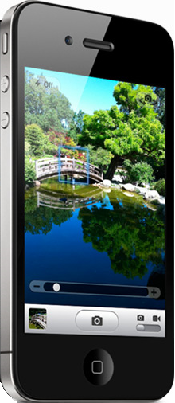
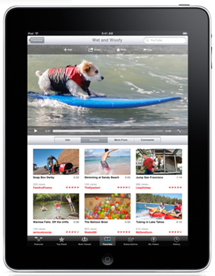



Context
Evolved hardware technologies
+
Improved network bandwidth
=
Entertainment apps on mobile
MobiHoc '10

Slide 45
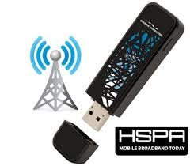
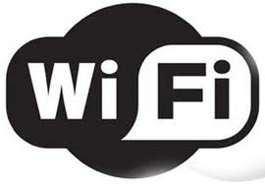
Context
When you are NOT mobile, you use
MobiHoc '10

Slide 46
Context
When you are mobile, you use
MobiHoc '10

Slide 47
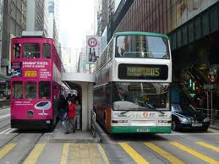
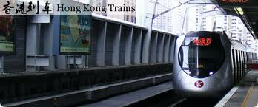

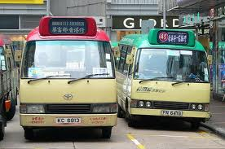
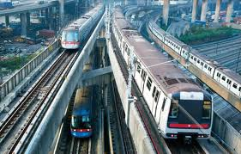
Context
Millions of passengers per day!
MobiHoc '10

Slide 48
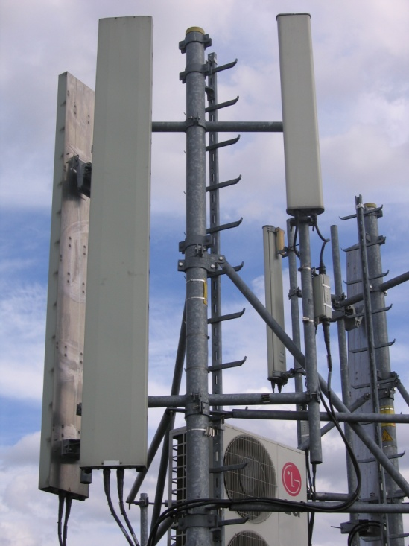
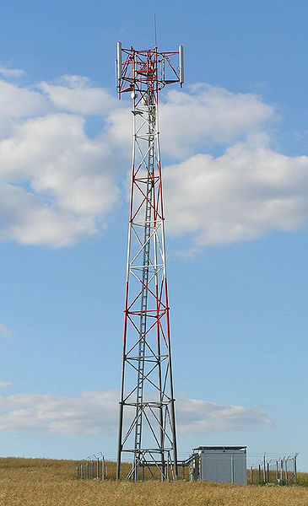


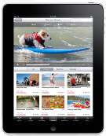



Context
Can HSPA provide the same level of service to mobile users on public transport?
HSPA Node B
HSPA Node B
pictures’ source: Wikipedia
MobiHoc '10

Slide 49
Outline
Measurement Methodology
General Impact of Mobility
Mobility Impact on Bandwidth Sharing
Mobility Impact in Transitional Region
Conclusion
MobiHoc '10

Slide 50
Measurement Routes
Type | Average Speed | Highest Speed | Characteristics
Trains | 40 kmh | 100 kmh | Surface ground
Subways | 30 kmh | 80 kmh | Underground
Self-driving Vehicles & Buses | 50 & 30 kmh | 80 kmh | Surface ground
Ferries | 80 kmh | 90 kmh | Sea, Surface ground
MobiHoc '10

Slide 51
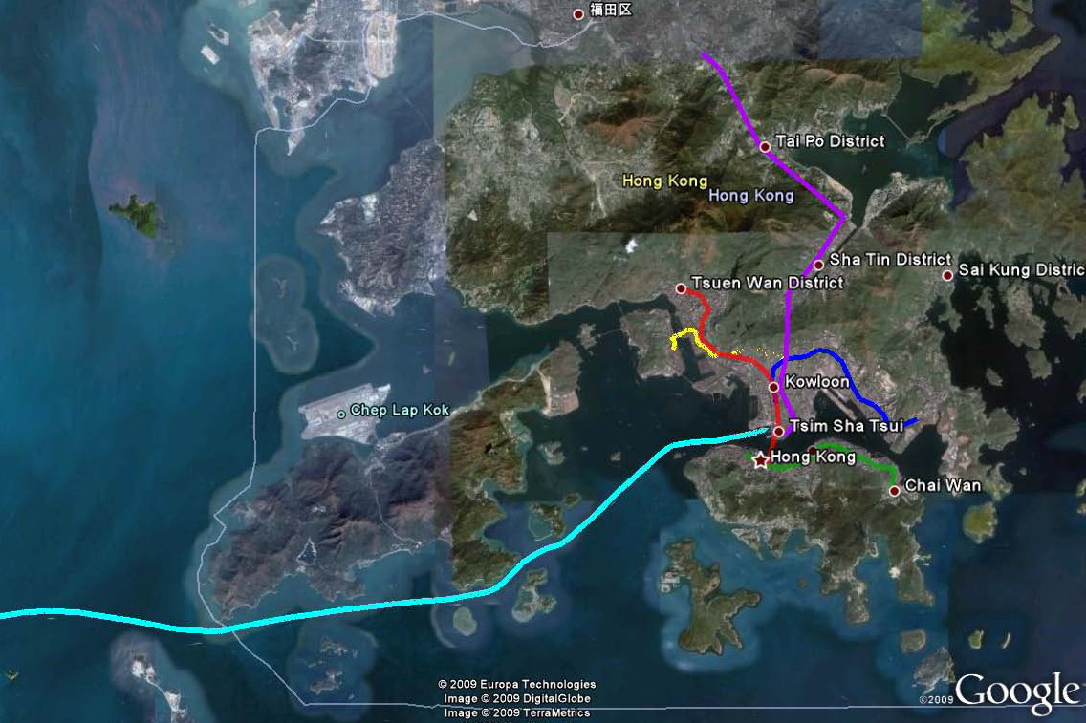
Measurement Route
Over 100 km in 3 months
MobiHoc '10

Slide 52
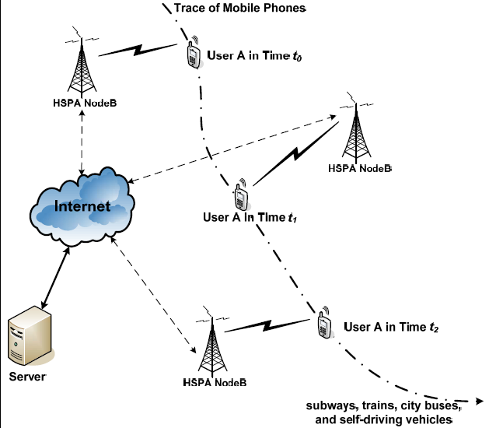
Measurement Setup
Two Servers:
  Lab & Data Center
Three types of evaluations:
  download only; upload only; simultaneous download & upload.
MobiHoc '10

Slide 53
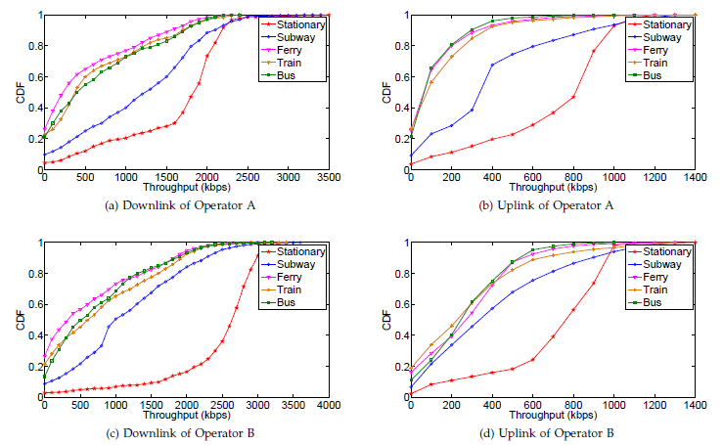
General Impact of Mobility
A large spread of HSDPA bit rates and signal quality
MobiHoc '10

Slide 54
Context
Common View: Mobility is irrelevant, if not detrimental, to the fairness in HSPA bandwidth sharing among users
Observation: The bandwidth sharing practice in stationary HSPA environments is unfair. In contrast, mobility surprisingly improves fairness of bandwidth sharing (fairer).
MobiHoc '10

Slide 55
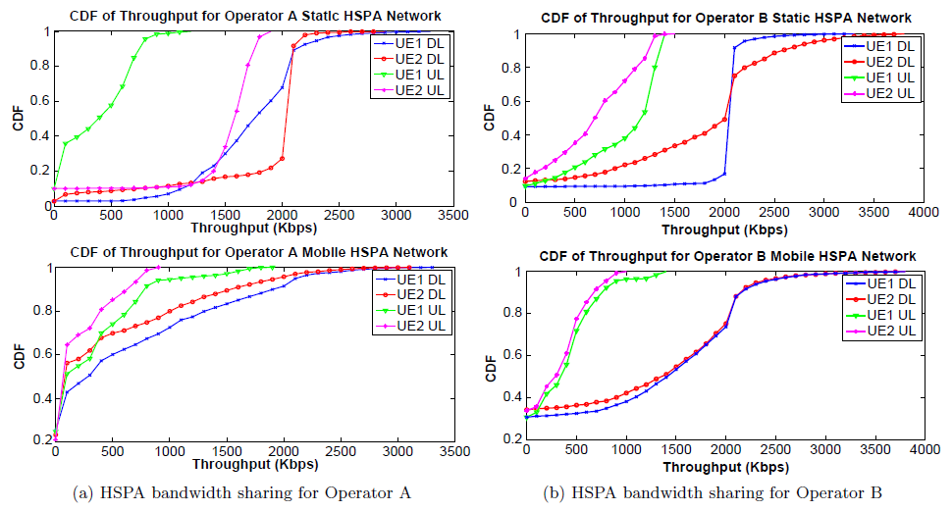
Bandwidth Sharing among Users
Mobility actually improves the fairness of bandwidth sharing among users
MobiHoc '10

Slide 56
Bandwidth Sharing among Users
UE can hardly keep its dominancy under rapid change of radio environment.
  Mobile nodes may see better signal quality at new locations
Cell to cell based scheduling algorithm prevent unfairness from propagating
MobiHoc '10

Slide 57
Context
Common View: Mobility affects all flows equally. And TCP flows suffer more than UDP ones
Observation: TCP flows unexpectedly see much better performance during mobility than UDP flows.
MobiHoc '10

Slide 58
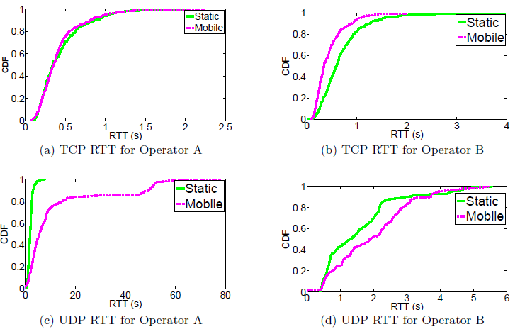
Bandwidth Sharing among Traffic Flows
TCP flows see better performance during mobility
MobiHoc '10

Slide 59
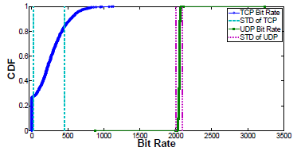
Bandwidth Sharing among Traffic Flows
TCP traffic is much constrained and adaptive to the channel condition, while UDP traffic keeps pumping almost the same amount of data regardless of the channel condition
MobiHoc '10

Slide 60
Context
Common View: Handoffs are triggered in the transitional region between cells and always result in a better wireless connection
Observation: Nearly 30% of all handoffs, selection of a base station with poorer signal quality can be witnessed
MobiHoc '10

Slide 61
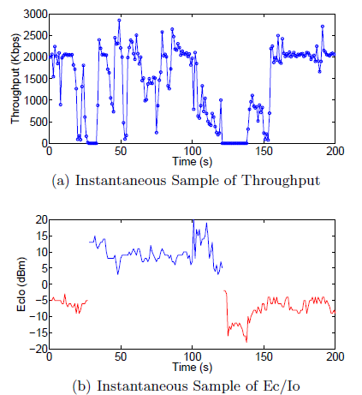
Mobility Impact in Transitional Regions
throughput often drops sharply, and sometimes, as high as 90% during handoff period.
MobiHoc '10

Slide 62
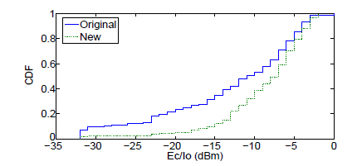
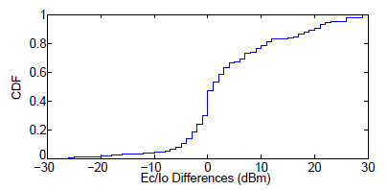
Mobility Impact in Transitional Regions
Ec/Io of the new base stations are statistically better than the original base stations by 10dBm.
But almost 30% of all the handoffs do not end up with a better base stations
MobiHoc '10

Slide 63
Conclusion
Mobility is a double edged sword
  Degrades HSPA services, e.g. throughput
  Improves fairness in bandwidth allocation among users and traffic flows
Communication characteristics in HSPA transitional regions are very complicated
MobiHoc '10

Slide 64
Acknowledgement
Part of the slides are adapted from the slides of Posco Tso, Harish Vishwanath, Erran Li and Justino Lorenco, Saro Velrajan and TCL India

