Slide 1




Comparison of SOM pipelines with genome-wide approaches
Maria Nikoghosyan
PhD student
Bioinformatics groups, Institute of Molecular Biology NAS RA

Slide 2

Outline
Genome-wide association studies (GWAS)
GWAS examples on the simulated data
SOM pipeline
Comparison of SOM with GWAS
Schizophrenia case-control GWAS and SOM analysis

Slide 3
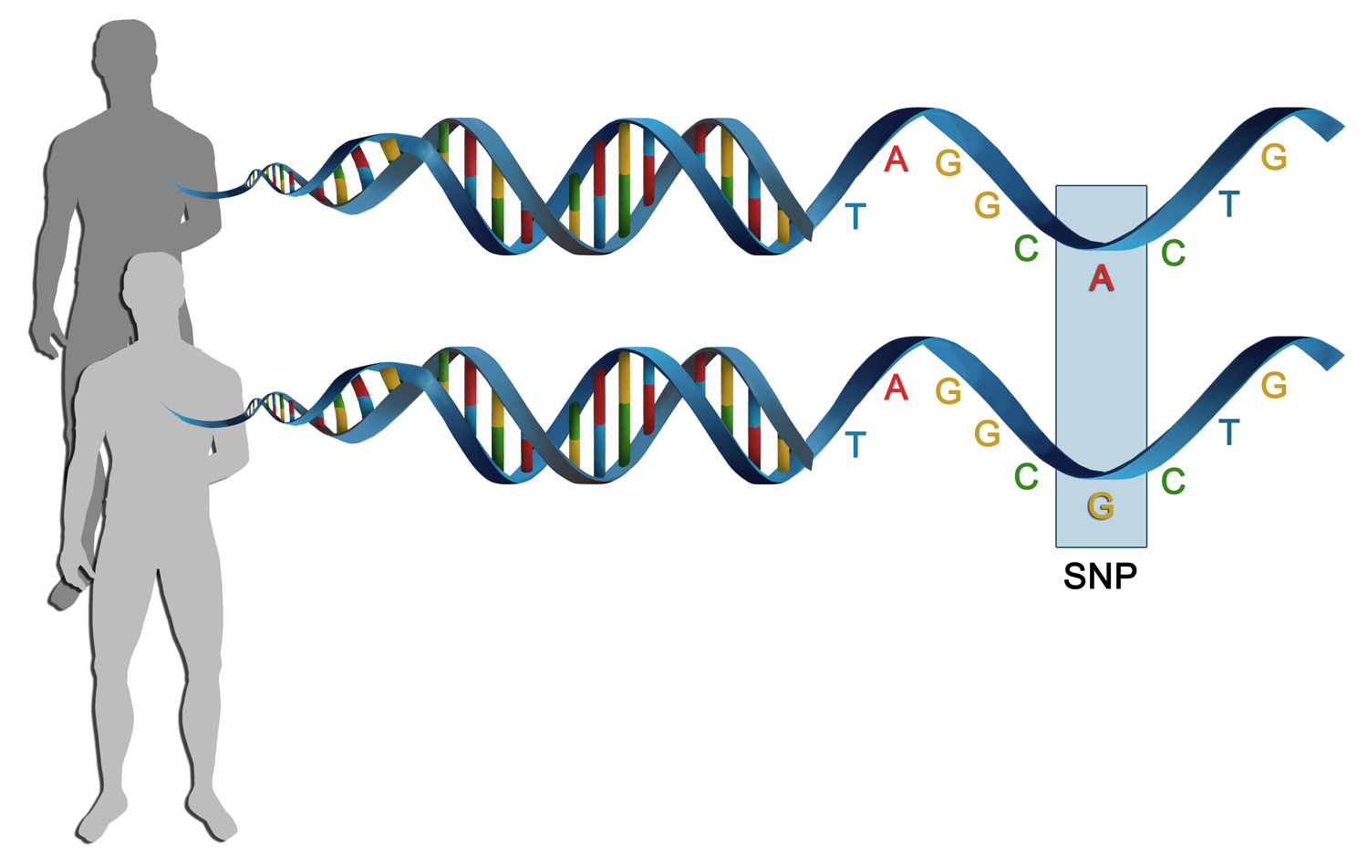
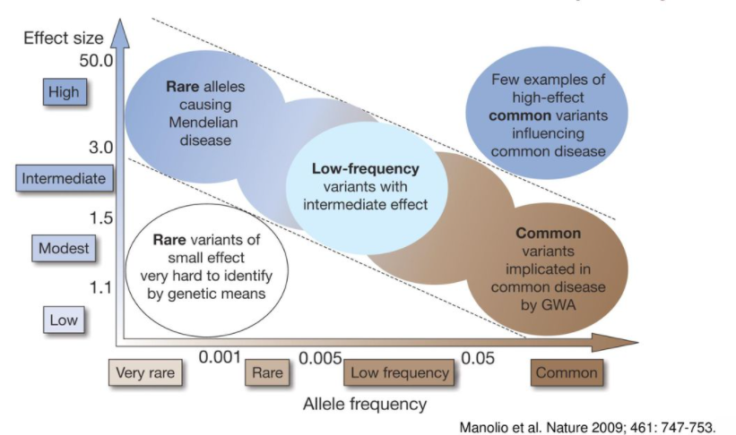
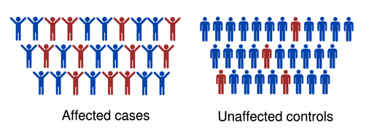
Complex diseases and traits
Genomic variations
Genomic variations
Individual SNPs have a low effect on phenotype

Slide 4
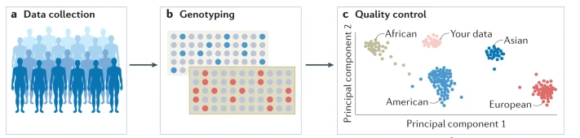
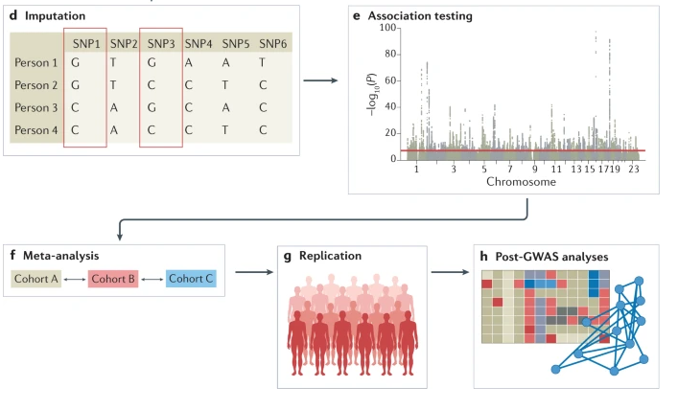
Genome-wide association study
Sample size is important
# cases/controls > 1000
NGS; microarrays
Population structure
Imputing missing genotypes

Slide 5
Genome-wide association study
Limitations:
Big sample size
Sensitive to variations in population
Association test – Regression analysis
Functional annotation

Slide 6
SOM pipeline

Slide 7
GWAS data simulation
Simulation genotypes
SNPs - allele frequency 0-1
3 options:
1
50030 SNPs with no association
20 associated SNPs
2
50000 SNPs with no association
50 associated SNPs
3
49900 SNPs with no association
150 associated SNPs
Preprocessing
Simulation groups
SNP selection
Minor allele frequency (MAF)> 0.05
Hardy-Weinberg equilibrium Fisher’s P < 1e-6
Remove heterozygosity outliers
100 Controls
&
100 cases

Slide 8
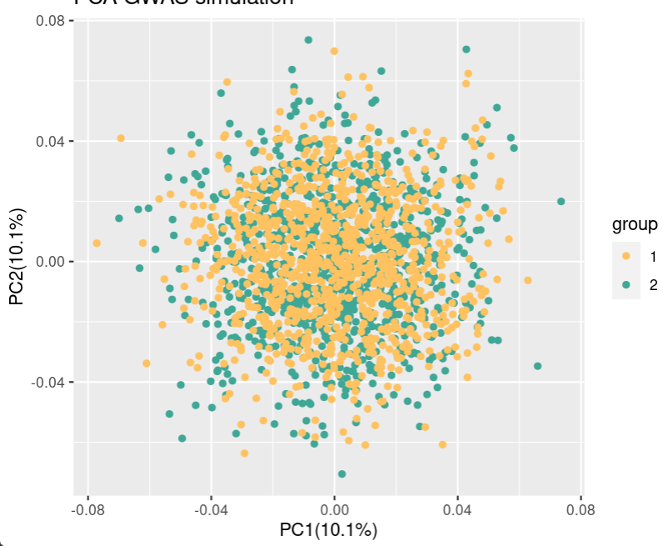



GWAS and SOM analysis
GWAS
PCA analysis
PCA plot for simulated data
Performance evaluation
Association test
Accuracy
Sensitivity
Specificity
Logistic regression
Multiple test corrections
(FDR)
No population structure
Using 10PC as a covariate

Slide 9
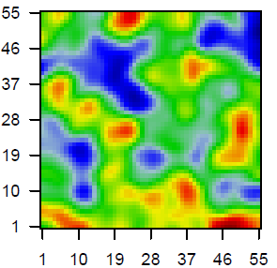
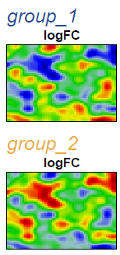
GWAS and SOM analysis
SOM
Group analysis
Difference analysis
SOM analysis
Samples
 | g1 | g2
1
2
Input genotypes
Cases
Controls
Metagene
Samples
 | S1 | S2 | S3 | S4 | S5 | S6
1
2
Cases
Controls
Metagene
 | S1 | S2 | S3 | S4 | S5 | S6
1
2
3
4
Difference metagenes
SNPs
 | Diff
1
2
Mean
Mean
Group metagenes
Metagene
 | g1 | g2
1
2
Output metagenes
Metagene
Samples
Cases
Controls
 | S1 | S2 | S3 | S4 | S5 | S6
1
2
Metagene

Slide 10
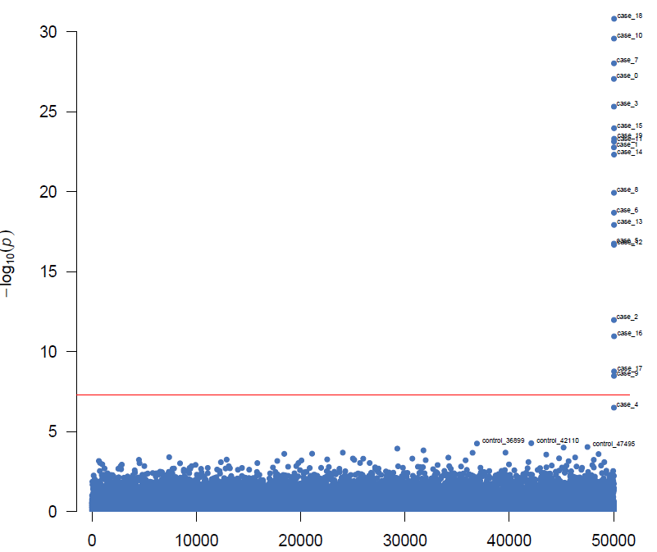
GWAS and SOM analysis
20 SNPs
SOM group portraits
Controls
Cases
Difference portrait
Control VS Case
P threshold = 5x10-8
Position
Accuracy | Sensitivity | Specificity
1 | 1 | 1
Accuracy | Sensitivity | Specificity
0.99 | 0 | 1

Slide 11
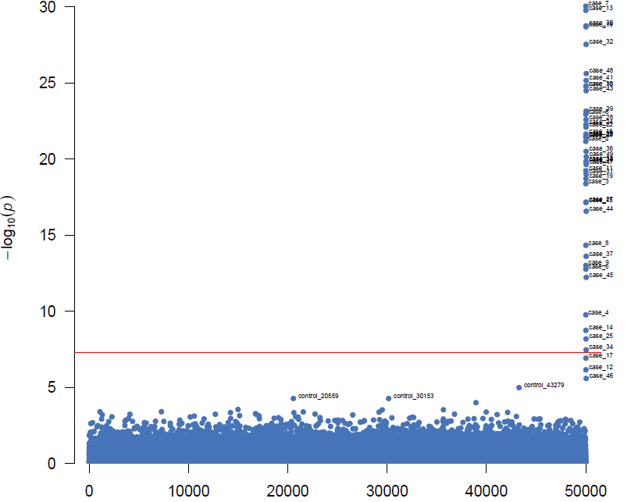
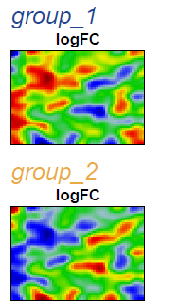
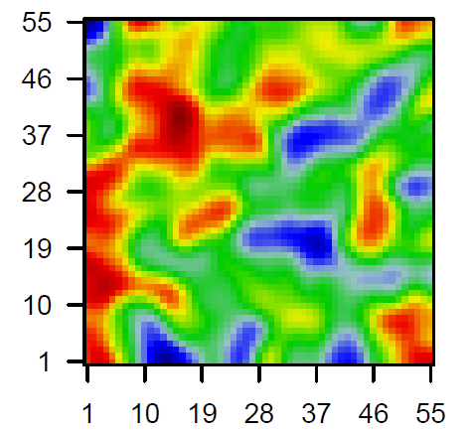
GWAS and SOM analysis
50 SNPs
SOM group portraits
Controls
Cases
Difference portrait
Control VS Case
P threshold = 5x10-8
Position
Accuracy | Sensitivity | Specificity
0.99 | 0.96 | 1
Accuracy | Sensitivity | Specificity
0.99 | 0.58 | 1

Slide 12
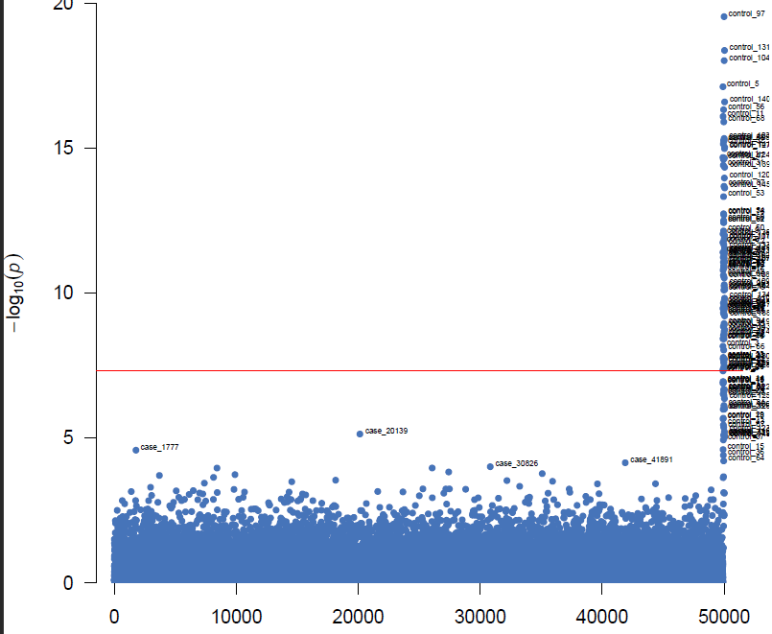
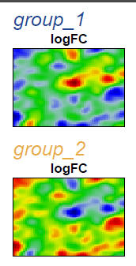
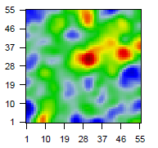
GWAS and SOM analysis
150 SNPs
SOM group portraits
Controls
Cases
Difference portrait
Control VS Case
P threshold = 5x10-8
Position
Accuracy | Sensitivity | Specificity
0.99 | 0.96 | 0.99
Accuracy | Sensitivity | Specificity
0.99 | 0.96 | 1

Slide 13
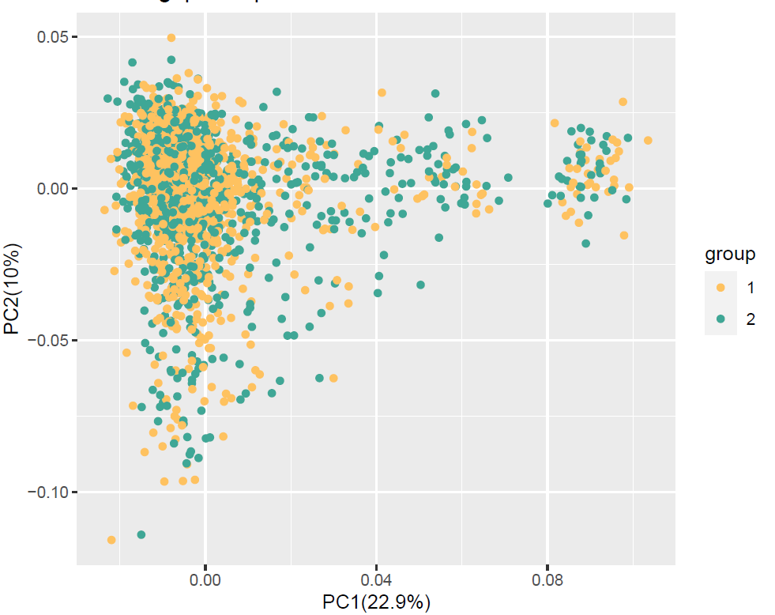
European population structure
PCA for European genotypes
No separation between cases and controls
PC1 and PC2 were chosen to be used in the association test as a covariates
Controls
Cases

Slide 14
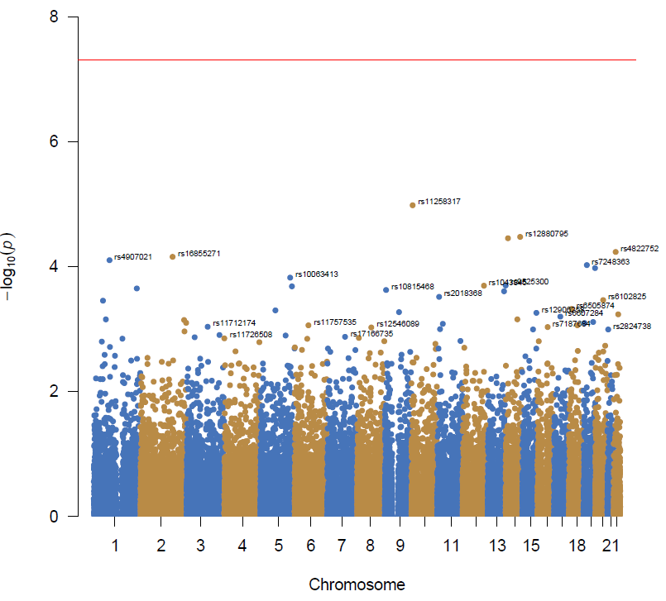
GWAS on dbGAP European data
P threshold = 5x10-8
Adjusted for multiple testing
P adjustment:
FDR (Top 50 SNPs) – 0.32 – 0.85

Slide 15
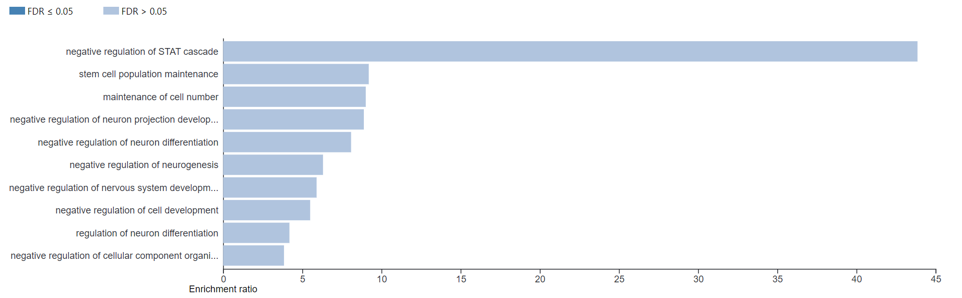
SNPs annotation

Slide 16
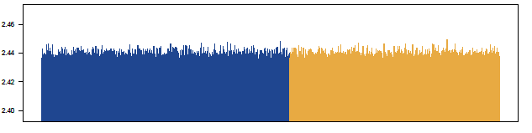
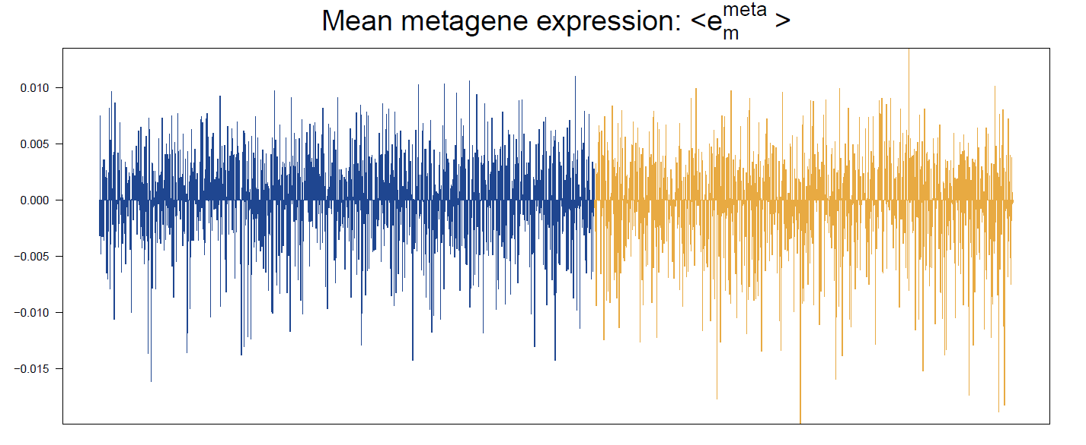
SOM on dbGAP European data
Sample mean allelic value
SNP mean score
Samples
Controls
Cases
Mean metagene value
Mean metagene score
Samples

Slide 17
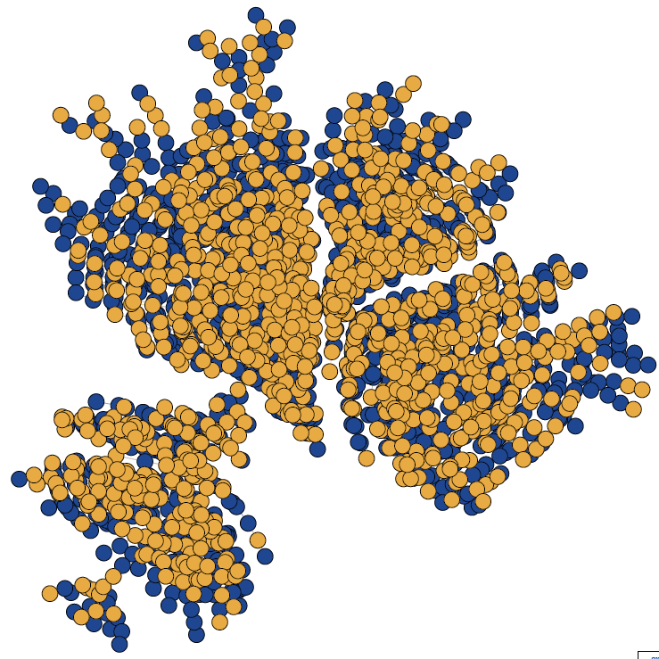
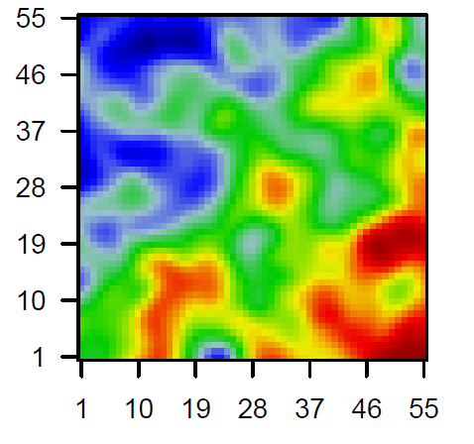
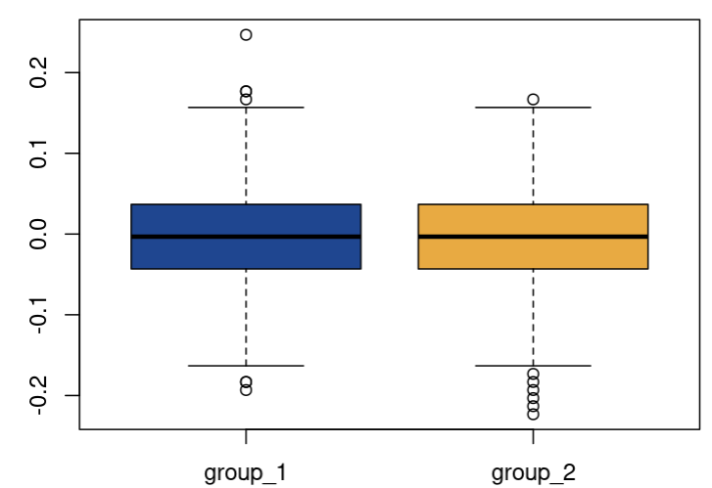
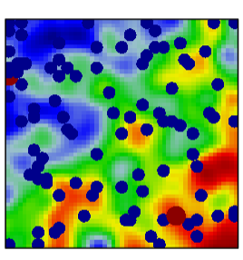
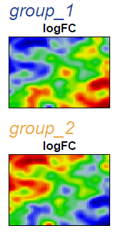
GWAS on dbGAP European data
Minimum spanning tree on metegenes
Difference portrait
Control VS Case
FDR – 0.3 – 0.88
Controls
Cases
Mean SNPs value for
Top 100 SNPs
Top 100 SNPs
(by FDR)
SOM group portraits
Mean SNP value
Controls
Cases
Control
Case

Slide 18
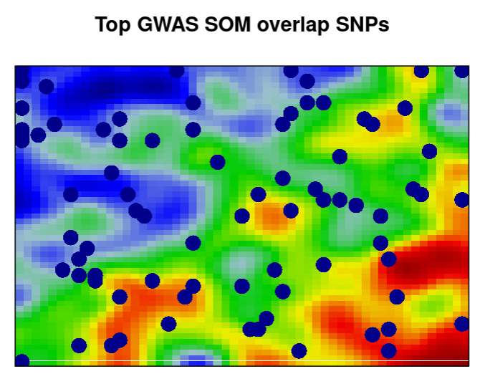
Comparison of GWAS and SOM results
Comparison of the top 100 significant GWAS SNPs with the top 100 SNPs from the SOM difference map
79 SNPs overlap
Top SNPs
rs11258317 (P = 6 x 10⁻⁶)
rs915071 (P = 2 x 10⁻⁶)
Bipolar disorder and schizophrenia (Wang KS et.al.2010)
GWAS and SOM common SNPs
Notes:
https://www.sciencedirect.com/science/article/abs/pii/S0920996410015318?via%3Dihub
Rs915071 – not significant

