Slide 1

STOCHASTIC PROCESSES · FINAL PRESENTATION
STOCHASTIC
OPINION DYNAMICS
From local, person-to-person interactions to macro-scale polarisation — and which update rule reproduces a real, polarised social network.
Karolina Bakalarz
Kinga Heda
Bartosz Łuksza
Bartłomiej Mielcarz
Maria Nowacka
Notes:
Good morning everyone. Our project is about stochastic opinion dynamics. The big idea is simple: people influence each other, and from many small, local interactions, large-scale patterns appear — sometimes everyone agrees, sometimes the group splits into camps. Today we go one step further than theory. We take four well-known update rules and we test them on a real, strongly divided social network, to see which rule actually reproduces what we observe in the real world. I am presenting on behalf of our team. Here is the plan: first the problem, then the four models, then how we ran the simulations, then the results, and finally our conclusions and ideas for future work.

Slide 2

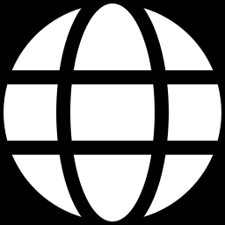
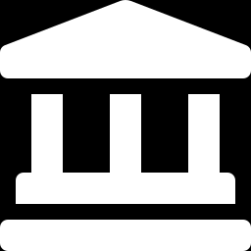
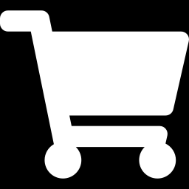
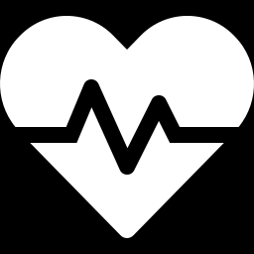
WHY OPINION DYNAMICS?
Opinion formation shapes modern society — we see it every day in social media, in political debate, and in marketing.
The scientific puzzle: how do simple interactions between individuals add up to large-scale outcomes, such as consensus or polarisation?
Online media
Politics
How information spreads and how echo chambers form.
Polarisation and the shaping of public opinion in elections.
Marketing
Public health
How consumer preferences spread from person to person.
Why some communities resist advice — e.g. attitudes to vaccines.
Notes:
Why study this at all? Because opinion formation runs through everyday life. On social media it decides how information spreads and how echo chambers form. In politics it drives polarisation and the way public opinion takes shape before an election. In marketing it explains how a preference jumps from one person to the next. And in public health it helps explain why some groups push back against advice, for example about vaccines. So the scientific puzzle is this: how do simple, local interactions between single people add up to big patterns — either agreement across the whole group, or a lasting split?

Slide 3
THE PROBLEM WE STUDY
How do simple, local interactions add up to global consensus — or to lasting polarisation?
WHAT WE MODEL
WHAT WE TEST
A network of interacting agents — people, blogs, or accounts.
Each agent holds a hidden true belief and shows a declared opinion.
At random moments, an agent updates from the opinions of its neighbours.
Two human factors enter the rule: noise (errors) and bias (resistance).
Which update rule reproduces real-world structure?
We run four stochastic rules on the very same real network.
We compare structure — how the camps cluster — not opinion trajectories.
Continuous opinion time-series barely exist, so structure is the honest target.
Notes:
Let me state the problem clearly. On the left is what we model. We have a network of agents — they can be people, blogs, or social-media accounts. Each agent carries a hidden, true belief inside, and shows a declared opinion on the outside; neighbours only see the declared one. Every now and then an agent looks at its neighbours and updates its opinion. Two very human ingredients go into the rule: noise, meaning small errors and misreadings, and bias, meaning how stubborn or resistant the agent is. On the right is what we test. We ask a sharp question: which update rule reproduces the structure we see in a real network? We will run four rules on the same real graph and compare how the camps cluster. We compare structure, not full opinion trajectories — and I will explain why in a moment: good trajectory data simply does not exist.

Slide 4
FROM LOCAL RULES TO A GLOBAL TREND
A short live run: every agent nudges toward its neighbours — watch the whole population move.
The simplest rule — pure averaging — melts into one centre, leaving only a few stubborn holdouts. Only richer rules will keep two camps apart.
Notes:
Before the formulas, let us just watch the idea in action. On the left is a small network; each dot is an agent, and its colour is its opinion — blue on one side, red on the other. On the right is the whole population at a glance, with the dashed line showing the average opinion. Now we let it run: at every step, agents nudge their opinion toward the neighbours they interact with. Watch what happens — the colours wash out, the dots on the right pull together, and the whole group slides toward a single centre. A couple of stubborn agents hold out, because of the noise, but the big picture is one consensus. This is the simplest rule, pure averaging. Keep this collapse in mind, because the real network we study does not look like this at all — it stays split. That is exactly why we need the richer rules on the next slide.

Slide 5
FOUR STOCHASTIC UPDATE RULES
Same idea, four mechanisms — each one is a stochastic process running on the network.
M1 · PURE AVERAGING
M2 · VOTER MODEL
Move toward the neighbours' average, plus a little noise.
Copy the opinion of one random neighbour.
linear limit of bounded confidence
classic binary baseline
M3 · BOUNDED CONFIDENCE
M4 · SOCIAL PRESSURE
Average only the neighbours that are close enough — within ε.
Declare 0 or 1 with a probability set by a hidden belief γ.
paper [1] · Shree et al.
paper [2] · Tang et al.
Notes:
Here are the four rules. Each is a stochastic process on the network — there is always some randomness. M1, pure averaging: an agent simply moves toward the average opinion of its neighbours, plus a bit of noise. It is the simplest, linear limit of bounded confidence. M2, the voter model: an agent just copies one random neighbour — a classic binary baseline. M3, bounded confidence, from our first paper, by Shree and co-authors: the agent averages only the neighbours it already mostly agrees with — those within a confidence range we call epsilon. M4, social pressure, from our second paper, by Tang and co-authors: the agent declares zero or one with a probability set by a hidden belief, gamma. The first two are baselines; the last two are the models we expect to behave like the real world. Let me show the two key formulas.

Slide 6
MODEL IN FOCUS — BOUNDED CONFIDENCE [1]
Each agent averages its own opinion together with the neighbours it already (almost) agrees with — those within the confidence bound ε.
Opinions that lie far apart are simply ignored, so the two distant camps never pull on each other.
Independent, zero-mean noise nᵢ(t) keeps agents from ever freezing into a perfect consensus.
Big picture: like-minded clusters lock in. The rule preserves a split that already exists.
Notes:
The first key model is bounded confidence. Read the formula like this: at the next step, an agent's opinion becomes the average of its own opinion and the opinions of the neighbours that are within a range epsilon of it — that is the bounded-confidence idea. If a neighbour's opinion is too far away, it is simply ignored, so two distant camps never influence each other. The noise term, n of t, is small, has zero mean, and just represents everyday errors; its effect is that the group never freezes into a perfect, exact consensus. The original paper asks the question in its title — how far apart do opinions drift — and the answer here is that like-minded clusters lock in. The important property to remember: this rule preserves a split that is already there.

Slide 7
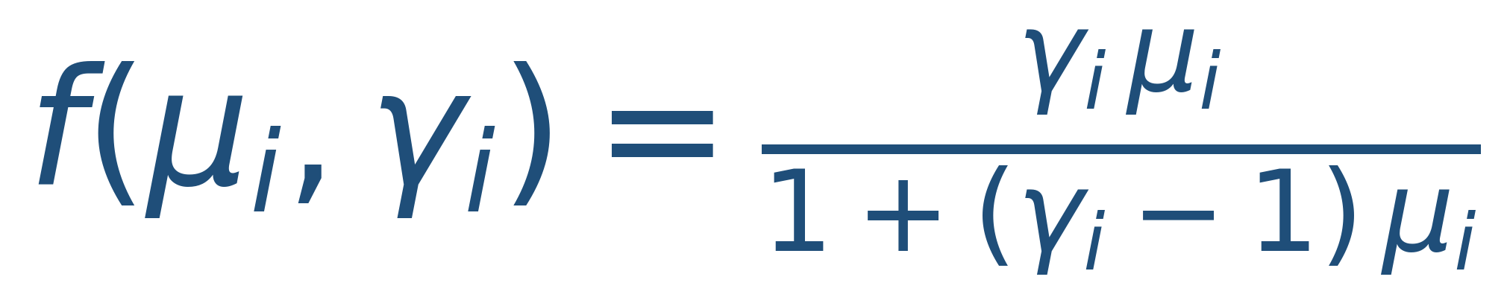
MODEL IN FOCUS — SOCIAL PRESSURE [2]
An agent declares opinion “1” with probability f, driven by μᵢ — the share of its neighbours currently declaring 1. That share is the social pressure.
The bias γᵢ blends the agent's hidden true belief with its honesty. High γ → stick to the true belief; low γ → conform to the crowd.
Because the true belief is persistent, declarations keep re-sorting toward the agent's real side.
This is the seed of “true belief vs declared opinion” — and of pluralistic ignorance.
Notes:
The second key model is social pressure. Here opinions are binary — zero or one. An agent declares one with a probability f. The driver, mu, is just the fraction of its neighbours who currently declare one; that fraction is the social pressure pushing on the agent. The parameter gamma is the bias: it mixes the agent's hidden true belief with how honest it is. A high gamma means the agent sticks to its true belief; a low gamma means it gives in and conforms to the crowd. The crucial point is that the true belief is persistent — it does not go away — so over time the declarations keep re-sorting back toward each agent's real side. This is exactly the idea of true belief versus declared opinion, and it is the seed of pluralistic ignorance, where people publicly go along with something they privately reject.

Slide 8
THE DATA — A REAL, POLARISED NETWORK
Adamic & Glance (2004): the U.S. political blogosphere. Blogs are nodes, hyperlinks are edges, and each blog is labelled liberal (blue) or conservative (red).
1,222
16,714
91%
0.81
blogs (giant component)
hyperlinks (edges)
links within the same camp
assortativity (Newman r)
Strong, real, structural polarisation. Our target: which model reproduces this r ≈ 0.81 ?
Notes:
Now the data. We use a classic real network from Adamic and Glance, two thousand four: the United States political blogosphere around the two thousand four election. Each blog is a node, each hyperlink between blogs is an edge, and every blog is labelled either liberal or conservative. The numbers tell the story. The main connected part has one thousand two hundred and twenty-two blogs and about sixteen thousand seven hundred links. Ninety-one percent of those links stay inside the same political camp. And the Newman assortativity — a single number that measures how strongly similar nodes connect to each other — is zero point eight one. That is very high. So this network is strongly, genuinely polarised, and that zero point eight one is the target our models have to reproduce.

Slide 9
WHAT EXACTLY DO WE TEST?
THE DATA GAP
THE WELL-POSED QUESTION
Continuous, stochastic opinion trajectories barely exist as real data — they are noisy and very hard to measure accurately.
The blog network gives us something solid instead: real structure plus static, binary labels.
So we do not try to fit trajectories. We test which dynamics reproduce the observed structural polarisation — the assortativity r.
That is the honest, well-posed, testable comparison.
From “no usable trajectory data” to a concrete structural benchmark.
Notes:
This slide is important because it keeps us honest. Ideally we would track how each person's opinion moves over time and compare that to the model — but that kind of continuous, noisy trajectory data barely exists, and where it does, it is very hard to measure cleanly. What the blog network gives us instead is solid and real: the true structure of the network, and a static, binary label for every blog. So we change the question into one we can actually answer. We do not fit trajectories. We test which dynamics reproduce the observed structural polarisation — that single assortativity number r. That is a fair, well-posed test. In short: we turned no usable trajectory data into a concrete structural benchmark.

Slide 10
IMPLEMENTATION & SIMULATION
SETUP
WHAT WE VARY & MEASURE
Python with NumPy and NetworkX; fully reproducible (SEED = 7).
The network is fetched from an open GitHub mirror, with local and synthetic fall-backs.
All four rules run on the real graph, started from the real political leaning.
Opinions live in the range [−1, 1], plus a small amount of starting noise.
Controls: M3 and M4 are also started from random opinions — does a model create polarisation, or only preserve it?
A sweep over the confidence bound ε for bounded confidence.
Metrics: the within-camp link fraction, the Newman assortativity r, and the correlation between opinion and true leaning.
Notes:
Here is how we actually ran it. Everything is in Python, using NumPy and NetworkX, and it is fully reproducible — we fix a single random seed, seven. The network is downloaded from an open GitHub mirror, with a local copy and a synthetic stand-in as back-ups, so the notebook runs anywhere. All four rules run on the real graph, and we start them from the real political leaning: liberal blogs start negative, conservative blogs start positive, with opinions living between minus one and plus one, plus a little starting noise. On the right is what we vary and measure. The key control: we also start models three and four from completely random opinions, to ask a deeper question — does the model create polarisation, or only preserve it that was already there? We also sweep the confidence bound epsilon for bounded confidence. And we measure three things: the fraction of links inside the same camp, the Newman assortativity r, and the correlation between final opinion and true leaning.

Slide 11
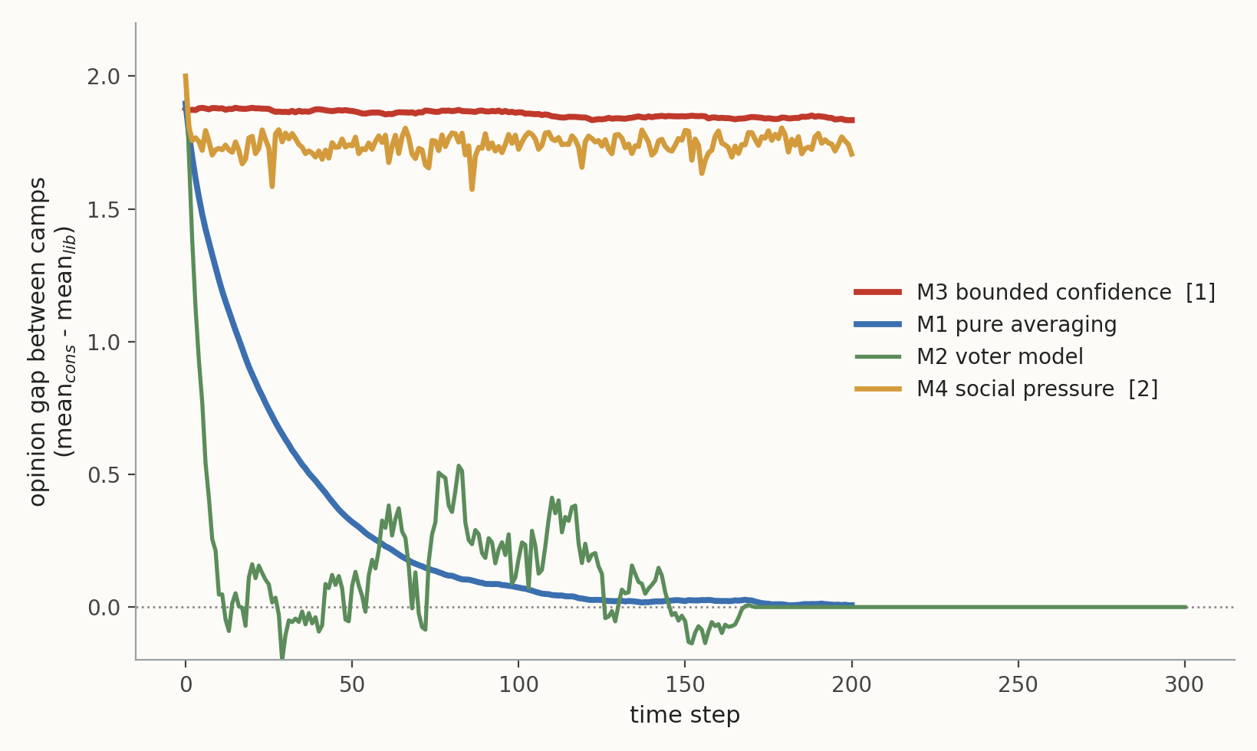
DO THE CAMPS STAY APART?
Opinion gap between the conservative and liberal camps over time.
Averaging → the gap collapses to about 0 (a single centrist consensus).
Voter → the gap also goes to 0 (unanimity, one camp wins).
Bounded confidence and social pressure → the gap stays high.
Notes:
Now the results. This first plot shows the opinion gap between the two camps — the conservative average minus the liberal average — as time goes on. Look at the four curves. Pure averaging, the blue line, slides smoothly down: the gap collapses to about zero, meaning everyone ends up in one bland centre. The voter model, the green line, also drops to zero — one camp simply takes over and you get unanimity. But the two interesting models behave completely differently. Bounded confidence, in red, and social pressure, in gold, both stay up near the top: the gap stays high, and the two camps remain clearly apart. So already we can see that only the two richer models keep the division alive.

Slide 12
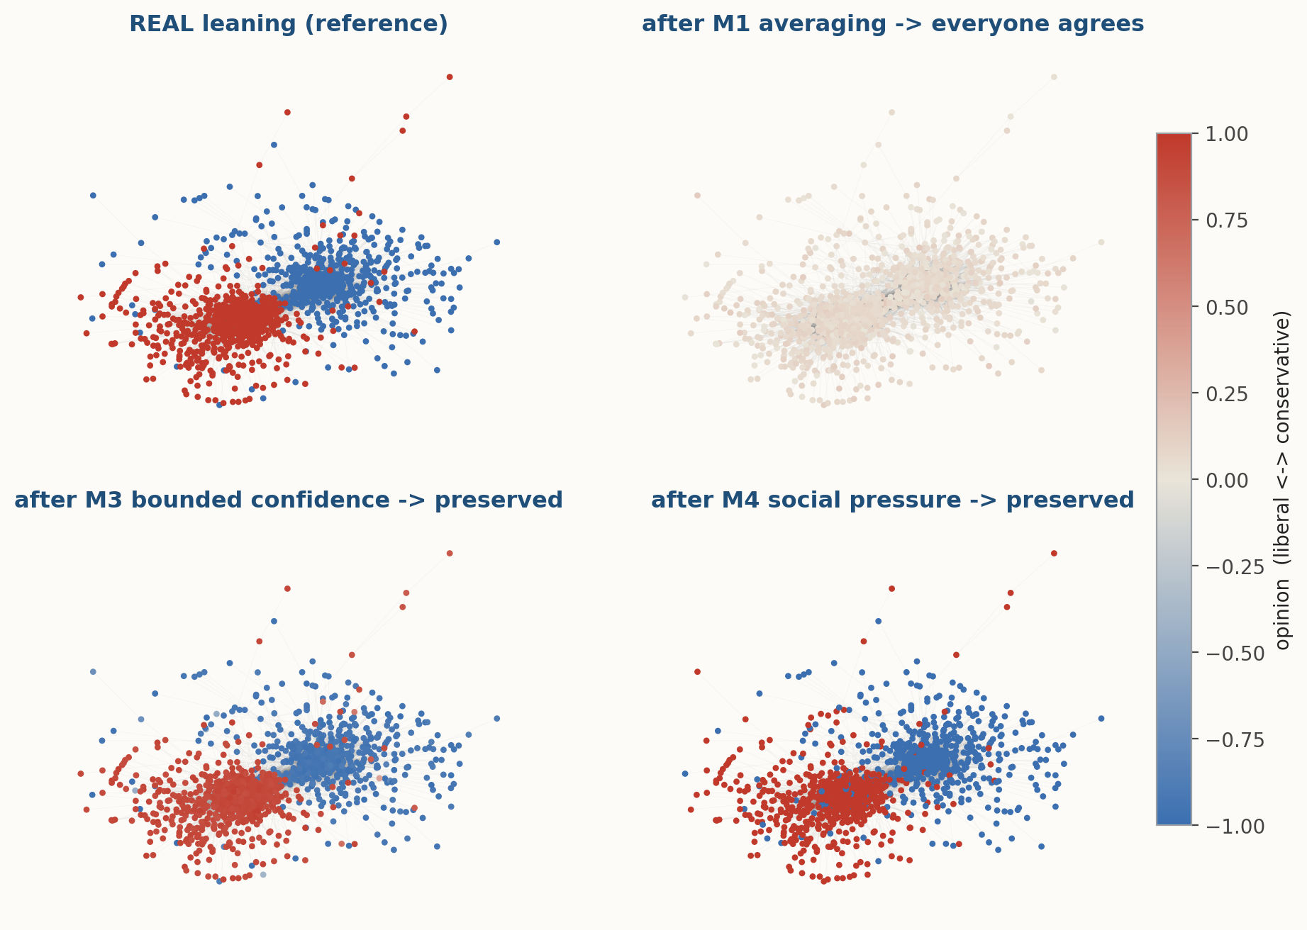
SAME NETWORK, FOUR OUTCOMES
Red = conservative, blue = liberal.
M1 averaging washes everyone toward the pale centre.
M3 bounded confidence and M4 social pressure keep the two clusters intact — just like reality.
Notes:
This is the picture I most want you to remember. It is the same real network drawn four times, with each blog coloured by its opinion: red for conservative, blue for liberal. Top-left is reality — two clear blocks, red and blue, sitting apart. Top-right is what pure averaging does: everything fades to a pale, washed-out centre — the structure is gone, everyone agrees. The bottom two are bounded confidence and social pressure, and you can see straight away that the red and blue clusters are still there, still separated, just like in the real network. So the eye confirms the numbers: only the two richer rules keep the split.

Slide 13
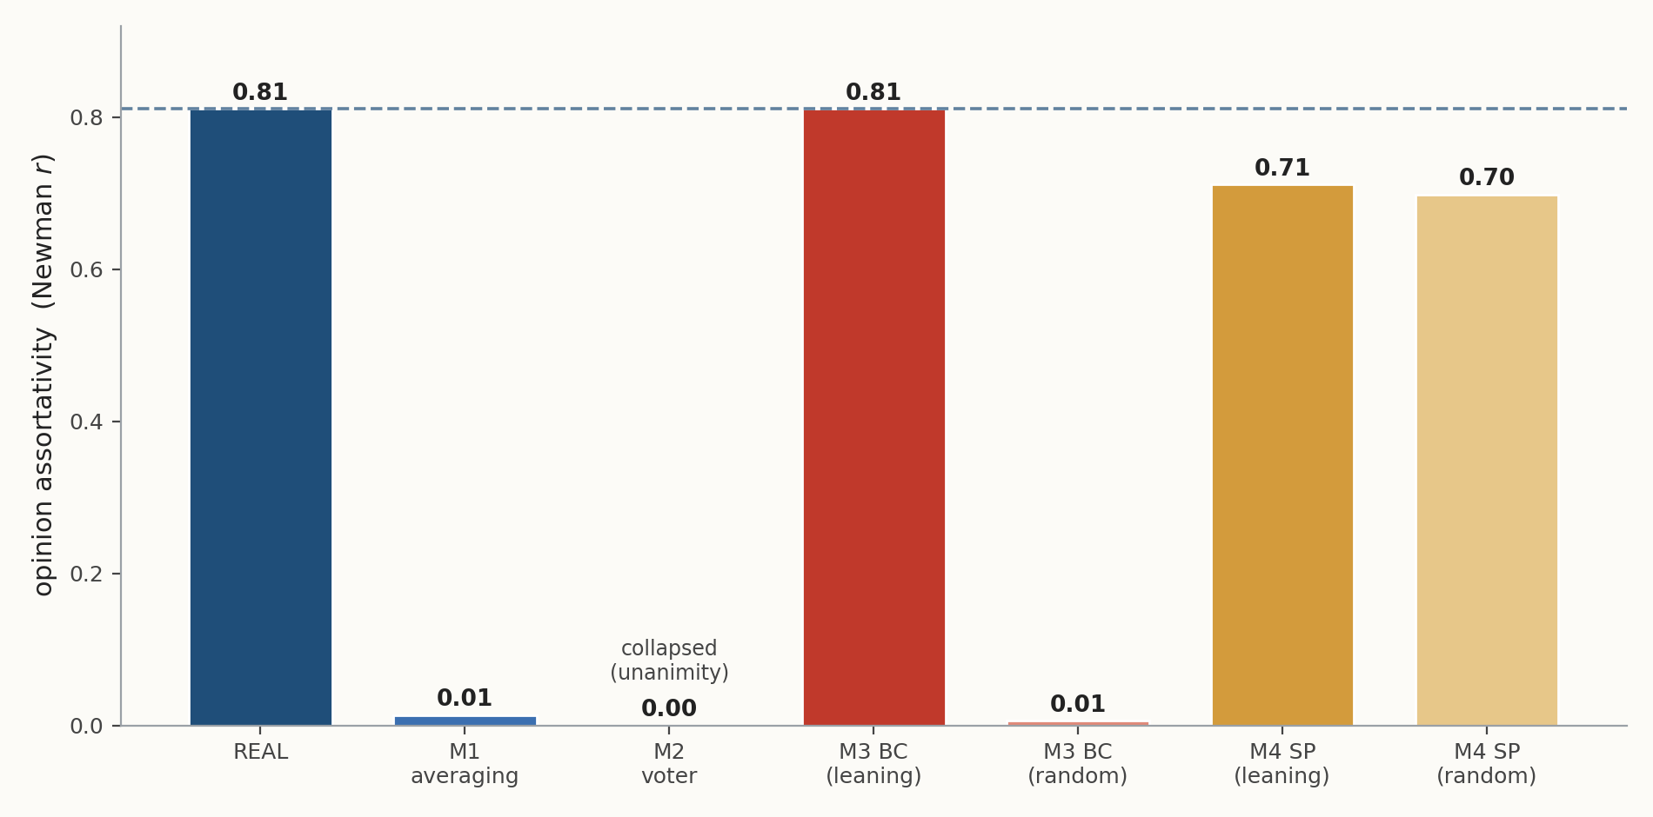
THE VERDICT
Newman assortativity r of the final opinions — model vs. reality.
Bounded confidence and social pressure recover r ≈ 0.81 / 0.71; averaging and the voter model collapse to ≈ 0.
Notes:
Now we put it on one scale. This bar chart shows the assortativity r of the final opinions for each model, against the real value of zero point eight one, marked by the dashed line. The real network is the tall navy bar on the left. Pure averaging and the voter model are basically flat on the floor — their r collapses to about zero, which means no structure at all. Bounded confidence, the red bar, lands right on the dashed line at zero point eight one — a perfect match. Social pressure reaches about zero point seven one, very close. So the verdict is clear: only bounded confidence and social pressure reproduce the real structural polarisation; averaging and the voter model destroy it.

Slide 14
PRESERVE vs RECONSTRUCT
What if we start from RANDOM opinions, instead of the real split?
BOUNDED CONFIDENCE
SOCIAL PRESSURE
r ≈ 0.01
r ≈ 0.70
Stays mixed. Bounded confidence only PRESERVES an existing split — it cannot create one.
Rebuilds the split. The hidden belief γ pulls declarations back to the true side — polarisation RECONSTRUCTS itself.
The “true belief vs declared opinion” mechanism — the seed of pluralistic ignorance.
Notes:
Here is the most subtle, and to us the most interesting, result. We re-ran the two winning models, but this time starting from completely random opinions instead of the real split. Bounded confidence, on the left, falls apart: its r drops to about zero point zero one. The network just stays mixed. The lesson is that bounded confidence only preserves a split that already exists — it cannot build one from scratch. Social pressure, on the right, does something remarkable: even from random opinions, it rebuilds the split, recovering r of about zero point seven. The reason is the hidden belief, gamma: it is persistent, so it keeps pulling each agent's public declaration back toward its true side, and the polarisation reconstructs itself. This is the structural signature of true belief versus declared opinion — exactly the mechanism behind pluralistic ignorance.

Slide 15
A PHASE TRANSITION IN ε
Opinions span [−1, 1]. Once the confidence bound ε ≥ 2, every neighbour counts → averaging → consensus.
ε | Outcome | Newman r
0.3 | two camps | 0.81
0.5 | two camps | 0.81
1.0 | two camps | 0.81
2.0 | consensus | 0.01
Below ε = 2, cross-camp pairs never merge — so the two camps survive.
Notes:
One more analysis, on bounded confidence. Remember opinions run from minus one to plus one, so the widest possible gap between two agents is two. We sweep the confidence bound epsilon. For epsilon zero point three, zero point five, and one, the result is the same: two camps survive, and r stays at zero point eight one. But the moment epsilon reaches two, something snaps: now every neighbour counts as close, even a complete opponent, so the rule becomes plain averaging, the whole network agrees, and r collapses to about zero. This is a phase transition. The intuition is simple — as long as epsilon is below two, cross-camp pairs are always too far apart to merge, so the division is protected.

Slide 16
WHAT WE FOUND
Averaging and the voter model erase the real polarisation.
Bounded confidence reproduces r ≈ 0.81 — but it only preserves structure.
Social pressure reconstructs polarisation from scratch, via a persistent hidden belief.
Honest caveat: we match structure, not trajectories — and bounded confidence's match is partly built in.
SCOREBOARD (r)
REAL
0.81
M1 averaging
0.01
M2 voter
—
M3 bounded conf.
0.81
M4 social pressure
0.71
Notes:
So what did we find? Four things. First, averaging and the voter model both erase the real polarisation — they predict one consensus or unanimity, which is not what we see. Second, bounded confidence reproduces the real value, r of zero point eight one, but it only preserves structure that is already there. Third, social pressure goes further: it can rebuild the polarisation from scratch, thanks to its persistent hidden belief. And fourth — the honest caveat, which we want to be upfront about — we match structure, not full trajectories, and bounded confidence's perfect match is partly built in, because we start it from the real split and the opinions barely move. The meaningful contrast is really against the models that collapse, plus the random-start controls. The scoreboard on the right sums it up: real zero point eight one, averaging and voter near zero, bounded confidence zero point eight one, social pressure zero point seven one.

Slide 17
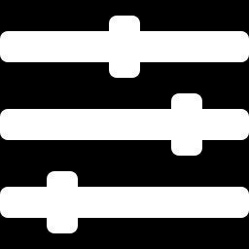
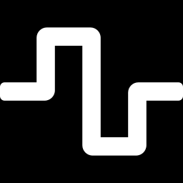
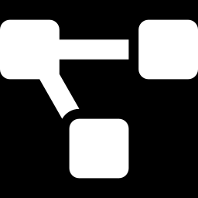
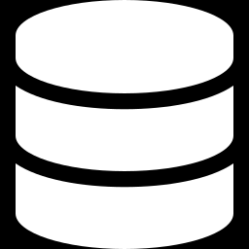
DIRECTIONS FOR FURTHER RESEARCH
Steering opinions — optimal control
Richer stochastic processes
A reinforcement-learning controller (LSPI) that nudges a network toward a target, even when the dynamics are unknown. [paper 3, Chen et al.]
Model the same opinions with Ornstein–Uhlenbeck / Fokker–Planck drift–diffusion and Hawkes self-exciting interactions.
Scale & realism
Better data
Larger, heterogeneous networks; nonlinear dynamics; game-theoretic, multi-agent settings.
Find or build continuous opinion trajectories, so we can validate dynamics — not only structure.
Notes:
Where could this go next? Four directions. First, instead of just watching opinions evolve, we can try to steer them — there is a third paper, by Chen and co-authors, that uses reinforcement learning to nudge a network toward a target opinion, even when the rules are unknown. Second, richer stochastic processes: we can describe the same opinions with continuous drift-and-diffusion models, like Ornstein–Uhlenbeck and Fokker–Planck, or with Hawkes processes that capture bursts of self-exciting interaction. Third, scale and realism: bigger, more varied networks, nonlinear rules, and game-theoretic, multi-agent settings. And fourth, the most useful of all: better data — if we can find or build real continuous opinion trajectories, we could finally validate the dynamics themselves, not only the structure.

Slide 18
THANK YOU
VERY MUCH
Questions are very welcome. · Takeaway: only models with a memory of true belief rebuild real polarisation.
Notes:
Thank you very much for your attention. If I had to leave you with one sentence, it would be this: only the models that carry a memory of a true, hidden belief can actually rebuild real polarisation. We are very happy to take any questions.

Slide 19
REFERENCES
[1] Shree S, S., G V, K., Chatterjee, A., & Jagannathan, K. (2021). Stochastic bounded confidence opinion dynamics: How far apart do opinions drift? arXiv:2112.04373.
[2] Tang, J., Adler, A., Ajorlou, A., & Jadbabaie, A. (2023). Stochastic opinion dynamics under social pressure in arbitrary networks. In 2023 62nd IEEE Conference on Decision and Control (CDC). IEEE.
[3] Chen, Y., Gao, H., Mazalov, V. V., & Liu, Y. (2026). Reinforcement learning-based optimal control for stochastic opinion dynamics. Scientific Reports, 16, 12392.
[4] Adamic, L. A., & Glance, N. (2005). The political blogosphere and the 2004 US election: divided they blog. In Proc. 3rd Int. Workshop on Link Discovery (LinkKDD).
Notes:
And these are our sources. Paper one is the bounded-confidence work by Shree and co-authors. Paper two is the social-pressure model by Tang and co-authors. Paper three is the reinforcement-learning control paper by Chen and co-authors, which points to our future work. And the data set itself comes from Adamic and Glance, two thousand five. Thank you.

